Slide 1
BUDGET WORKSHOP
April 21, 2026

Slide 2
BUDGET ROLES SUMMARY
Accounting prepares:
Revenue estimates – current and next year
Expenditure estimate – current year
Forms for Directors to make budget requests
Draft and final budget documents
Directors
Prepare detailed budget requests
Prepare capital requests
Committees
Prioritize related projects
City Manager/CFO
Review requests, prioritize capital requests, make cuts
City Council
Review and approve budget
Hold public hearing to obtain input

Slide 3
BUDGET PREPARATION SCHEDULE

Slide 4
FINANCIAL STRUCTURE
Funds
General – accounts for most municipal operations
Major revenue sources
Sales tax
Use tax
Other taxes
Transfers from Enterprise funds
Major expenditures
Personnel
Transfers to operating and reserve funds

Slide 5
FINANCIAL STRUCTURE (continued)
Funds (continued)
Enterprise – account for all utility operations
Major revenue sources
Charges for services (Sanitation)
Transfers from BMA (Water and Wastewater)
Major expenditures
Wastewater plant operating contract
Personnel
Materials
Transfers to General Fund and reserve funds

Slide 6
FINANCIAL STRUCTURE (continued)
Funds (continued)
BMA – account for utility debt service and utility revenues
Major revenue sources
Charges for services
Major expenditures
Debt service on utility debt
Transfers to Water and Wastewater operating funds to cover operating expenses

Slide 7
FINANCIAL STRUCTURE (continued)
Funds (continued)
Reserve Funds
Stabilization
Transfers from General, Water, Wastewater, and Sanitation
Expenditures only via ordinance
Capital
Transfers from General and Sanitation
Dedicated utility fees for Water and Wastewater
Expenditures for capital

Slide 8
FINANCIAL STRUCTURE (continued)
Funds (continued)
Other funds
E-911 – transfers from General fund and E-911 fees
Economic Development – ¼% sales tax and portion of lodging tax
CIP – Sales Tax – ½% sales tax
CIP – Wastewater Regulatory – wastewater capital fee/fund is being closed. Capital fees now recorded in Capital Reserve Fund.
GO Bond Funds – numerous funds used to track GO bond proceeds and expenditures
Golf Course – green fees, membership fees, cart rental, tore merchandise, and General fund transfers
Municipal Airport – fueling fees, hanger rental, and General fund transfers
Worker’s Comp – transfers from operating funds
Health Insurance – transfers from operating funds and premiums
Auto Collision – transfers from operating funds

Slide 9
SIGNIFICANT ITEMS
Revenue:
Sales tax estimates
Use tax estimates
Utility rate adjustments
Personnel:
Personnel additions
Benefit costs
Stabilization Reserve Fund
Capital Reserve Fund

Slide 10
REVENUE

Slide 11
SALES TAX ESTIMATES

Slide 12
USE TAX ESTIMATES

Slide 13
SALES TAX ESTIMATES
Changes in local market:
Various New Retail Locations Whataburger,Scooters, Dutch Bros, Jimmy's Egg, HTeaO, Remi’s Arcade, Palace Rooms, and Lollipops Woodfire and Grocery, Dollar General(Oak Park), and Neals as well as upgrades and expansions of existing retailers
Staff is conservatively estimating and projects a reduction in Sales Tax over Current year by 1.0%

Slide 14
INFLATION ADJUSTED SALES TAX

Slide 15
UTILITY RATES
Budget includes Phase 1 of 5 year rate study effective July 1, 2026
An ordinance will be brought before council in the coming months
Inclining block rate structure
Capital improvement fees
Rate levels sufficient to sustain operations and maintenance
Comprehensive rate study
Rate study conducted in FY 2026 for FY 2027 – FY 2031

Slide 16
PROPOSED UTILITY RATE PLAN

Slide 17
PERSONNEL

Slide 18
PERSONNEL POSITIONS
Staffing Changes
No additions to be made in FY 2026-27
Conversion of 1 Engineering position to a Drafting Tech
One vacant Fire position eliminated to provide funds for fire inspection services

Slide 19
GENERAL EMPLOYEE PENSION STATUS

Slide 20
SALARIES AND BENEFITS
Compensation Increases
Included in this budget are the compensation increases 2.5% COLA and 2.5% Merit
Health Insurance – 10th year with UMR
FY 2027 consultant estimates a increase 10% increase across in stop loss and similar claims volume
City continues to instill measures to bring cost down
FY 2027 contributions decreased by $109K
Work Comp
FY 2027 contributions from departments increased by about $64k

Slide 21
OTHER ITEMS

Slide 22
STABILIZATION RESERVE FUND
Stabilization Reserve – established by ordinance of Council
Requires minimum 2% annual contribution from General, Wastewater, Water, and Sanitation
Requires a minimum balance of 16% and maximum of 35%
Excerpt from Stabilization Reserve Ordinance:
Amounts held in the Stabilization Reserve Fund that are below the minimum threshold may be expended only under specific limited circumstances.
i. Expenditures for emergency situations for life, health, or public safety issues for which no existing appropriation exists;
ii. Situations where a significant revenue decline arises that could not have reasonably been foreseen, and for which new revenue is not available and transfers of existing appropriations are not considered feasible or appropriate in maintaining existing service levels;
iii. Correcting the results of an inaccurate estimate, accounting error, or budgeting error.

Slide 23
CAPITAL RESERVE FUND
Capital Reserve Fund established by ordinance
Ordinance requires 5 year capital plans for Water, Wastewater, and Sanitation
Transfers sufficient to cover these annualized capital expenses are typically made from the operating funds
New utility rates provide sufficient cash to make necessary transfers
Debt is needed and shown for wastewater plant and AMI

Slide 24
WASTEWATER CAPITAL PLANS

Slide 25
WATER CAPITAL PLANS

Slide 26
SANITATION CAPITAL PLANS

Slide 27

FY26-27 Capital BUDGET
Workshop Presentation
Staff Recommendations
4.21.2026

Slide 28
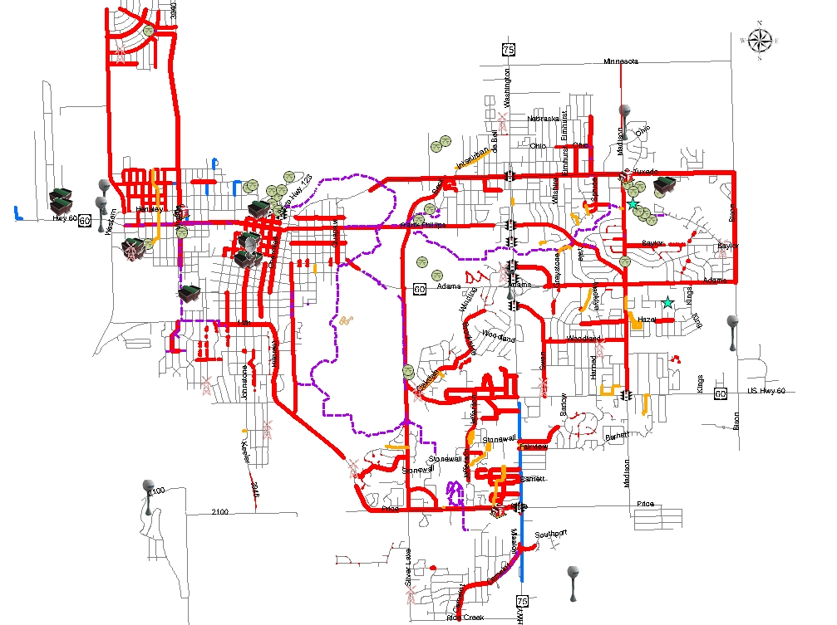
G.O BOND AND SALES TAX PROJECTS SINCE 1999 TOTAL PROJECT COST - $104.79MM
2008-Present
STREET – 38.21MM
FACILITIES/EQUIP – 27.983MM
SANITARY SEWER – 0MM
DRAINAGE – 4.425MM
PARK – 17.297MM
WATER - 0MM
DOWNTOWN – 1.700MM
This is for funding up to year 5 of 2020 Sales Tax Ext and 2023 Issuance of 2020 GO Bond
1999-Present
STREET – 51.045MM
FACILITIES/EQUIP – 22.910MM
SANITARY SEWER – 8.55MM
DRAINAGE – 8.36MM
PARK – 13.353MM
WATER - .57MM
This is for funding up to year 5 of 2020 Sales Tax Ext and 2023 Issuance of 2020 GO Bond
1999-Present
STREET – 48.7%
FACILITIES/EQUIP – 21.9%
SANITARY SEWER – 8.2%
DRAINAGE – 8.0%
PARK – 12.7%
WATER – 0.5%
2008-Present
STREET – 42.7%
PARK – 19.3%
FACILITIES/EQUIP – 31.2%
DRAINAGE – 4.9%
Downtown – 1.9%

Slide 29
CAPITAL IMPROVEMENT PROJECT BUDGETS
CARRY OVER PROJECTS FROM:
WASTEWATER REGULATORY FUND
CITY HALL FUND
STORM SEWER FUND
2018B GO BOND
2019B GO BOND
2022 GO BOND
2023 GO BOND
CAPITAL RESERVE FUND
½ CENT SALES TAX
NEW PROJECTS FROM:
WASTEWATER FUND
WASTEWATER REGULATORY FUND
CITY HALL FUND
CAPITAL RESERVE FUND
½ CENT SALES TAX
Notes:
This election
Categories by total
$16.5 million includes COI
Percentage by category
Again, funding for ongoing street repair is lessening in the GO Bond issues due to increase funding in CIP funding
Allows us to focus on the needs in Parks and Rec that have gone without needed funding in the past

Slide 30
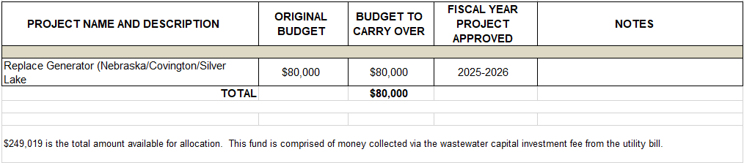
WASTEWATER REGULATORY FUND CARRY OVER PROJECTS
$249,019 is the total amount available for allocation
Notes:
This election
Categories by total
$16.5 million includes COI
Percentage by category
Again, funding for ongoing street repair is lessening in the GO Bond issues due to increase funding in CIP funding
Allows us to focus on the needs in Parks and Rec that have gone without needed funding in the past

Slide 31
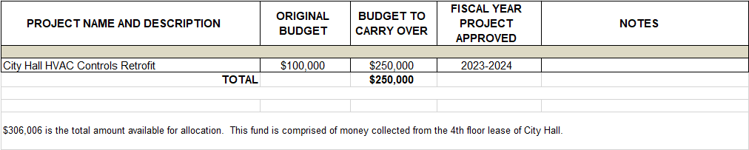
CITY HALL FUND CARRY OVER PROJECTS
$306,006 is the total amount available for allocation
Notes:
This election
Categories by total
$16.5 million includes COI
Percentage by category
Again, funding for ongoing street repair is lessening in the GO Bond issues due to increase funding in CIP funding
Allows us to focus on the needs in Parks and Rec that have gone without needed funding in the past

Slide 32
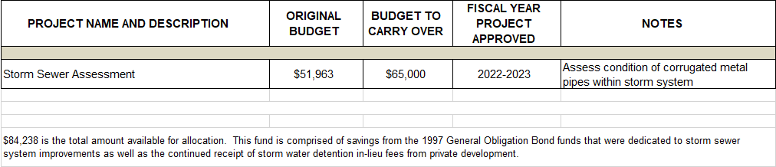
STORM SEWER FUND CARRY OVER PROJECTS
$84,238 is the total amount available for allocation
Notes:
This election
Categories by total
$16.5 million includes COI
Percentage by category
Again, funding for ongoing street repair is lessening in the GO Bond issues due to increase funding in CIP funding
Allows us to focus on the needs in Parks and Rec that have gone without needed funding in the past

Slide 33
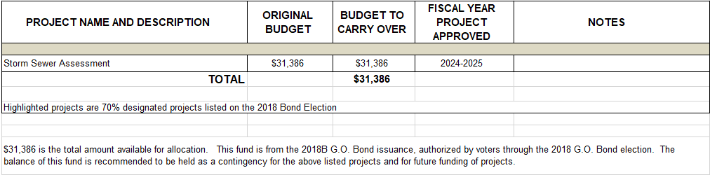
2018B BOND FUND CARRY OVER PROJECTS
$31,386 is the total amount available for allocation
Notes:
This election
Categories by total
$16.5 million includes COI
Percentage by category
Again, funding for ongoing street repair is lessening in the GO Bond issues due to increase funding in CIP funding
Allows us to focus on the needs in Parks and Rec that have gone without needed funding in the past

Slide 34
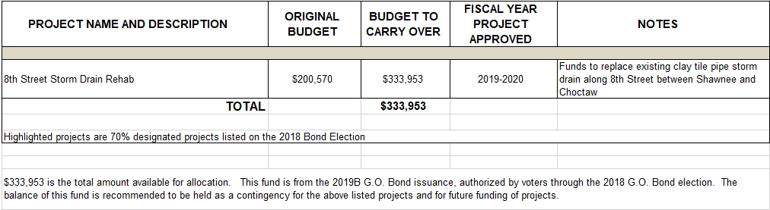
2019B BOND FUND CARRY OVER PROJECTS
$333,953 is the total amount available for allocation
Notes:
This election
Categories by total
$16.5 million includes COI
Percentage by category
Again, funding for ongoing street repair is lessening in the GO Bond issues due to increase funding in CIP funding
Allows us to focus on the needs in Parks and Rec that have gone without needed funding in the past

Slide 35
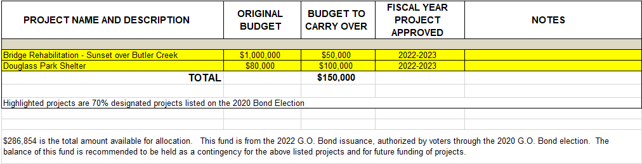
2022 BOND FUND CARRY OVER PROJECTS
$286,854 is the total amount available for allocation
Notes:
This election
Categories by total
$16.5 million includes COI
Percentage by category
Again, funding for ongoing street repair is lessening in the GO Bond issues due to increase funding in CIP funding
Allows us to focus on the needs in Parks and Rec that have gone without needed funding in the past

Slide 36
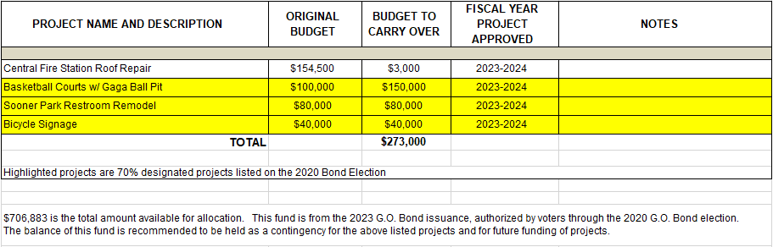
2023 BOND FUND CARRY OVER PROJECTS
$706,883 is the total amount available for allocation
Notes:
This election
Categories by total
$16.5 million includes COI
Percentage by category
Again, funding for ongoing street repair is lessening in the GO Bond issues due to increase funding in CIP funding
Allows us to focus on the needs in Parks and Rec that have gone without needed funding in the past

Slide 37
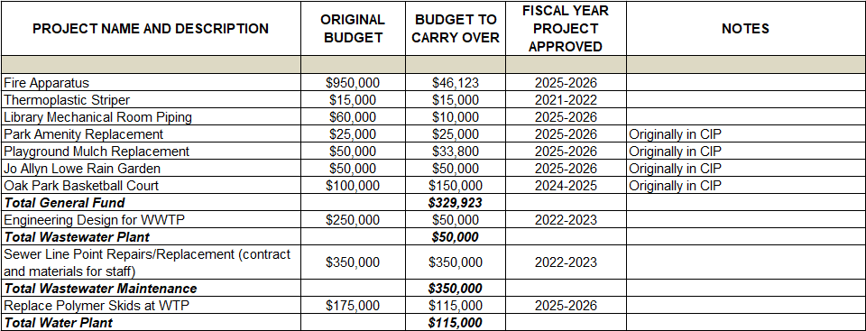
CAPITAL RESERVE FUND CARRY OVER PROJECTS
Notes:
This election
Categories by total
$16.5 million includes COI
Percentage by category
Again, funding for ongoing street repair is lessening in the GO Bond issues due to increase funding in CIP funding
Allows us to focus on the needs in Parks and Rec that have gone without needed funding in the past

Slide 38
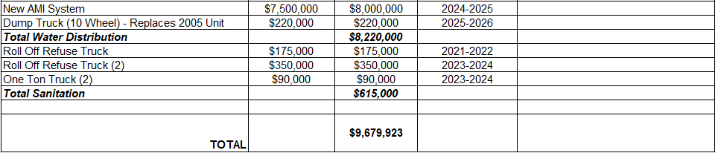
CAPITAL RESERVE FUND CARRY OVER PROJECTS (CTD)
Notes:
This election
Categories by total
$16.5 million includes COI
Percentage by category
Again, funding for ongoing street repair is lessening in the GO Bond issues due to increase funding in CIP funding
Allows us to focus on the needs in Parks and Rec that have gone without needed funding in the past

Slide 39
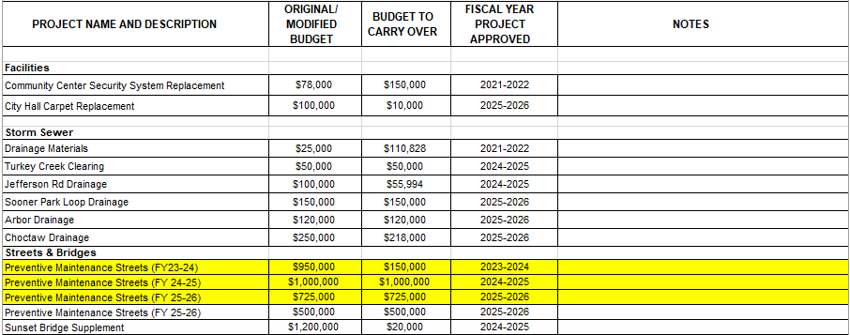
½ CENT SALES TAX CARRY OVER PROJECTS
Notes:
This election
Categories by total
$16.5 million includes COI
Percentage by category
Again, funding for ongoing street repair is lessening in the GO Bond issues due to increase funding in CIP funding
Allows us to focus on the needs in Parks and Rec that have gone without needed funding in the past

Slide 40
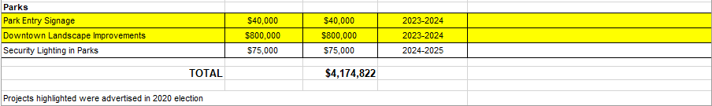
½ CENT SALES TAX CARRY OVER PROJECTS
Notes:
This election
Categories by total
$16.5 million includes COI
Percentage by category
Again, funding for ongoing street repair is lessening in the GO Bond issues due to increase funding in CIP funding
Allows us to focus on the needs in Parks and Rec that have gone without needed funding in the past

Slide 41
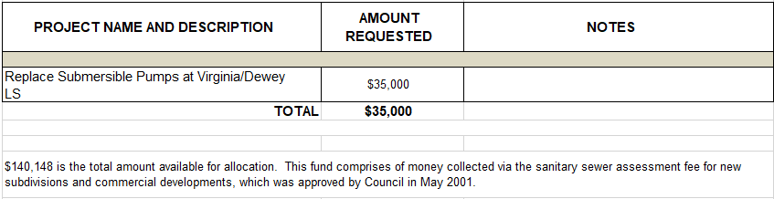
WASTEWATER FUND PROPOSED PROJECTS & EQUIPMENT
$140,148 is the total amount available for allocation
Notes:
This election
Categories by total
$16.5 million includes COI
Percentage by category
Again, funding for ongoing street repair is lessening in the GO Bond issues due to increase funding in CIP funding
Allows us to focus on the needs in Parks and Rec that have gone without needed funding in the past

Slide 42
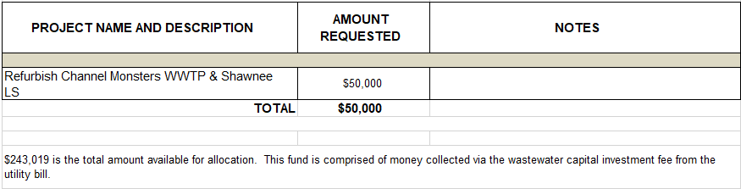
WASTEWATER REGULATORY FUND PROPOSED PROJECTS & EQUIPMENT
$243,019 is the total amount available for allocation
Notes:
This election
Categories by total
$16.5 million includes COI
Percentage by category
Again, funding for ongoing street repair is lessening in the GO Bond issues due to increase funding in CIP funding
Allows us to focus on the needs in Parks and Rec that have gone without needed funding in the past

Slide 43
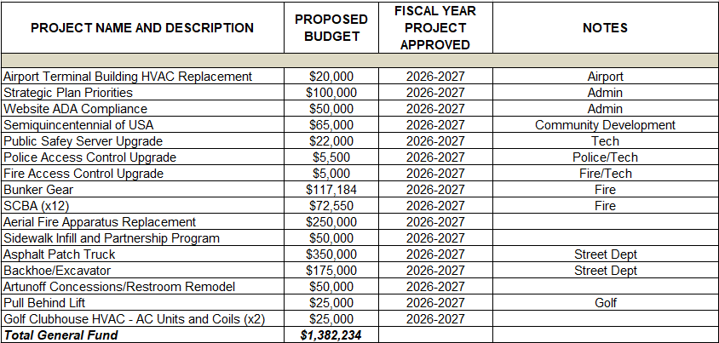
CAPITAL RESERVE FUND PROPOSED PROJECTS & EQUIPMENT
Notes:
This election
Categories by total
$16.5 million includes COI
Percentage by category
Again, funding for ongoing street repair is lessening in the GO Bond issues due to increase funding in CIP funding
Allows us to focus on the needs in Parks and Rec that have gone without needed funding in the past

Slide 44
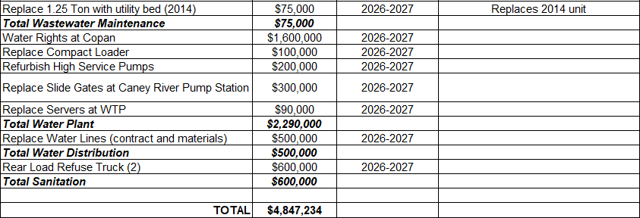
CAPITAL RESERVE FUND PROPOSED PROJECTS & EQUIPMENT (CTD)
Notes:
This election
Categories by total
$16.5 million includes COI
Percentage by category
Again, funding for ongoing street repair is lessening in the GO Bond issues due to increase funding in CIP funding
Allows us to focus on the needs in Parks and Rec that have gone without needed funding in the past

Slide 45
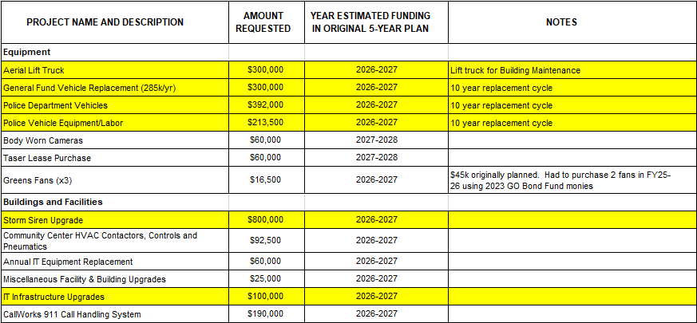
½ CENT SALES TAX PROPOSED PROJECTS & EQUIPMENT
$4,019,842 is the total amount available for allocation
Notes:
This election
Categories by total
$16.5 million includes COI
Percentage by category
Again, funding for ongoing street repair is lessening in the GO Bond issues due to increase funding in CIP funding
Allows us to focus on the needs in Parks and Rec that have gone without needed funding in the past

Slide 46
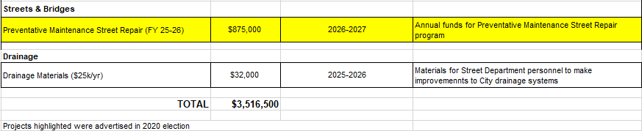
½ CENT SALES TAX PROPOSED PROJECTS & EQUIPMENT (CTD)
$4,019,842 is the total amount available for allocation
Notes:
This election
Categories by total
$16.5 million includes COI
Percentage by category
Again, funding for ongoing street repair is lessening in the GO Bond issues due to increase funding in CIP funding
Allows us to focus on the needs in Parks and Rec that have gone without needed funding in the past

Slide 47
QUESTIONS & DISCUSSION?
FY 26-27 CAPITAL BUDGET
Workshop Presentation
Staff Recommendations
4.21.2026
Notes:
This election
Categories by total
$16.5 million includes COI
Percentage by category
Again, funding for ongoing street repair is lessening in the GO Bond issues due to increase funding in CIP funding
Allows us to focus on the needs in Parks and Rec that have gone without needed funding in the past

