Slide 1
LWV of Kent
Education Committee
Ohio State
Board
of Education
Deborah Austin Sanders and Sara Ashley Cooke

Slide 2
LWV of Kent
Education Committee
The Ohio State Board of Education is an elected executive agency of the Ohio state government, responsible for managing the state's public K-12 education.
The Ohio State Board of Education, which has 19 members – including 11 who are elected and eight who are appointed by the governor.

Slide 3
LWV of Kent
Education Committee
While local districts can choose textbooks and other learning materials not specified in state law, the state board sets an overall vision for education with a strategic plan.

Slide 4


Slide 5
LWV of Kent
Education Committee
Under state law, Ohio must redraw its state school board boundaries every decade.
On January 31, 2022, Governor Mike DeWine announced new district boundaries for the Ohio State Board of Education as part of Ohio’s redistricting after the 2020 census.

Slide 6
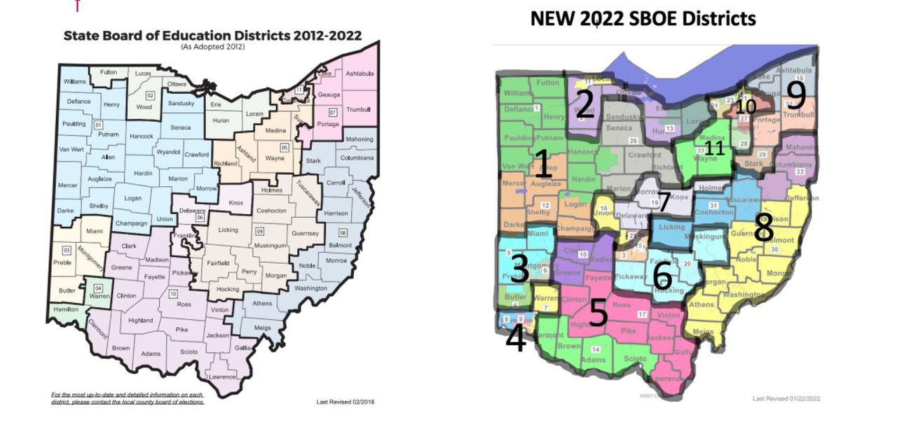
LWV of Kent
Education Committee

Slide 7
Q&a
(QUESTIONS AND ANSWERS SESSIONS)

