Slide 1
Harmony PR/Outreach/Advocacy August 2024 –
September 2024 bi-monthly updates

Slide 2
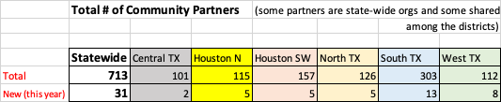
HPIE Community Partnerships
Advisory councils?
Lunch / Learns
Leadership Programs for Chiefs?

Slide 3
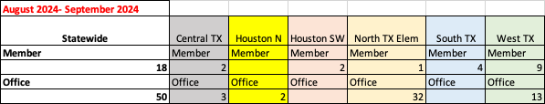
Civic Leaders / Elected Officials/ Staff Visits

Slide 4

Advocacy Update
HOH Goal?
HOH will be paid by?
our n TCSA position on voucher/ESA?

Slide 5
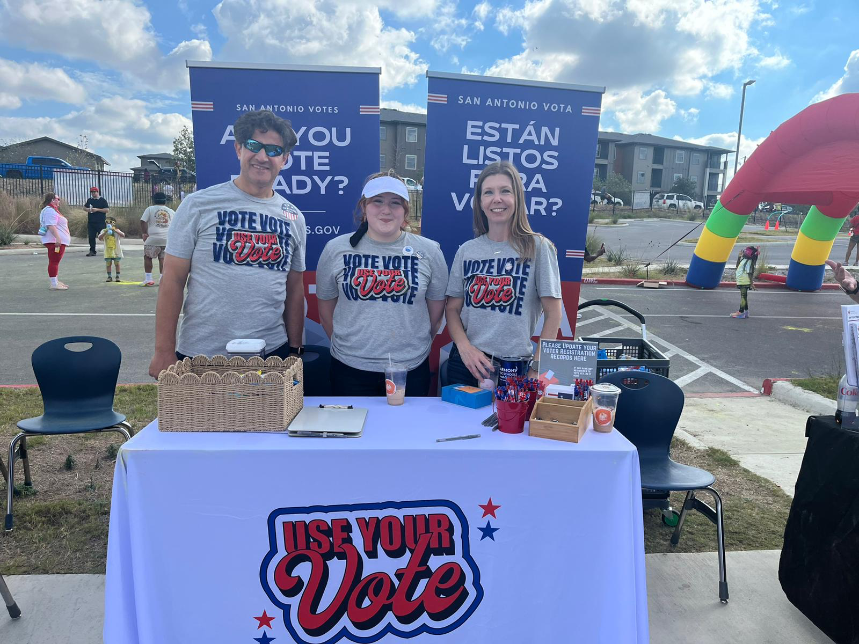
Advocacy Update 2
Voter Registration Efforts
# of Eligible Seniors
Staff/Parents/Alumni
who were registered
Last Year
125 (in 50 days)
This Year
138 so far (60 days)

Slide 6
SLS Update
November 13, 2024, Wednesday
TIME EVENT
12:00 pm - 3:00 p.m. Arrivals at Twin Lakes Family YMCA in Cedar Park
3:00 pm - 6:00 p.m. Fun and Physical Activities at YMCA (more details coming soon)
6:00 p.m- 7:00 p.m. Dinner
7:00 p.m. 9:00 p.m. Team Bonding Power Night Activities at YMCA(more details coming soon)
10:00 p.m. Lights out
November 14, 2024, Thursday
TIME EVENT
7:00 a.m. Breakfast at the YMCA
9:00 a.m. - 12:00 p.m. Session I at the State Capitol
12:00 p.m. - 1:00 pm Lunch
1:00 p.m. - 2:30 p.m. Session II at the State Capitol
2:30 p.m. Departures
https://docs.google.com/spreadsheets/d/1n60SDoHKbVh5AcIkTgsOX1RoIV4rfHunJIHgVmrNWuM/edit?gid=0#gid=0

