Slide 1
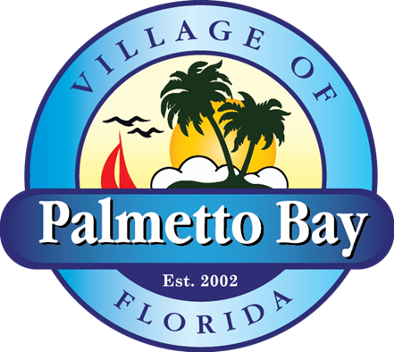
FISCAL YEAR 2022
MAXIMUM MILLAGE RATE

Slide 2
Palmetto Bay’s Millage Rate History

Slide 3
Millage Rate Comparison
Palmetto Bay would be the 7th lowest millage rate among 35 municipalities in the county. The cities with a lower rate have a lesser percentage of homesteaded properties and higher average taxable values. Homesteaded properties are capped at a maximum increase 0f 3% annually.
Source: Miami Dade County Property Appraiser

Slide 4
MILLAGE RATE OPTIONS
MILLAGE RATE AT 2.235
SERVICES WOULD HAVE TO BE HELD AT FISCAL YEAR 2021 LEVELS
MILLAGE RATE AT 2.400 - Additional Revenue: $527,774
Special Events $200,000
Police Officer $150,000
Additional Personnel $218,000
-Administrative Assistant for Village Clerk and Attorney
-Public Information Officer (PIO)
-AV Technician
-Reservation Specialist for Parks and Recreation
MILLAGE RATE AT 2.600 – Additional Revenue: $1,167,500
Capital Replacement Program $600,000

Slide 5
Average cost to Palmetto Bay Resident
The average taxable residential value of a Palmetto Bay home for FY2022 is $326,075
MILLAGE RATE AT 2.235 - $728.79
MILLAGE RATE AT 2.400 - $782.59 ($53.80 increase from 2.235)
MILLAGE RATE AT 2.600 - $847.81 ($119.02 increase from 2.235)

