Slide 1
Department of OB, Gyn & RS
Caring for Our Own Emotional Well-Being During Covid-19

Margo Pumar, MD, MA
Amanda Yeaton Massey, MD

Slide 2
Town Hall Agenda
Introductions
Current state summary
Discussion: Staff and provider experiences
Discussion: New ideas for a new normal
Closing summary

Slide 3
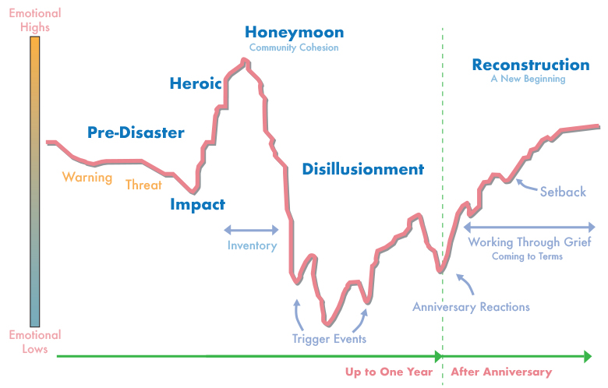
SARS-Covid19 Pandemic
Phases of Disaster

Slide 4
Already facing . . .
LOSS
Isolation and lack of physical touch
Risk of Illness and spread
Loss of usual coping mechanisms
Rapid, frequent change
Supply shortages
Ethical dilemmas
Worsening inequities
Informational bombardment
Increased intensity of work
Increased administrative burdens
Increased personal financial burdens
Visitor restrictions
Patients with technology and language challenges
Fighting a disease for which we still have mountains to learn
CoVID19
A Disease Right Now that’s Smarter Than Us
ISOlatIoN
Bombardment
S P R E A D
Risk OF ILLNESS
R A P I D
FREQUent
CHANGE
Supply
Not enough Supplies
Not enough Time
Not enough Information
Not enough Truth
Not enough . . .
Shortages
Worsening Inequities
INTENSITY
Ethical DILEMMAS $urdens WoRK
Notes:
[]Alisa to make graphic of words
Isolation and lack of physical touch (loved one, colleagues, patients)
Risks to self and family members
Rapid, ongoing changes and need to frequently learn new protocols and adjust
Supply shortages (medical and domestic)
Increased intensity of clinical work - seeing the most medically acute, greater mental health demands, IPV
Ethical dilemmas
Worsening social, economic, and health inequities
Loss of usual coping mechanisms
New levels of informational bombardment
Increased financial burdens due to illness and dependent care
Visitor restrictions increase burden on medical providers to provide support
Patients who cannot access virtual care or are non-English proficient
Increased administrative burdens (increased requests for disability and Rx)
New organizational structures and processes (RSCs and VACC)
Fighting a disease for which we still have mountains to learn

Slide 5
Notes:
[]Alisa will take a whirl

Slide 6
Seeking Help
“This is just getting to be too much…”
Virtual visits with your PCP
Caring for the Caregiver
Faculty and Staff Assistance Program
Mental health services (Talkspace)
Spiritual Care services; Parnassus/Mount Zion: (415) 353-1941 Mission Bay: (415) 514-4200
National Domestic Violence Hotline at (800) 799-7233
Substance use: harmreduction.org
San Francisco Services:
Mental Health Warm Line (855) 845-7415
Suicide Prevention Hotline (415) 781-0500

Slide 7
Other Important Resources:
http://psychiatry.ucsf.edu/coronavirus
https://coronavirus.ucsf.edu/emotional-health-wellbeing-resources
https://www.cdc.gov/coronavirus
https://www.who.int/docs/default-source/coronaviruse/mental-health-considerations.pdf

Slide 8
On behalf of San Francisco and the Bay Area… Thank you!

