Slide 1
Candid Search Training
21 August 2026
Waco-McLennan County Library – Central Library
11:45 AM – 1:00 PM

Slide 2
Premises, Disclaimers, & Apologies
I operate from the guiding principle that everyone in an organization should be involved in fundraising (vs. responsible).

Slide 3
Premises, Disclaimers, & Apologies
I operate from the guiding principle that everyone in an organization should be involved in fundraising (vs. responsible).
Today, I will use the following terms relatively interchangeably: fundraising; grantseeking; development; advancement.

Slide 4
Premises, Disclaimers, & Apologies
I operate from the guiding principle that everyone in an organization should be involved in fundraising (vs. responsible).
Today, I will use the following terms relatively interchangeably: fundraising; grantseeking; development; advancement.
I speak primarily from my experiences. I am open to the idea that I could possibly be wrong … but don’t go crazy.

Slide 5
Premises, Disclaimers, & Apologies
I operate from the guiding principle that everyone in an organization should be involved in fundraising (vs. responsible).
Today, I will use the following terms relatively interchangeably: fundraising; grantseeking; development; advancement.
I speak primarily from my experiences. I am open to the idea that I could possibly be wrong … but don’t go crazy.
I’m not THAT kind of fundraising person. Feel free to interrupt me.

Slide 6
Premises, Disclaimers, & Apologies
I operate from the guiding principle that everyone in an organization should be involved in fundraising (vs. responsible).
Today, I will use the following terms relatively interchangeably: fundraising; grantseeking; development; advancement.
I speak primarily from my experiences. I am open to the idea that I could possibly be wrong … but don’t go crazy.
I’m not THAT kind of fundraising person. Feel free to interrupt me.
I am assisting Cooper Foundation. I am not employed by them. The ideas and information expressed here are not necessarily representative of their values, beliefs, attitudes, or opinions.

Slide 7
The most successful, dynamic, well-funded nonprofits always begin by living out of mission, so that rather than just talk about their mission, they can show donors how they are acting on that mission.
There is a far greater integrity and far more compelling example to point to when done in this order. Given the choice of which to act on first, choose mission every single time.
Commit to mission, ensure that everything is being done to be worthy of generosity, recognize and act on the potential at hand, bring energy and passion, joy and innovation to the equation, and see how quickly money follows mission.
--- paraphrased from Kerry Alys Robinson

Slide 8
A Grant Is Not:
Panacea
Quick fix
Easy money
Donation
Gift
Undesignated funds
Transferrable
Everlasting

Slide 9
A Grant Is:
A contract based on performance, mutual trust, reciprocity, & negotiation

Slide 10
A Grant Is:
A contract based on performance, mutual trust, reciprocity, & negotiation
A unique entity designed to meet a specific need in time – “ if you’ve seen one grant …”

Slide 11
A Grant Is:
A contract based on performance, mutual trust, reciprocity, & negotiation
A unique entity designed to meet a specific need in time – “ if you’ve seen one grant …”
One type of monetary award within a systematic, strategic plan detailing a diversified approach to generating revenue

Slide 12
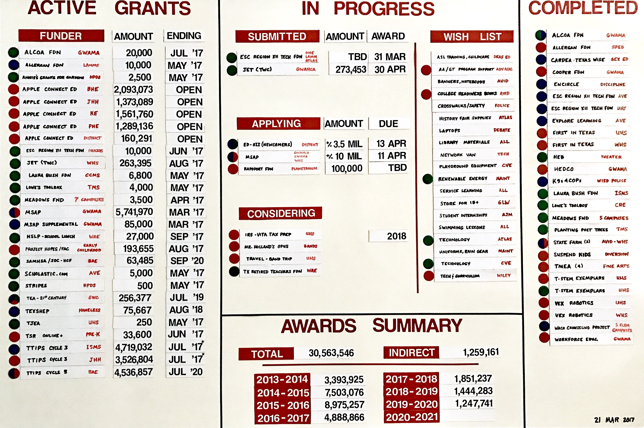

Slide 13
Revenue Streams
  Contributions
  Dues/memberships
  Program fees
  Fee for services
  Events
  Grants
  Investment income
  Sale/donation of assets
  Sale of products
  Real estate
  Donor-advised funds
  Planned giving
  Trusts/bequests
  In-kind gifts

Slide 14
Candid
“TDFKAFDO”
The Database Formerly Known As Foundation Directory Online

Slide 15
Candid Is …
One of the least horrific tools (in a galaxy of suboptimal tools)

Slide 16
Candid Is …
One of the least horrific tools (in a galaxy of suboptimal tools)
Best utilized when you enter it with a purpose, get what you need, and get out of it

Slide 17
Candid Is …
One of the least horrific tools (in a galaxy of suboptimal tools)
Best utilized when you enter it with a purpose, get what you need, and get out of it
A place of exploration, but not a place to spend huge chunks of time

Slide 18
Candid Is …
One of the least horrific tools (in a galaxy of suboptimal tools)
Best utilized when you enter it with a purpose, get what you need, and get out of it
A place of exploration, but not a place to spend huge chunks of time
Not a magic solution or a substitute for skills, a plan, or meaningful contact with humans

Slide 19
Candid Is …
One of the least horrific tools (in a galaxy of suboptimal tools)
Best utilized when you enter it with a purpose, get what you need, and get out of it
A place of exploration, but not a place to spend huge chunks of time
Not a magic solution or a substitute for skills, a plan, or meaningful contact with humans
Available to you through the generous wisdom of Cooper Foundation

Slide 20
Dale A. Barron, LCSW-S
dalebarron13@gmail.com
254.644.8438

