Slide 1

2024
SEPTEMBER 6,7,8

Slide 2
About Throwback Music Fest”…
THROWBACK MUSIC FEST (TMF) IS HELD BY THE GLADSTONE PARK CHAMBER OF COMMERCE,
WITH ASSISTANCE FROM THE GLADSTONE PARK NEIGHBORHOOD ASSOCIATION,
AND IS THE PREMIER END OF SUMMER STREET FESTIVAL IN THE CITY OF CHICAGO.
JOIN US AS WE TRAVEL BACK IN TIME THROUGH THE MUSIC AND FUN OF THE 1960’S, 70’S, 80S, AND 90’S!
EVERY YEAR OVER 15,000 RESIDENTS FROM THE FAR NORTHWEST SIDE OF THE CITY & SURROUNDING SUBURBS JOIN IN THE FUN, GOING BACK TO THE INAUGURAL TMF IN 2016. THAT’S A LOT OF PEOPLE AND A LOT OF FUN!
IN ADDITION TO THE MUSIC, THERE IS A WIDE VARIETY OF EVENTS, INCLUDING OUR HEROES CELEBRATION,
CLASSIC CAR SHOW, MISS THROWBACK PIN-UP COMPETITION, PET PARADE, KID’S AREA, PLUS ARTS & CRAFTS!
STRETCHING NEARLY 2 BLOCKS LONG, TMF – IN ADDITION TO PROVIDING TOP RATE ENTERTAINMENT –
WELCOMES LOCAL BUSINESSES, RETAIL VENDORS, AND A VARIETY OF FOOD OPTIONS!
‘TMF’ IS LOCATED IN AN EASILY ACCESSIBLE AREA AT THE NORTHERN CONVERGENCE OF
MILWAUKEE AVENUE WITH ELSTON AVENUE, AT APPROXIMATELY 6000 N. MILWAUKEE.
THIS PROVIDES A PERFECT OPPORTUNITY FOR ATTENDEES TO WALK, RIDE THEIR BIKES,
OR TO UTILIZE PUBLIC TRANSPORTATION AND RIDE SHARES.

Slide 3
Stats & Facts
* OVER 90,000 ATTENDEES SINCE 2016!
(FEST CANCELED IN 2020 DUE TO COVID PANDEMIC)
* 24 SCHOLARSHIPS HAVE BEEN PROVIDED TO LOCAL STUDENTS
AS A RESULT OF PROCEEDS RAISED FROM TMF!
OVER 75% OF OUR SPONSORS ARE REPEAT SPONSORS, WHO RECOGNIZE THE VALUE OF SPONSORSHIP
& VALUE THE OPPORTUNITY TO CONNECT WITH THE ATTENDEES ON A YEARLY BASIS.
* THE GLADSTONE PARK NEIGHBORHOOD IS HOME TO MANY FIRST RESPONDER FAMILIES, MUNICIPAL EMPLOYEES,
& BLUE COLLAR WORKERS. MEDIAN HOUSEHOLD INCOMES RANGE FROM $80,000 - $120,000.00.
* WHILE THE FEST IS ‘FAMILY FRIENDLY’, AVERAGE ATTENDEE AGE FALLS IN THE 35-55 DEMOGRAPHIC.
* TMF HAS WELCOMED HEADLINERS RANGING FROM GIN BLOSSOMS, THE BUCKINGHAMS,
7TH HEAVEN & 16 CANDLES; TO TRIBUTE BANDS SUCH AS AMERICAN ENGLISH, THINK FLOYD,
KASHMIR, QUEEN EXPIERIENCE, BRUCE IN THE USA – AND MORE!

Slide 4
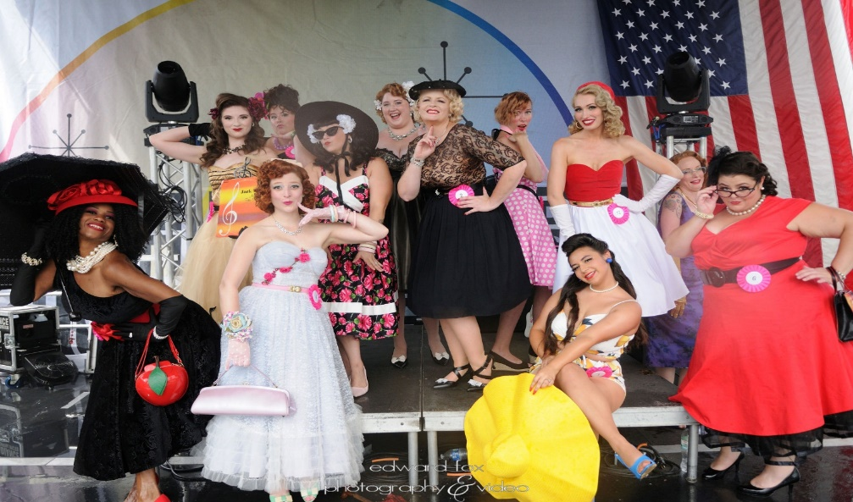
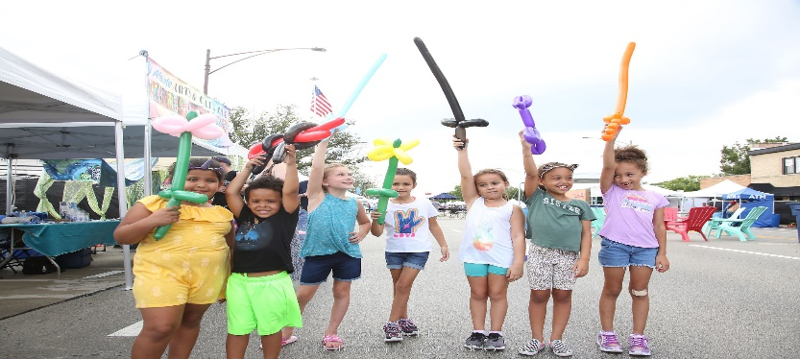
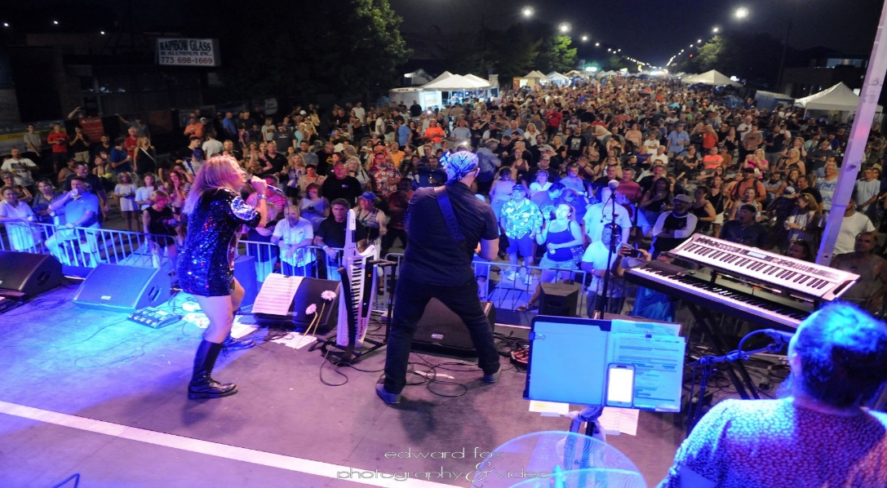
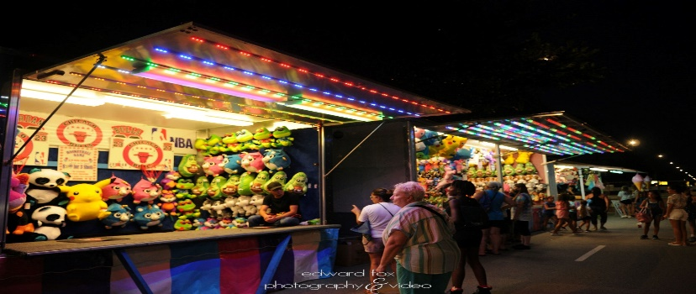
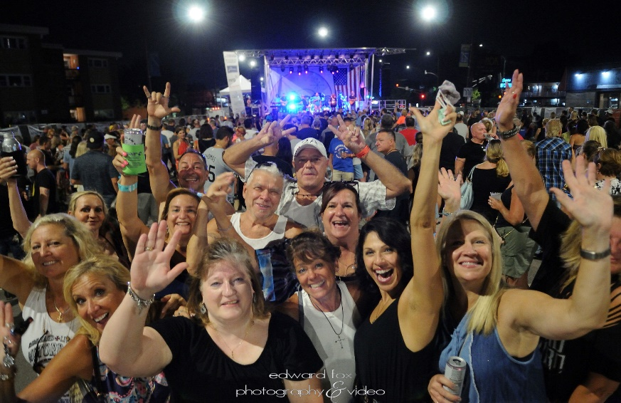
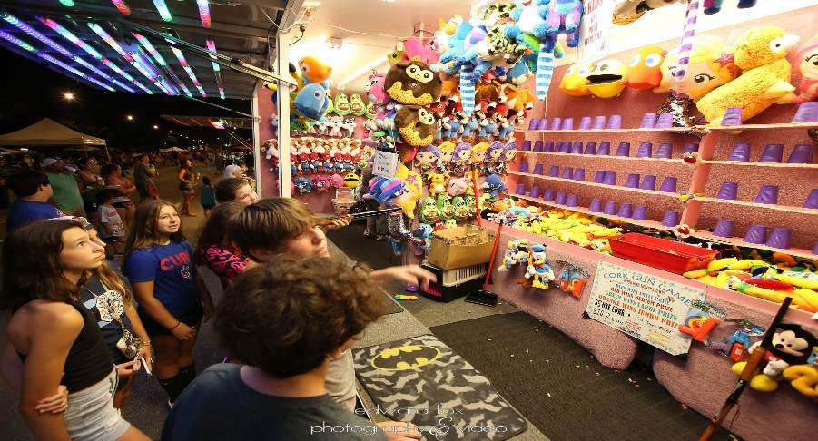
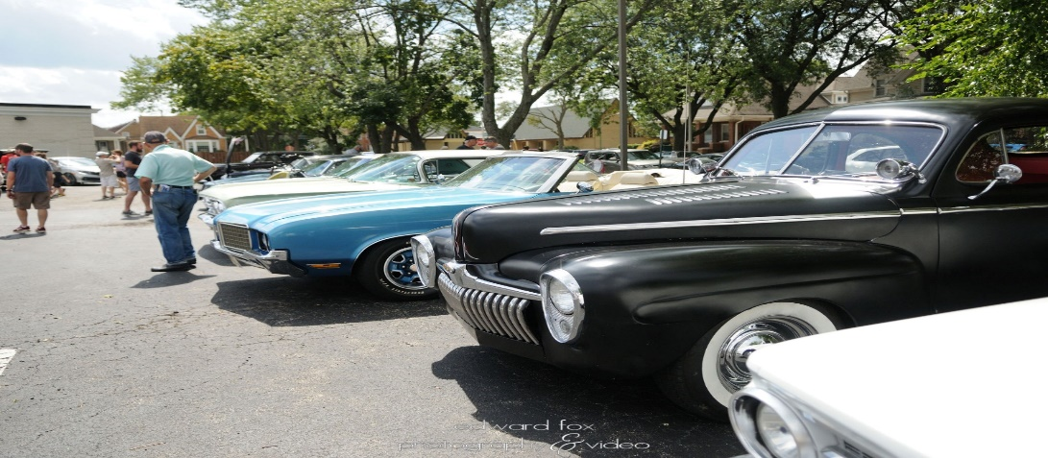
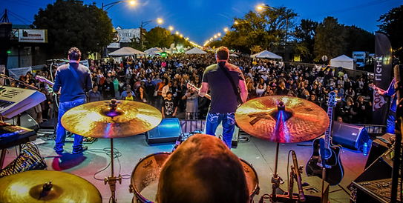
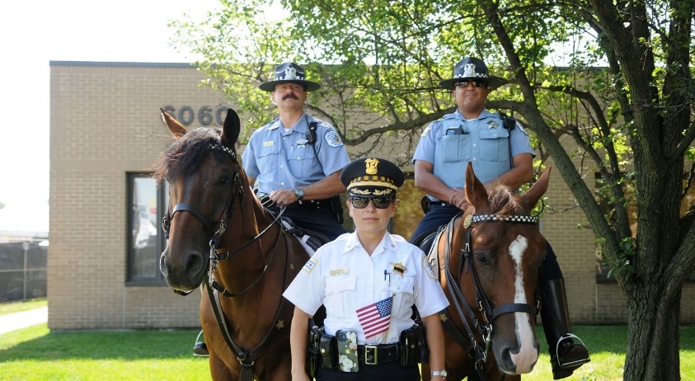
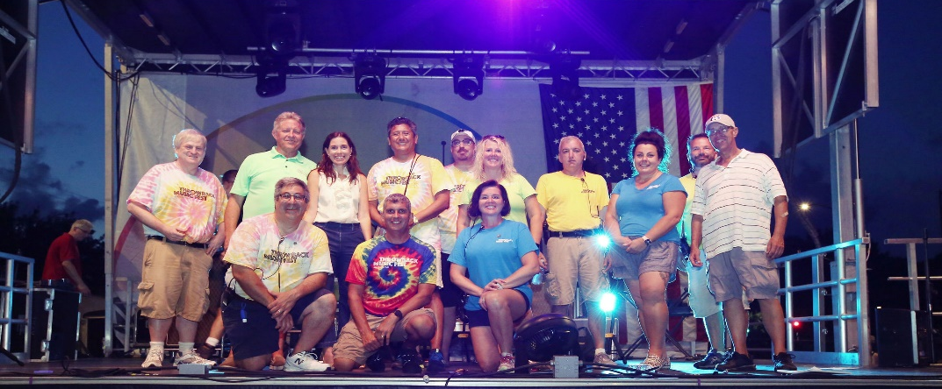
Fun for All Ages and Events of All Kinds…!

Slide 5

Sponsorship Opportunities
PRESENTING SPONSOR
- 1 AVAILABLE –
$12,000.00
Fest name to include sponsor: “Throwback Music Fest Presented by (business name)”
Logo on stage side banner
emcee mentions/recognition over the duration of the fest and between each band
Logo & link on fest website, logo on social media and in print media & social media
On-site banner placement in premium location (up to 4 – provided by sponsor)
200sq. Ft. furnished tent with two 8’ tables, 4 chairs & electricity
CARNIVAL SPONSOR
- 1 AVAILABLE-
$5,000.00
Banner placement at entrance of carnival
Logo & link on event website and included in print media & social media
Logo on stage side banner
emcee mentions/recognition on Friday, Saturday and Sunday between each band
On-site banner placement in premium location (up to 4 – provided by sponsor)
10x10’ tent furnished with 8’ table, 2 chairs, & electricity
OFFICIAL SPONSOR
$3,000.00
Logo & link on event website and included in print media & social media
Logo on stage side banner
On-site banner placement in premium location (up to 4 – provided by sponsor)
200 sq. ft. display furnished tent with two 8’ tables, four chairs & electricity
Emcee mentions/recognition on Friday, Saturday, Sunday between each band
COMMUNITY SPONSOR
$1,500.00
Logo & link on event website and included in print media & social media
On-site banner placement (up to 2 – provided by sponsor)
10x10’ tent furnished with one 8’ table, 2 chairs & electricity
2 Emcee mentions/recognition on Friday, Saturday, Sunday
PATRON SPONSOR
$650.00
On-site banner placement (up to 4 – provided by sponsor – max size 4’ x 8’)
ENTRANCE BANNER SPONSOR - $400.00
Guaranteed banner placement at one of the 3 entrances
(up to 2 – provided by sponsor – max size 4’ x 8’) 18 available
BANNER SPONSOR
$300.00
On-site banner placement
(up to 2 – provided by sponsor – max size 4’ x 8’)
All sponsorship payments must be received no later than Monday, July 15th.

Slide 6

Contact Us!
HAVE QUESTIONS? INTERESTED IN A SPONSORSHIP OPPORUTNITY - OR PERHAPS HAVE AN IDEA FOR A CUSTOM SPONSORSHIP? REACH OUT AND LET’S TALK!
CATHY VOIGHT, EXECUTIVE DIRECTOR
EXECDIR@GLADSTONEPARKCHAMBER.COM
(773) 756-6206
DANIEL A. CIOLINO, PRESIDENT
DCIOLINO@WINTRUST.COM
(773) 499-7900
JAIME MORALES, VICE PRESIDENT
JAIME1.MORALES1@GMAIL.COM
(847) 612-9853
YOUR NAME, TITLE
YOUR E-MAIL
YOUR PHONE #
THE GLADSTONE PARK CHAMBER OF COMMERCE IS A REGISTERED 501(C)(6) NON-PROFIT ORGANIZATION

