Slide 1
Why Start in Early Childcare?
🌱 90% of brain development occurs before age 5
🌱 Relationships provide the foundation for learning
🌱 Social-emotional skills support school readiness
🌱 Early supports create opportunities for all children to thrive
        Why? Because it is both a period of tremendous opportunity and one of our best chances to promote equity.
        Marmot, 2010; Blair & Raver, 2015; Shonkoff et al., 2012
Notes:
PAACT exists because early childhood is one of the biggest opportunities we have to change life trajectories. Yet we're seeing increasing behavioral challenges, stress, and unmet social-emotional needs in classrooms. The question is not whether children need support. It's how we provide it in scalable ways.

Slide 2
Why Now?
• Increased stress and trauma in young children
• Escalating behavioral challenges in classrooms
• Rising educator stress and burnout
• Growing need for practical, relationship-based supports
    Programs need strategies that support both child well-being and educator resilience.

Slide 3
WHY COMPASSION
Compassion May Create the Conditions for Learning
🧡 Children & Safety→ Children feel supported Reduces stress | 🤝 Builds→ Connection Strengthens relationships Increases belonging | 🌱 Supports Development Improves self-regulation Encourages positive interactions
When children feel safe and connected, they develop the self-regulation skills they need to engage in learning, build relationships, and thrive.

Slide 4
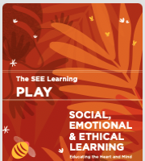
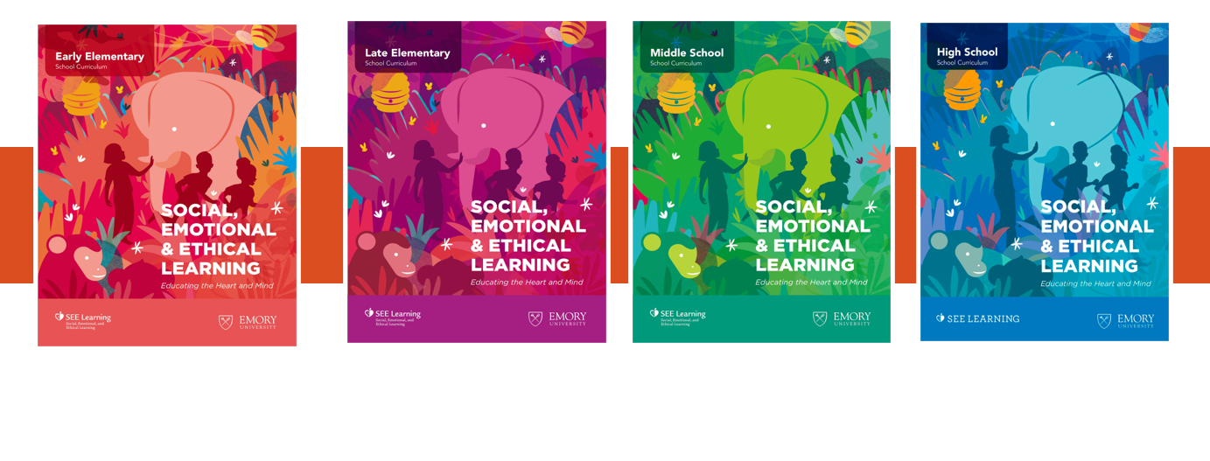
What is SEE Learning Play
Compassion
Resilience
Emotional awareness
Self-regulation
Play-based learning
Flourishing

Slide 5
Shared Goals. Shared Impact.
🎯 PAACT Priority | 🔬 Study Outcomes
🧒 Healthy Development | Understand drivers of child mental health
📚 School Readiness | Insights that support school readiness
👨‍👩‍👧 Family Support | Insights that can Inform family-centered solutions
📊 Data-Driven Decisions | Generate actionable evidence
🌉 Greater Equity | Identify where support is needed most
SHARED OUTCOME: How can we help more Atlanta children enter school healthy, supported, and ready to thrive

Slide 6
SEE Play Aligns Naturally Within Existing SEL
Fits with what teachers already use
Goes deeper in engaging student development
Turns SEL into action
Teacher voices:
“Fit into supports we already had.”
“Created a more unified SEL approach.”
Teacher voices:
“More child-friendly with activities and visuals.”
“Kids used their words and engaged more.”
Teacher voices:
“Helped the kids more.”
“Did kindness better… felt more accountable.”
Notes:
“We’re seeing the strongest impacts in the areas that matter most for classroom functioning—relationships, engagement, and smoother daily routines.”

Slide 7

What the Program Looks Like
Building a Compassionate Classroom
Notes:
“At a big-picture level, this focuses on a small set of practices that integrate into daily routines—not separate lesson blocks.”

Slide 8

The Compassion Tree
Building a Compassionate Classroom

Slide 9
The Compassion Tree: Lets Share
What did you notice doing this activity?
How did it feel to contribute to the tree and see others' contributions?
How did participating in this activity affect your mood or mindset?
In what ways do you envision using a Compassion Tree or similar activity in your classroom?
How might this activity help students connect with one another?

Slide 10
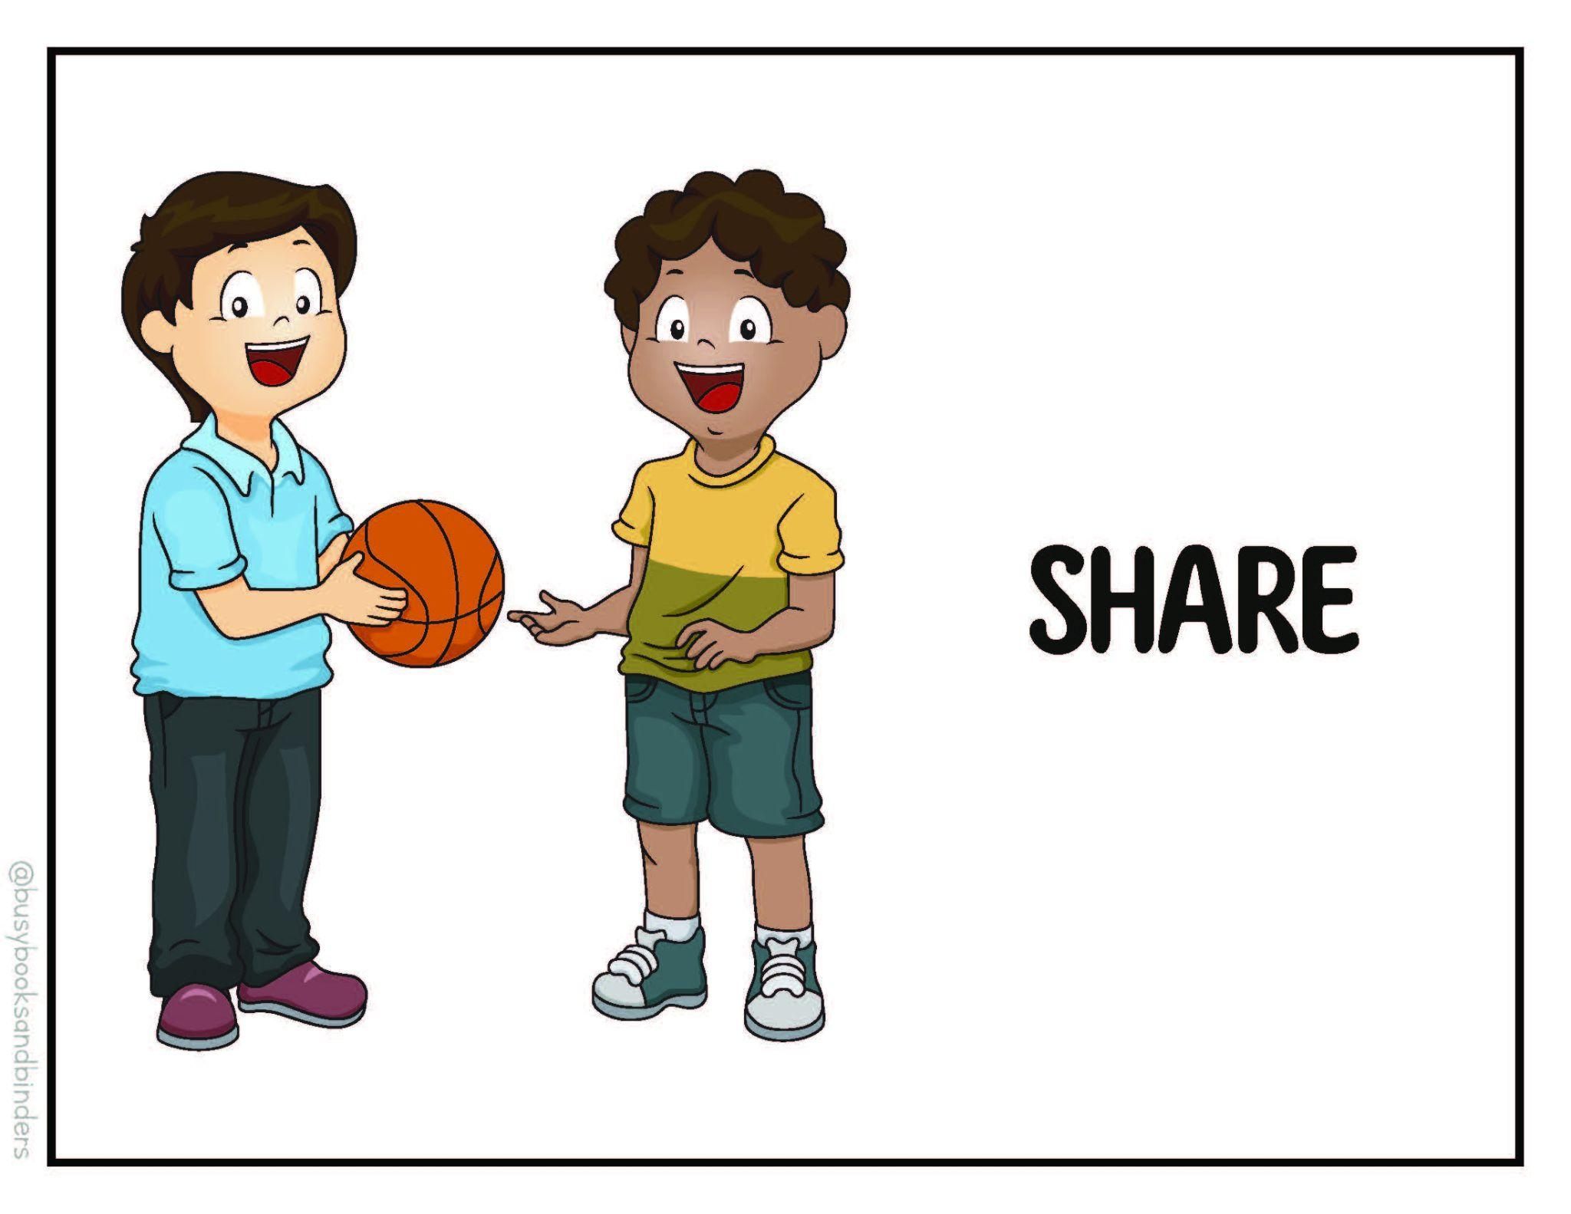
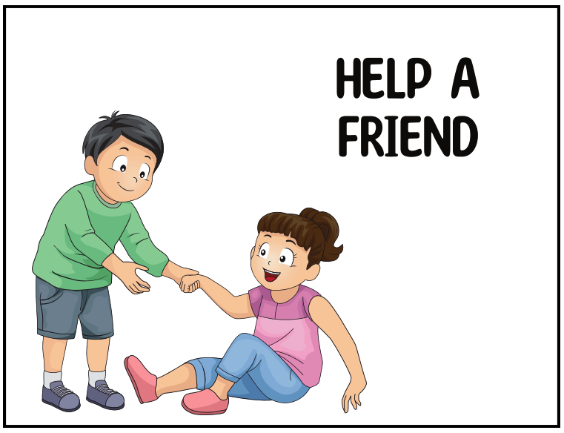

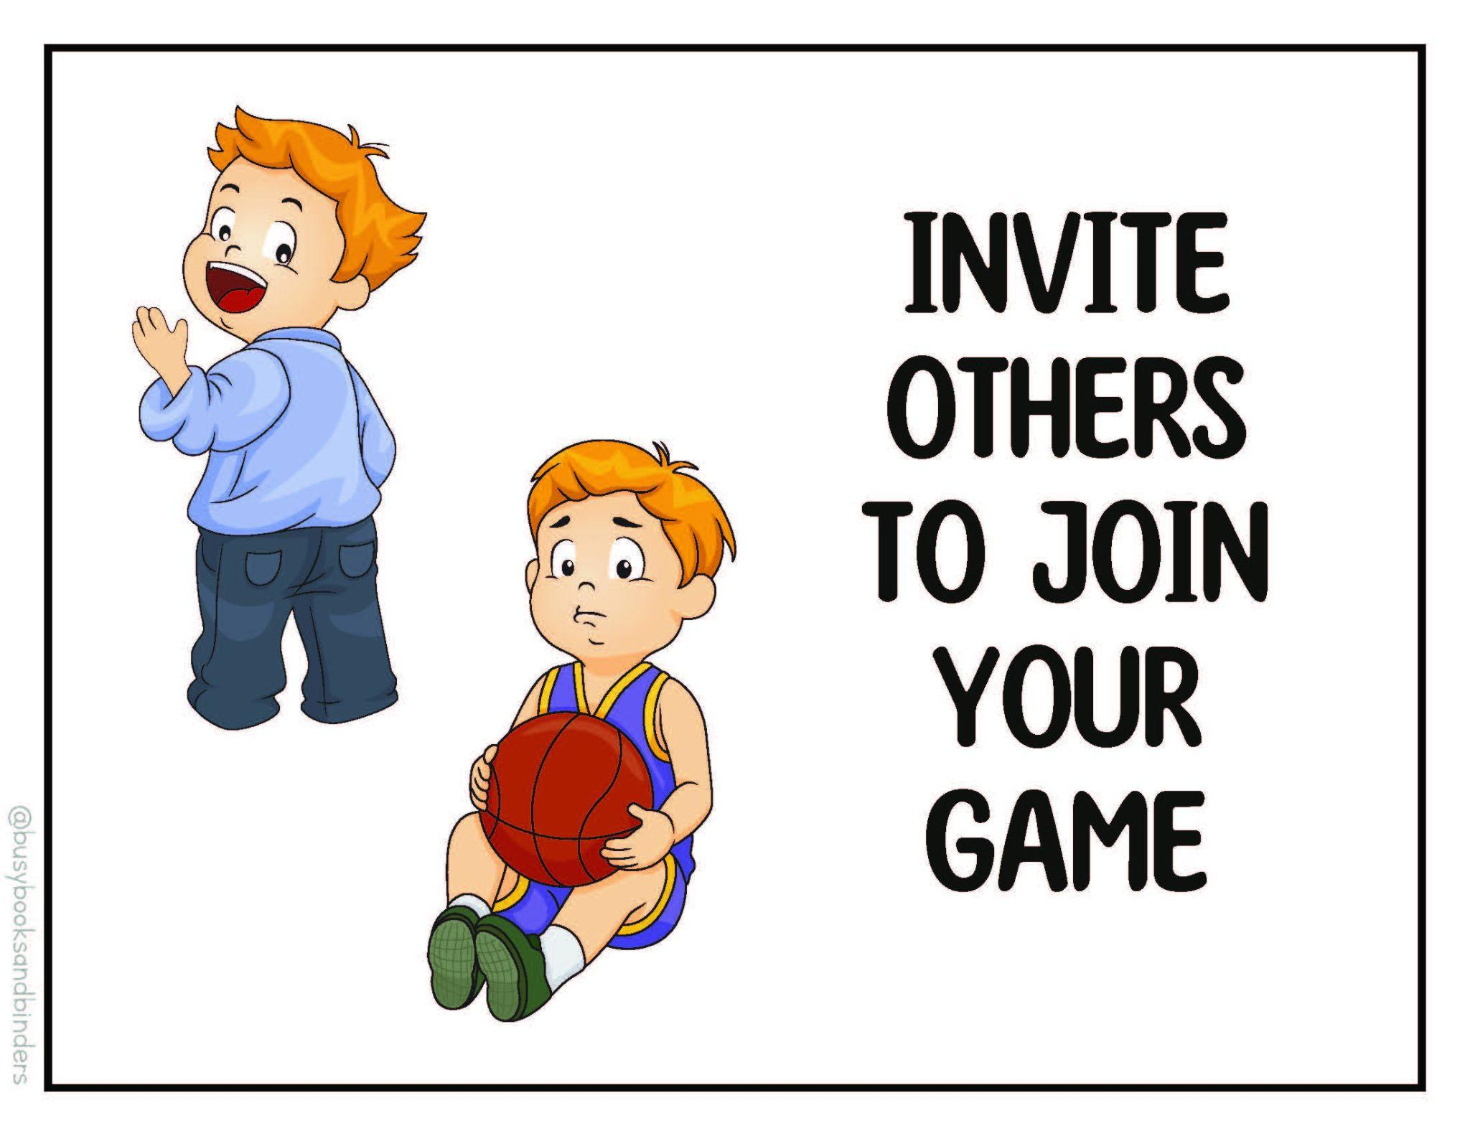
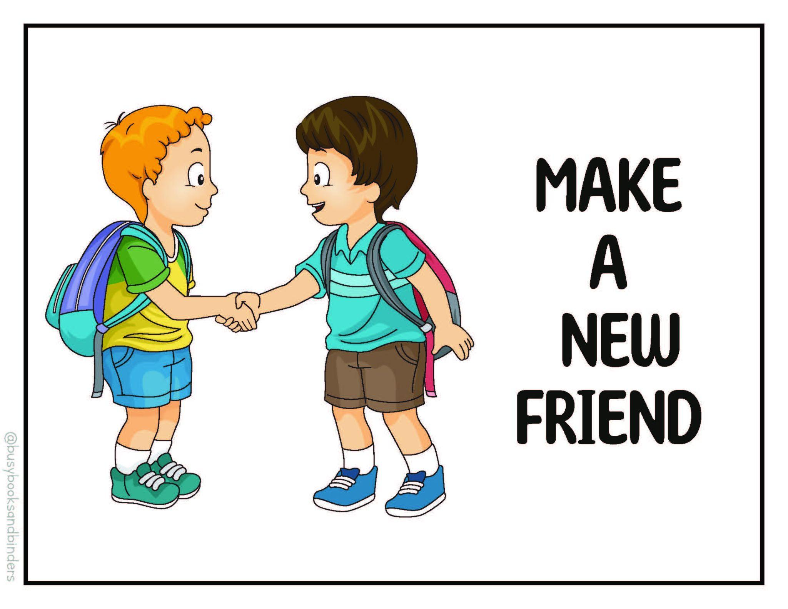
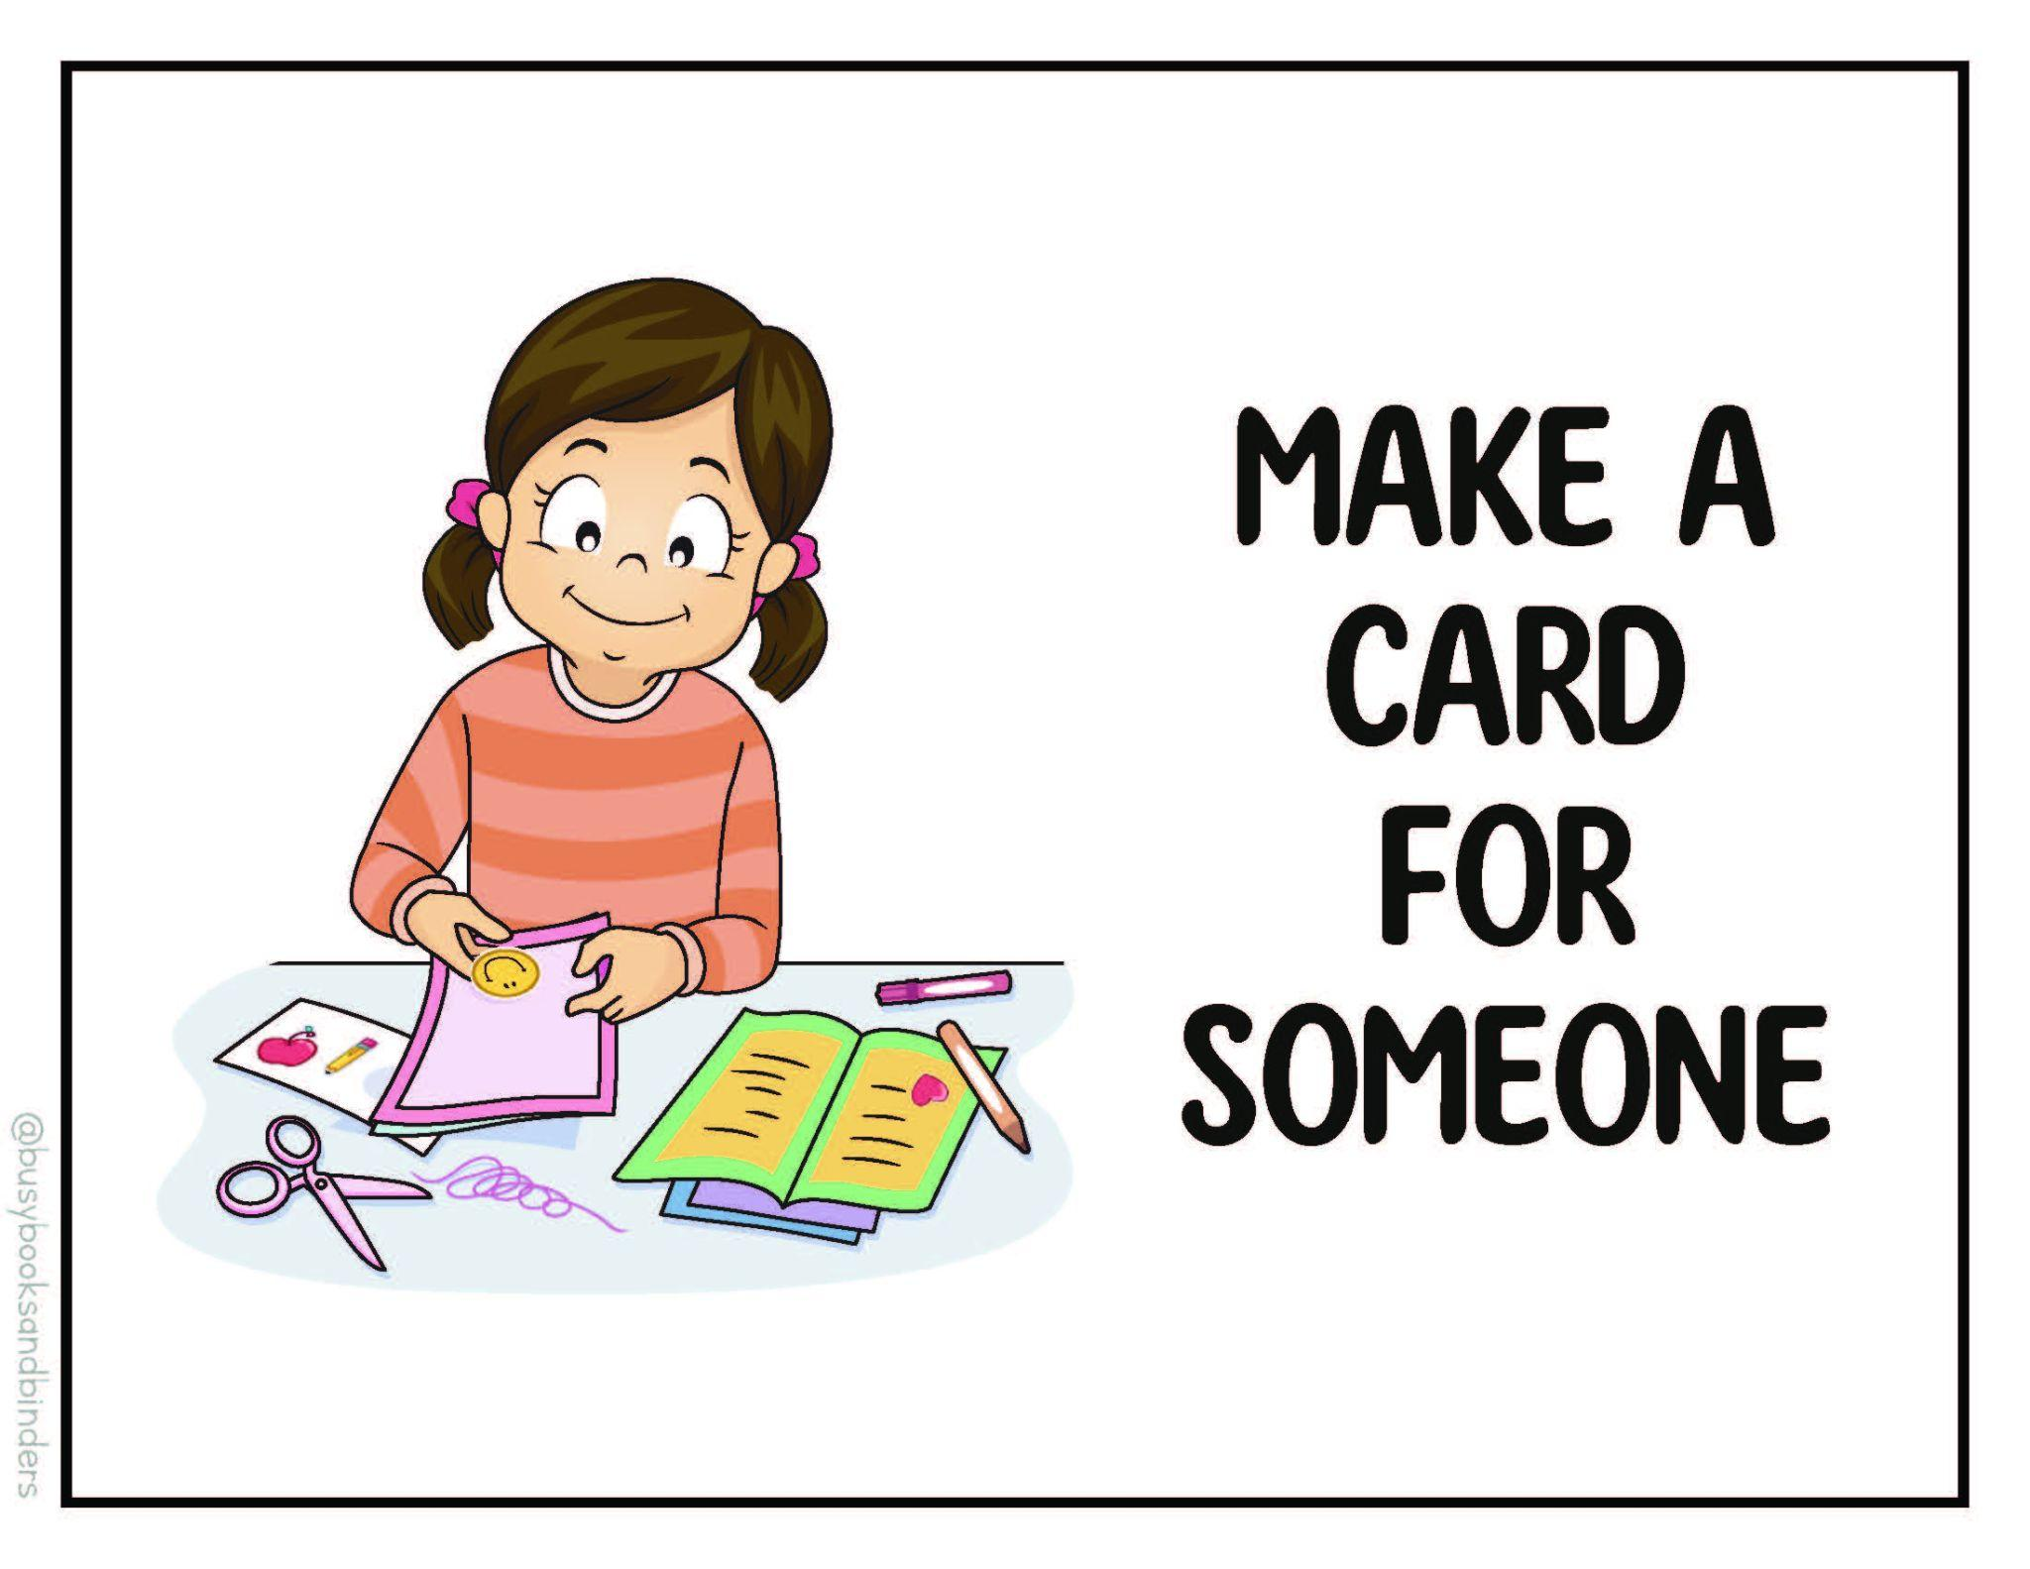
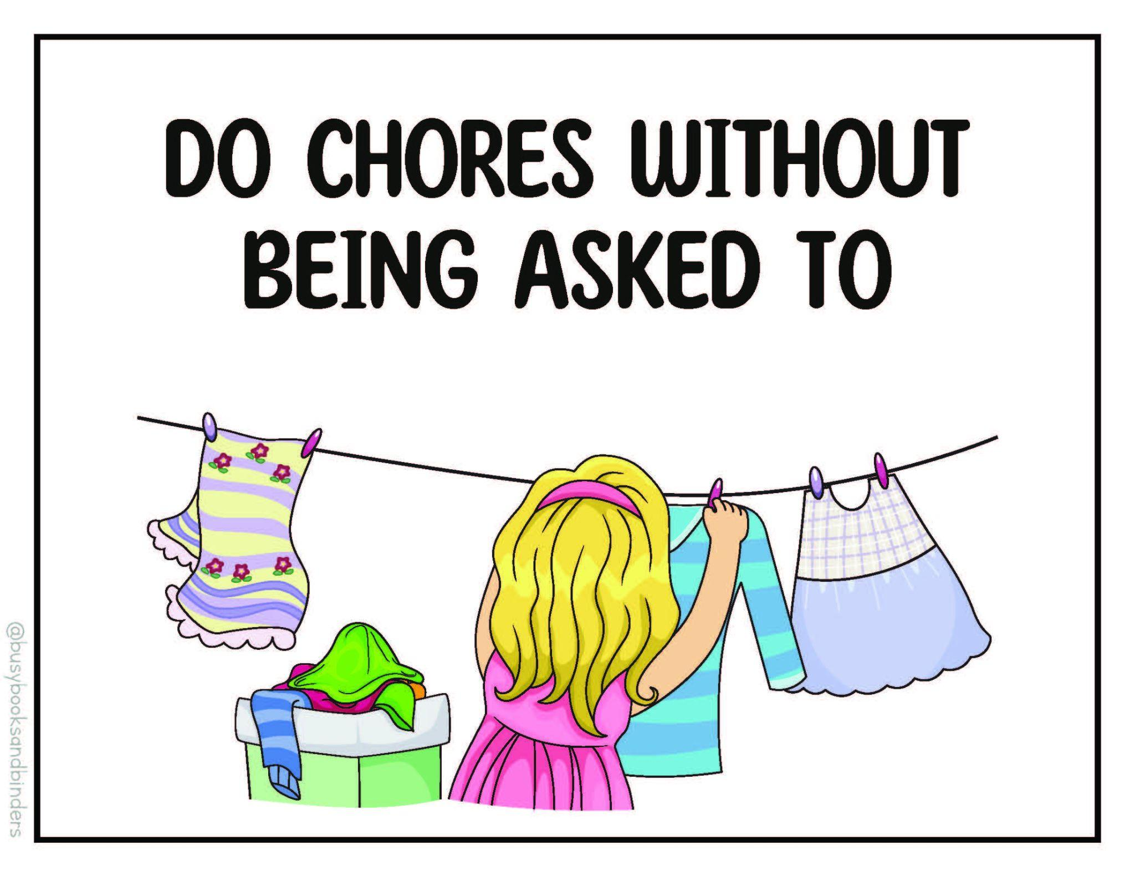
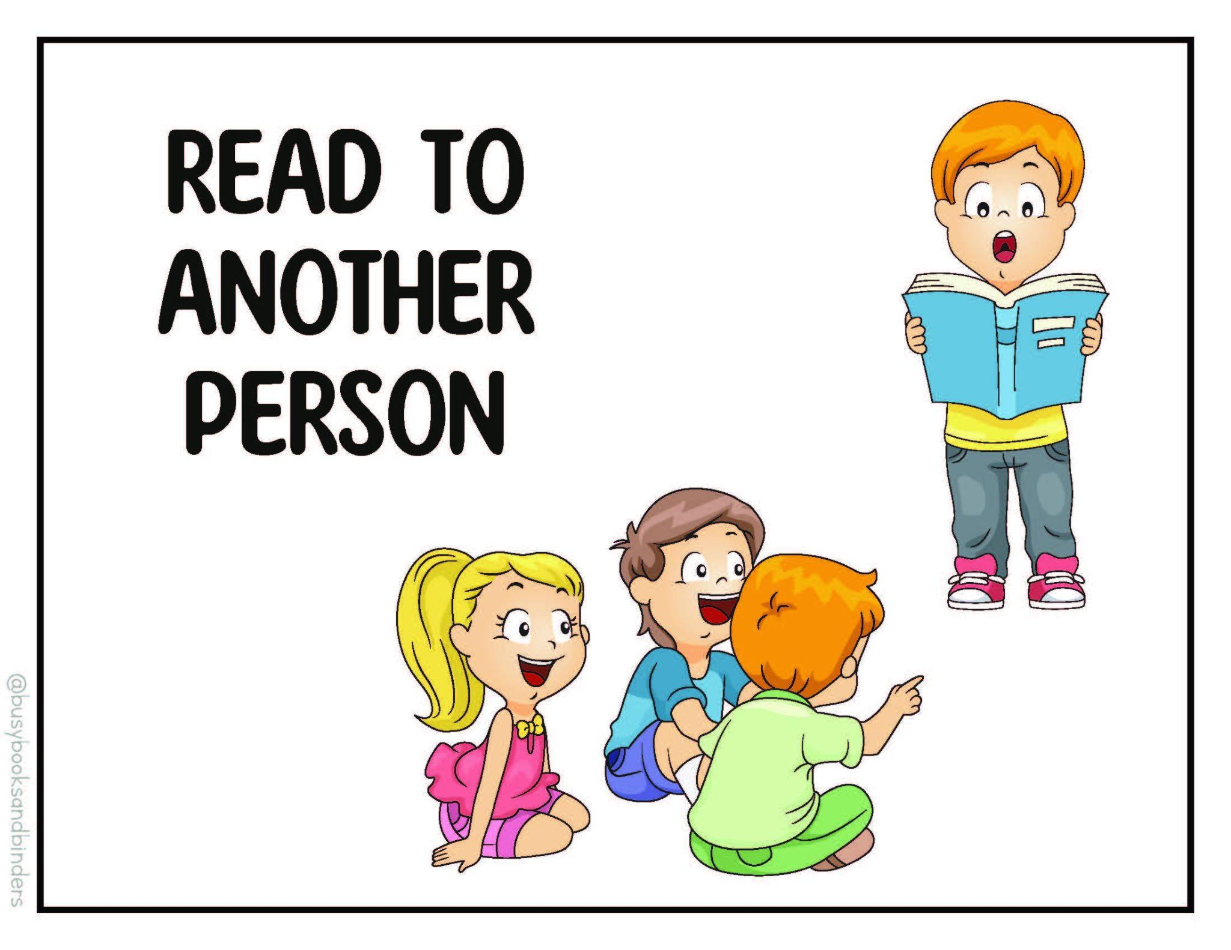
Examples of Compassionate Acts

Slide 11
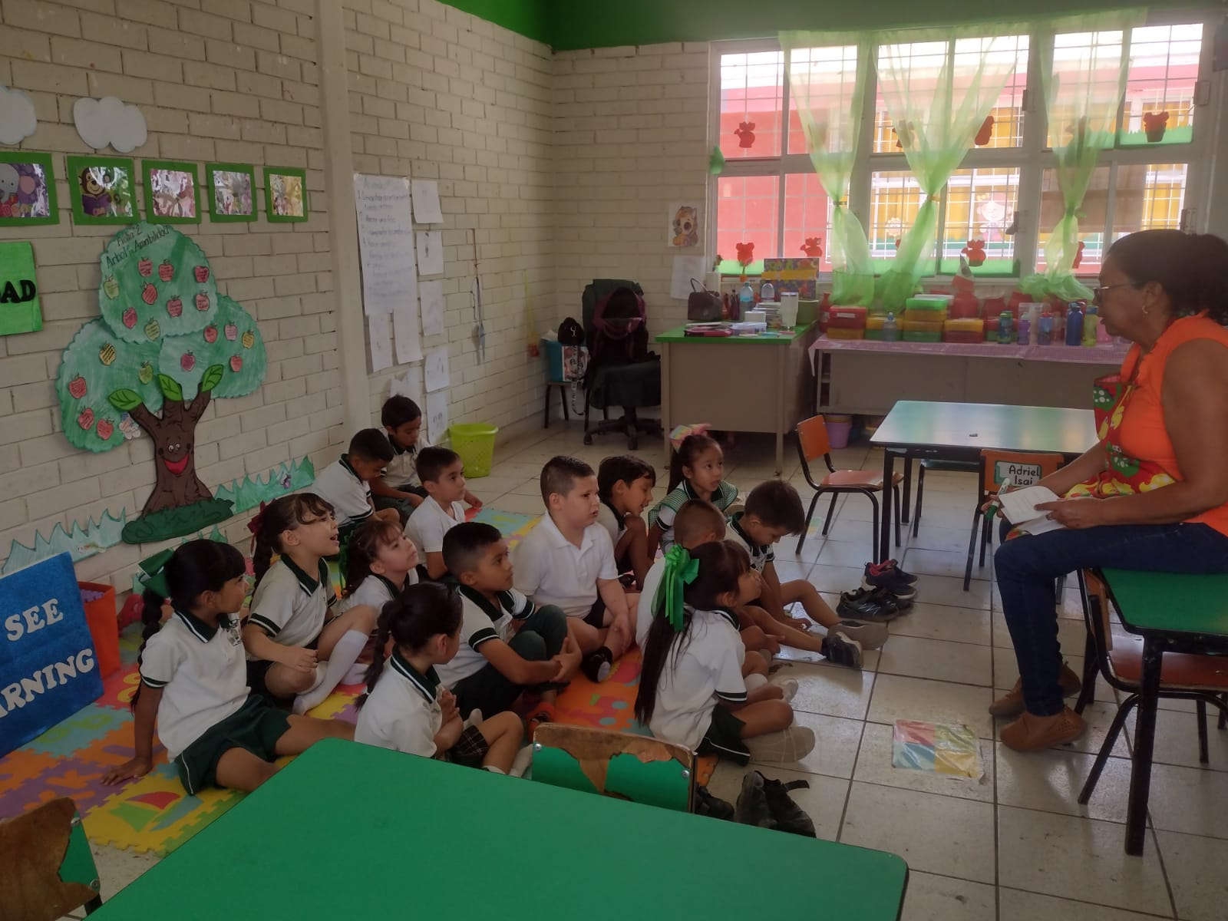

Notes:
SEE Learning Play in Mexico -
Teachers noticed that students moved away from "tattling" (noticing what peers were doing wrong) and moved towards noticing kindness (when a peer was helpful or played well). THEN they saw students transition from only noticing kindness within their class to reporting acts of kindness at home and from family.

Slide 12
What the Program Looks Like
Core practices embedded in
  Transitions
  Routines
  Interactions
Notes:
“At a big-picture level, this focuses on a small set of practices that integrate into daily routines-not separate lesson blocks.”

Slide 13
What We See So Far - Early Signals from the Classroom
Improvements in prosocial behavior & teacher–child relationships
Gains in engagement and early academic skills
Biggest benefits for children with greatest need
High implementation in real classrooms
100% of teachers wanted to continue
Notes:
“We’re seeing the strongest changes in the areas that matter most for classroom functioning- relationships, engagement, and smoother daily routines.”

Slide 14
How PAACT Can Help – Why Now
As we pursue external funding, we are seeking:
🌟 $1M+ Funding Opportunity
• Interest from William T. Grant & Spencer Foundations
🤝 Your Partnership Matters
• Need 100 early childhood classrooms to move proposals forward this Fall
Notes:
If our pilot findings hold true in a larger study, this work has the potential to strengthen school readiness, support child well-being, and generate evidence that helps more Atlanta children thrive. That's why we're excited to explore this work with partners like PAACT.

Slide 15
How PAACT Can Help – What to do
As we pursue external funding, we are seeking:
  📄 Letters of support from community partners
  🤝 Opportunities for collaboration and feedback
  📢 Champions who believe this work has potential to benefit Atlanta children & families
Notes:
If our pilot findings hold true in a larger study, this work has the potential to strengthen school readiness, support child well-being, and generate evidence that helps more Atlanta children thrive. That's why we're excited to explore this work with partners like PAACT.

