Slide 1



PPP Loans:
Navigating the Forgiveness Process
Bradley J. Tate, JD, LL.M.

Slide 2
About the Paycheck Protection Program

Slide 3
Paycheck Protection Program Overview
The Paycheck Protection Program (PPP) was established to provide nearly $350 billion in loans and loan guarantees for the covered period of February 15, 2020 through June 30, 2020.
PPP will cover payroll costs (up to annual amounts of $100,000 per employee); continuation of group health care benefits; employee salaries, commissions, or similar compensation; mortgage payments; rent; utilities; and interest on any other debt obligations incurred before the covered period.
PPP will extend eligibility to companies of 500 employees or less and 501(c)(3) nonprofits, veterans' organizations, and tribal small business concerns.
Sole-proprietors, independent contractors, and other self-employed individuals may also participate.

Slide 4
Loan Forgiveness is available up to the principal amount of the financing.
Loan forgiveness would be reduced for employers who lay-off workers or reduce employee compensation except where employers rehire workers or pay additional wages to tipped workers.
Loan forgiveness is available for payroll costs, mortgage interest, rent, and utility payments.
Forgiven loan amounts will not be included as gross income.
The general formula is the lesser of the average total monthly payments for payroll costs during the 1-year period before the date the loan is made, multiplied by 2.5; or $10 million.
Qualified SBA lenders will be able to loan money directly to eligible customers.
There will be limited funding.

Slide 5
Changes/Updates to CARES Act
PPP Flexibility Act
24 Week period for loan
Extended repayment to 5 years
FTE Safe Harbor Provisions
Reduced payroll requirement to 60%, but set as a minimum
Multiple IFRs and 51 FAQs
Provide clarification to legislation
Potential for more as forgiveness process starts

Slide 6
PPP Loans – by the Numbers through August 8, 2020
Approved Loans 5,212,128
Approved Dollars $525,012,201,124
Average Loan Size $100,729
Percent of Loans at or < $100,000 82%
Participating Lenders 5,460
Funds Remaining $130 billion or so
Last Day PPP Loan App Approval 08/08/20

Slide 7
PPP – What’s coming next?
1. Potential new PPP legislation in the hopper (HEALS Act Bills)
Leading proposal: Second PPP loan for companies 300 employees or less, eligible if revenue dropped > 50% by reason of COVID
Possible expansion to additional nonprofits
Possible round 2 of economic impact payments
Possible dramatic expansion of employee retention credit
2. In pipeline
a. New IFRs
b. New Forgiveness Form(s)
3. Constant new reliance FAQs
a. 08/11/20 Loan Forgiveness Frequently Asked Questions (FAQs)
b. https://home.treasury.gov/system/files/136/PPP--Loan-Forgiveness-FAQs.pdf

Slide 8
Covered Period

Slide 9
Choosing Covered Period 24 vs. 8
Factors to consider
8 weeks is a race
Spend out in 8 may lead to overly aggressive behavior - 8 not recommended for sole prop or partner
24 weeks is coasting
Allows one to take foot off the gas pedal
But, 24 drags loan out, may create new treacheries (potential drop in pay forgiveness reduction)
24 eases up pressure from 60% rule

Slide 10
PPP Statutory Formula for Forgiveness
Incurred AND Paid
PPP loan forgiven if borrower uses all of loan proceeds for forgivable purposes and pay and headcount levels maintained(CARES §1106(b)*)
Forgiveness for amounts (*incurred AND paid) over 8-week period following the date of the loan (CP or APCP):
Payroll costs
Non-payroll costs
Payments of interest on mortgage debt incurred < 02/15/20
Rent payments on leases in force < 02/15/20, and
Utility payments under service agreements dated < 02/15/20

Slide 11
Form 3508

Slide 13
Let’s Talk Forgiveness

Slide 14
Forgiveness Rules Basics
1. Borrowed correctly (qualified borrower, correct amount, needed money, no
satisfactory alternative sources of funds, right person borrowed, etc.)
a. Must you show drop in revenue after borrowed money? No
b. Instead, must demonstrate uncertainty as to future at time borrowed
2. PPP proceeds spent on covered, forgivable uses
3. For full forgiveness, at least 60% spent on covered payroll costs
4. No drop in pay (or meet “drop in pay” safe harbor)
5. No drop in headcount (or meet one of 2 “drop in headcount” safe harbors or
5 reduction exceptions)
6. Submit Forgiveness Application
a. Form 3508/3508-EZ
7. Document and disclosure

Slide 15
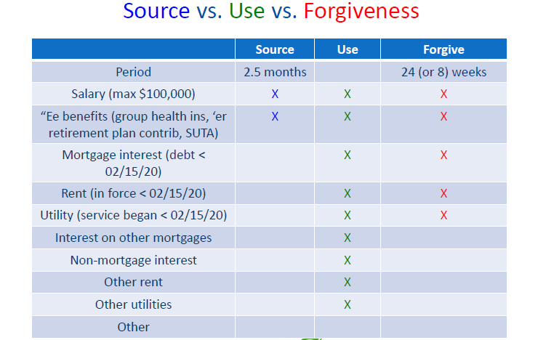

Slide 16
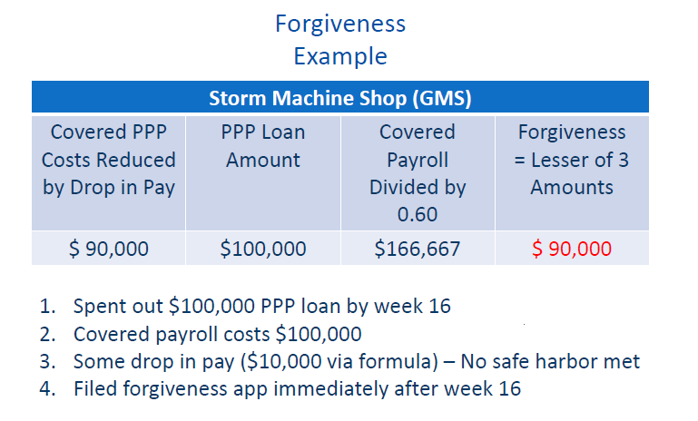

Slide 17
When to file?

Slide 18
When to file forgiveness application
End of 8 weeks
When all funds are spent before 24 weeks
End of 24 weeks
By December 31, 2020
At the latest 10 months after the end of the covered period

Slide 19
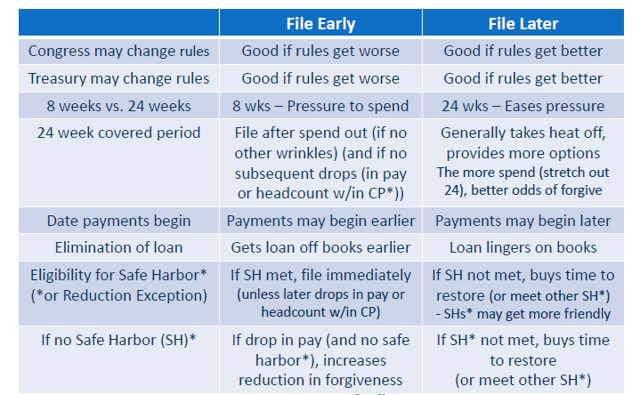
When should you file for forgiveness?

Slide 20
So what does this mean?
Example: Carper’s BBQ, LLC’s covered period (CP) begins on June 1 and
ends on November 15. Spends out PPP loan proceeds in week 16.
Cannot apply for forgiveness prior to 8 weeks (July 26)
Can apply only after PPP loan proceeds spent out (after week 16) (after September 20)
Can submit prior to end of CP (prior to November 15)
Need not wait to submit until November 15 or December 31
If drop in pay or headcount (and no safe harbor or reduction exception), forgiveness amount may be reduced.
10 months after end of CP

Slide 21
What is the process?
Prepare forgiveness application with all supporting documentation
Submit forgiveness application to the bank with all documents
Lender has 60 days to review and submit to the SBA
Bank submits to SBA
SBA has 90 days to respond to application.
If the SBA forgives the entire loan, the principle and accrued interest will be wired to the lender.

Slide 22
Lender Certifications
Before the SBA will accept the submission, lenders must confirm the following for each PPP forgiveness application:
The submission accurately reflects the lender’s decision regarding the borrower’s loan forgiveness application.
The information provided by the lender to the SBA with the submission accurately reflects the lender’s records for the PPP loan.
The lender has made its decision in accordance with the requirements set forth in the Forgiveness Rules.
The PPP loan has not been cancelled or repaid.
The lender has not submitted a previous loan forgiveness decision to the SBA for that particular PPP loan, unless the application is a resubmission following a rejection or a reconsideration of a denial without prejudice.

Slide 23
Possible Responses
The Procedural Notice clarifies that when a lender submits its decision on a forgiveness application to the SBA through the PPP Forgiveness Platform, the lender must check a box indicating the decision. The choices for the lender will be:
Approved in Full
Approved in Part
Denied
Denied without Prejudice — This should be used only when an SBA loan review is pending at the time the borrower submits a loan forgiveness application.

Slide 24
About Payroll Costs

Slide 25
PPP Loan
Fill Up Forgiveness First With Safe Spending
Fill up forgiveness bucket first with non-controversial spending on forgivable uses
If near end of forgiveness period, still room in bucket (more forgiveness to be achieved), spend on less certain PPP expenditures

Slide 26
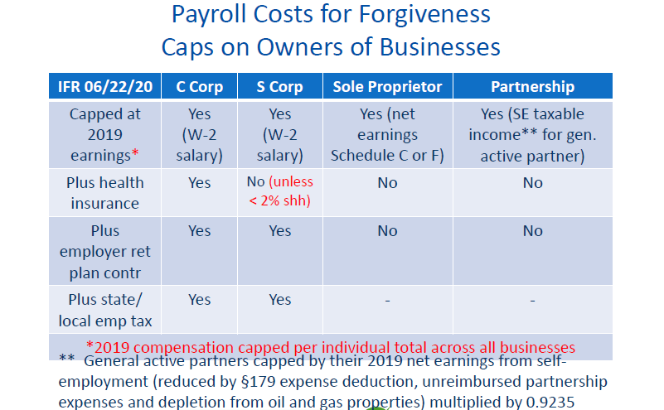

Slide 27
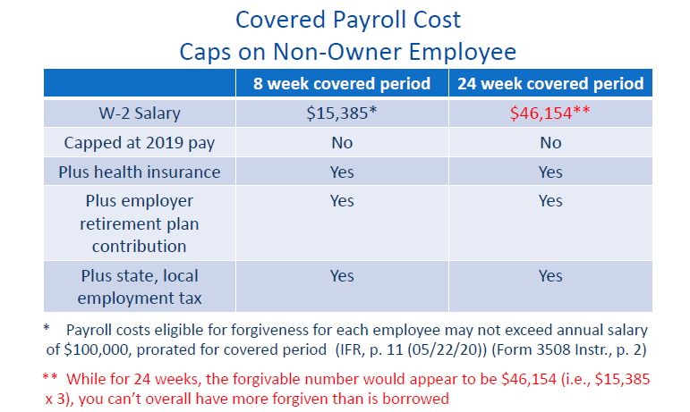

Slide 28
Covered Payroll Cost Caps on Non-Owner Employee
Manufacturing, Inc.’s business slows after Covid hits
No employee has a drop in pay
Two out of four employees are let go and are not replaced, all resulting in $10,000 reduction in forgiveness
The company meets a safe harbor re: this drop in headcount
For the two employees with no drop in headcount (for which Manufacturing borrowed up to $20,833 each), up to $46,154 each is allowedin the forgiveness computation
If Manufacturing waits long enough to submit its forgiveness app (until the $10,000 “drop in headcount“ deficit is “erased”), then 100% may be forgiven
As such, the “drop in headcount” sinning may be expunged

Slide 29
Partnership and Partners - Forgiveness Rules
Partnership borrows for partner –Partner does not borrow for him or herself (IFR 04/14/20)
Borrowable amount = Net 2019 self employment (SE) taxable earnings from partnership of general partner
Cannot exceed $20,833/partner (amount capped at $100,000 pace) (computed by 2019 net SE earnings (up to $100,000) multiplied by 10/52 = amount up to $20,833)
Health insurance cost and retirement plan contribution do not add on top of SE taxable income
SE taxable income to general partner broader than mere guaranteed payments for services

Slide 30
Payroll Costs
Bonuses and Hazard Pay
Hazard pay is easy. Bonus, less easy. (IFR, p. 11 (05/22/20))
Some bonuses and hazard pay during covered period eligible for forgiveness
If employee’s total comp no exceeds $100,000 annualized, employee’s hazard pay and bonuses eligible for forgiveness
My questions: Is such payment in ordinary course of business? Are they appropriate and helpful? Or just done to maximize PPP forgiveness? Are bonuses customary this time of year? What is the business reason? Does it make sense here to enrich someone (who did not earn the money) with government money? Is the bonus a prepay of future salary?

Slide 31
Drop in Pay/Drop in FTE

Slide 32
Drop in Pay
If punishable drop in pay, then PPP forgiveness reduced (unless meet safe harbor)
Punishable drop in pay occurs when any one worker (earning at or below $100,000 pace) experiences (post-base period) drop in pay by > 25%
Salary or hourly rate – Drop in either hurts
Form 3508EZ – Qualify to file if no punishable drop in pay and meet other test

Slide 33
Drop in Pay (cont.)
6. End point to file application
Spend out can be end point
After spend out, safe harbor can be end point
7. One safe harbor –Restore drop in pay by 12/31/20 OR EARLIER
Pick your moment
How to restore = Ramp back up pay to pre-01/01/20 level
File forgiveness app on a date payroll restored
Uncertainty: If drop in pay after restoration, is safe harbor lost?
8. If drop in pay and no safe harbor, 24-week period hurts (will increase
amount of reduction in forgiveness)

Slide 34
Drop in Pay Safe Harbor
December 31, 2020 Safe Harbor: If certain employee salaries (and
wages) reduced between 02/15/20 and 04/26/20, but borrower
eliminates those reductions by 12/31/20 or EARLIER,
borrower exempt from reduction in forgiveness for drop in pay
Must qualify for safe harbor (SH)
If no pay cut after 02/15/20 thru 04/26/20, no SH

Slide 35
Drop in Pay
Safe Harbor Examples
No drop in pay (02/15/20 to 04/26/20) – No safe harbor
Example 1: Joey’s Toilet Paper Supply, LLC’s employees did not have a drop in pay between 02/15/20 and 04/26/20. Joey’s employee headcount increased during such time. After 04/26/20, business fell sharply, and employee layoffs hit hard.
Since pay did not drop 02/15/20 through 04/26/20, no safe harbor
No drop in pay (02/15/20 to 04/26/20) – No safe harbor
Example 2: Mattie’s Gym’s employees had a huge drop in pay between 02/15/20 and 04/26/20. Mattie is eligible for the “restore” (magic moment) safe harbor on or before 12/31/20
Since pay did drop 02/15/20 through 04/26/20, safe harbor available
Be careful: It’s not known whether subsequent drop in pay hurts you

Slide 36
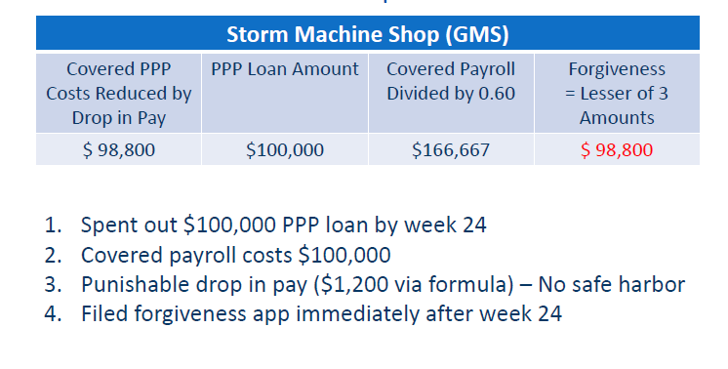
Drop in Pay Forgiveness Example

Slide 37
Drop in Headcount (FTE) Rules
1. A drop in headcount (FTEE) from base (reference) period to covered period reduces PPP forgiveness (unless meet a safe harbor(s) or reduction exception(s))
2. Amount of forgiveness reduced by same % as % of drop in headcount
3. Example: 10.0 FTE employees (FTEE) during base (reference) period dropped to 8.0 FTEE in covered period. Since % of FTEE dropped by 20%, only 80% of otherwise eligible expenses forgiven.
If meet safe harbor(s) or reduction exception(s), forgiveness not reduced

Slide 38
4.Drop in headcount occurs upon drop in number of employees (or average paid hours)
5.Forgiveness reduced by % of employees (or paid hours) reduced if:
Average weekly FTEE during covered period is less than
FTEE reduction during chosen base (reference) period (either 02/15/19 to 06/30/19 or 01/01/20 to 02/29/20)*

Slide 39
Drop in Headcount
Safe Harbor vs. Reduction Exception
Safe Harbor (SH)
FTE ratio automatically 100%
Result –No reduction of forgiveness amount
Reduction Exception
Vacant position counted as if filled
Thus, business not harmed for reduction in FTE chart for that particular worker

Slide 40
Drop in Headcount2 Safe Harbors (SH), 5 Reduction Exceptions
2 Safe Harbors (SH)
Moment in time
Business dropped off over COVID*
5 Reduction Exceptions (RE)
Employee won’t restore hoursEmployee fired for cause
Employee voluntarily resigned
Employee requested reduction in hours
Can’t get employee back/ Can’t get good one(s) back

Slide 41
Other Considerations

Slide 42
Deductibility of Expenses Funded by Forgiven PPP Loan
Forgiven PPP loan is not income taxable income
IRS in Notice 2020-32 –Any expense funded by forgiven PPP loan is not income tax deductible
IRS may not be correct –It’s only their opinion) (see Shepard, Lee A., “Paycheck Protection Program Business Expenses”, Tax Notes Today (04/27/20))
Congress needs to clear the mess up
Example: For any taxpayer that files income tax return before receive PPP forgiveness, how to handle?
Deduct now, recapture later?
Not deduct now?
Affects fiscal year end 2020 filers (and calendar year if no forgiveness in 2020)

Slide 43
New Rental Rules
Rental expense may not include any amount attributable to the business operation of a tenant or subtenant of the PPP borrower
If rental costs are $10,000 per month and a sublease for $2,000 per month is in place, the PPP borrower can only have $8,000 per month forgiven.
Rent or lease payments to a related party are eligible for loan forgiveness provided that (1) the amount of loan forgiveness requested for those payments is no more than the amount of mortgage interest owed on the property during the covered period that is attributable to the space being rented by the business, and (2) the lease and the mortgage were entered into prior to Feb. 15, 2020.

Slide 44
Loans Over $2 million
SBA says they will audit all loans over $2 million
Certification that “[c]urrent economic uncertainty makes this loan request necessary to support the ongoing operations of the Applicant.”
Borrowers with outstanding loans over $2 million should have a statement in their file on the necessity of the loan.

Slide 45
Questions?
Brad Tate
btate@htbcpa.com
504-274-0200

