Slide 1

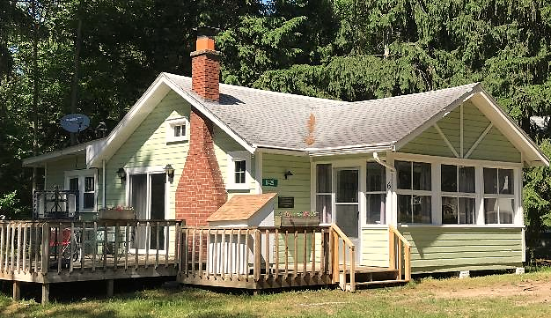
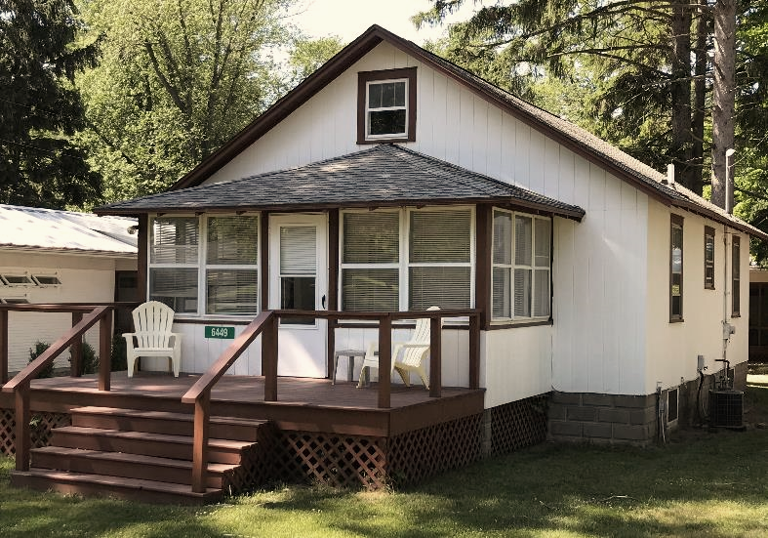
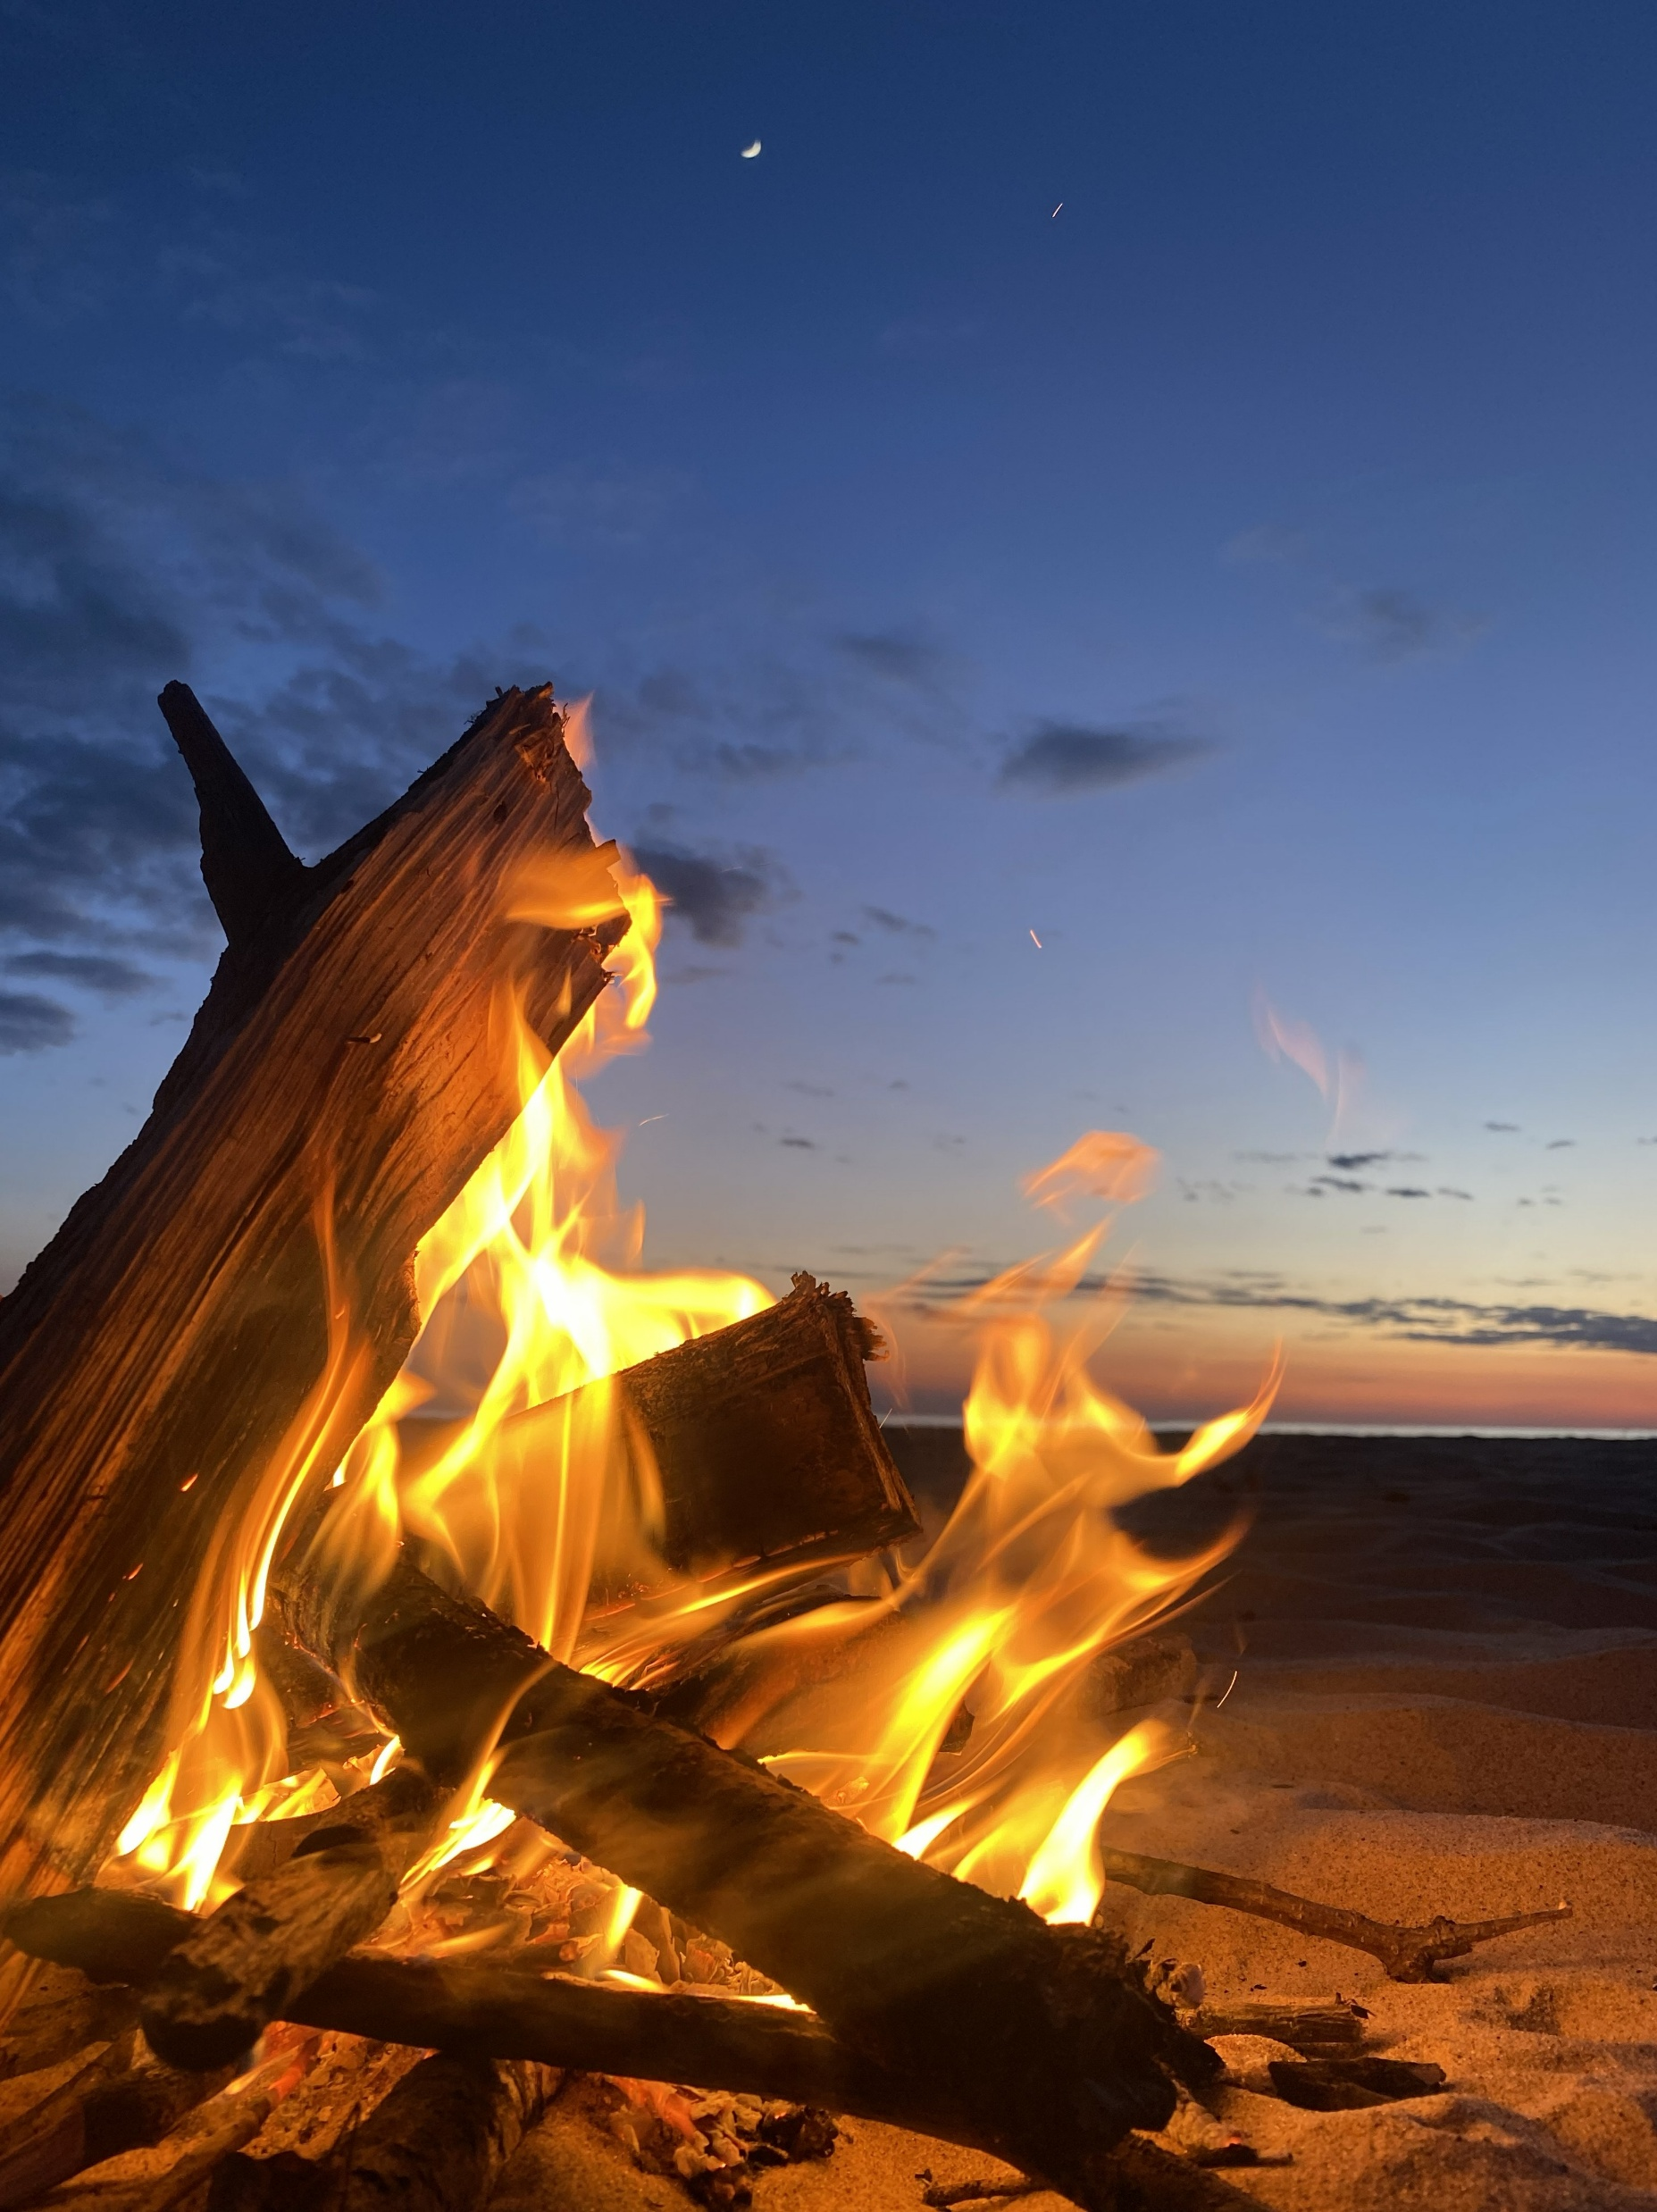
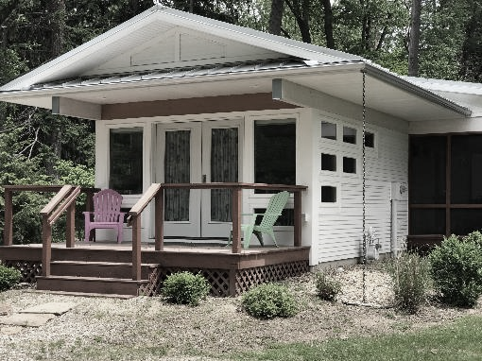

June is a great time to visit southwest Michigan! And we have 5 cottages available for family getaways or clergy Praycations.
Anderson Cottage & Bungalow
feature a combined living room, dining room and kitchen. One bathroom, 2 bedrooms and a sleeping porch sleep up to 6 people.
The Cottages each of our 3 cottages have 2 bedrooms, 2 bathrooms, a full kitchen, lovely screened porch and can sleep up to 6 people.
To reserve-
call 269-426-3881 or
Email office@TowerHillCamp@org
Step Out of the Ordinary and Into the Sacred

