Slide 1
CHRIST CHURCH
GRIEF SUPPORT GROUP
Session 1
October 15, 2024
THE REVS. JOANNA HOLLIS AND DAPHNE ROBERTS

Slide 2
Opening prayer
Merciful God, whose Son Jesus wept at the death of Lazarus: look with compassion on all who are bound by sorrow and pain through the death of their loved ones. Comfort them, grant them the conviction that all things work together for good to those who love you, and help them to find sure trust and confidence in your resurrection power; through Jesus Christ our deliverer. Amen.

Slide 3
Group norms
ZOOM ETIQUETTE: It is expected everyone leaves their videos on and mic muted until asked to speak. The hosts may mute you if necessary (to limit background noise, etc.).
CONFIDENTIALITY: Whatever is shared within the group remains confidential. Share with others outside the group only what you have learned about yourself.
RESPECT: It is important to respect your own grief as well as others. It is important to respect everyone’s right to grieve in their own way, to have whatever feelings they are having and to be on whatever timeline they are on in their healing journey.

Slide 4
Group norms
ADVICE: We are here to share personal feelings and current concerns but are not here to fix problems. You are welcome to ask questions, but you may not give advice unless the other person asks for it.
PARTICIPATION: You may choose to share or remain silent. No one will be put on the spot or forced to talk, but anyone who feels comfortable sharing will be given that chance. If you do choose to speak, please limit your time speaking to give others a chance to share if they wish.
ACTIVE LISTENING: While others are sharing, please listen with an open heart and mind and make every effort not to interrupt when someone is speaking.
CONFIDENTIALITY (again): Whatever is shared within the group remains confidential. Share with others outside the group only what you have learned about yourself.

Slide 5
INTRODUCTIONS AND HOUSEKEEPING
Brief self-introductions (name, location)
Housekeeping
  How we will spend our time
    Short presentation/teaching
      This is a time to ask content-related questions. We will leave story sharing for the reflection time.
    Reflection Time (in small groups and/or in the big group)
    Ending Prayer

Slide 6
5 stages of grief:
Why They are important to know
They can help you anticipate and comprehend some of the reactions you may experience throughout the grieving process.
They can also help you understand your needs when grieving and find ways to have them met.
Understanding the grieving process can ultimately help you work toward acceptance and healing.

Slide 7
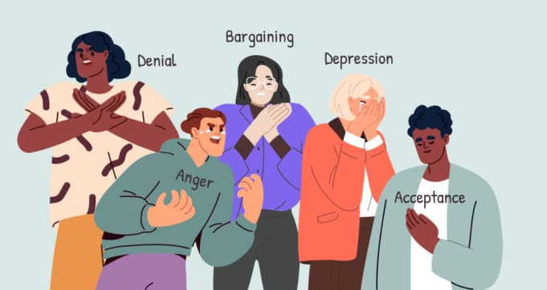
5 stages of grief
FROM: https://calmerry.com/blog/grief-and-loss/five-stages-of-grief-you-should-know-about/

Slide 8
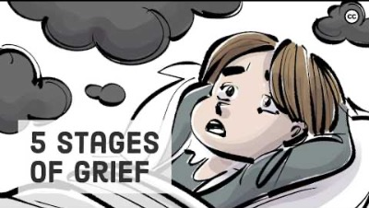
https://youtu.be/Zk7pOnUPL74?si=RA_07Lxk6EECPUWB

Slide 9
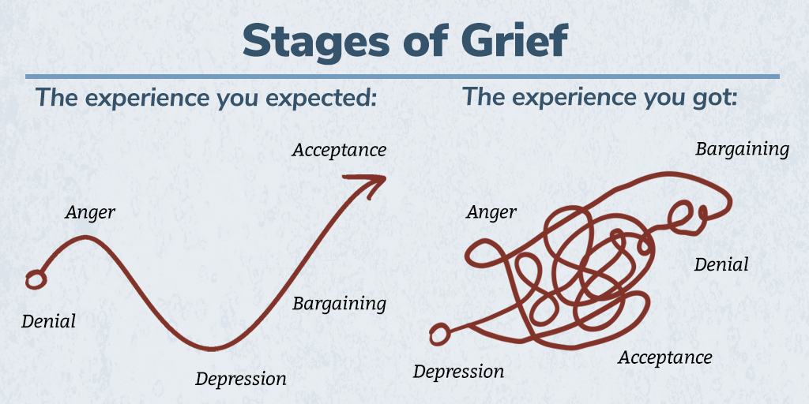
Just to reiterate: GRIEF IS NON-LINEAR!
FROM: https://speakinggrief.org/get-better-at-grief/understanding-grief/no-step-by-step-process

Slide 10
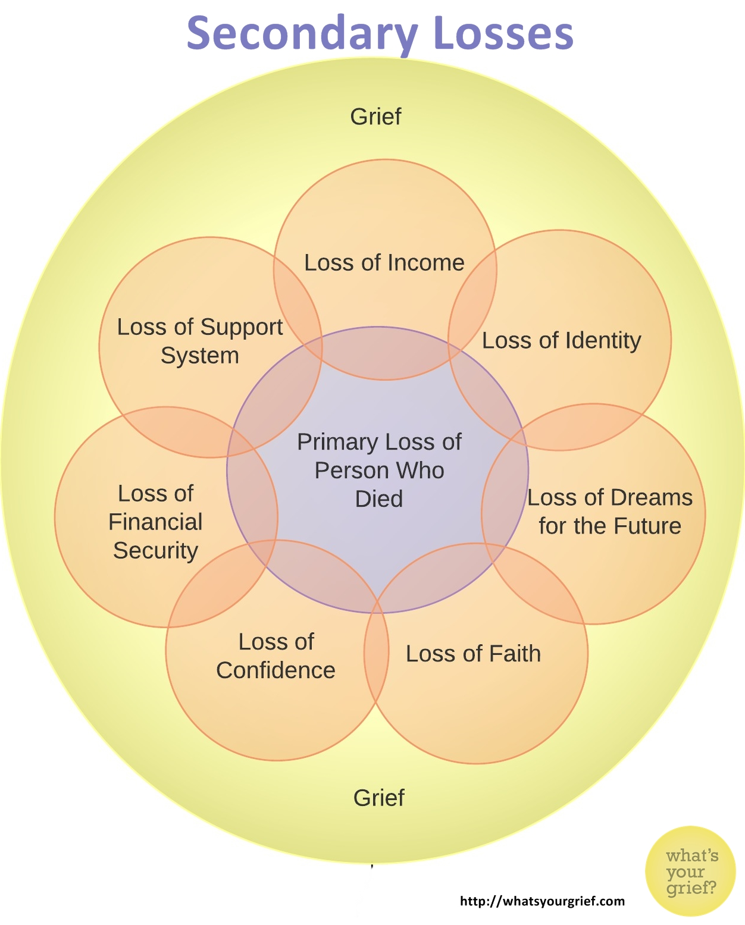
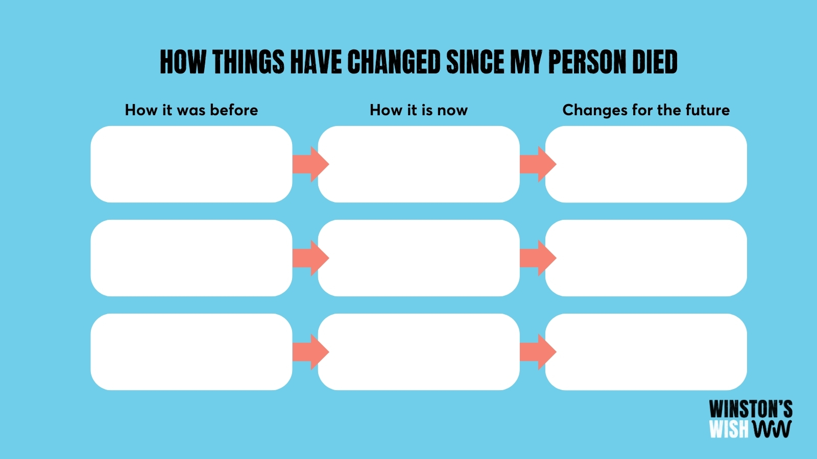
Secondary grief

Slide 11
Myths about grief
FROM: https://www.therecoveryvillage.com/mental-health/grief/grief-myths/
MYTH | REALITY
Everyone grieves in stages. | Grief doesn’t follow the rules.
Grief and mourning are the same. | Grief can produce many behaviors; mourning is one of them.
Women grieve more than men. | All people grieve differently.
If you’re not crying, you’re not really grieving. | Crying is not essential to grieving.
Ignoring your pain will help it go away. | Ignoring your pain is a temporary solution at best.

Slide 12
Myths about grief
FROM: https://www.therecoveryvillage.com/mental-health/grief/grief-myths/
MYTH | REALITY
The first year is the hardest. | Grief is hard, period.
Grief gets better over time. | Grief doesn’t follow a set timeline.
Grief has an endpoint. | Grief doesn’t end, but it changes.
The goal of grief is to find closure. | Finding closure is important, but it doesn’t close the book on grief.
People struggling with grief just need to get over it. | You can’t just move on from grief and sometimes, professional help is necessary.

Slide 13
GROUP REFLECTION
Who/what are you bringing to this grief group today?
What has the spirit called attention to today
regarding your own grief process?

Slide 14
CLOSING prayer
God of peace, you have taught us that in returning and rest we shall be saved,
in quietness and confidence shall be our strength. By the might of your Spirit lift us, we pray, to your presence, where we may be still and know that you are God; through Jesus Christ our Lord. Amen.

