Slide 1
CHRIST CHURCH
GRIEF SUPPORT GROUP
Session 3
NOVEMBER 19, 2024
THE REVS. JOANNA HOLLIS AND DAPHNE ROBERTS

Slide 2
Opening prayer
Merciful God, whose Son Jesus wept at the death of Lazarus: look with compassion on all who are bound by sorrow and pain through the death of their loved ones. Comfort them, grant them the conviction that all things work together for good to those who love you, and help them to find sure trust and confidence in your resurrection power; through Jesus Christ our deliverer. Amen.

Slide 3
Group Norms and Housekeeping
NORMS
  ZOOM ETIQUETTE
  CONFIDENTIALITY
  RESPECT
  ADVICE
  PARTICIPATION
  ACTIVE LISTENING
HOUSEKEEPING
  Content-related questions during presentation/teaching time are welcome.
  Story telling is welcome during group reflection time.

Slide 4


Slide 5
A Short Video
https://www.youtube.com/watch?v=BQAE7BVMp6U

Slide 6
NAVIGATING THE HOLIDAYS
Honor yourself
Manage expectations
Plan ahead
Expect the unexpected
Set realistic goals
Surround yourself with support
Be careful of “should”
Memorialize the person who died
Do something for someone else
Open your heart

Slide 7
Another Short Video: Memorializing the Person Who Died
https://youtu.be/dTwsfZtvhQg?si=yx14z9icvZI0sLjx

Slide 8
MEMORIALIZE THE PERSON WHO HAS DIED
Announce beforehand that someone different will carve the turkey.
Create a memory box. Fill it with photos of your loved one or memory notes from family members and friends. Ask young children to contribute drawings in the memory box.
Make a decorative quilt using favorite colors, symbols, images or pieces of clothing/fabric that remind you of the person who died.
Light a candle in honor of your loved one.
Put a bouquet of flowers on your holiday table in memory of your loved one.
Visit the cemetery and decorate the memorial site.
https://www.vitas.com/family-and-caregiver-support/grief-and-bereavement/holidays-and-grief/coping-with-grief-during-the-holidays

Slide 9
MEMORIALIZE THE PERSON WHO HAS DIED
Have a moment of silence during a holiday toast to honor your loved one.
Place a commemorative ornament on the Christmas tree.
Write a poem about your loved one and read it during a holiday ritual.
Play your loved one’s favorite music or favorite game.
Plan a meal with your loved ones’ favorite foods.

Slide 10
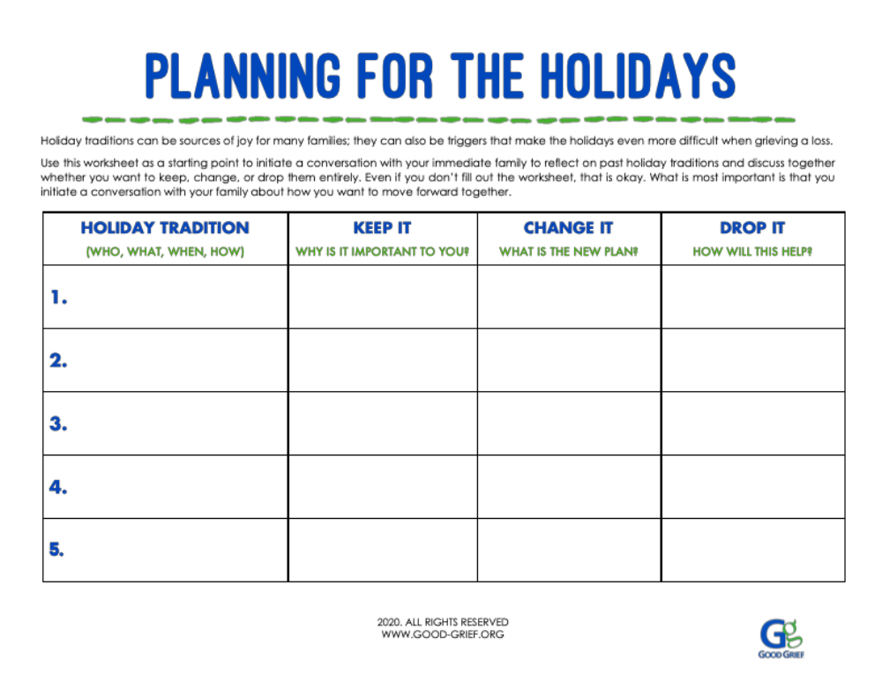

Slide 11
REFLECTION QUESTION
What has the Spirit called attention to today regarding grief and coping with the holidays?

Slide 12
CLOSING prayer
God of peace, you have taught us that in returning and rest we shall be saved,
in quietness and confidence shall be our strength. By the might of your Spirit lift us, we pray, to your presence, where we may be still and know that you are God; through Jesus Christ our Lord. Amen.

