Slide 1
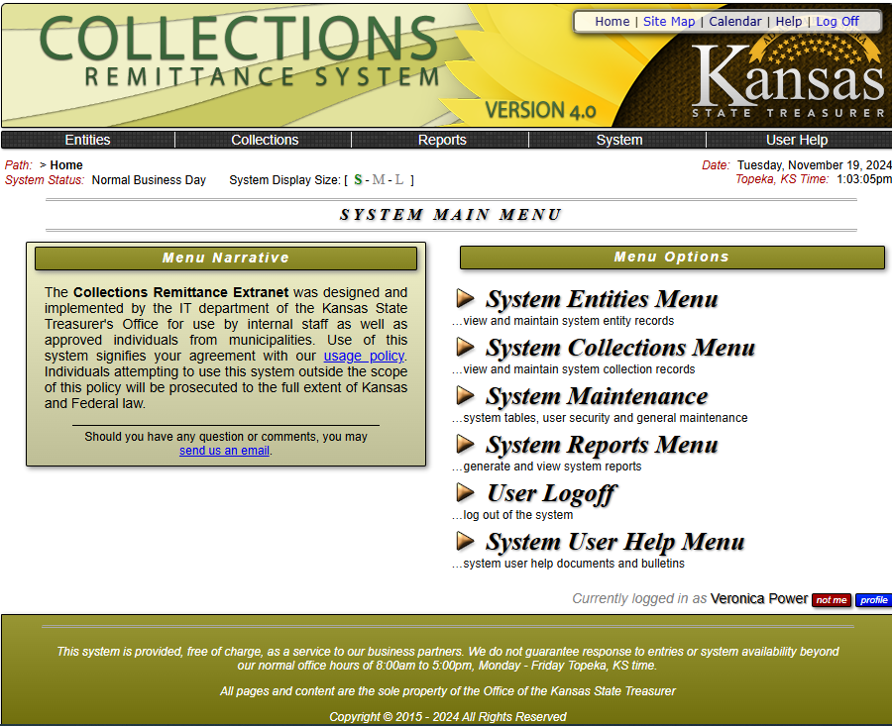
Utilizing the Collections Remittance system

Slide 2
Completing a KDADS Security User Agreement

Slide 3
What is the purpose of this form?
Effective 2025, Kansas nursing facility providers will use the Collection Remittance System (CRS) to make their Quality Care Assessment payments (Bed Tax).
Completing and submitting the Security User Agreement is the first step for our NFs to gain access to CRS.
Providers will no longer record their payments through Bed Assessment.
Providers are responsible for keeping their CRS User information up-to-date to ensure payments are made on time.
The Security User Agreement will be the method by which the Provider will communicate any changes to the facility’s users to KDADS.
It will take approx. 2 weeks to initially be fully approved to utilize the CRS and make payments. Payments must be initiated 4 days prior to the due date to avoid late penalty.
Notes:
This system is only for Nursing Facilities and Nursing Facilities for Mental Health making payments to Quality Care Assessment (Bed Tax).
Don’t wait until the last minute to submit this form and make your payment.
Give yourself plenty of time to complete the initial set up process as it can take up to 2 weeks. After the initial set up, payments need to be initiated 4 days prior to the due date.

Slide 4
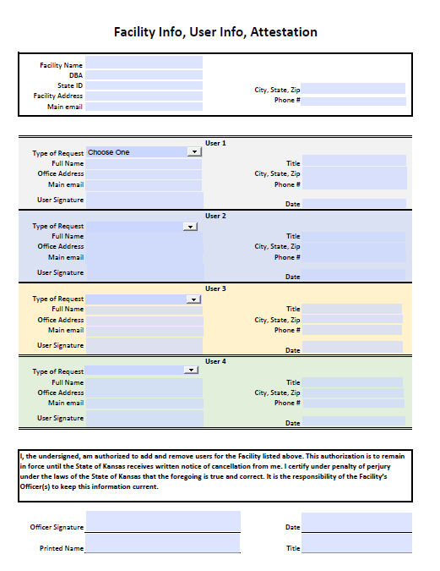
Where do I find the security user agreement?
There are 2 ways to access the form.
KDADS Webpage – https://www.kdads.ks.gov/partners-providers/aging-services/nursing-facility-and-adult-care-home-programs
Send an email request to: KDADS.CollectionsRemittanceSystem@ks.gov

Slide 5
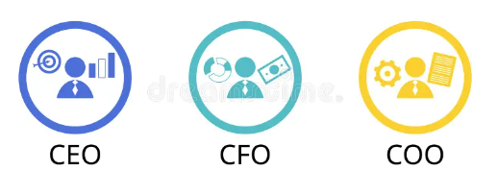
When do I need to submit the security user agreement?
Examples of an Officer
Chief Executive Officer- CEO
Chief Financial Officer -CFO
Chief Operating Officer - COO
An Officer of the facility (CEO, CFO, COO) will need to complete and submit this form when a facility needs to:
  Add a User
  Remove a User
  Or reinstate a previously approved User.
Notes:
Multiple actions can be used on one form. I.e. you can remove someone that is no longer employed and add the new employee on the same form.
The Officer may also fulfill the role of Administrator. In these instances, the form needs to be signed using their Officer credential/title.

Slide 6

How do I complete the security user agreement?
Download the fillable PDF.
The top section pertains to the facility. An Officer of the facility will enter the following information.
Facility Name
DBA (if applicable)
State ID
Facilities physical address
Officer Email address
Officer Phone number
Examples of an Officer
Chief Executive Officer- CEO
Chief Financial Officer -CFO
Chief Operating Officer - COO

Slide 7

How do I complete the security user agreement?
The middle section pertains to specific Users that will be making the Quality Care Assessment (Bed Tax), CHOW and Medicaid Enrollment payments.
Enter the following information.
Type of Request – this is a drop down, choose the correct selection – Add, Remove, or Reinstate a User
User’s Information
Each User must sign (electronic signatures accepted)
*Complete a section for each approved user.
Notes:
Multiple actions can be used on one form. For example, the same form can be used to remove someone that is no longer employed and add the new employee on the same form. Users who are being removed do not need to include a signature.

Slide 8

Who should be a crs user?
Staff that will be regularly making payments on behalf of the facility.
Each facility is allowed to have as many users as it would like. However, a minimum of 2 and no more than 4 Users is recommended.
Suggest adding submission of this document as part of your HR internal procedure when you have a staff change pertaining to those making payments.
Passwords expire every 90 days. This means a new password may need to be utilized each time a quarterly QCA payment is made.
KDADS will email each approved User with additional instructions for initial access to the CRS. Please ensure the correct email address is provided for each User.

Slide 9

How do I complete the security user agreement?
The bottom section pertains to an Officer of the facility. (CEO, CFO, COO) The Officer has authority to designate Users.
The Officer must read the attestation and sign the document. (electronic signatures accepted)
Once completed, be sure to save the document in the following format: Facility State ID, MM.DD.YY (ex. N012345 04.04.24).
It’s the facilities responsibility to keep the Users information up to date with KDADS.

Slide 10

How do I submit the security user agreement?
After all the Users and the Officer of the facility sign the Security User Agreement, email the completed form to: KDADS.CollectionsRemittanceSystem@ks.gov

Slide 11
What happens next?
After KDADS receives, reviews, and approves the completed Security User Agreement;
An email will be sent to each approved User with additional instructions for accessing the CRS.
It could take up to two weeks to receive the approval email as KDADS works to approve access to several hundred Users.
Notes:
Please refer to the “Onboarding - First Time Login w/ Temp Password” presentation to continue.

Slide 12
What if I have questions or get stuck?
Technical Support: E-mail: kdads.collectionsremittancesystem@ks.gov
Phone: 785-296-7998
Internet browsers that support CRS in their newest version:
  Chrome – Recommended
  Edge– Recommended
  Firefox

