Slide 1
2024–25
Homeless by Dwelling Type

Slide 2
Summary of 2024–25 Statewide Results
Enrollment
Homeless Counts
Temporary Doubled-Up
(Shared Housing)
Hotels/
Motels
Temporary Shelters
(Would otherwise sleep on street)
Temporary Unsheltered
(Live in car, park, bus station, street)
5,965,383Cumulative
298,254
(2.7% of cumulative)
2024–25
+0.2%
since last year
97.2%
2024–25
-0.1%
since last year
41.5%
2024–25
-5.4%
since last year
95.3%
2024–25
+2.5%
since last year
0%
2024–25
0%
change since last year

Slide 3


Homeless Student Enrollment Counts
298,254
+11,401
2024–25
since last year

Slide 4
Homeless Counts Over Time
Counts of homeless students continued their gradual rise through the 2024–25 academic year, peaking at 298,254.

Slide 5
2024–25 Race/Ethnicity
Homeless counts across all race/ethnicities increased since prior year except for the White student group which decreased by 97 students.
Race / Ethnicity | 2024-25 Homeless Student Enrollment | Difference from Prior Year
Hispanic or Latino | 219,779 | 8,979
African American | 23,919 | 906
Asian | 9,635 | 773
Two or More Races | 9,343 | 425
Not Reported | 2,844 | 307
Pacific Islander | 1,685 | 66
American Indian or Alaska Native | 2,109 | 31
Filipino | 2,877 | 11
White | 26,063 | -97

Slide 6
Homelessness by Race/Ethnicity Over Time
Hispanic or Latino students saw the largest rise in homelessness in 2024–25, with smaller increases also observed among Asian and African American students.
Hispanic or Latino
White
African American
Asian
Two or More
Filipino
Not Reported
American Indian or Alaska Native
Pacific Islander

Slide 7
Statewide Homeless Enrollment by Grade
Grade 12 consistently has the highest numbers of homeless students, but counts have been increasing across all grade levels over the last six years.
Year | TK | K | 1 | 2 | 3 | 4 | 5 | 6 | 7 | 8 | 9 | 10 | 11 | 12 | Total
2019-20 |  | 21,677 | 18,516 | 18,812 | 19,106 | 19,580 | 18,896 | 18,577 | 17,231 | 17,792 | 17,925 | 18,644 | 17,939 | 19,931 | 244,626
2020-21 |  | 16,355 | 17,027 | 17,602 | 17,943 | 18,146 | 18,545 | 17,208 | 16,098 | 16,949 | 16,165 | 17,849 | 17,199 | 19,171 | 226,257
2021-22 |  | 17,576 | 15,371 | 16,927 | 17,464 | 17,740 | 17,535 | 17,158 | 15,488 | 16,511 | 17,244 | 17,961 | 17,840 | 19,376 | 224,191
2022-23 |  | 21,630 | 18,192 | 18,239 | 19,257 | 19,632 | 19,678 | 18,706 | 17,884 | 17,478 | 18,187 | 18,836 | 18,435 | 20,326 | 246,480
2023-24 | 7,758 | 19,885 | 20,557 | 21,526 | 21,532 | 22,152 | 22,164 | 21,154 | 20,088 | 20,378 | 22,090 | 22,207 | 21,042 | 24,320 | 286,853
2024-25 | 9,445 | 20,615 | 21,404 | 22,002 | 22,235 | 22,011 | 22,747 | 21,582 | 20,714 | 21,073 | 23,925 | 23,043 | 21,984 | 25,474 | 298,254

Slide 8
County-Level Reviews

Slide 9
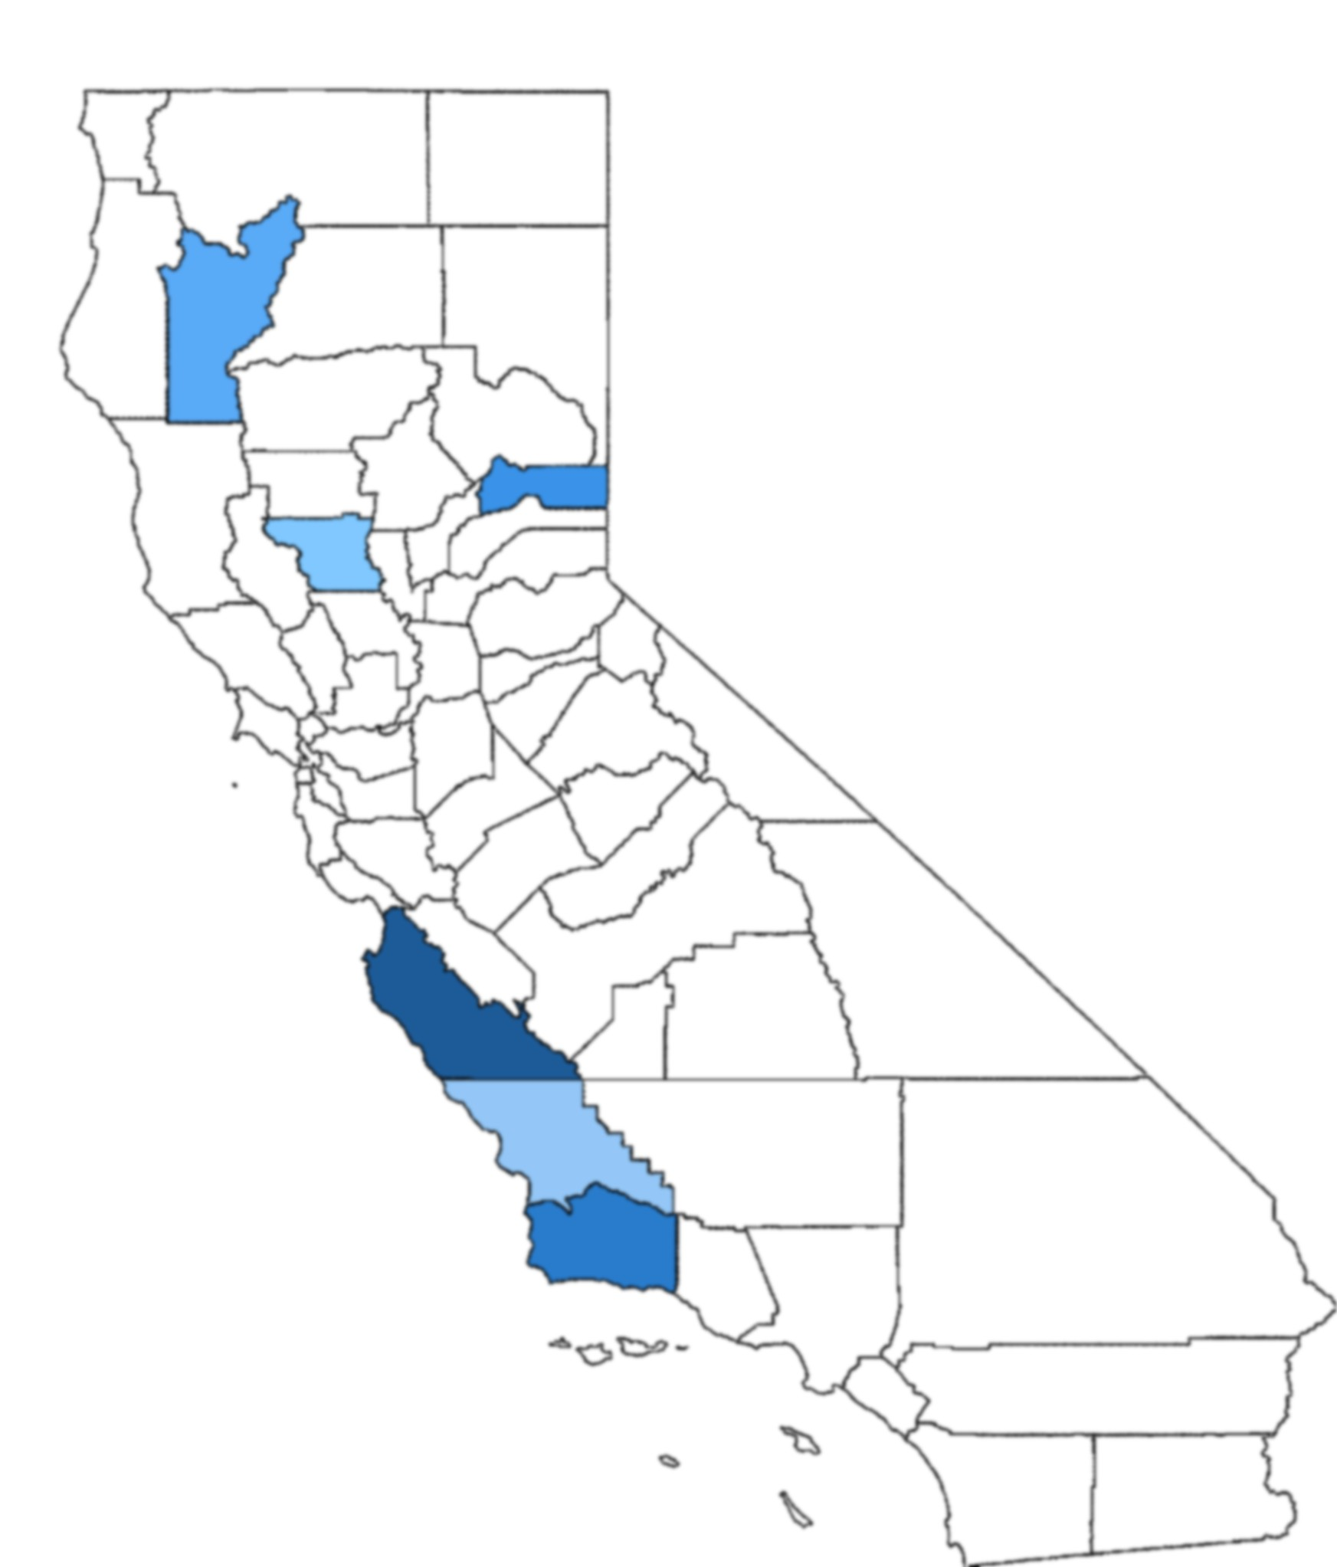
Counties with Greater than 10 Percent Homeless Population
County | Cumul. Enroll | Homeless Count | % Homeless | Diff to Prior Year
Monterey | 74,457 | 13,010 | 17.5% | 0.7%
Santa Barbara | 69,022 | 9,783 | 14.2% | 1%
Sierra | 414 | 57 | 13.8% | 6.5%
Trinity | 1,773 | 229 | 12.9% | -0.9%
San Luis Obispo | 33,975 | 3,959 | 11.7% | 0.3%
Colusa | 4,744 | 519 | 10.9% | 1.3%

Slide 10
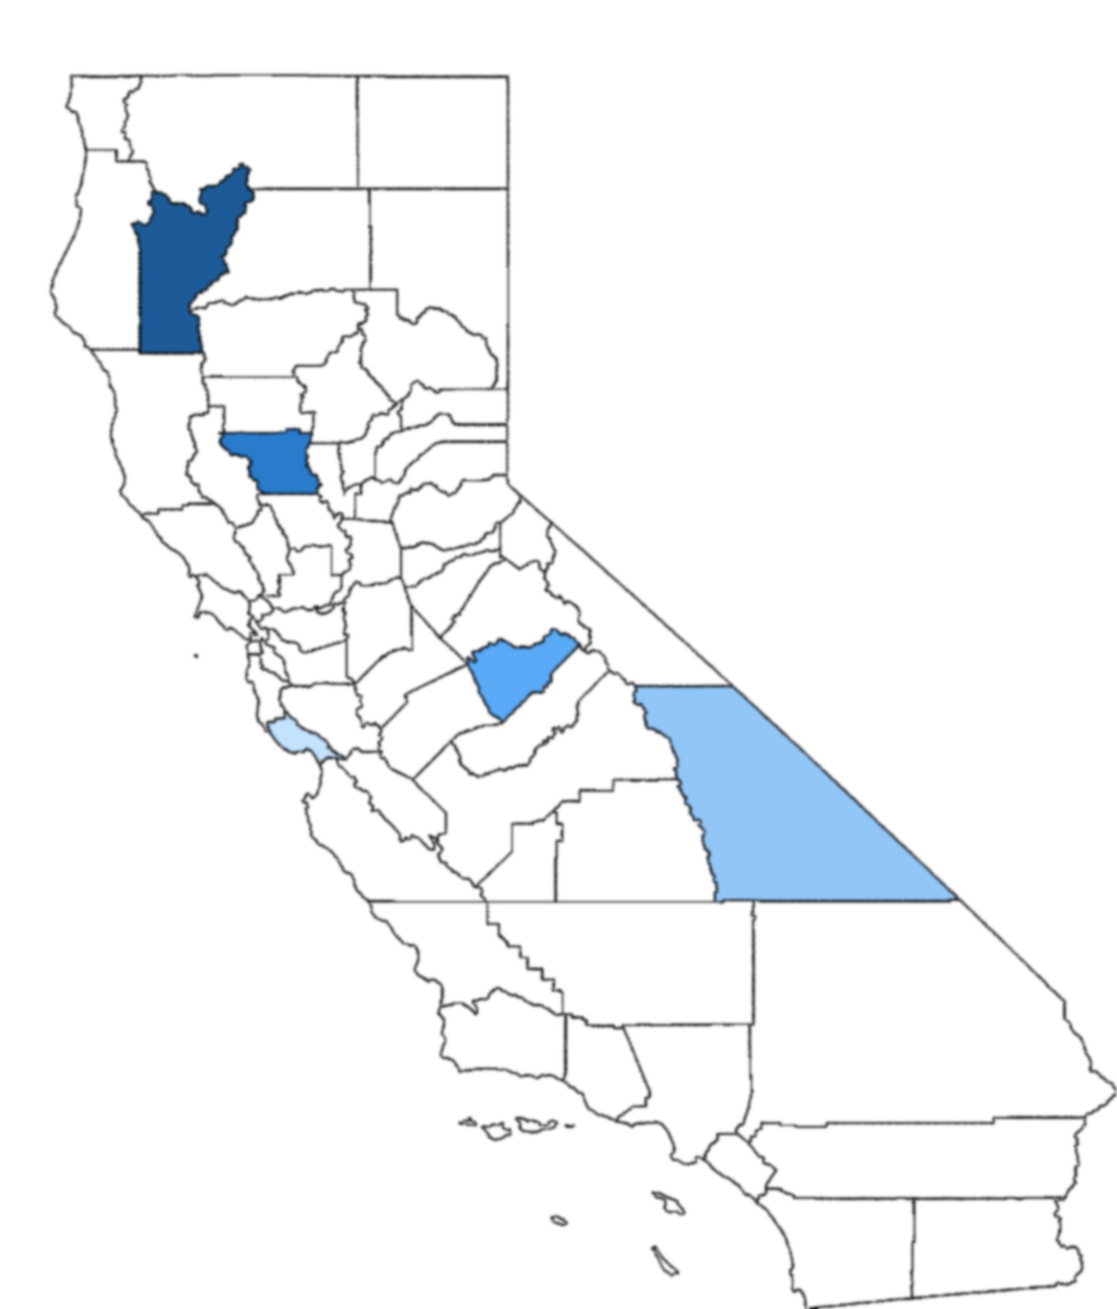
Counties With The Highest Percentages of Unsheltered Students*
County Name | Unsheltered Students
Trinity | 53 (23.1%)
Colusa | 93 (17.9%)
Mariposa | 27 (17.4%)
Inyo | 46 (12.4%)
Santa Cruz | 308 (11.9%)
*as a percentage of homeless students

Slide 11
Counties with the Largest Increase in Homeless Students
County | Cumul. Enroll | Homeless Counts | % Homeless of Enrollment | Diff from Prior Year
Sierra | 414 | 57 | 13.8% | 6.5%
Inyo | 5,188 | 371 | 7.2% | 2%
Mendocino | 13,162 | 1,059 | 8.1% | 1.8%
Colusa | 4,744 | 519 | 10.9% | 1.3%
Butte | 30,893 | 2,114 | 6.8% | 1%
San Joaquin | 163,872 | 8,243 | 5% | 1%
Santa Barbara | 69,022 | 9,783 | 14.2% | 1%

Slide 12
District-Level Reviews

Slide 13
Districts with Largest Increases* in Homeless Populations
These five district’s populations of homeless students (as a percentage of total population) all increased by 10 percentage points or more in the 2024–25 academic year, with Round Valley Unified and Baker Valley Unified increasing by 30 to 35 percentage points each.
Round Valley Unified
Baker Valley Unified
Mountain View Elementary
Julian Union Elementary
Shoreline Unified
*as a percentage of total population

Slide 14
Districts With Largest Percentages of Unsheltered Students
Of districts with 10 or more unsheltered students total.
County | District | Unsheltered Students*
Trinity | Douglas City Elementary | 13 (92.9%)
Marin | Shoreline Unified | 40 (75.5%)
San Bernardino | Baker Valley Unified | 35 (71.4%)
Los Angeles | Palos Verdes Peninsula Unified | 124 (66.7%)
Los Angeles | Claremont Unified | 114 (54.6%)
Colusa | Williams Unified | 87 (49.4%)
Alameda | San Leandro Unified | 58 (42.7%)
*percentages are percent of homeless students

Slide 15
Unaccompanied Youth

Slide 16

Students Not in Direct Care of Parent/Guardian
9,713
+882
2024–25
since last year

Slide 17
Unaccompanied Youth Counts Over Time
Since 2019–20, the count of homeless students who are not in the direct care of parents/guardians has increased by 3,106 students.

Slide 18
Unaccompanied Youth by Dwelling Types
The housing situation for these youth are predominantly in “temporary doubled-up.”
Temporary
Doubled-Up
Hotels/
Motels
Temporary
Shelters
Temporary
Unsheltered
81.9%
2024–25
+2.7%
since last year
2.1%
2024–25
-0.5%
since last year
9.7%
2024–25
-2%
since last year
6.3%
2024–25
-0.3%
since last year
Would otherwise sleep on street
Live in car, park, bus station, street
Shared housing

Slide 19
Unaccompanied Youth by Gender
The counts by gender show an even split between male and female students.
2024–25
Non-Binary
Male
Female
Non-Binary

