Slide 1

Supplier Diversity in Energy in Arizona
Lea Márquez Peterson, MBA, IOM
Arizona Corporation Commissioner

Slide 2
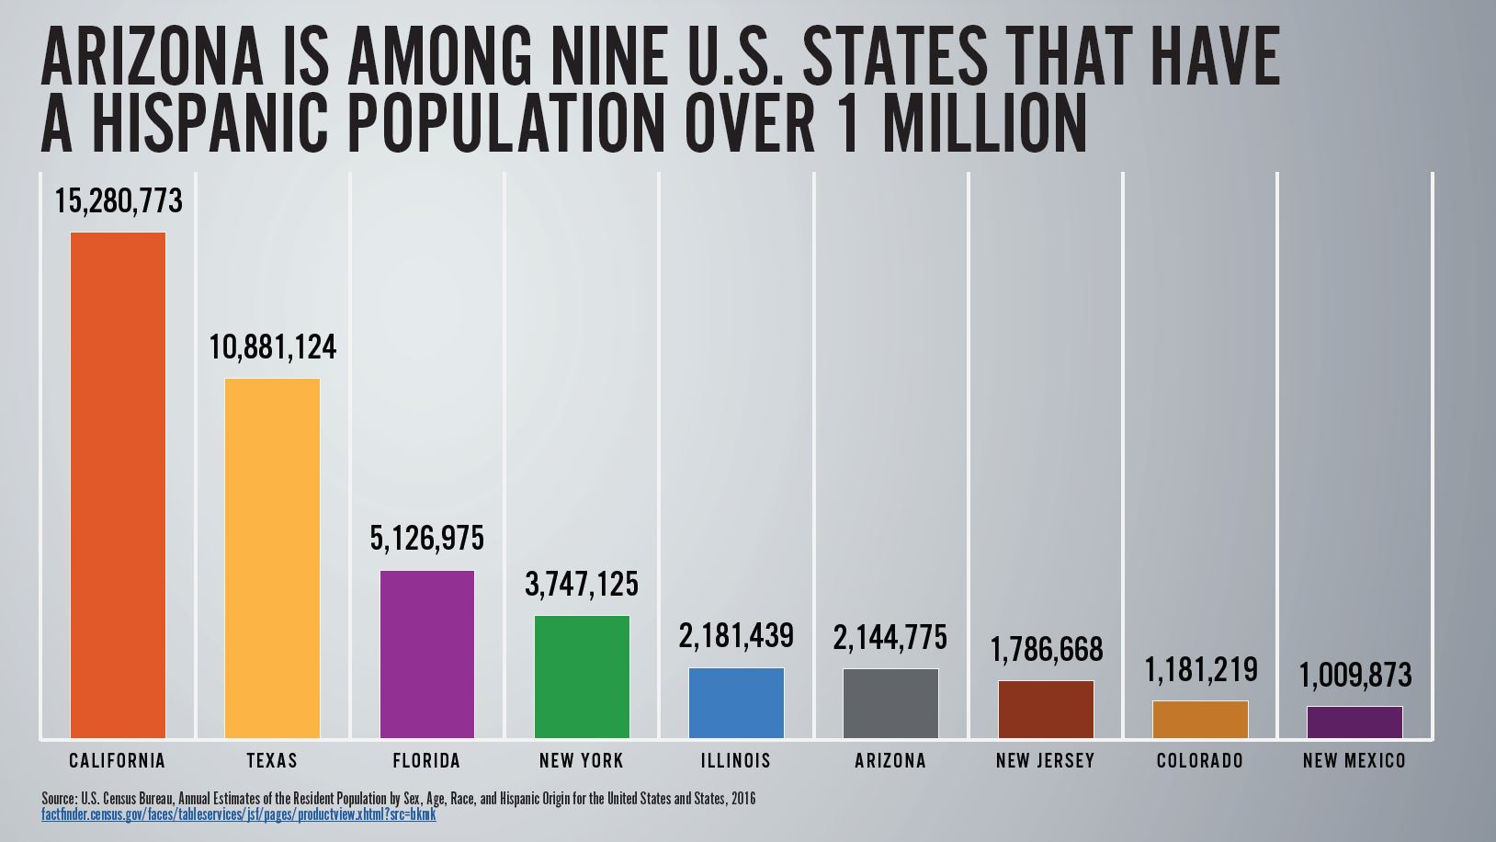

Slide 3
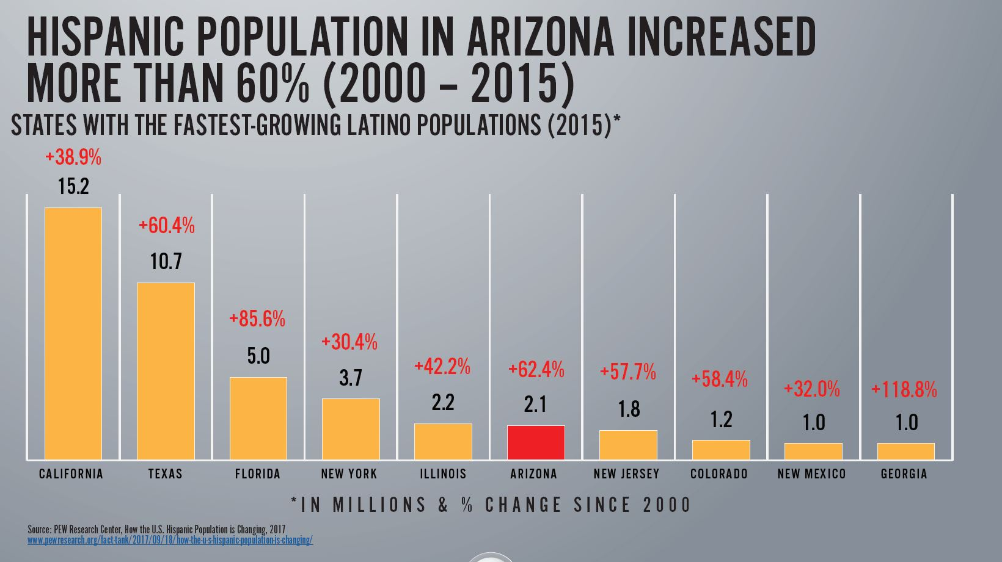

Slide 4





Hispanic owned businesses in Arizona
Arizona is home to an estimated 123,000 Hispanic-owned businesses, according U.S. Census figures, with a majority of those companies owned by Hispanic women.

Slide 5

Arizona’s largest and longest-serving energy provider serving 2.7 million customers.
Recognized Certifications:
Minority-owned Business Certification: National or Regional Minority Supplier Development Councils
Women-owned Business Certification: Women’s Business Enterprise National Council
Small Business Certification: HubZone, Veterans and Disabled Veterans from local, state or federal government agencies

Slide 6
Diverse Supplier Training Program
Nine-month training program in Phoenix, AZ
Learn how to respond to RFPs
APS facility tours
Instruction from APS experts and ASU W. P. Carey School of Business
Develop a Capability Statement
Introduction to prime contractors and/or other area utilities

Slide 7

2020 Small Business Expenditure Goals
TEP serves 417,000 customers in the Tucson metropolitan area

Slide 8

Southwest Gas spent $213M Companywide with diverse suppliers (2018)
In Arizona, Southwest Gas spent $129M with 24 diverse suppliers.
$43M in goods (commodities/materials – pipe, fittings, meters, etc.)
$86M in services (e.g. work done by contractors)
Community Partners: Associated Minority Contractors of Arizona,
Arizona Hispanic Chamber of Commerce,
Pacific Southwest Minority Supplier Development Council, Minority & Small Business Alliance of Southern Arizona, and Women’s Business Enterprise Council.

Slide 9
Opportunities / Trends
Diversification of Arizona’s energy mix (move from coal to clean energy)
  Transition for Coal communities
  Renewable energy projects
  Energy Efficiency use of outside contractors
Technology / Innovation
  Energy Storage – better manage supply during peak periods
Electric Vehicle implementation and growth

