Slide 2
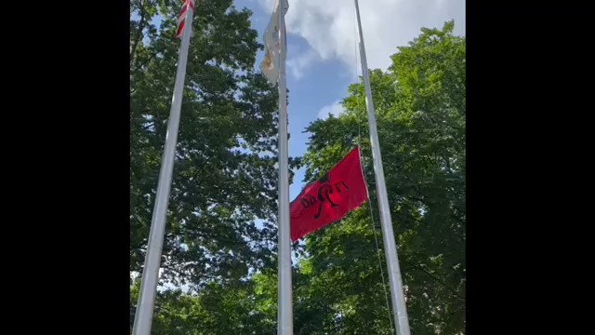
Tribute To Suzanne Anderson

