Slide 1
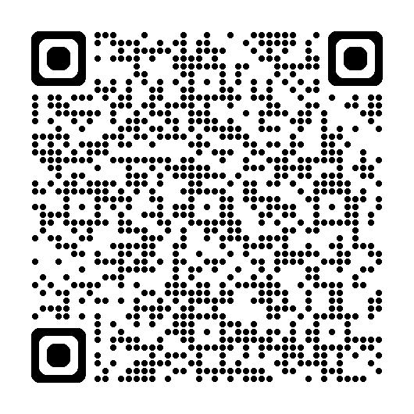
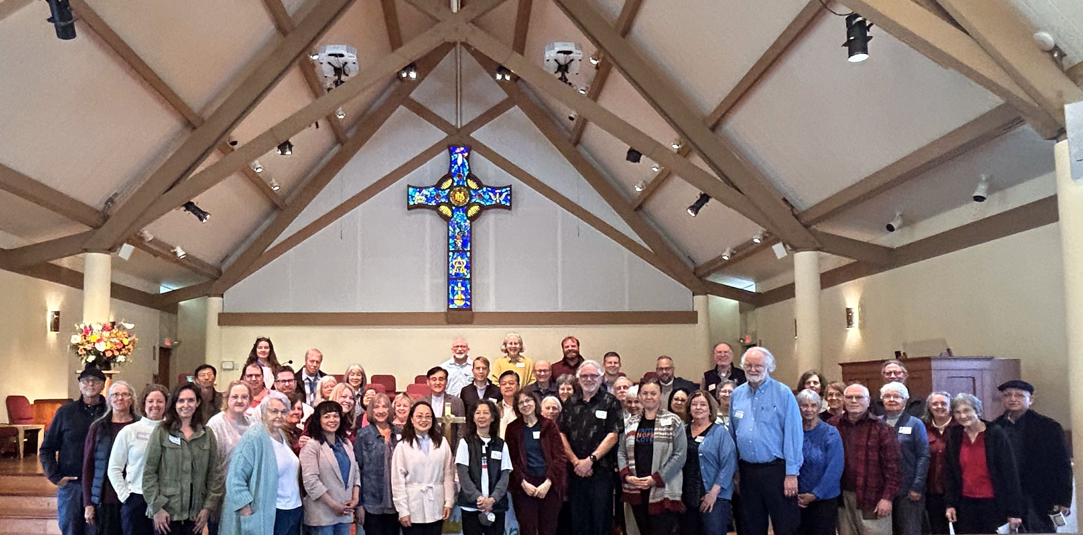
Presbytery of San José invites all
to First Pres. Mountain View
Saturday, Sept 6, 2025
8:30am – 1:30pm
Nurture, Educate, Advocate and Resource
(N.E.A.R.) Gathering
with special guest Rev. Mark Labberton
tinyurl.com/sjNEAR2

