Slide 1
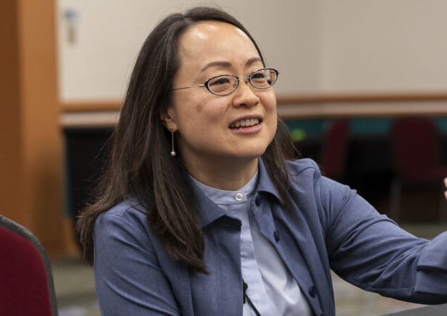
May 3 NEAR Gathering at First Presbyterian Church of Monterey
Hear and Meet the new Stated Clerk of the Denomination and Executive Director of Interim Unified Agency,
The Rev. Jihyun Oh
She will give two talks, "Mutuality in Mission” and "Responding Faithfully to our Times”
After the talks and lunch First Pres Monterey will be organizing optional excursions in the afternoon.
This will be a great event for spiritual growth and faith learning.
Car pooling is available

