Slide 1
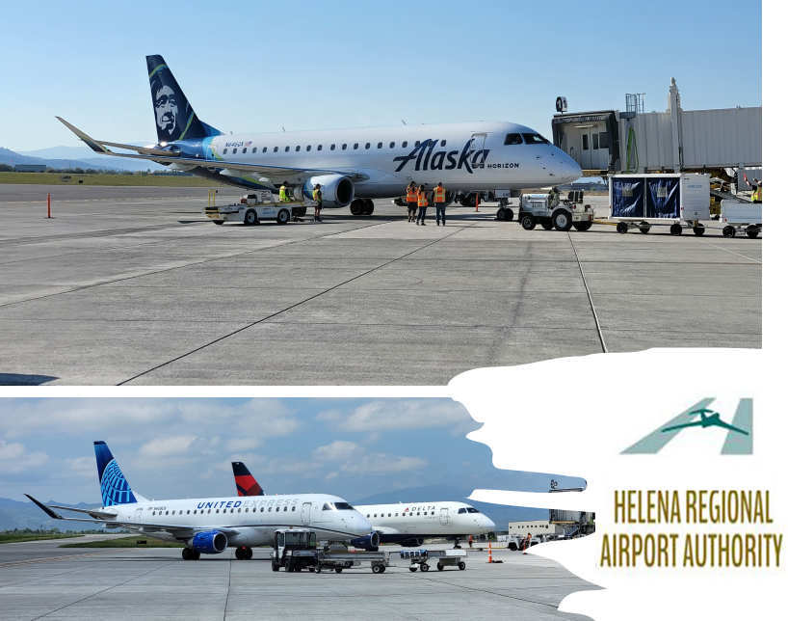
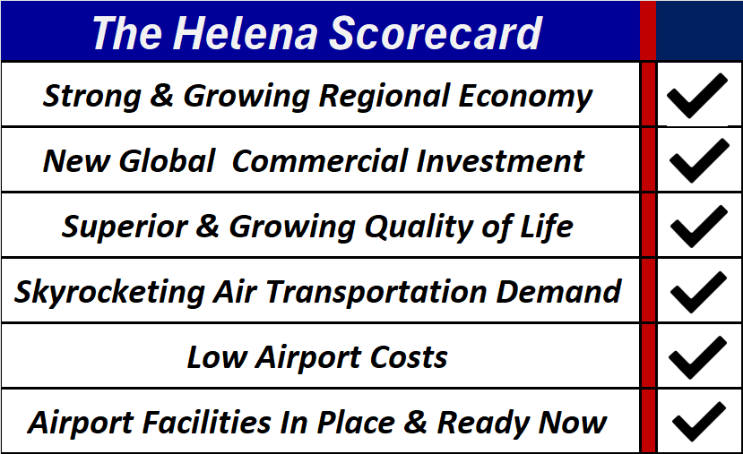
Today, Airlines Can’t Take Chances
Helena Has It All Right Now. Ready.
The #1 Gateway To Montana: America’s Growth Basin.

Slide 2

Helena is rapidly attracting major industries from all parts of the USA. These are bringing more discretionary spend to the region, and that means stronger air travel demand.
America’s Businesses Are Moving…
… and Helena Is A Major Selection Point
Boeing – from Northwest
Federal Reserve Bank Regional Office
Pioneer Aerospace – Major Supplier
Northrup/Grumman – From So Cal and East Coast
Blue Cross/Blue Shield Processing Center
So Fi

Slide 3
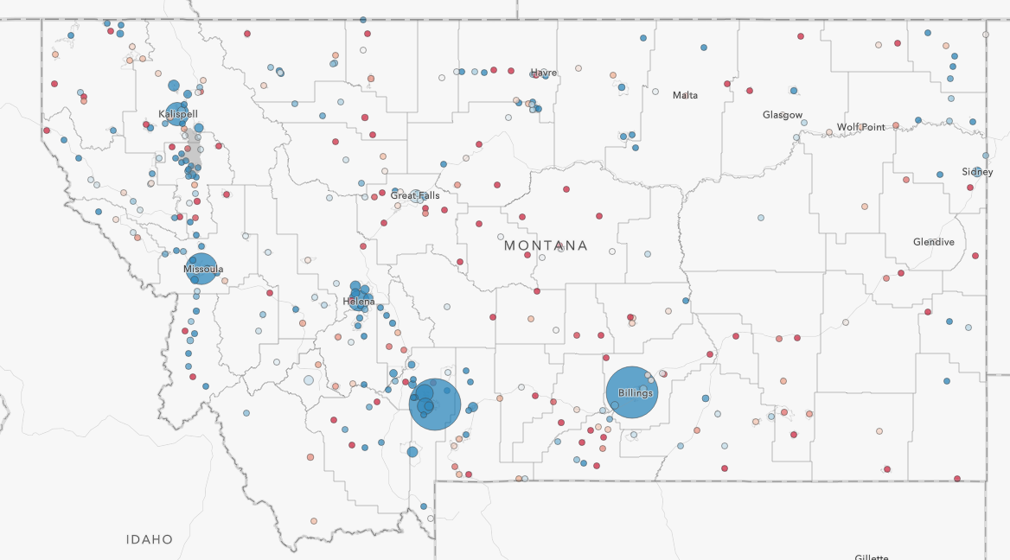
With in-migration of business from other regions, Helena is the growth centroid in Montana, and is the natural air gateway for the region. Air service access opportunities are expanding.
Helena – Where The Growth Is In Montana

Slide 4
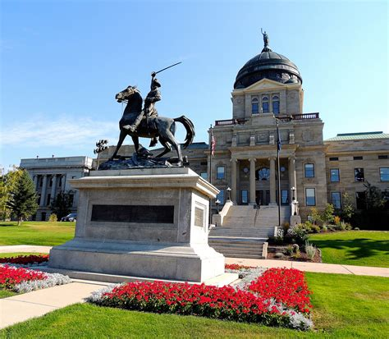
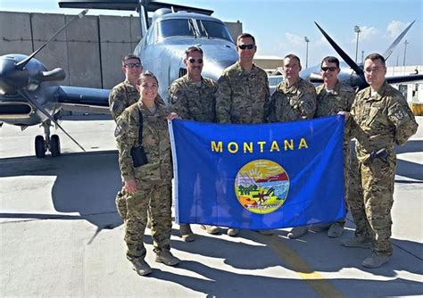
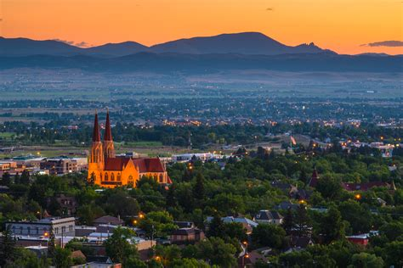
Plus, A Solid, Business Travel Foundation
Strong Income Growth – Low Seasonality
Telecommuting population – rapidly growing demographic since 2020 due to new residents
State Capital – Federal and State Agency Presence. Community of business interest with the Arizona capital
Leisure Travel to Warm Destinations in the winter season – plus summer northbound demand, to0
The medical capital of Montana. Two Public Health Organizations – St. Peter’s Hospital and now Benefits Health (satellite of Great Falls Hospital)
Fort William Harrison National Guard / Army Aviation Units based at airport
Largest Aerial Fire Tanker Base in Montana
Rocky Mountain Emergency Services Training Center – rapidly growing student population from all over U.S. Airports
Carroll College – top rated private college in U.S. 5 years running, enrollment growing rapidly
Helena College University of Montana
So-Fi – one of their few nationwide offices – growing rapidly
Great Divide Ski Area

Slide 5
Helena Area Foundational Growth
All Point To Air Travel Expansion
2,400 new homes approved for East valley alone (outside City limits)
New West side City of Helena annexation – significant development
State’s newest AA High School (3 high schools in Helena area now).
4 new elementary schools due to rapid population growth.
Costco example – built a store in Helena to serve Helena – Great Falls and Butte markets – over 4,000 customers/month from nearby Cascade County alone. One of the most successful Costco stores in the nation per capita.
New Utility Connections - #3 in state from 2019-2023 following Bozeman and Missoula areas
Helena area has a more affordable cost of living than other Montana areas which is driving new growth to Helena’s area central to the state.

Slide 6
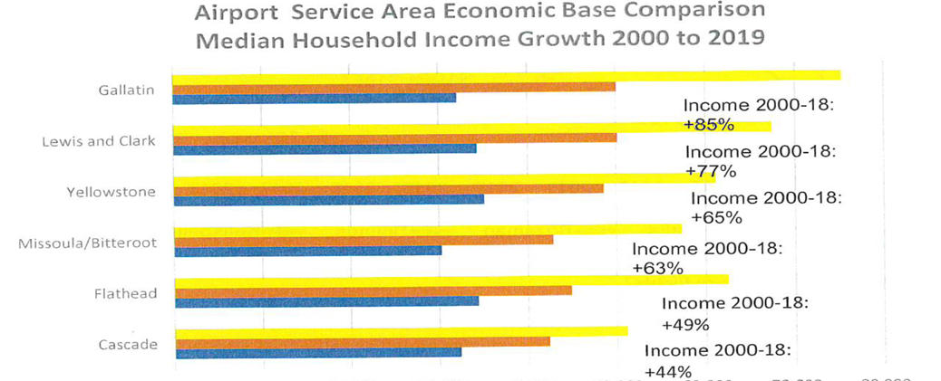
Income Growth is the foundation of air service demand.
Helena leads Montana. This generates discretionary income for Phoenix service.
Helena – On The Growth Path

Slide 7
The Helena Regional Airport Advantage
We’re Focused On Success of Our Airline Partners
Low Costs- One of the lowest CPE’s in the nation
Operating here delivers more to the bottom line
NO commitment to a long-term airline agreement
We understand the industry is volatile
NO terminal debt included in the airline rate base
    Helena’s visionary long term planning pays off for our incumbents
Helena Airport is ready for the future, now.
From E-175s to mid-body 767s & A330/350s
Point: Helena is a better application of airline fleet resources

Slide 8

Airport CPE Comparisons
Helena has diversified revenue sources – 76% from non-aviation

Slide 9
Helena = Revenue To The Bottom Line
Cost Per Passenger (CPE) Delivers To The Bottom Line
Helena is $4.91 (well below the non-hub airport national average of $10.11)
One of the lowest cost airports in Montana, much lower than nearby Great Falls ($8.77) or Missoula ($7.55)
Do the math! An A220-300 or A319 at 80% load factor 2X week = over $50,000 lower annual airport costs at Helena than Great Falls.
And costs are still dropping! Helena CPE will go lower as more flights/airlines/passengers increase as the airport is keeping rates flat. Alaska and United are adding capacity. Other revenue sources fund airport O&M (76% of revenue is from non-aviation activities!)

Slide 10
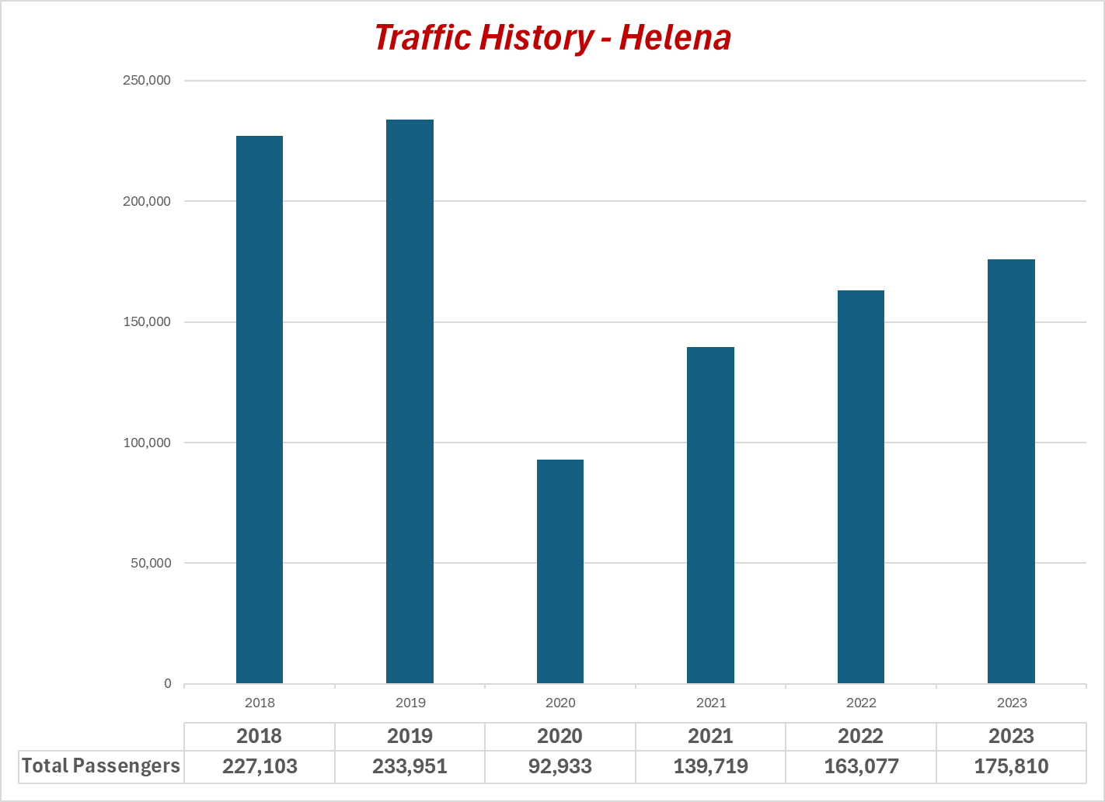
This capacity shortfall points to rapid traffic capture for Breeze
Helena Post Covid Opportunities
Y/E 4Q 2023 Load Factors
System | Hubsite | Load Factor
Alaska | SEA | 80.46
Delta | SLC | 78.82
United | DEN | 84.89
TOTAL |  | 81.00
Pre-Covid capacity has yet to be fully restored, resulting in near choke-point load factors.

Slide 11
Enter The Helena Market & We’ll Help
Shoulder The Risk.
Airport use fees waived 100% for the first two years for any new service
Marketing support of new service available from the Helena Air Service Alliance
Revenue Gurarantee | $100,000
Marketing Spend | $50,000
Value of Fee Waivers - Two Years | $155,150
Total | $305,150

Slide 12
Call Us For More Great News!
Jeff Wadekamper, Airport Director
(406)-442-2821
jwadekamper@helenaairport.com
Mike Boyd, Boyd Group International
(303)-725-7004
MikeB@aviationplanning.com

