Slide 1

WORLD CUP 2026
SBS World Cup Special Report Sponsorship Proposal
March 2026

Slide 2

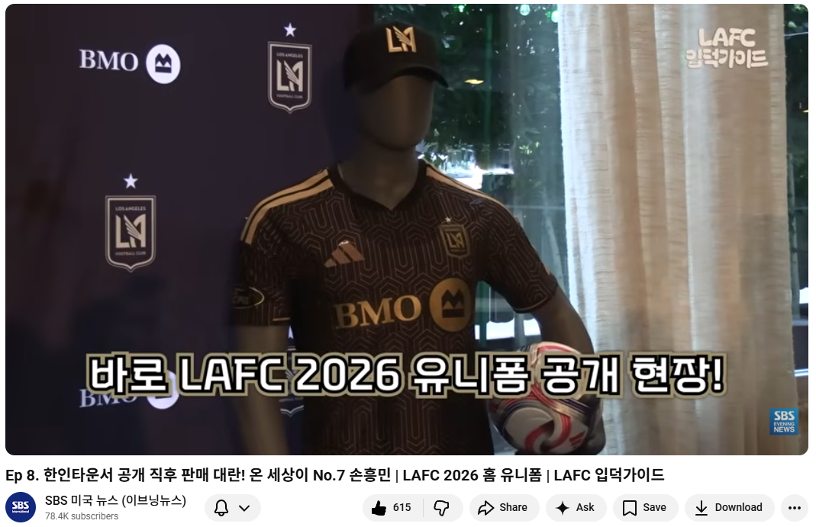
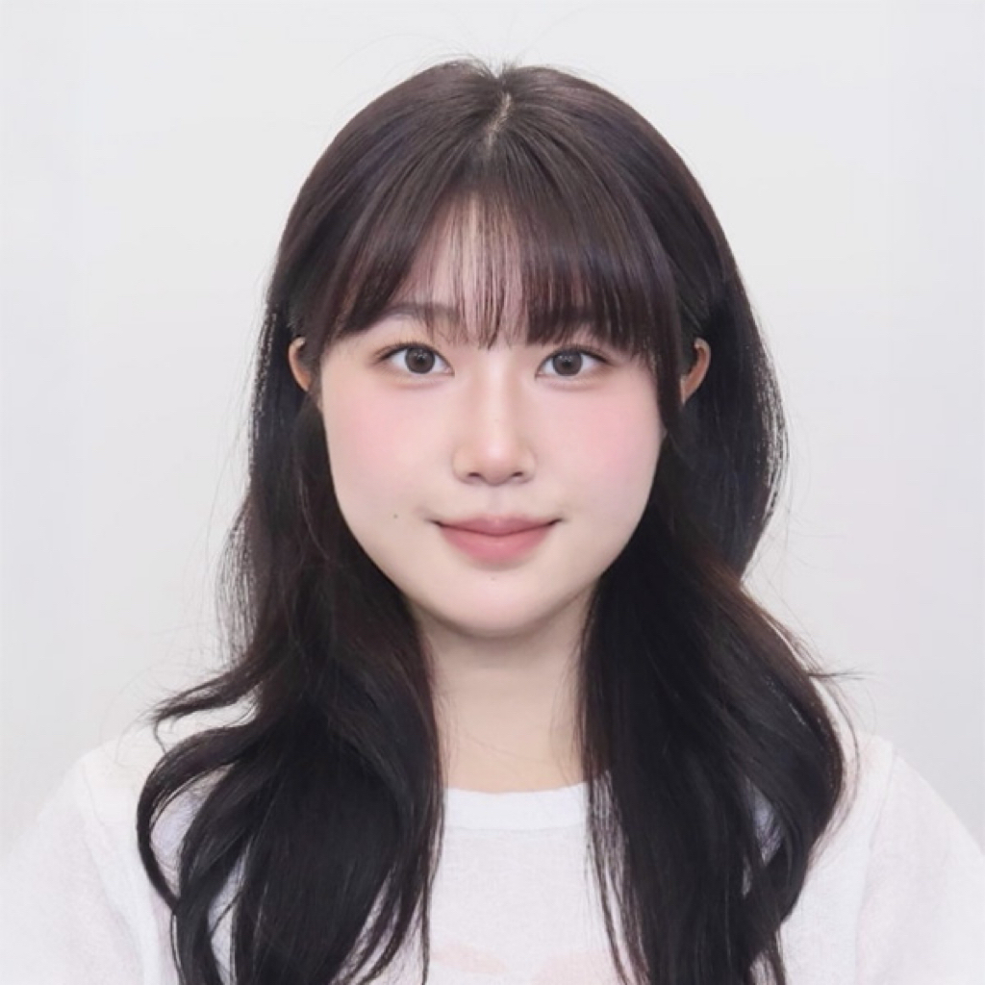
World Cup 2026_Special Report Program Introduction
The FIFA World Cup stands as a premier global sporting event, engaging audiences across all demographics with unparalleled passion and scale. To provide comprehensive and timely coverage—not only of the Korean National Team but also of top national teams worldwide—SBS has curated a multi-generational broadcast team. This approach ensures a rich blend of perspectives and expert insights, enhancing viewer engagement and delivering a dynamic World Cup viewing experience.
SBS Special World Cup Sports News Cast
Introducing SBS’s newest on-air talent. Drawing on her vibrant and engaging hosting experience with Kakao Shopping Live in Korea, she brings a dynamic, upbeat presence to the screen. In this World Cup special sports program, she will deliver the perspectives and voices of Generation Z, fostering strong connection and relatability with viewers.
EP.8
49K
View
A seasoned sports journalist specializing in major teams such as LAFC and the LA Dodgers. As the content lead for SBS’s “LAFC Fan Guide” series, she brings deep expertise in soccer along with a strong foundation of firsthand insights and on-the-ground experience.
SBS Sports Reporter:
Ju-eun (Kaitlyn) Ha
SBS Host:
Eun-Chae Lee

Slide 3

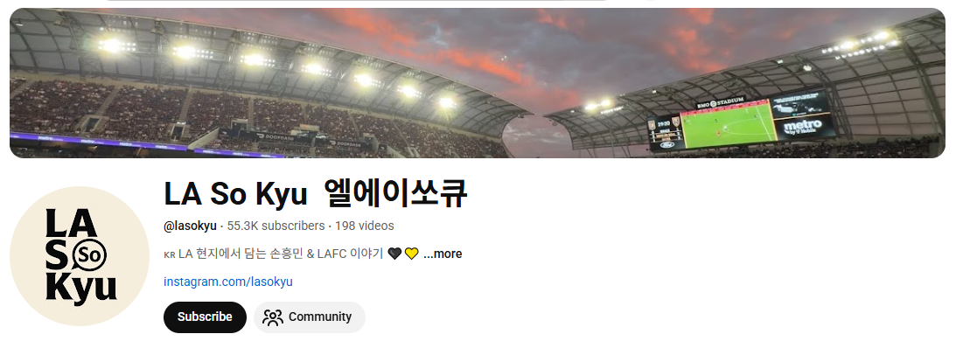

World Cup 2026_Special Report Program Special Guests
Collaboration: Two soccer YouTubers based in LA
Casting in progress
Casting completed
@lasokyu •55.3K subscribers
Live scenes of Son Heung-min and LAFC, straight from Los Angeles. Three weeks before Son Heung-min’s official transfer, I made the first LAFC Son jersey at LAFC HQ and received his first LAFC autograph upon arrival. As a 5-year LAFC fan, I bring you exclusive match-day moments and real fan experiences
(Former Radio Korea reporter)
@chaespur •1.44K subscribers
Football ⚽ | Golf 🏌️ | Travel ✈️ | Vlogs 📹
Tottenham Hotspur, LAFC, Premier League & golf adventures

Slide 4
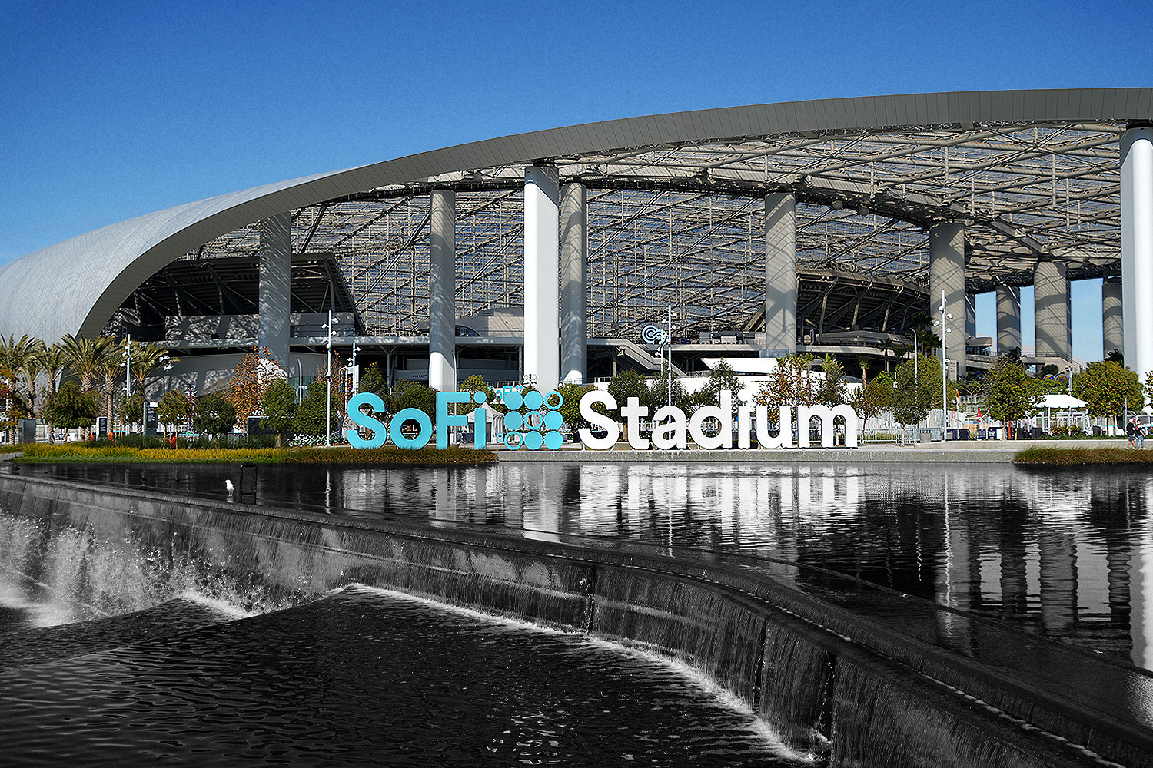
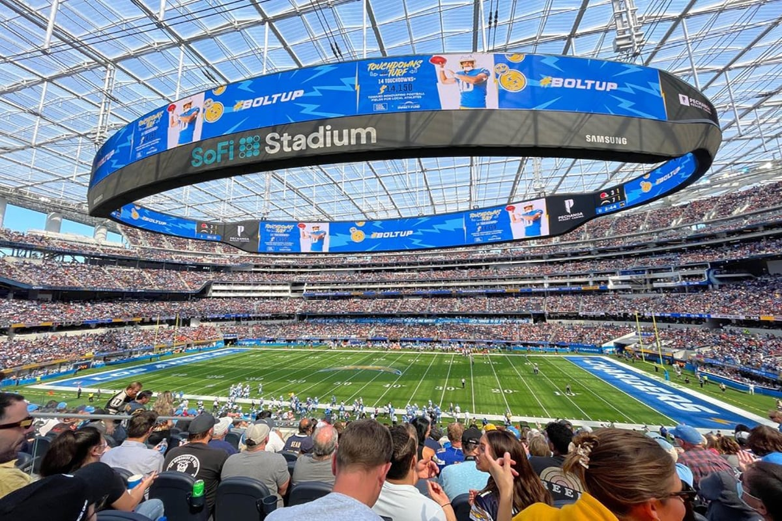
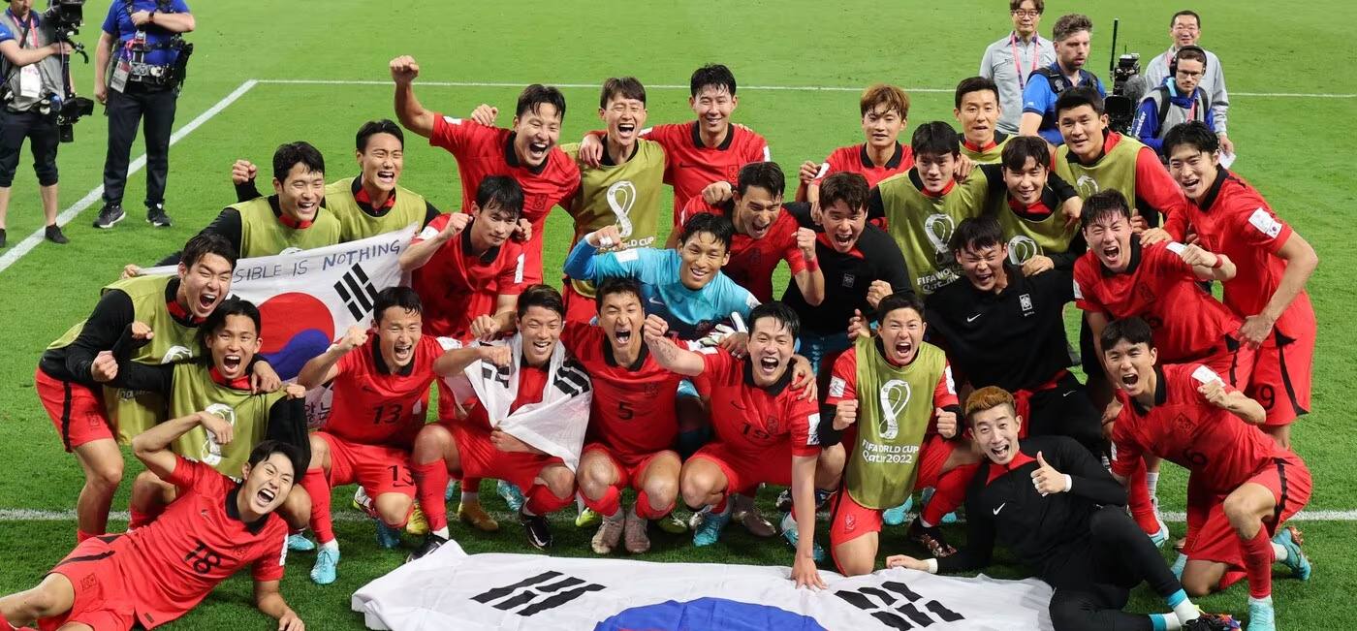
World Cup 2026_Match Schedules
World Cup 2026 Match Schedule
Stage | Date(s)
Opening Match | June 11
Group Stage | June 11 – June 27
Round of 32 | June 28 – July 3
Round of 16 | July 4 – July 7
Quarterfinals | July 9 – July 11
Semifinals | July 14 – July 15
Third Place Match | July 18
Final | July 19
World Cup 2026 L.A SoFi Stadium Schedules
Date | Round | Matchup | Kick-off Time (Local)
6/12 | Group Stage (Group D) | USA vs. Paraguay | 6:00 PM
6/15 | Group Stage (Group G) | Iran vs. New Zealand | 6:00 PM
6/18 | Group Stage (Group B) | Switzerland vs. UEFA Play-Off A Winner* | 12:00 PM
6/21 | Group Stage (Group G) | Belgium vs. Iran | 12:00 PM
6/25 | Group Stage (Group D) | UEFA Play-Off C Winner* vs. USA | 7:00 PM
6/28 | Round of 32 | Runner-up Group A vs. Runner-up Group B | 12:00 PM
7/2 | Round of 32 | Winner Group H vs. Runner-up Group J | 12:00 PM
7/10 | Quarter-final | Winner Match 91 vs. Winner Match 92 | 12:00 PM

Slide 5
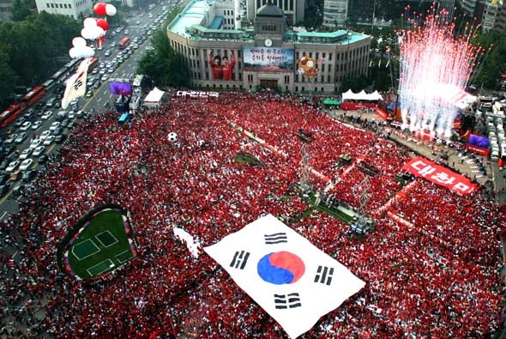
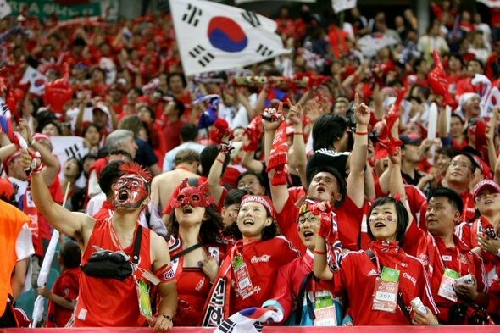
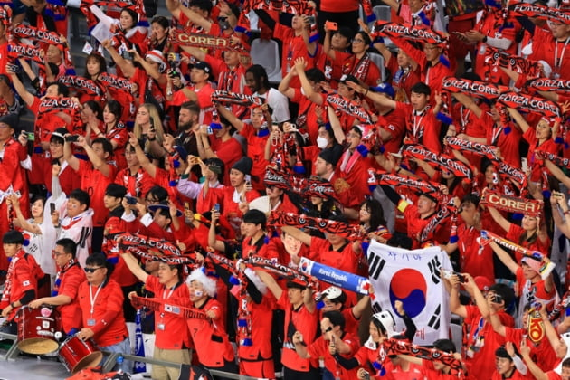
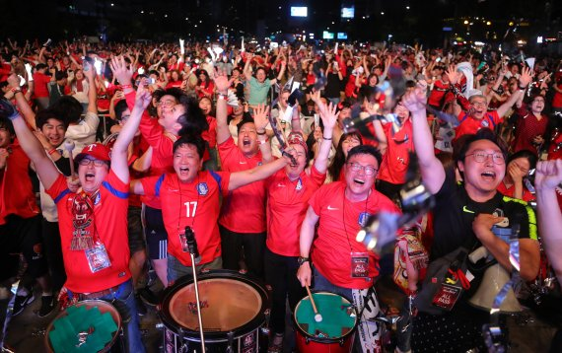
World Cup 2026_KOREA Team Group Stage Schedules
Korea Team Match Schedule
Match | Vs. | Date (Local) | Time (PT) | Location
Match 1 | vs Winner of European Playoff D | June 11, 2026 (Thu) | 7:00 PM | Guadalajara – Estadio Akron
Match 2 | vs Mexico | June 18, 2026 (Thu) | 6:00 PM | Guadalajara – Estadio Akron
Match 3 | vs South Africa | June 24, 2026 (Wed) | 6:00 PM | Monterrey – BBVA Stadium
Street cheering events will be held in Los Angeles’ Koreatown for all three qualifying matches of the Korean national team. The SBS Special Report Team for the 2026 World Cup will be on-site to capture and deliver the electrifying atmosphere of the crowd, along with authentic fans reactions and voices.
In the 2026 FIFA World Cup, the South Korean national team is placed in Group A, and all three of their group stage matches will be played in Mexico.

Slide 6
World Cup 2026_Special Report Program Content & Schedule
Contents
1. Match Updates and Results
2. Preview of Tomorrow's Matches and Spotlight on Key Players
3. Local Coverage (Cheering Squads and Atmosphere in Each Country, Stadium Surroundings)
Broadcast Period: 6/10-7/20
Duration: 4~5 Min. / Episode
Total: 24 Episodes (Total Air: 72 times)
World Cup 2026 Special Report_June Schedule
Coverage | CH | Time | Wed | Thur | Fri | M | Tu | Wed | Thur | Fri | M | Tu | Wed | Thur | Fri | M | Tu | Total
 |  |  | 6/10 | 6/11 | 6/12 | 6/15 | 6/16 | 6/17 | 6/18 | 6/19 | 6/22 | 6/23 | 6/24 | 6/25 | 6/26 | 6/29 | 6/30
S.CA | 18.2 | 8pm-9pm | 1 | 1 | 1 | 1 | 1 | 1 | 1 | 1 | 1 | 1 | 1 | 1 | 1 | 1 | 1 | 15
Nationwide | 2080 | 8pm-9pm | 1 | 1 | 1 | 1 | 1 | 1 | 1 | 1 | 1 | 1 | 1 | 1 | 1 | 1 | 1 | 15
 | 1483 | 9pm-10pm | 1 | 1 | 1 | 1 | 1 | 1 | 1 | 1 | 1 | 1 | 1 | 1 | 1 | 1 | 1 | 15
 |  |  |  |  |  |  |  |  |  |  |  |  |  |  |  |  |  | 45
World Cup 2026 Special Report_July Schedule
Coverage | CH | Time | Wed | Fri | M | Wed | Thur | M | Tu | Fri | M | Total
 |  |  | 7/1 | 7/3 | 7/6 | 7/8 | 7/9 | 7/13 | 7/14 | 7/17 | 7/20
S.CA | 18.2 | 8pm-9pm | 1 | 1 | 1 | 1 | 1 | 1 | 1 | 1 | 1 | 9
Nationwide | 2080 | 8pm-9pm | 1 | 1 | 1 | 1 | 1 | 1 | 1 | 1 | 1 | 9
 | 1483 | 9pm-10pm | 1 | 1 | 1 | 1 | 1 | 1 | 1 | 1 | 1 | 9
 |  |  |  |  |  |  |  |  |  |  |  | 27

Slide 7
World Cup 2026_Special Report Program Sponsorship Benefits
* Title: Sponsor name and Sponsor Official World cup Logo with Program title
(The selection of the program title shall be determined through consultation with SBS, reflecting the advertiser's input to the fullest extent possible.)
* Open & Close Bill Board (5 Sec ;The open billboard and the closed billboard do not necessarily need to share the same design or content.)
* Top left sponsor Official World Cup logo exposed at all times
(The open billboard and the closed billboard do not necessarily need to share the same design or content.)
* 30" Sponsor CM after Program
* Special Program PR AD with Title Sponsor name and Logo
* The episodes are also uploaded to the SBS YouTube channel.
* SBS NEWS team will cover the sponsor and report the news during regular news hours
Exclusive Sponsorship PKG
$40,000

Slide 8
World Cup 2026_Special Report Program Sponsorship Benefits
Title Sponsor Benefits
AD Benefits | Period | KSCI CH18.2 | DIRECTV CH 2080 | Spectrum CH 1483 | Total Frequency
Origianl Broadcast Title Sponsor Name & Logo | 06/10-07/20 | 24 | 24 | 24 | 72
Open Billboard |  | 24 | 24 | 24 | 72
Close Billboard |  | 24 | 24 | 24 | 72
Top Left Logo Expose all times in Program |  | 24 | 24 | 24 | 72
30 sec CM after Program |  | 24 | 24 | 24 | 72
Program PR CM (20sec) with Sponsor Name and Logo | 06/08-07/20 (43 Days) | 215 | 215 | 86 | 516
SBS NEWS_Sponsor Cover | TBD | 1 | 1 | 1 | 3
Total Exposure |  |  |  |  | 879
Exclusive Sponsorship PKG
$40,000
SBS is seeking to facilitate the cross-uploading of the videos to the personal
YouTube channels of chaespur and LA SO KYU, in addition to the official SBS channel.

