Slide 1


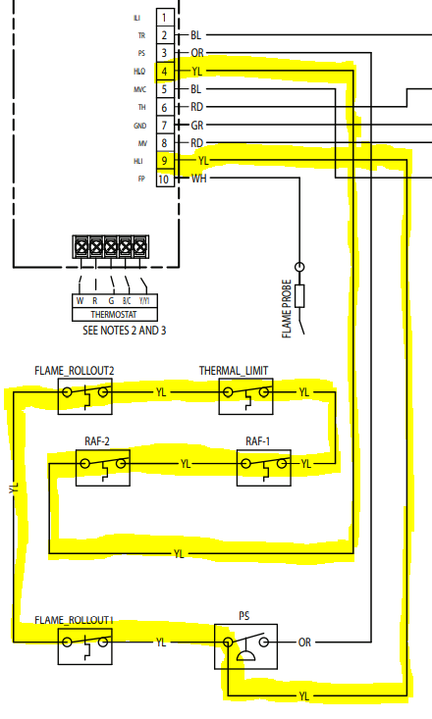
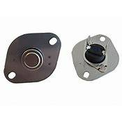
Locating & Correcting a 4.0 Alert Code on Gas Furnaces
Tech Tip
MONTH 2022
Temperature limit switches are designed to open and drop a call for heat when the temperature get too hot in an area. There are several ways to check a limit switch:
Using an Ohm meter, unplug one end of a wire on the switch and measure across the contact points. If the meter reads ‘0’ or ‘OL” the switch is open.
Another way is using the continuity selection, a constant ‘beep’ or ‘tone’ tells you the switch is closed and working right. No tone means it’s open and should be replaced.
If you are still getting a 4.0 error after locating the high limit, limit’s and roll out switches there are two more located in the back of the furnace in the blower compartment and sometimes hard to find. The are called ‘reverse airflow switches’ (RAF) used for different install applications.
As shown to the right, they are wired in a ‘daisy chain’ and can be checked using the HLI & HLO on the board where the thermostat wires are connected. Checking for ‘tone’ or resistance using Ohms you can tell if the circuit is complete.
If it is open, be sure to inspect the wires for fray or a loose connection and check each switch like any other switch to verify it is working properly. When working right, you will read 24VAC with power on and leads on the HLI & HSO points.
The blower will have to be pulled out to get to these switches as they are difficult to see and easy to miss.
Field Service Representative Contact
SW FL 239-277-0344; Option 3 SE FL 954-421-7133; Option 2
N FL 844-358-7263; option 2

