Slide 1







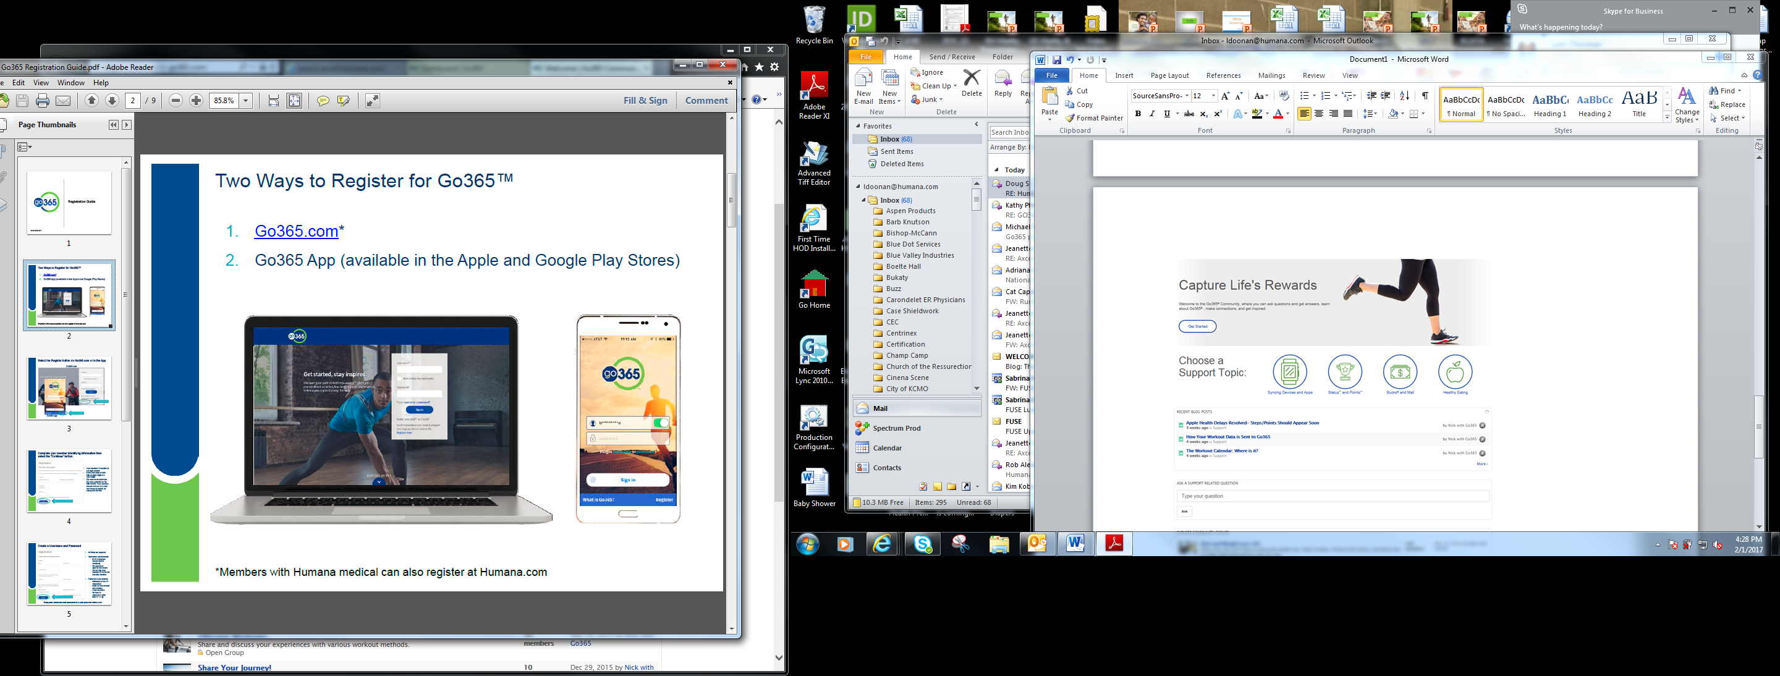
READY.
SET.
Go365
It’s simple to get started with Go365TM. Here’s how to get rewarded for your healthy behaviors.
Register on www.Go365.com to set up your account and create a personal username and password
  Be sure to use the Web and not the Go365 app to register for the first time
Once registered, download the Go365 App!

