Slide 1

What is a biometric screening?
A quick health check that measures the following:
Body mass index (BMI)
Blood glucose
Total cholesterol
Blood pressure
Blood measurements can be taken through a finger prick or venipuncture
Recommended activities in Go365, such as a biometric screening, are not medical advice. Consult your physician.

Slide 2
Big Points booster!
Biometric Screening Measurement | Points earned for completing | Potential Points for healthy in- range result
Body mass index (BMI) | 800 Points | 800 Points ≥ 18.5 and < 25, OR BMI ≥ 25 and < 30, with a waist circumference < 40" for males and < 35" for females
Blood glucose | 400 Points | 400 Points < 100 mg/dL or A1c < 6.5%
Total cholesterol | 400 Points | 400 Points < 200 mg/dL or an HDL ≥ 40 mg/dL for males and ≥ 50/mg/dL for females
Blood pressure | 400 Points | 400 Points < 130/85 mm Hg
Total | 2,000 Points | 2,000 Points
Total possible Points: 4,000
Points are per program year
*Adult children are not eligible to earn Points or Bucks for biometric screening completion or in-range results

Slide 3


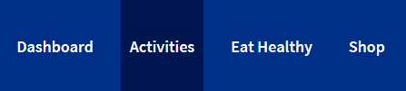



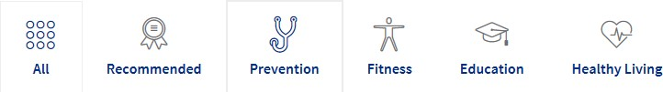
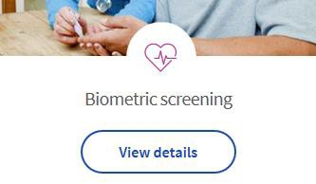

Find an option on Go365.com
Sign into Go365.com
Click “Activities”
Filter by “All” or
“Prevention”
Click “View details” under Biometric Screening
Note if you don’t see the Biometric Screening activity as an option, you may have to click a button “Show more.”

Slide 4
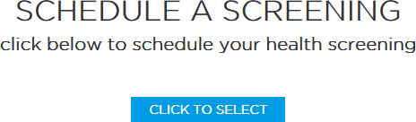

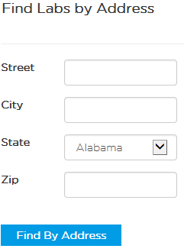

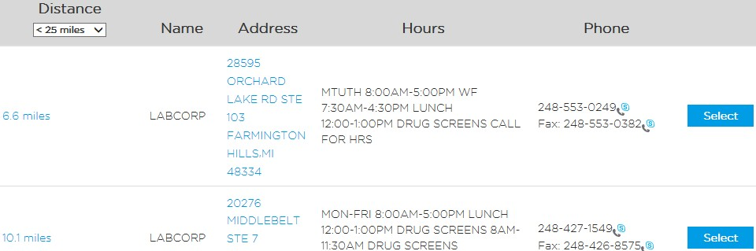

Steps to make appointment
LabCorp Patient Service Centers
Click “Click to Select” to schedule a screening.
Enter address fields and click “Find By Address” then select the location in the list of options by clicking “Select.”

Slide 5
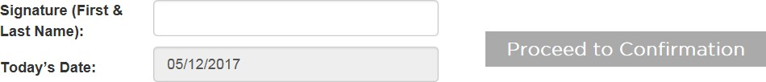

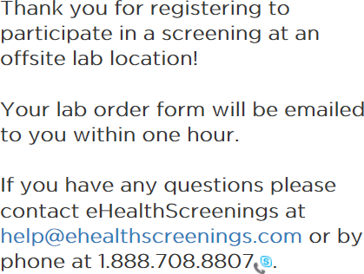


Steps to make appointment
Agree to the Health Screening Consent and HIPAA by checking the box “I Agree.”
Provide your first and last name to sign then click “Proceed to Confirmation.”
LabCorp Patient Service Centers
You will receive an appointment confirmation screen with the location of your selected lab and the following message.
Required: Bring the lab order form (your voucher) with you to your appointment!

Slide 6
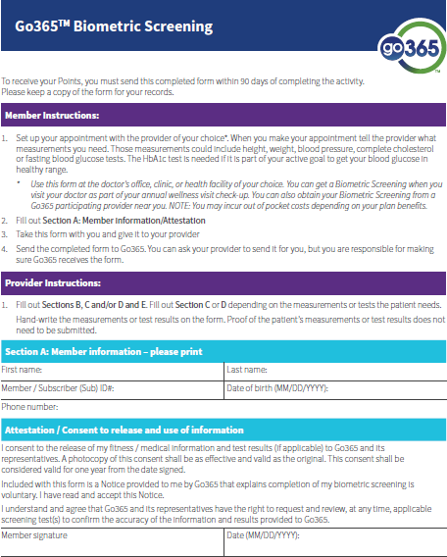
Primary Care Physician
Prefer your own doctor? Make an appointment and bring the Biometric Screening Form (located in the Biometric Screening section on Go365.com) to your appointment. Expect a blood draw from your arm.
Submit the form to Go365 on or before March 31, 2022 to update your account.
Note: coinsurance, copays or other costs may apply if you go to your doctor.

