Slide 1
2025 Market Value
Update
March 14, 2025
Dakota County Assessing Services
County Wide data and Lakeville Specific data

Slide 2
Estimate Market Value Annually
Assessment Date is January 2
Market Value = the price that would prevail under competitive open-market conditions
DOR Sale Ratio Study measures level of assessment and indicates change (Mass Appraisal)
  Consider sales between 10/1/23 & 9/30/24
  Maintain a level of assessment between 90% and 105% on all property types
  Preliminary 2025 median assessment ratios for all property types fall between 94.1% and 95.5%
Notes:
2025 Medians all fall between 94.1 and 95.5% for all property types.
Res 4,645 Sales – 95.0 med
Apt 14 sales – 95.4% med
Com 57 sales – 95.3% med
Ind 20 sales – 95.5% med
*Ag 8 sales – 94.1% med (34.5 ac & up)

Slide 3
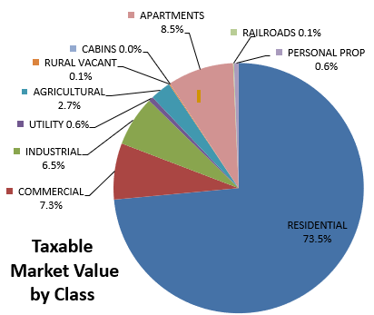
2025 Market Value Summary
Estimated Market Value is $78.66 billion
  Lakeville $13.94 billion (up $716.8 million over last year)
Taxable Market Value is $76.57 billion
  Lakeville $13.65 billion (up $725.3 million over last year)
  $899.7 million of
  new construction
  market value
      $257.2M Lakeville
  Tax Capacity of
  new construction
  is $10.5 million
      $2.94M Lakeville
Notes:
Estimated MV Includes all taxable property types Up 4.43% from 2024 (75.32B)
Taxable MV Up 4.69% from 2024. (73.14 Billion)
*Diff between EMV & TMV is primarily Hstd MV Excl…also, Dis Veterans Excl, Green Acres & Open Space deferments
Hstd MV Exclusion – $1,409,735,000 for 2025 pay 26. $1,503,557,617 for 24 pay 25. $719.4 M for 2023 ($782.79 M for 2022) (1.58 B for 2021)
Disabled Vet Exclusion – $471,552,300 for 2025 p 2026. $402,800,100 for 24 pay 25. $358 M for 2023 ($330.08 M for 2022) ($315.85 M for 2021)
2025 NC down 13.9% 2024 NC down .82%. 2023 up 33.97% (2022 up 26.2% $872.7 M from 2021) (2021 up 10.6% $692.39, from 2020 Asmt ($625.8 million)
2025 NC Tax Cap down 23% from 2024 13.7M
Source data:
AA808DCO: HS MV Exclusion & Dis Vet Exclusion; AA714DCO: Usage TMV, NC; AA717DCO: Usage EMV

Slide 4
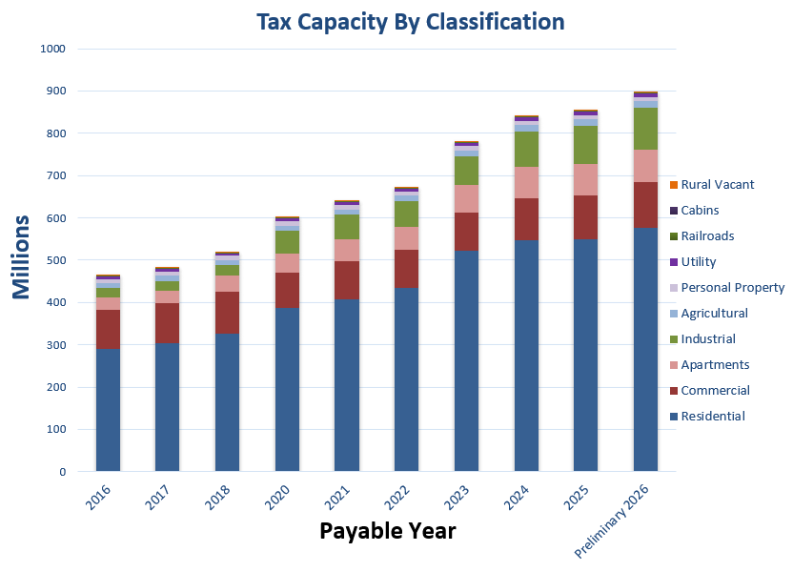
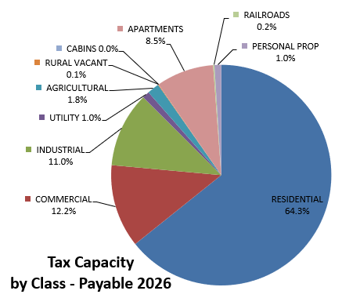
2025 Market Value Summary
Tax Capacity is $896.77 million (Payable in 2026)
  Increased 4.99% from Payable 2025
  Lakeville Tax Capacity is 157.1M, increased 6.07% from Pay 2025
Notes:
Tax Cap increased 4.99% from 858.1M, 2.16% from $840M in 2023. from $780.27 million in 2022 (2022 Increase of 16.23% from $671.4 Million)
Tax Capacity figures will likely decrease slightly as the year goes on due to valuation and classification changes.
Additionally, the legislature may make changes that impact market value and/or tax capacity values.
The effect of any legislative actions will not be known until mid-summer.

Slide 5
2025 Market Value Summary
Residential: Median Increase 3.66%
  Median Homestead Market Value $385,300
  Lakeville Median Increase 4.07%
  Lakeville Median Homestead Market Value $468,000
  $572.5 million of new construction
    1,310 new housing starts
    Lakeville $213.1 million of residential new construction
    425 new housing starts
Notes:
Next few slides will talk more specifically about value changes for main property types:
2025: County-wide Median Value Changes:
Residential (SFD, Duplex, Triplex): 3.38%, Townhouse: 2.91%, Condo: 2.11%, All res combined: 3.29%
2025 Median up 3.66% 2024 Median Homestead Value: $372,500 (+.11%)
NC 2025 1,310 starts, 2024 =1,168, 2023 =1,502
Total Res NC Value Added:
2025 NC: $572.5M up 2.2%. 2024: $560,583,300 (-9.6%), 2023: $622,083,300 (+18%)
Noted for your reference of where numbers above are from: *Mean & median value from AA729DCO, *New houses/townhouses based on dwelling with year built, *AA714DCO: Res NC

Slide 6
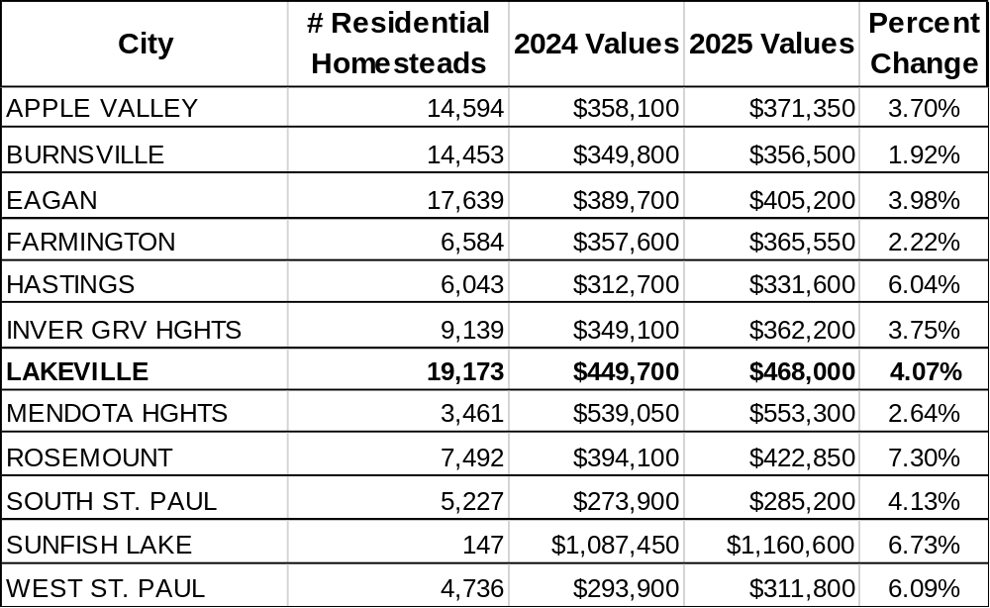
2025 Median Homestead Values
Notes:
New Slide
Definitions: # of Residential Homesteads: This report includes Homestead residences, townhouses and condominiums; but excludes properties that have new construction value added for Assessment Year 2025, Payable Year 2026.
Median values: The value of the middle item when all items are arranged (sorted) by size.
Percent of Change: The increase or decrease in the value over the preceding year value.

Slide 7
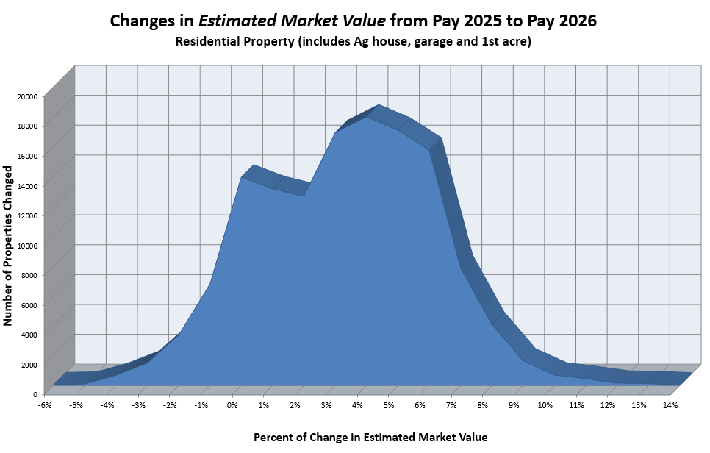
Changes in Estimated Market Value from Pay 2025 to Pay 2026
Notes:
This graph shows the total population of residential properties and the number that changed at each % interval
Value changes vary by city by NBHD by parcel
2025:
85.5% (115,543 of 136,706 properties) changed between 0% and 7%
92.5% (126,448 of 136,706 properties) changed between -1% and +8%
Bulk of changes primarily in the 2-5% range
Rosemount (6.04%), W.S.P. (5.71%), Hastings (5.42%) saw largest increases of larger cities.
Vermillion Township (11.28%) and Sunfish Lake (7.19%) saw the largest increases of the small cities &TWSP

Slide 8
2025 Market Value Summary
Apartments:
  -1.1% median decrease
    Lakeville -.65% median decrease
  1.06% aggregate increase
    4.0% aggregate Lakeville increase
  Includes $222.5 million of new construction
    7 new projects with approximately 1,400 units added
    Lakeville: $25.8M apartment new construction
    Authentix completed during 2024 with 252 units
Notes:
2025: Apartments had an aggregate change of 1.06%. The aggregate change included approximately $222 million in new construction compared with $250 million in 2024. Median population change of existing improved was -1.1%. 54,797 units 2025, 53,416 units 2024
New construction highlights: 7 new Apartment /Assisted Living projects with apx 1,400 units to be added (some incomplete for 2025). CW Total units: 54,797 (2.5% increase over 2024)
NC down -4.2% from 2024

Slide 9
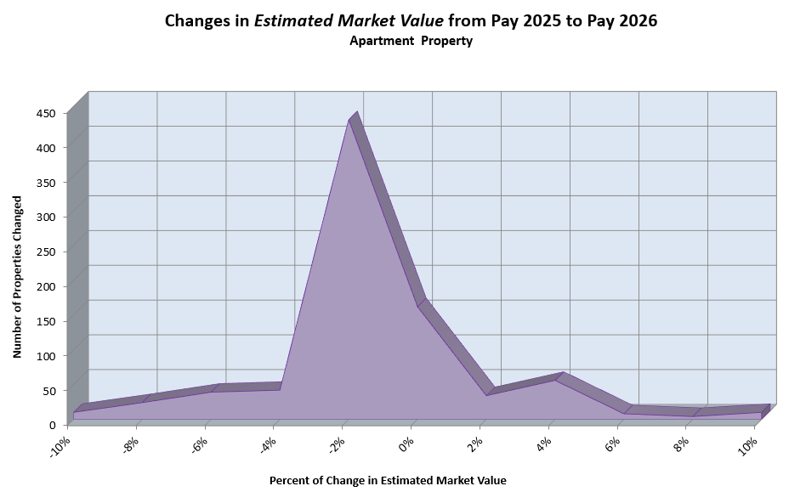
Changes in Estimated Market Value from Pay 2025 to Pay 2026
Notes:
2025:
Approximately 74% remained unchanged or received reductions up to 3%
The remaining 26% may have reductions or increases outside of these parameters (largely due to revaluation efforts)
Apartment – approximately 90% were between -6% - +4% changes in value

Slide 10
2025 Market Value Summary
Commercial: Median increase 3.6%
  Lakeville: Median increase 3.5%
Industrial: Median increase 7.15%
  Lakeville: Median increase 7.89%
  6.49% aggregate increase
  10.38% aggregate Lakeville increase
  Includes $100.6 million of new construction
    Lakeville $18.36 Million
    Commercial $48.3 million Lakeville $3.56M
    Industrial $52.3 million Lakeville $14.8M
Notes:
2025: C/I had an aggregate combined change of 6.49%. Changes vary by market segment, location and class of property. The aggregate change included approximately $100.6 million in new construction compared with $247.3 million in 2024. NC DOWN 55% COM, 62% IND.
New construction highlights:
META Data Center in Rosemount, just started for 2025, est. 750k sf when complete
RL Cold Storage Warehouse in Lakeville, currently U/C
Additional 30-unit industrial condo complex in Rosemount (37 complete for 2024)
Health Partners medical clinic in Apple Valley
Boulder Lakes Warehouse and two self storage facilities

Slide 11
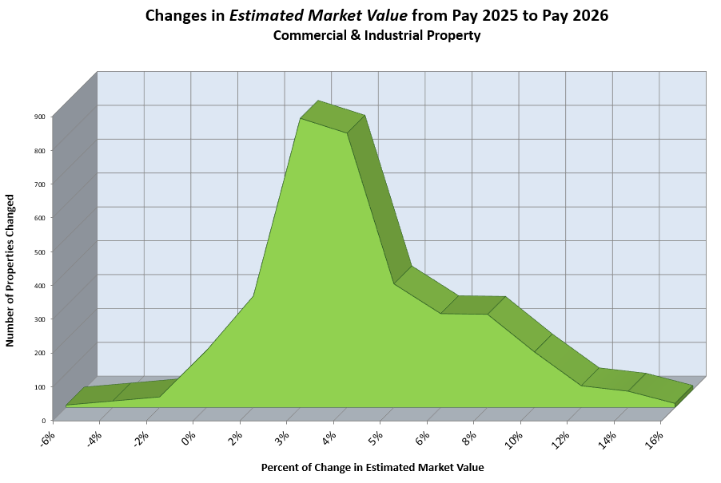
Changes in Estimated Market Value from Pay 2025 to Pay 2026
Notes:
2025:
Industrial sector generally ranged from 5 - 9% increases with Burnsville, Eagan, Farmington and Lakeville at upper end of this spectrum. Some properties may have received increases above this range due to current market conditions and strong industrial demand.
Commercial sector generally ranged from 2 - 5% increases (largest spike) with all jurisdictions generally within this range. Certain property types may have received increases above this range (smaller/mid-sized office, smaller retail/neighborhood center, service garages and some hotels) Some properties remained generally flat to slightly decreasing (corporate/large office, and some office condo’s). Of all combined Commercial/Industrial properties: Approximately 8% remain generally unchanged or saw decreases, approximately 64% saw increases of 1-6%, approximately 28% received increases of 7% or more
General value change percentages encompassing 90% of population:
Commercial – approximately 90% were between 0 – +11% increases
Industrial – approximately 90% were between +4 - +15% increases

Slide 12
2025 Market Value Summary
Agricultural:
    EMV increased approximately 8.45%
    Lakeville EMV increased approximately 2.3%
      Lakeville generally based on residential development highest and best use and valued significantly higher than typical township ag land
      Locally determined
    TMV increased approximately 5.31%
    Lakeville TMV changes were similar to county rates for Green Acres parcels
      Taxable values set by Department of Revenue
Notes:
2025:
Agricultural:
EMV increased approximately 8.45%
Tillable & Non-tillable increased 8.45%
TMV increased approximately 5.31% TMV (GA & Ag Preserve values set by the DOR)
Tillable & Non-tillable increased 5.31%
Weighted average per acre tillable $9,900, non-tillable $3,260
If not GA or Ag preserve the taxable change would be the same as the estimated change.

Slide 13
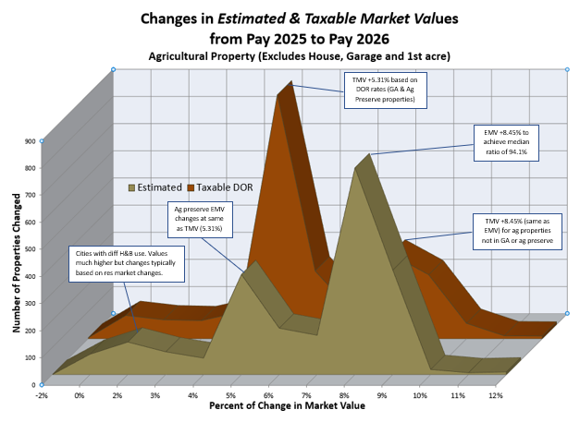
Changes in Estimated & Taxable Market Value from Pay 2025 to Pay 2026
Notes:
2025:
Ag Median Value Changes:
8.45% - highest peak represents the change in both tillable and non-tillable estimated ag values
5% peak includes Ag Preserve parcels (in which the DOR rate is used for both estimated and taxable)
0-5% would represent parcels in which ag is not the highest and best use. Most often valued as potential residential development, in which case the value would change based on res changes int hose areas.
Taxable (Green Acres, Ag Preserve) values are determined by the DOR and increased 5.31%
The 8.45% peak would represent ag properties not in either green acres or ag preserve, in which case they would have increased in-line with estimated values.

Slide 14
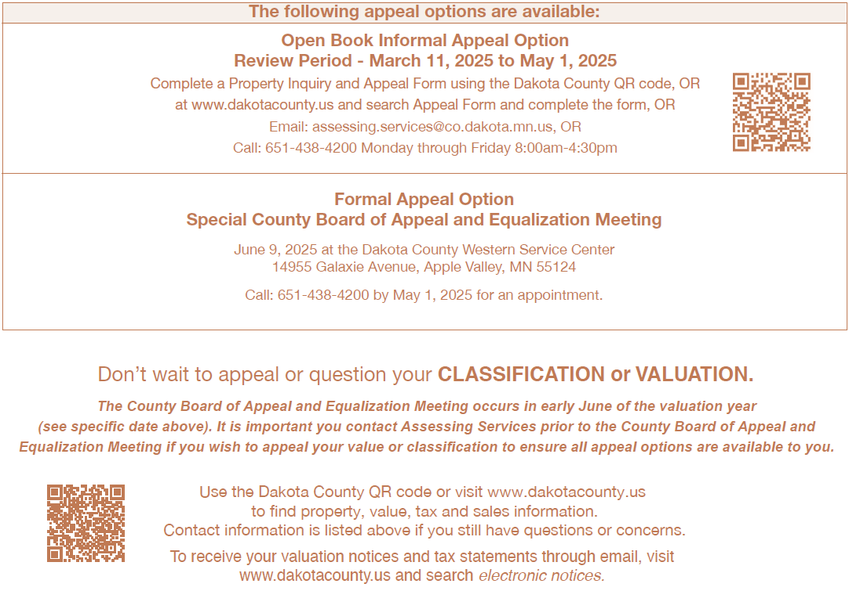
Value Notices / Appeal Methods
Minnesota Tax Court - File by April 30th of payable year
Notes:
168,700+ value notices & pay 2025 tax statements start mailing March 11th. Includes eNotices at 27,437 (6.6% increase over 2024)
We encourage taxpayers to visit online to review sale information and property records…….
Informal appeal Open Book, reach us Mon-Fri 8-4:30 by phone or email
Call out QR Code addition - We encourage the use of the online appeal form, many benefits for taxpayers and county staff.
2024 Assessment: approximately 719 appeals with 32% by Property Inquiry and Appeal Form – 226 CASES (March 2024 – June CB)
2023 assessment: approximately 1,151 appeals with 31% by Property Inquiry and Appeal Form - 353 CASES (March 2023 – June CB)
County Board June 9th
Any unresolved appeals will have option to appeal to the County Board of Appeal and Equalization, which is by appointment, June 9th
Call by May 1st for Appointment. Final appeal option is Tax Court File by April 30th of the Payable Year (4/30/2026)

