Slide 1
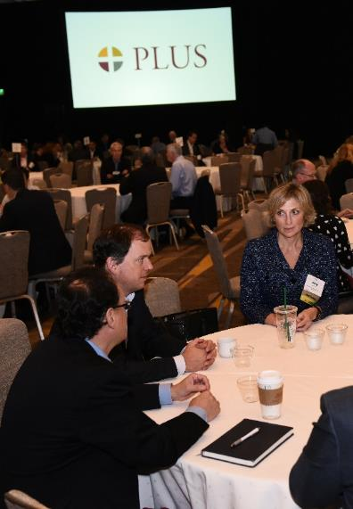

PLUS Conference Student Scholarship Program
Professional Liability Underwriting Society (PLUS) Conference
What: This scholarship pays for a student to attend the 2019 PLUS Conference on November 11 – 13 in Washington, DC.
Who: Full-time junior or senior undergraduate or a graduate students.
Recipients receive complimentary registration and travel expenses
Attend all keynotes and education sessions
Network at receptions and meet the Future PLUS Leadership Committee
Application Deadline: Friday, September 27
For eligibility and application requirements, visit:
http://plusweb.org/Community/Future-PLUS/Conference-Student-Scholarship-Program
Notes:
This program will provide education about the professional liability industry and issues facing underwriters, brokers and claims professionals for college or graduate students. Students will have the opportunity to learn from industry leaders in small group settings, by attending sessions, and by interacting with industry professionals in attendance.
Benefits for students participating in the PLUS Conference:
Networking with professionals in professional liability insurance (e.g. carriers, brokers) from all over the country
Gain industry insights which will be useful in future interviews
Experience to add to resume

Slide 2

About PLUS & The PLUS Conference
WHAT IS PLUS?
WHAT IS THE PLUS CONFERENCE?
PLUS is recognized as the primary source of professional liability educational programs and seminars, networking events, educational products, and information regarding professional liability.
PLUS Membership consists of over 7,000 individuals, representing over 1,000 companies active in the many fields of professional liability.
The PLUS Conference has been a staple in professional liability for over 30 years. This is the place where business is conducted, relationships are developed, and partnerships blossom for anyone in the professional liability industry.
The PLUS Conference is attended by professional liability Executives, Underwriters, Brokers, Attorneys, Risk Managers and anyone else in the PL insurance industry.
Additional Information about PLUS can be found at:
www.plusweb.org
Full Conference Information can be found at: www.conference.plusweb.org

