Slide 1
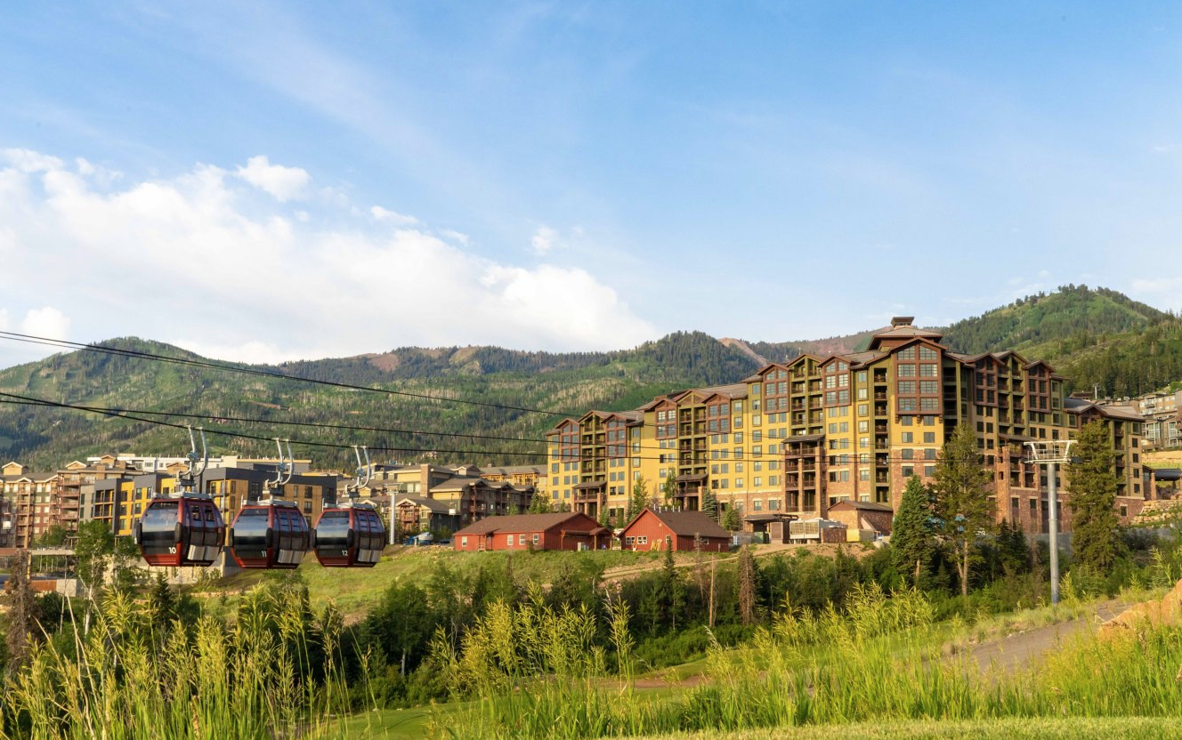
Vail Update
Ryan Pratt- Director, General Manager
Notes:
Record Season for Park City for Snowfall
Happy to extend our Season till May 1st

Slide 2
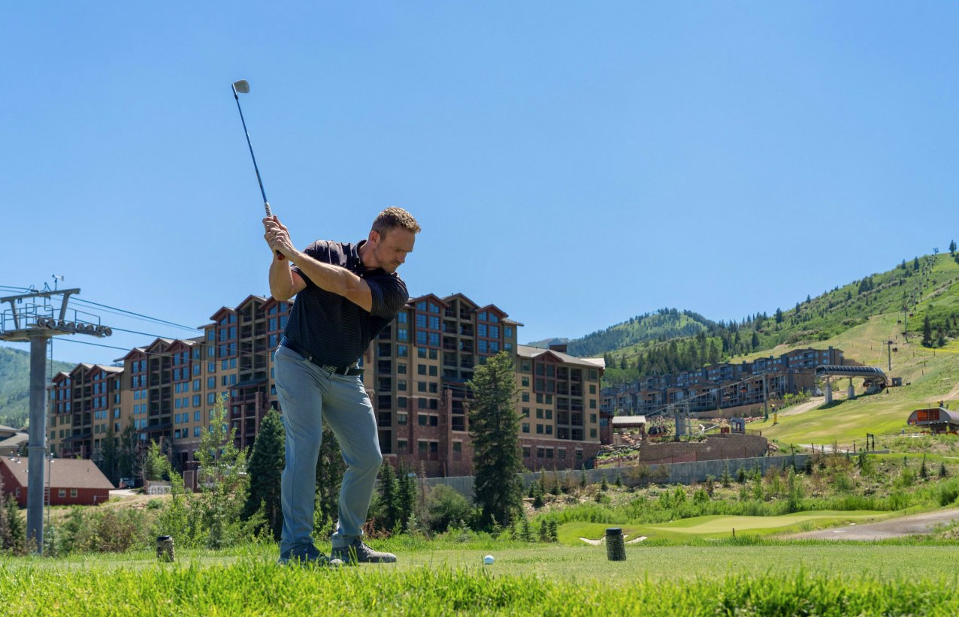
Summer at a Glance
Summer Activities have been activated with great feedback from our “Backyard” offerings including Mtn Biking, Hiking, and the Adventure Park at the Park City Mountain Village.
All RMA owners receive a daily comp summer chairlift and gondola scenic ride when owner card is presented to the ticket office.
Canyons Golf Course is in full swing for summer! Owners receive a discounted rate of $85 per round.
Notes:
Record Season for Park City for Snowfall
Happy to extend our Season till May 1st

Slide 3
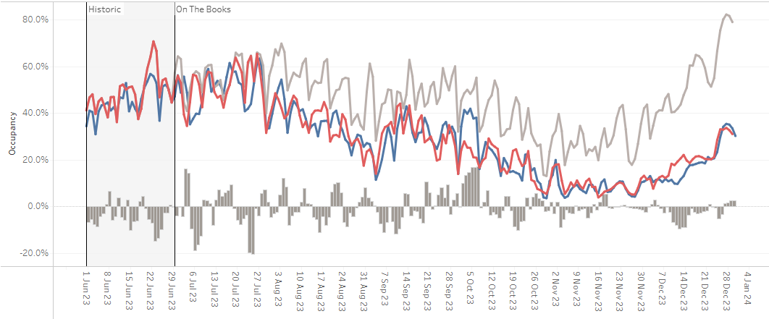
Park City Market Occupancy Snapshot
Notes:
Intro: this report reflects the entire Park City Market and these results were updated on 6/30/23.
Blue line reflects current occupancy, Red Line STLY, Grey Line: how we finished LY
A couple things to call out here: Occupancy is tight to STLY but slightly below with group really driving business
Further out most favorability lives between 9/16 and 10/7 – likely driven by Group business given that transient continues to follow short booking window trend
Early Booking window into Pre-Holiday is still to far out. However it will driven by School Calendars shifting more into January when compared to FY23.

Slide 4
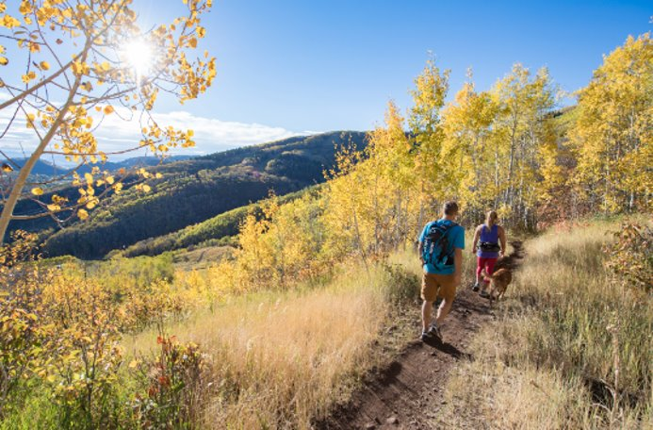
Operations Update
Continue to hear great feedback on the fitness center upgrade.
5 hour limit signs have been placed in the EV parking spots as a courtesy to all EV users.
All requests for 2023/2024 Owner Reservations are complete.
If any owners have not yet reserved, please do so ASAP on the Owner Portal.
IT improvements to the Owner Portal in the works with more to come.

Slide 5



Canyons Village Upcoming Events
Canyons Village Summer Concert Series
Select Thursday and Saturday nights trough August 31st
Big Stars, Bright Night Concert Series
parkcityinstitute.org/bsbn
Free Outdoor Yoga
Every Friday and Saturday at 9am in Canyons Village through August 12th
Park City Farmers Market
Every Wednesday, 11am – 5pm, in the Cabriolet Lot through Oct. 18th
Notes:
Lots of great activities in the Canyons Village to kick off Summer from the CVMA

Slide 6
Grand Summit Team
Ryan Pratt- Director, General Manager
ryan.r.pratt@vailresorts.com
Tiffaneelee Torres- Director of Rooms
tltorres@vailresorts.com
Donna Sheeran- Owner Relations Manager
donna.d.sheeran@vailresorts.com
Bridget Bull- Front Office Manager
bridget.bull@vailresorts.com

