Slide 1
State of the Industry
The Green Industry in 2026 — A Five-Year Look Back
Dr. Charlie Hall, Chief Economist
Notes:
Cultivate 2026 opener — five-year look back, three data sources.

Slide 2

End Consumer
(residential & institutional)
IGC’s
Box stores
Landscape
Service Providers
E-commerce
Re-wholesalers
Nursery & Greenhouse
Firms
Allied Trade
Structures, tools, equip &
Machinery
Plant protection products
Oil, fuel, & other petroleum
products
Wrappings,
Containers,
Labels,
Irrigation
Paper products:
(Catalogs; signs; packaging)
Peat & Bark products
Breeders
Propagators
Brokers

Slide 3
GROWERS
The pandemic reset has held for growers
Growers reporting gross sales up more than 25% vs. pre-pandemic 2019
63%
59%
64%
69%
59%
2022
2023
2024
2025
2026
• Roughly 6 in 10 growers are up more than 25% vs. 2019 — in every survey.
• The higher plateau is simply the new normal… until recession.
Source: EAGL & YMM grower pulse survey, 2022–2026
Notes:
The pandemic step-change held — ~60% up >25% vs 2019 every year.

Slide 4
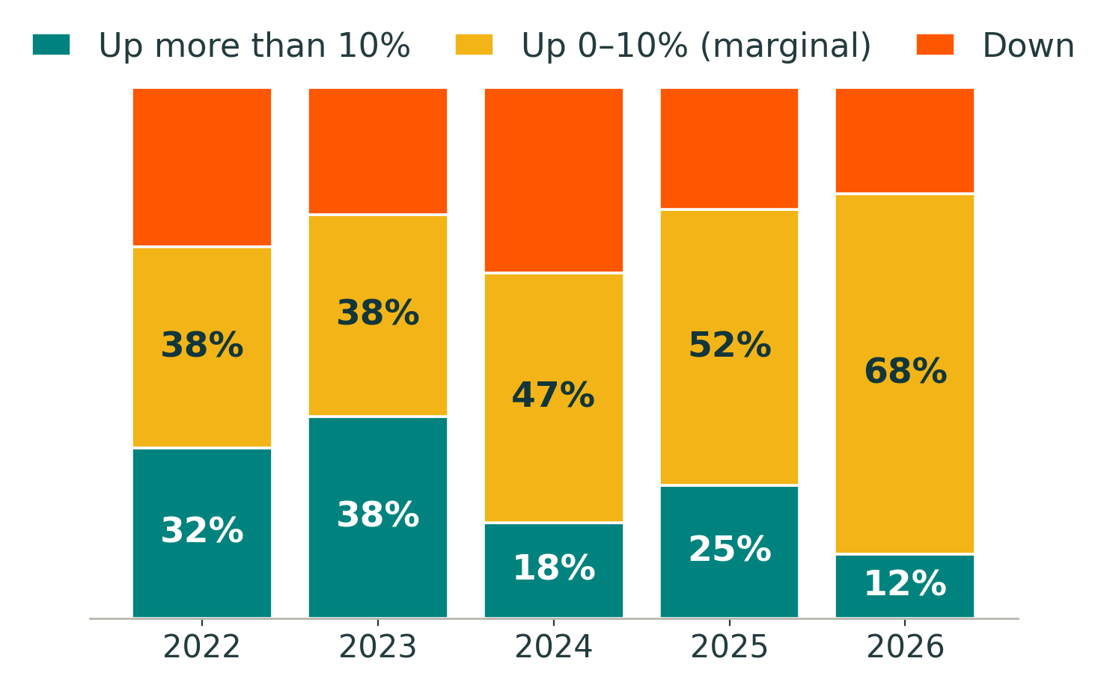
GROWERS
Growth has decelerated
Strong (>10%) growth: 38% of growers in 2023 → just 12% in 2026 — now it’s price, not volume
Source: EAGL & YMM grower pulse survey, 2022–2026
Notes:
Growth normalized; what remains is mostly price.

Slide 5
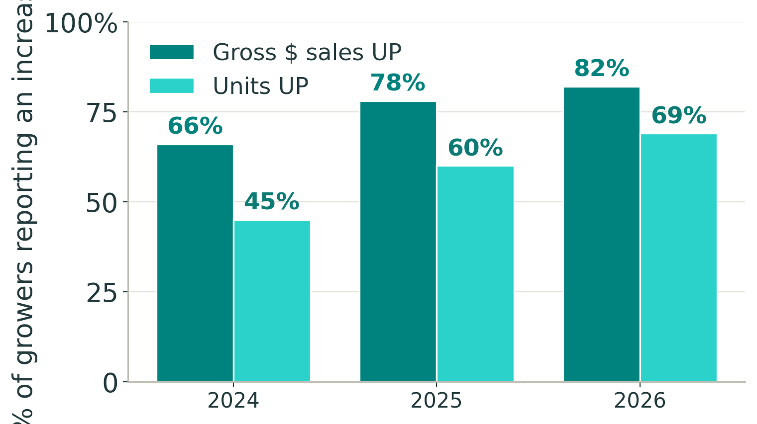
GROWERS
Dollars up. Units flat.
In 2024, 66% of growers grew dollars but only 45% grew units — price carried the difference
Source: EAGL & YMM grower pulse survey, 2024–2026
Notes:
Dollars and units diverge once we can measure units. Pause on 2024.

Slide 6
GROWERS
In their own words
Four themes recur every single year
WEATHER
THE TRADE-DOWN
“This season has felt like a bare-knuckle boxing match most days.”
“Consumers gravitated to lower-priced items — which has eroded our margins.”
— Upper Midwest grower
— Wholesale grower
TARIFFS
THE SAWTOOTH
“We saw a profound sales drop when the worldwide tariffs were announced.”
“Profitable in odd years, unprofitable in even ones — we lost money in 2024.”
— Grower, 2025
— Nursery operator
Notes:
Grower voices — weather, trade-down, tariffs, the sawtooth.

Slide 7
STATE OF THE INDUSTRY
The Financials
Notes:
Section: the audited financials.

Slide 8
THE FINANCIALS
What the financials confirm
67 firms · full-year results, 2021–2025 — revenue up, margins compressed
+30%
31.5%
6.4%
10.3%
Net sales growth
Gross margin (−3.7 pts)
Operating margin
ROIC ≈ cost of capital
• Gross margin down 3.7 pts since 2021; operating margin still below 2021 (9.3%).
• ROIC of 10.3% sits right at the cost of capital — value creation is thin.
Source: YMM All-Firms Cohort Performance Review, FY2025 (N = 67), Texas A&M University
Notes:
Revenue up, margins compressed; ROIC ~ cost of capital.

Slide 9
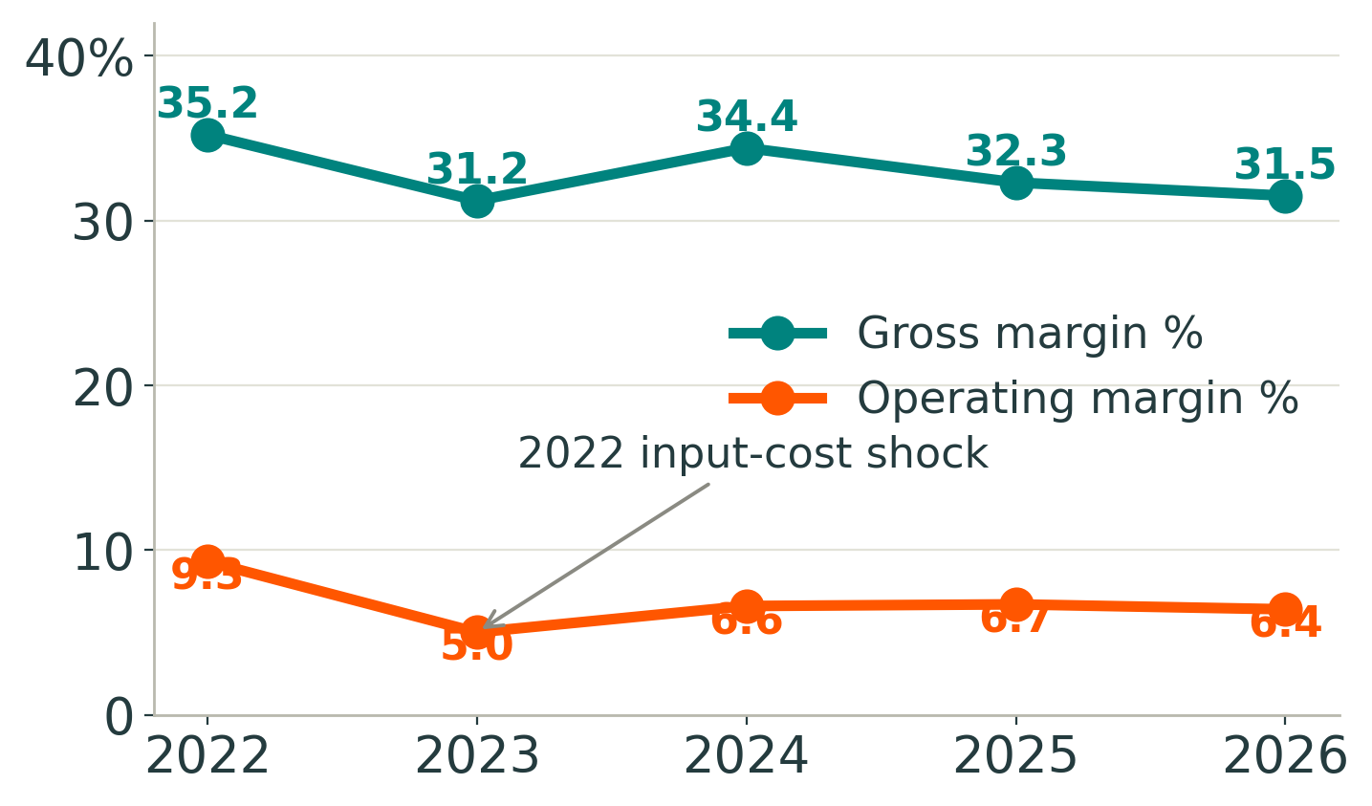
THE FINANCIALS
Costs are the binding constraint
COGS rose from 64.8% to 68.5% of sales; the 2022 shock halved operating margin
Source: YMM All-Firms Cohort Performance Review, medians (N = 67)
Notes:
2022 shock; recovery incomplete. Costs are the constraint.

Slide 10
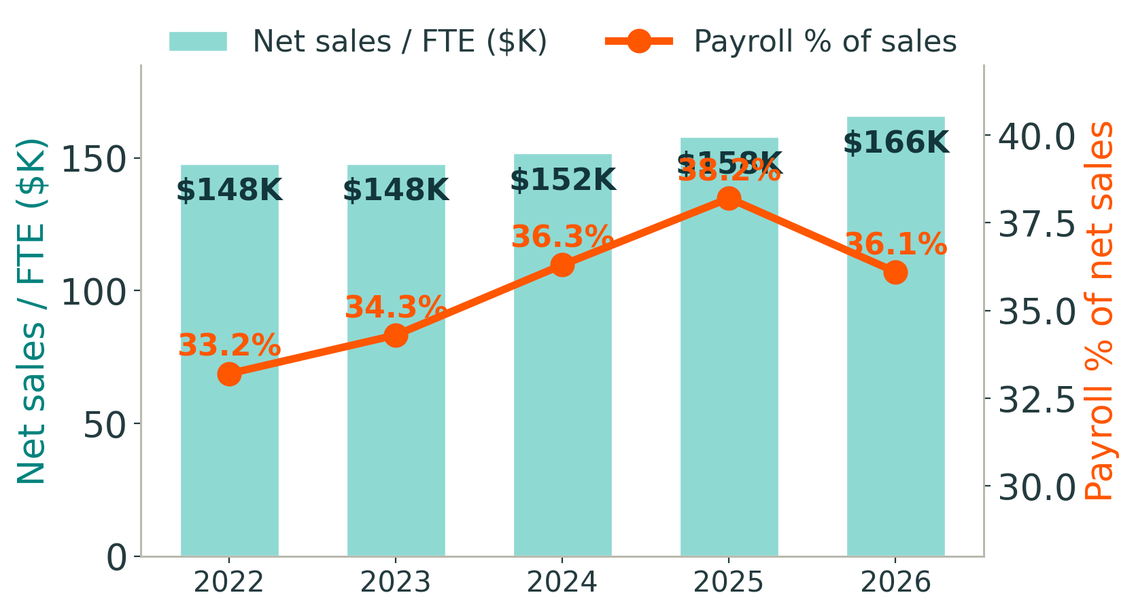
THE FINANCIALS
Wages are outrunning productivity
Sales per employee up ~12%, but payroll rose from 33.2% to 36.1% of sales
Source: YMM All-Firms Cohort Performance Review, medians (N = 67)
Notes:
Productivity up ~12%, payroll up ~3 pts.

Slide 11
STATE OF THE INDUSTRY
The Retail Counter
Notes:
Section: the retail register.

Slide 12
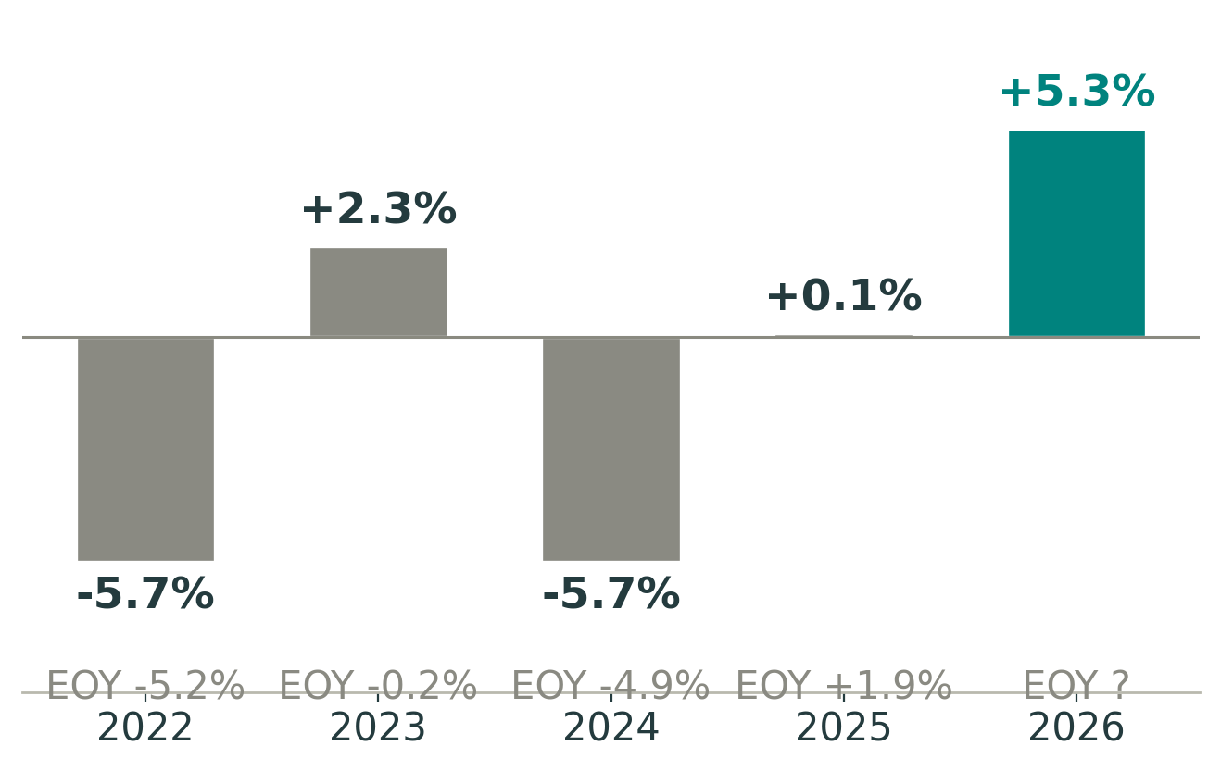
THE RETAIL COUNTER
The consumer is back in 2026
+5.3% YTD across 104 centers — the strongest mid-year in five years
Source: Garden Center Group, Weekly Data Report, Week 26 (95 of 104 centers)
Notes:
2026 is the best mid-year in five years, +5.3%.

Slide 13
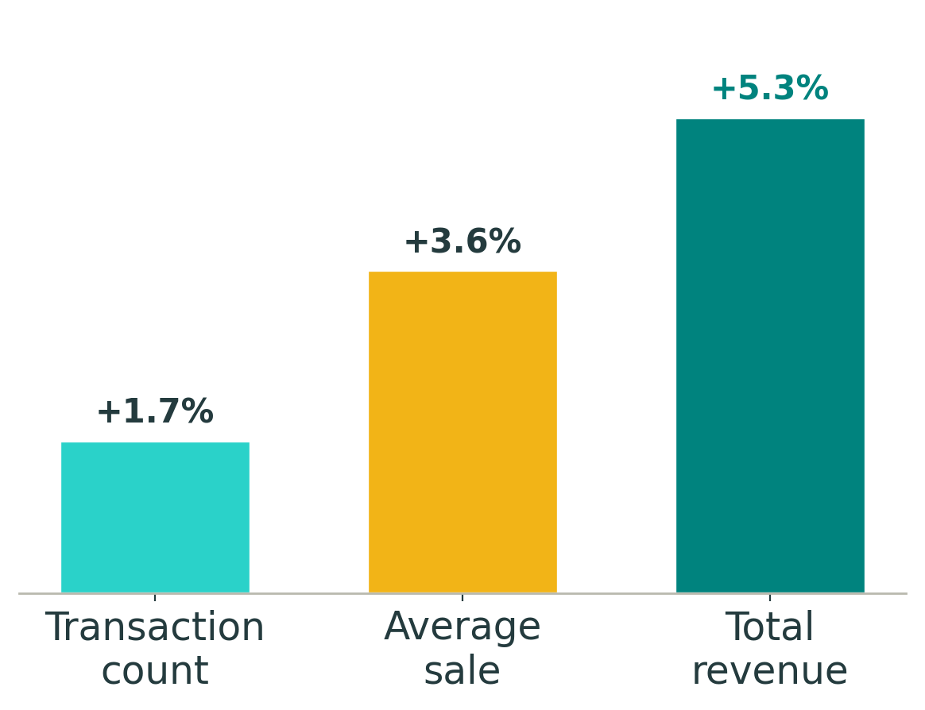
THE RETAIL COUNTER
Even the recovery is price-led
Average sale is up +3.6%, but transactions only +1.7% — ticket beats traffic
Source: Garden Center Group, Weekly Data Report, 2026 YTD
Notes:
Ticket-led, not traffic-led. Watch traffic.

Slide 14
The state of the industry, in one breath
GROWERS
Dollars creep up on price; units are flat. The 2019 reset held.
THE FINANCIALS
Revenue up ~30% since 2021, but margins carry all the stress.
THE RETAIL COUNTER
Demand is recovering in 2026 — led by ticket, not traffic.
The reset held — but we’ve entered a slower, price-led normalization: units flat, margins stressed, weather and tariffs the volatility.
Notes:
Synthesize the industry; bridge to the economy.

Slide 15
THE OUTLOOK
The Economy & the Outlook
Notes:
Part 2: the macro backdrop and outlook.

Slide 16
THE ECONOMY
Charlie’s Snapshot
My one-paragraph read — as of July 2, 2026
The economy is running in place — GDP at 2.1%, activity slightly negative, sentiment cratered at 44.8 even as real disposable income is up 6.3%. People have money but they’re spooked. Labor is solid (unemployment 4.2%, claims 215K), yet 61.5% participation means the shortage isn’t resolving. I put recession odds under 20% — but this feels like treading water, not momentum.
For operators, the mixed signals create openings: building-material & garden sales +7.5%, existing-home sales up, remodeling index at 62 — the hay is out there. But input costs stay high (grower index 173, diesel $4.67) while big-box comps limp at 0.6%. This is a margin-defense moment: hold pricing discipline, watch labor as the new H-2A rule resets your wage floor, and don’t chase volume with discounts when confidence is this fragile.
Source: Hall, Green Industry Economic Dashboard — Snapshot, July 2, 2026
Notes:
Charlie’s Snapshot — my one-paragraph read. Treading water.

Slide 17


THE ECONOMY
The dashboard at a glance
Consumer demand, input costs and labor are flashing red — the caution is real, but it’s not yet a contraction.
Notes:
Dashboard at a glance — consumer/costs/labor red. Read for convergence.

Slide 18
THE ECONOMY
What’s going on with consumers?
• Cost of living is still the #1 worry — sentiment has cratered to 44.8.
• Higher-for-longer rates are biting housing and big-ticket demand.
• Spending holds up — funded by savings drawdown and transfers, not rising real income.
• The gap between how we FEEL and how we SPEND is the whole story.
Notes:
What is going on with the consumer?

Slide 19
THE ECONOMY
How we feel ≠ how we spend
Households keep spending — by drawing down savings, even as confidence craters
44.8
+6.3%
3.0%
Consumer sentiment (U. Michigan)
Real disposable income
Personal savings rate
• Nominal spending is up ~6.3%, but real income ex-transfers is negative — the cushion is thinning.
• I put it 60/40 this pace softens over the next two quarters once savings run down.
Source: Hall, Green Industry Economic Dashboard, July 2, 2026 (BEA, U. Michigan)
Notes:
Feel vs spend — sentiment 44.8, spending on a thinning cushion.

Slide 20
THE ECONOMY
Inflation is sticky — and above target
Energy from the Iran conflict pushed prices up; the June ceasefire is easing them
3.4%
3.6%
2.0%
PCE inflation, May (YoY)
Fed’s 2026 projection
Fed’s target
• Input costs stay elevated for growers — the margin squeeze isn’t over.
• Watch energy: the ceasefire holding is the swing factor for H2.
Source: U.S. BEA; FOMC Summary of Economic Projections, June 17, 2026
Notes:
Inflation sticky ~3.4%, above the 2% target. Energy drove it.

Slide 21
THE ECONOMY
The Fed: higher for longer
New Chair Kevin Warsh has tilted hawkish — the dot plot now hints at a hike, not a cut
3.50–3.75%
3.8%
3.0%
Fed funds rate (held 4×)
Dot-plot year-end 2026
Long-run neutral
• Markets price little-to-no easing this year — don’t budget on cheaper money in 2026.
• The cost of carrying inventory and debt stays high.
Source: Federal Reserve FOMC statement & projections, June 17, 2026
Notes:
The Fed higher-for-longer; Warsh hawkish; a hike is on the table.

Slide 22
THE ECONOMY · YOUR CALL
The rate call
— your forecast —
Last year you called 25-bp cuts in September and December, then two more in 2027.
The June 2026 dot plot flipped hawkish — the median now points to a possible hike.
What’s your updated 2026–2027 path? ▶ Drop your call here.
Notes:
MY RATE CALL — insert my updated 2026–27 path here.

Slide 23
THE ECONOMY
Housing: resale churn, not new builds
New construction is cautious; the action is homeowners reinvesting where they are
1.18M
6.43%
62
Housing starts
30-yr mortgage
NAHB remodeling index
• Residential investment fell 2.9% and starts are muted — new-build landscape work stays soft.
• Rate-locked owners remodel instead of moving — refresh demand: mulch, replacements, outdoor living.
Source: Hall, Green Industry Economic Dashboard, July 2, 2026 (Census, NAHB, Freddie Mac)
Notes:
Housing: resale churn, not new builds; refresh work is the bright spot.

Slide 24
THE ECONOMY
The green-industry read
Demand is intact; the squeeze is margin, not sales
$63.8B
+7.5%
+0.6%
Consumer spending on plants
Building-material & garden sales
Big-box comp sales
• The demand story holds — people are still buying, and refresh work is strong.
• But near-record input costs against 0.6% big-box comps = margin-compression territory.
Source: Hall, Green Industry Economic Dashboard, July 2, 2026 (BEA, Census)
Notes:
The green-industry read — demand intact ($63.8B), margin squeezed.

Slide 25
THE ECONOMY
Labor: still tight at the edges
Hiring cooled, but employers aren’t letting people go — and the pool isn’t refilling
4.2%
215K
61.5%
Unemployment
Initial claims
Participation rate
• Job openings ~7.6M — still ~1.2 per unemployed worker, historically elevated.
• Low participation keeps competition for workers firm (the wage story is in the cost section).
Source: Hall, Green Industry Economic Dashboard, July 2, 2026 (BLS, DOL)
Notes:
Labor still tight at the edges; participation stuck at 61.5%.

Slide 26
THE ECONOMY
Recession risk: low, but not zero
Close, but not yet — this feels like treading water, not momentum
< 20%
~15%
0.10
My recession-odds call
NY Fed yield-curve model
Sahm Rule (0.50 = trigger)
• Financial stress is low and claims are contained — no contraction signal yet.
• Base case: growth cruises near ~2%, not a downturn.
Source: Hall, Green Industry Economic Dashboard, July 2, 2026; NY Fed
Notes:
Recession risk under 20%; close, but not yet.

Slide 27
INPUT COSTS
What’s moved since Q1
Six inputs, three directions — and a July collision
Labor (H-2A)
DOWN
New OEWS-based AEWRs cut the benchmark; state minimums now bind
Fuel / Diesel
DOWN
May $5.60 peak easing; crude back to the mid-$70s
Freight
UP
Supply-led upcycle; spot rates at multi-year highs
Fertilizer (N)
MIXED
Spring spike unwinding; 2027 cost risk remains
Tariffs
UP
IEEPA struck; a 122 bridge hands to a 301 rebuild — no net relief
Energy risk
ELEVATED
Hormuz risk premium not yet fully cleared
Bottom line: July is the convergence point — 122 sunsets, first 301 determinations land, and new H-2A wages take effect, within days.
Source: DOL, EIA, USDA NASS, USTR, Cass; YMM analysis, June 2026
Notes:
Input-cost scorecard — what moved since Q1. July convergence.

Slide 28
INPUT COSTS
Your 2026 cost outlook: +3.6%
A tug-of-war — energy & freight pull up, a decelerating wage rule pulls down
+3.6%
42.9%
+2.5–4.4%
2026 forecast (was +5.2% in March)
Labor’s share of the basket
2027 preliminary range
• Energy and freight pulled costs up; a re-written federal wage rule pulled labor down.
• A 3.6% increase you fail to pass through is 3.6% straight out of an already-thin margin.
Source: Hall, Index of Prices Paid by Growers — Mid-Year Supplement, June 18, 2026
Notes:
The headline: +3.6% in 2026. Labor-vs-energy tug-of-war.

Slide 29
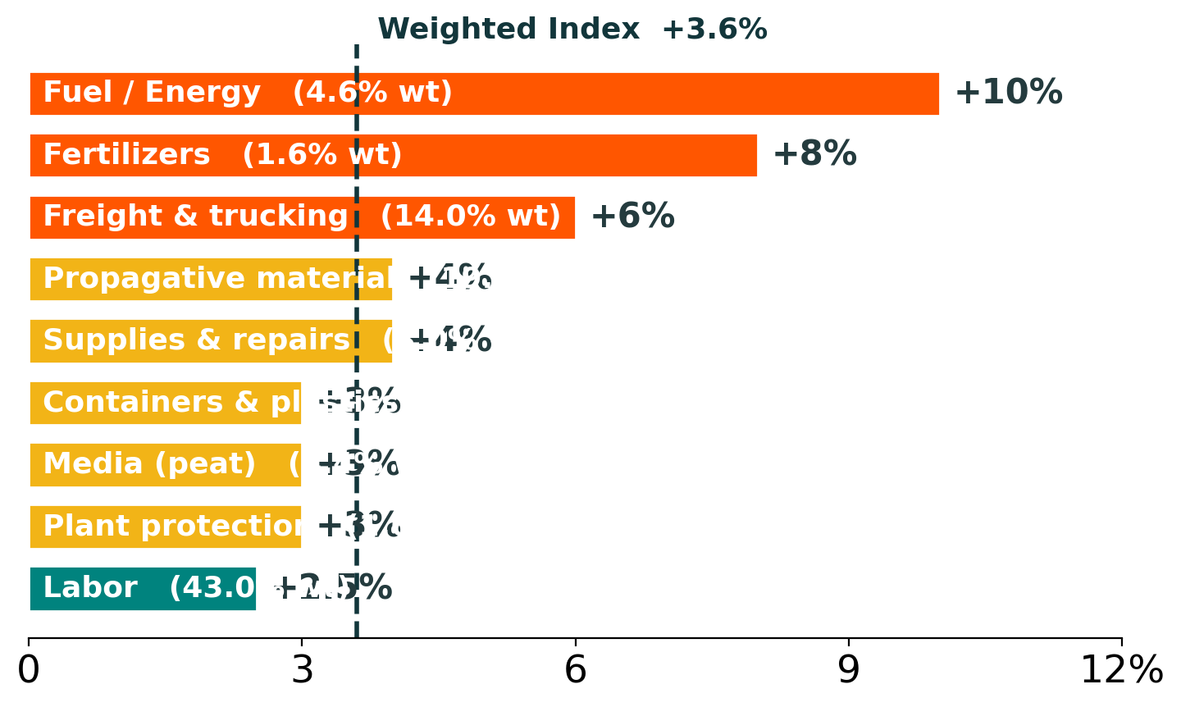
INPUT COSTS
The Index, line by line
Fuel, fertilizer and freight lead; labor — 43% of the basket — finally slows
Source: Hall, Index of Prices Paid by Growers, Mid-Year Supplement 2026
Notes:
The Index line by line — fuel/fert/freight lead; labor slows.

Slide 30
INPUT COSTS
Why labor finally stopped roaring
One Farm Labor Survey rate became two OEWS skill tiers — and ~92% of jobs price at Level I
Level I
Level II
+2.5%
Entry · 17th pctile · ≈ $13.70
Experienced · occupation mean
Net labor cost, 2026 (was +4–7%)
• The old single ~$17.43 rate split into two; DOL expects the vast majority to land at the lower Level I.
• State minimums (CA, FL, +6) bind and enforcement tightens supply; ~70% the rule survives 2026.
Source: U.S. DOL (OEWS-based AEWR IFR, Oct 2, 2025); Hall, Index of Prices Paid Supplement, 2026
Notes:
Why labor stopped roaring — the H-2A rewrite. Make the two-tier point: one FLS rate became two OEWS AEWRs — Level I (entry, 17th pctile, ~$13.70) where ~92% of jobs land, and Level II (experienced, occupation mean, higher). Net labor +2.5%; ~70% the rule survives 2026.

Slide 31
INPUT COSTS
Energy, fertilizer & freight: pulling up
Spot prices normalized — but the 2026 annual average still carries the spring spike
+10%
+8%
+6%
Fuel / energy, 2026
Fertilizer (N), 2026
Freight, 2026
• Brent hit $120+ then fell near $72 — but urea ran +42% and diesel touched $5.60.
• Freight flipped to a supply-led upcycle — the second-biggest reason the Index isn’t falling.
Source: Hall, Index Supplement & EAGL Quarterly Outlook, June 2026
Notes:
Energy, fertilizer & freight — spike lives in the 2026 average.

Slide 32
INPUT COSTS
The tariff wall, rebuilt — and the 2027 fork
The legal basis changed, not the burden; July is the hinge
FEB 20
FEB 24
JULY
Supreme Court strikes the IEEPA tariffs (6–3) — the basis, not the goal
A temporary Section 122 bridge fills the gap; USMCA & 232 goods exempt
122 sunsets; the country-by-country Section 301 rebuild begins
+2.5% · orderly path
+4.4% · harder path
Section 122 lapses into a clean 301
Heavier 301 duties on key origins
~55/45 in favor of the orderly path — the biggest known unknown for your 2027 budget.
Source: SCOTUS (Learning Resources v. Trump); USTR; Hall, Index Supplement 2026
Notes:
The tariff fork — 122 to 301; July hinge; two 2027 paths.

Slide 33

RESOURCES
Go deeper: the live dashboard
For EAGL firms — the Index and benchmarks, updated between editions
eaglnetwork.com/dashboards/
green-industry
EAGL members — log in to explore the
Index, cost lines, and cohort benchmarks live.
Notes:
The live dashboard — for EAGL firms (members only).

Slide 34
THE PLAYBOOK
How Should Firms Respond?
Notes:
Part 3: what firms should do.

Slide 35
RESPOND
1 · Track your trade-area analytics
One year of negative YoY comps doesn’t tell the whole story
• Performance is mixed and regional — your market is not the national number.
• Track customer counts and average sale in YOUR trade area, over time.
• Decide from your own data, not the headlines.
Notes:
Move 1: track your own trade-area analytics.

Slide 36
RESPOND
2 · Close the margin gap
The distance between bottom- and top-quartile firms is enormous — and closeable
24% vs 45%
1% vs 13%
Gross margin: P25 vs P75
Operating margin: P25 vs P75
• Pricing discipline and product mix are the biggest levers you control.
• Benchmark to the P75 — that gap is your profit-improvement roadmap.
Source: YMM All-Firms Cohort Performance Review, 2025 (N = 67)
Notes:
Move 2: close the P25–P75 margin gap — the money slide.

Slide 37
RESPOND
3 · Price to your value, not your cost
Your floor is total cost; your ceiling is your customer’s willingness to pay
68.5%
36.1%
COGS as % of sales
Payroll as % of sales
• Floor: every Index tick raises your cost — document it line by line and pass it through.
• Ceiling: don’t stop at cost-plus — the green industry is recession-resistant. Price to your value.
Source: YMM All-Firms Cohort, 2025; Hall, Index of Prices Paid Supplement, 2026
Notes:
Move 3: price to your value — floor is cost, ceiling is value.

Slide 38
RESPOND
4 · Manage your working capital
Inventory is backing up — “Covid-era plans in a post-Covid market”
85 → 107
5–10%
Working-capital days, 2021→2025
Production cuts some growers plan
• SKU-rationalize — free the cash tied up in slow movers.
• Lean working capital lifts ROIC without touching the top line.
Source: YMM All-Firms Cohort; EAGL/YMM survey, 2025–2026
Notes:
Move 4: manage working capital; SKU-rationalize.

Slide 39
RESPOND
5 · Defend your value proposition
Where the consumer is spending, and where they’re not
• Consumers traded down — lean into value ($10–$15) winners.
• Natives, innovation, and experience are where the growth is.
• Don’t chase price on premium the market won’t pay.
• Protect the brand and the relationship, not just the transaction.
Notes:
Move 5: defend your value proposition.

Slide 40
Homework: five moves for the back half
1. Track your trade-area analytics — not the national headline.
2. Close the margin gap — benchmark to the P75.
3. Price to your cost floor — before spring 2027.
4. Manage working capital — SKU-rationalize the overhang.
5. Defend your value proposition — lean into value and natives.
The reset held. Growth is slower and price-led. Manage what you control — margin, cash, and your value.
Notes:
Homework recap — five moves; end on value.

Slide 41

We Want Your Feedback!
Review this session at
Cultivate.cnf.io
Scan the QR code:
1) Open the camera app on your device
2) Point the camera at the QR code
3) Tap the web link
Notes:
Feedback — scan and review.

Slide 42
Do Not Copy, Post, or Distribute
This work may not be reproduced, modified, publicly displayed or distributed in any form by any means without express written permission of AmericanHort and the presenter. To secure permission, please contact AmericanHort.
Presentation Disclaimer
Presentations are intended for educational and informational purposes only and do not replace independent professional judgement. Statements of fact and opinion expressed are those of the presenters individually and, unless expressly stated to the contrary, are not the opinion or position of AmericanHort, its cosponsors, or its committees. AmericanHort does not endorse or approve, and assumes no responsibility for the content, accuracy or completeness of the information presented. Attendees should note that sessions are recorded and may be published in various media, including print, audio and video formats without further notice.
This presentation and its contents are provided “AS IS” without warranty of any kind, either express or implied, including, but not limited to, the implied warranties of merchantability, fitness for a particular purpose, or non-infringement.
Notes:
Required AmericanHort copyright + disclaimer.

