Slide 1
MALDIVES
CAVE DIVING
ACCIDENT

Slide 2
MALDIVES DIVING ACCIDENT
Lots of bad info
You may not know
what you think
you know

Slide 3
MALDIVES DIVING ACCIDENT
Sources
of info

Slide 4
MALDIVES DIVING ACCIDENT
5 divers died
1 rescue diver died
Criminal investigations
in both Maldives and Italy

Slide 5
MALDIVES DIVING ACCIDENT
Rescue diver “military-trained”
Dove single AL80 tank
With other rescuers
All found first body
Didn’t exit cave
Found unconscious inside, brought up
Died at hospital
C.O.D. – Decompression sickness

Slide 6
MALDIVES DIVING ACCIDENT
Rescue diver “military-trained”
Dove single AL80 tank
With other rescuers
All found first body
Didn’t exit cave
Found unconscious inside, brought up
Died at hospital
C.O.D. – Decompression sickness

Slide 7
MALDIVES DIVING ACCIDENT
Difficulty
of determing
definitive
cause-of-death

Slide 8
MALDIVES DIVING ACCIDENT
25 divers on the boat
5 in dive party
6th person chose not to dive
Maldives depth limit is 30m (100ft)
Cave entrance is 50m (165ft)
Chamber #1 is roughly 30m long (100 feet)
Chamber #2 is pitch black, also 100 feet long
No Chamber #3, but a dead end side area in #2,
1 diver found in tunnel between #1 and #2
4 divers found in side dead end (#2)

Slide 9
MALDIVES DIVING ACCIDENT
Level of diver certification
Was this the plan? (6th diver)
Size of their tank (80cf or 12L?)
Tanks filled to what pressure
Diving on air, nitrox, or tri-mix??
Gas left in the tanks when recovered
Did they have lights and lines
Had any of them been there before
Why were they separated
Complete background and history

Slide 10
MALDIVES DIVING ACCIDENT
Out-of-air
Nitrogen narcosis
Oxygen toxicity
2.0atm – 284’
1.6atm – 221’
1.4atm – 189’
Can you test for out-of-air?
Can you test for oxtox or narcosis at autopsy?
Can you test for panic at autopsy?

Slide 11
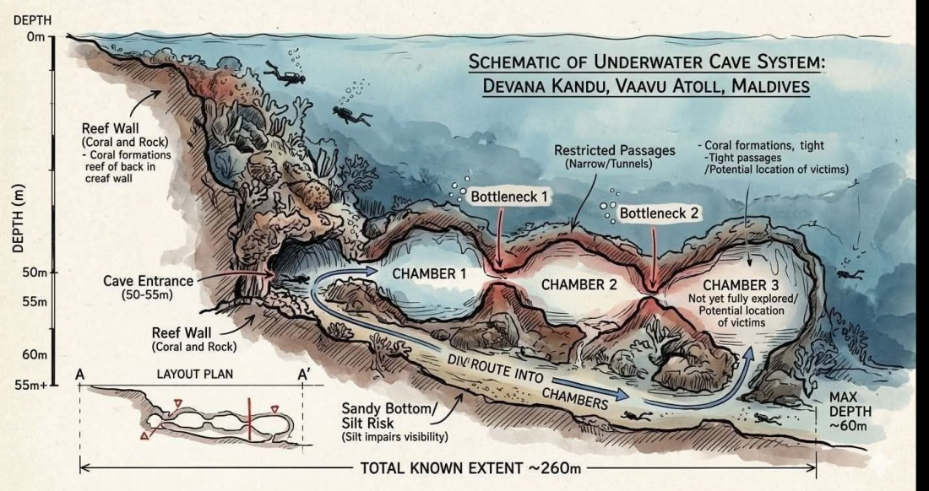
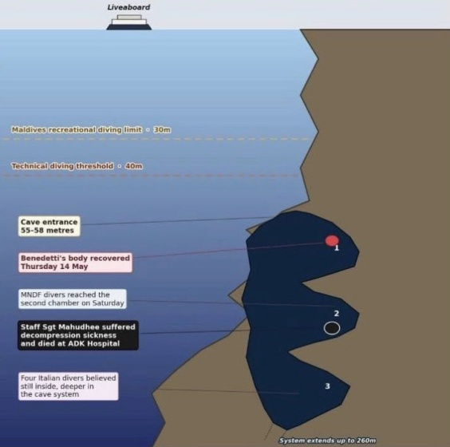
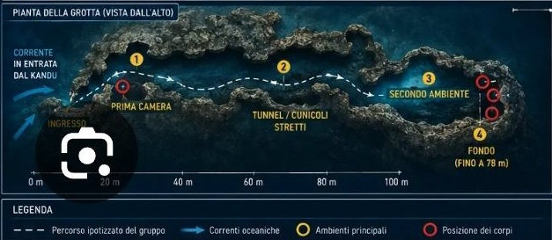
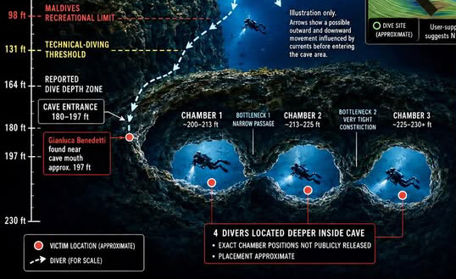
MALDIVES DIVING ACCIDENT
INACCURATE MAPS (AI-GENERATED)

Slide 12
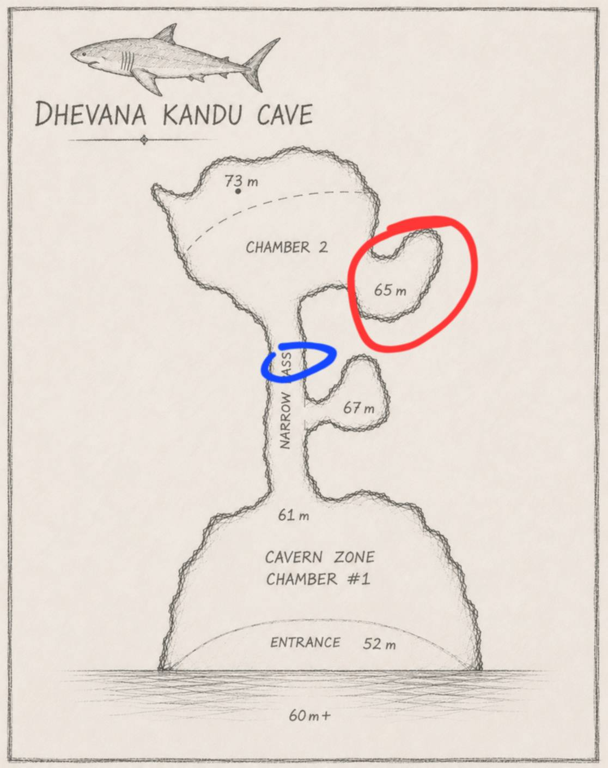
MALDIVES DIVING ACCIDENT

Slide 13
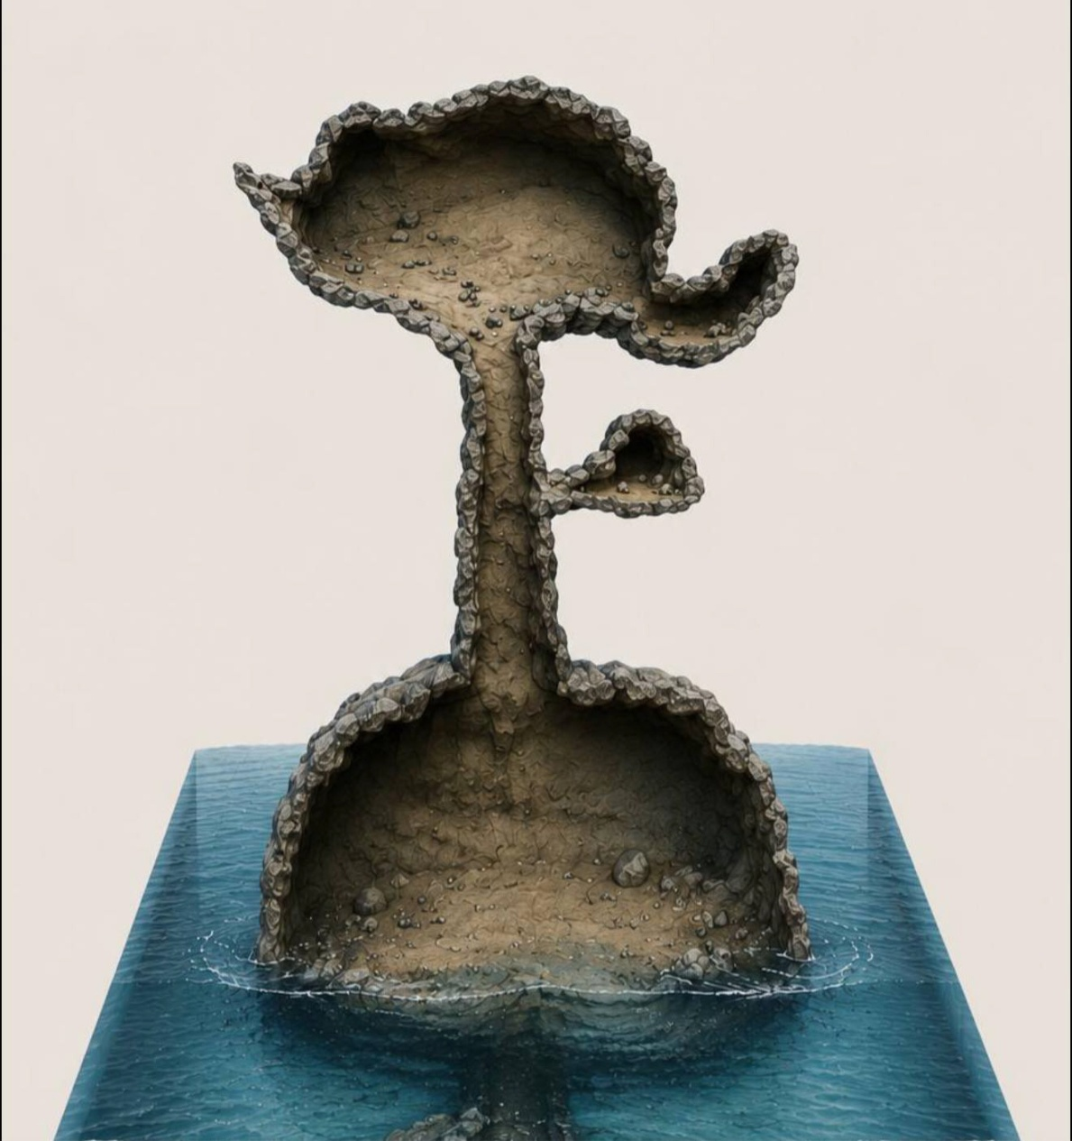
MALDIVES DIVING ACCIDENT

Slide 14
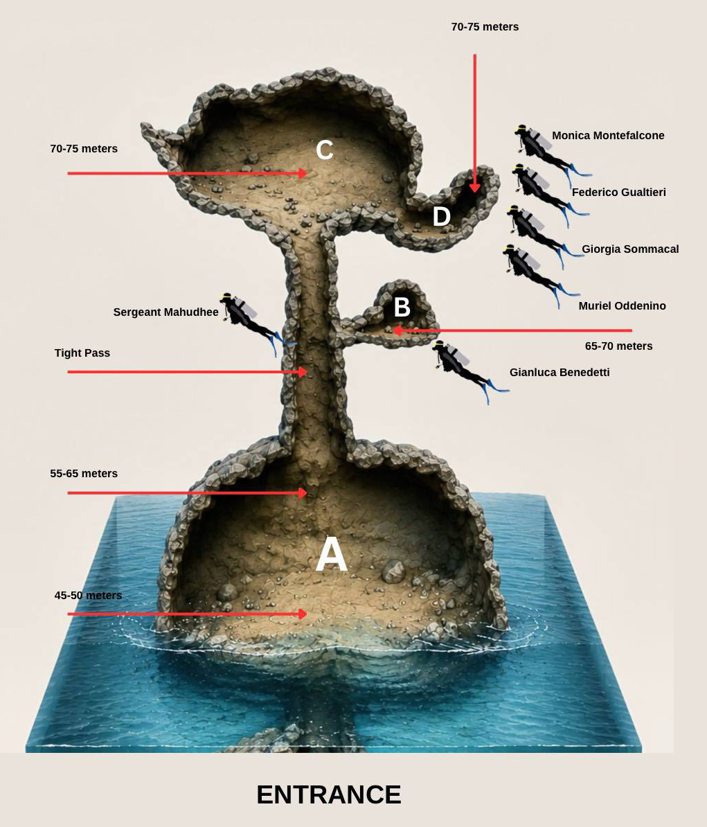
MALDIVES DIVING ACCIDENT

Slide 15
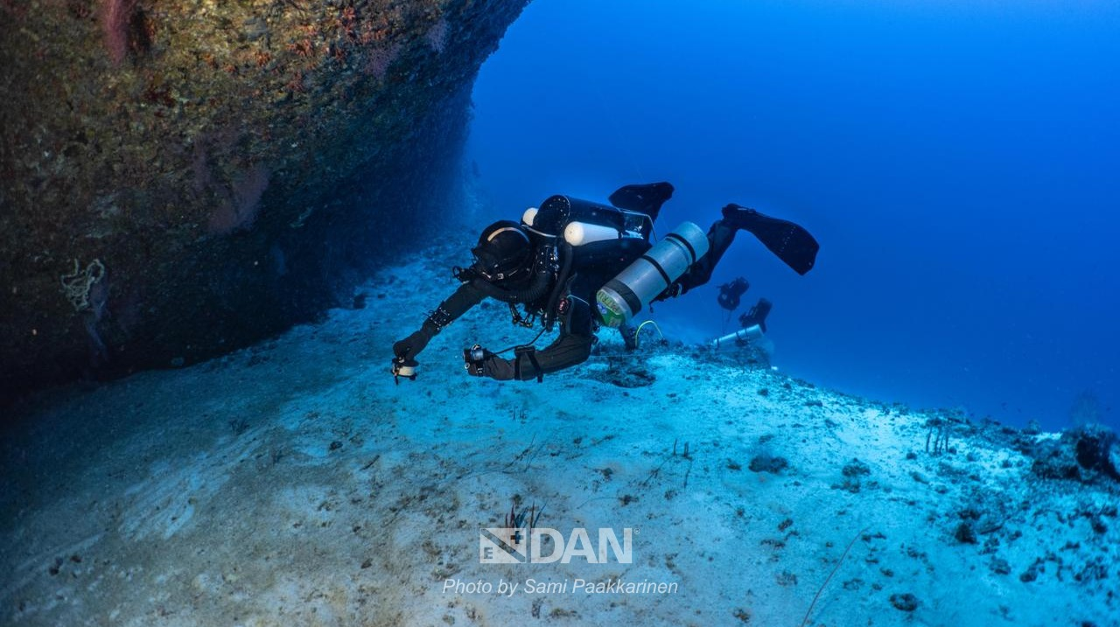
MALDIVES DIVING ACCIDENT

Slide 16
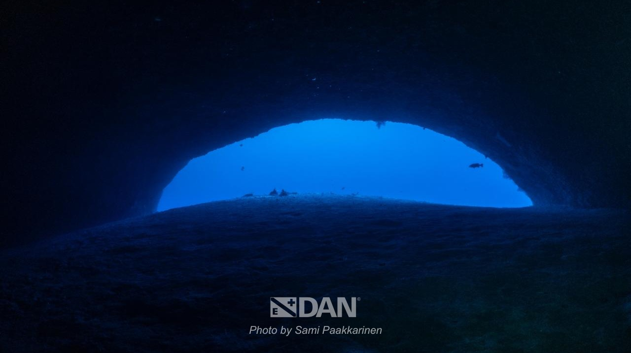
MALDIVES DIVING ACCIDENT

Slide 17
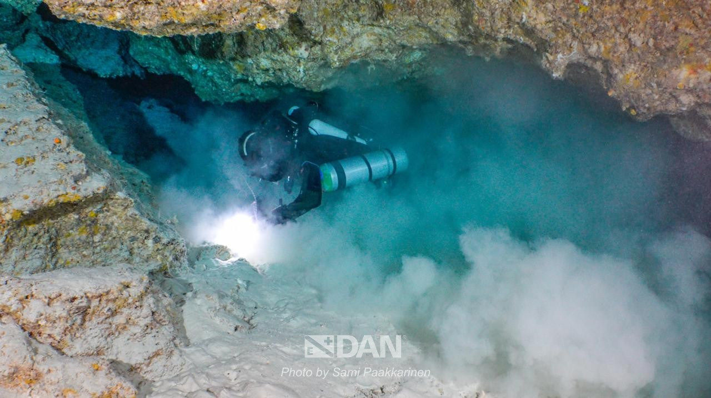
MALDIVES DIVING ACCIDENT

Slide 18
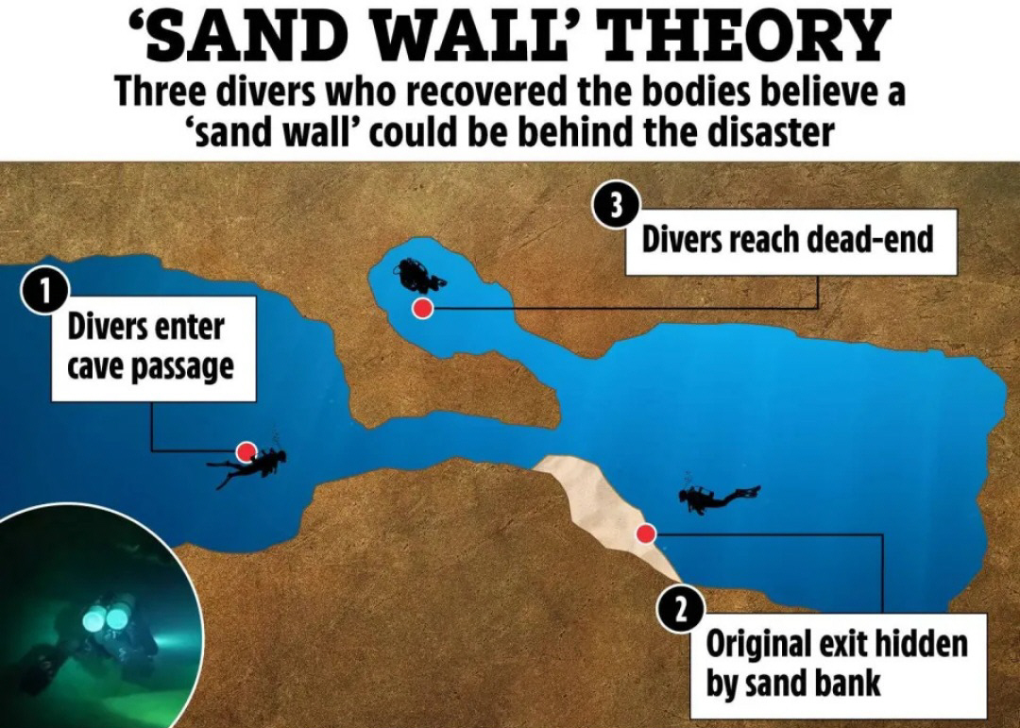
MALDIVES DIVING ACCIDENT

Slide 19
MALDIVES DIVING ACCIDENT
We may never
know exactly
what happened
and what went wrong

Slide 20
MALDIVES DIVING ACCIDENT
You never get hurt
on a dive
you don’t make.

Slide 21
MALDIVES DIVING ACCIDENT
QUESTIONS???

Slide 22
CONTACT INFO
jkades@me.lacounty.gov
huggins@usc.edu
kenkurtis@aol.com

Slide 23

Los Angeles County
Dept. of Medical Examiner
WHY
DIVERS
DIE
A review of the diving fatality
in Los Angeles County in 2025
(plus analysis of the Maldives accident)
Panelists: Captain John Kades, Alex Van, Ken Kurtis

