Slide 1
Network Moves-Metro NY
06/15/2025

Slide 2

Introduction
What’s Not Changing
What is New / Changing Labels – Pallet IDs-HBC/GM Packing List / Store Check In Documents-HBC/GM
Label Examples –HBC/GM
Important Facts
FAQ’s

Slide 3
Introduction
What are we doing:
HBC/GM will move to Bethlehem from Brattleboro effective 6/15/25
NOS(Davidson)will move to Brattleboro effective 7/20/25
Supplies will move to Brattleboro effective 7/20/25
How are we doing it: A dedicated and experienced project team has been established to manage a seamless transition
How to contact us: Please reach out to your Customer Experience Manager or Customer Service

Slide 4

What is NOT changing:
The following items will not change with the new warehouse:
Delivery Paperwork
Delivery Receipt Waybill
Pick Up Return Documents
Invoices (electronic or hardcopy)
Order and Delivery Processes
Current Credit / Receiving Processes remain the same
Order adjustments

Slide 5
What IS changing:
The following delivery paperwork changes will occur, and are outlined in the following pages:
Labels – Pallet IDs-HBC/GM
Packing List / Store Check In Documents-HBC/GM

Slide 6
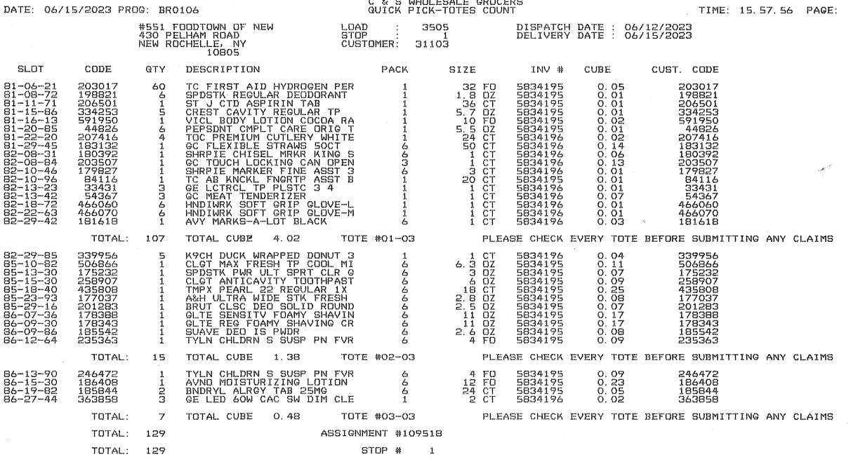
Delivery Paperwork Changes – Packing List / Store Check-in Document
Old Version (GM / HBC)

Slide 7
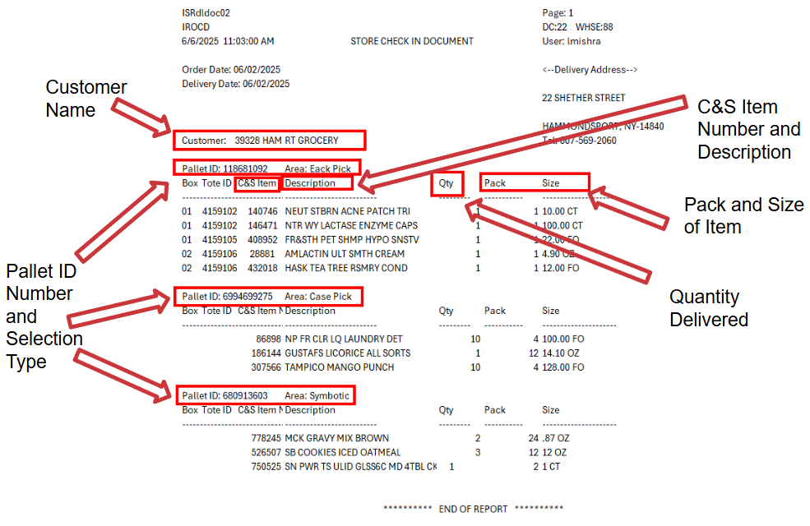
Delivery Paperwork Changes – Packing List / Store Check-in Document
New Version

Slide 8
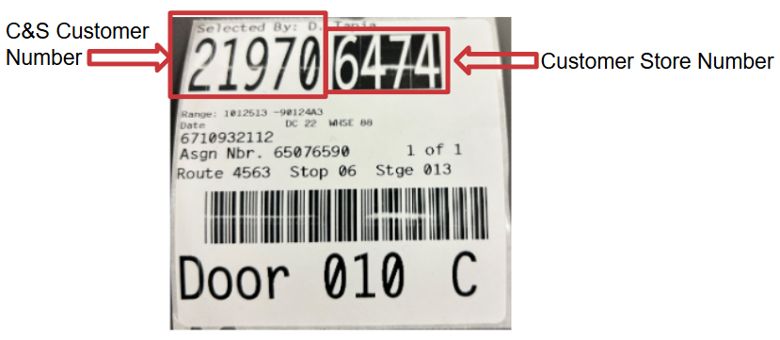
Fullcase Master Labels

Slide 9
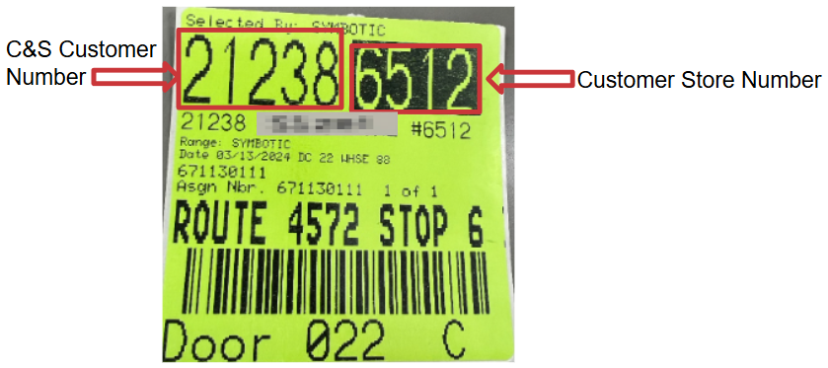
Item Selection Label – Symbotic Selection

Slide 10
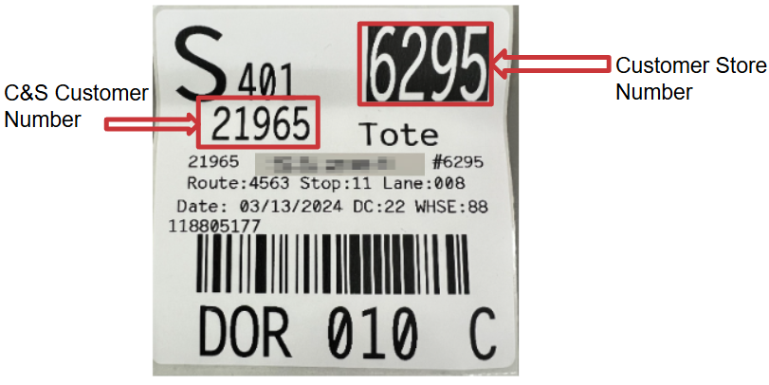
Each Pick Master Tote Pallet Label

Slide 11
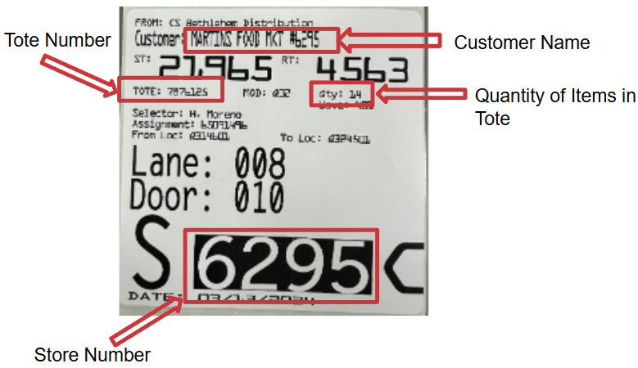
Each Pick Tote Label

Slide 12
Important Facts
Many Packs are changing in HBC/GM. Please look at the packs in the ordering device as you write your HBC/GM starting next Sunday 6/15
Polling Time for HBC/GM is moving 1pm and to a Monday-Friday Schedule effective 6/15
Polling Time for NOS is moving to Noon and to a Monday-Friday Schedule effective 7/20
Polling Time for Supplies is moving to Noon and to a Mon-Fri Schedule effective 7/20
Stores Will Receive Two Deliveries a Week for NOS and Supplies Based on Grocery Schedule
Please Review your Delivery Schedule to see your Stores Exact Polling/Delivery Schedule

Slide 13
FAQ’s
Question | Answer
Will how I order my product change? | No. Customers will continue to use their ordering systems for all order entries into C&S.
Will I still get itemized invoices with my delivery? | Yes. The invoice is not changing.
Will I still get a Pallet ID Label? | Yes, please refer to pages 8,9 and 10 for the pallet IDs.
Will I get an ? Item Summary for HBC/GM? | Yes, please refer to page 7 for the new version of this document.
Do I still need to follow my current receiving policies? | Yes! Receiving and credit policies will remain the same. Stores will continue to follow all policies as they do today.
What if I have questions or need help with getting paperwork I am missing? | Please contact our Customer Service Department at 1-800-888-6737 and one of our agent’s would be happy to assist you.

