Slide 1

The MPA Portfolio Process
Emily B. McCartha, PhD
MPA@UNC Adjunct Instructor
UNC School of Government
Notes:
Both John and Amy do a brief introduction

Slide 2
Session Objectives
Why is this required?
Introduce the MPA portfolio process.
Explain the role of the portfolio course.
Discuss what you need to do now!
Notes:
Amy

Slide 3
“Mastery” in Graduate School
UNC-CH requires each master’s candidate to write a thesis and pass a written / oral exam.
The thesis is a piece of independent research, and the exam must be comprehensive.
Professional programs may, with approval, substitute requirements relevant to the field.
Substitutes must prove strenuous and independent mastery of the discipline.
Notes:
John

Slide 4
MPA Substitute: The Portfolio
The written portfolio requires students to “articulate, synthesize, and reflect on the knowledge…acquired in the MPA program.”
The oral exam requires students to “defend their knowledge [of PA] and withstand questioning and criticism in any setting.”
The work must go above and beyond regular coursework and normal class time.
Notes:
John
Highlight here at least 12 hours weekly of writing and editing

Slide 5
Overview: The Written Portfolio
The portfolio contains 3 big pieces w/sub pieces:
A synthesis,
3 area assessments
3 appendix items (pieces of original work) associated w/the area assessment topics
Notes:
John

Slide 6
Overview: The Written Portfolio
Most of the work is done outside of class.
Class helps clarify questions/confusions and stimulate thinking through group support
A three-person faculty committee grades the portfolio; two members must vote to “pass.”
Notes:
John

Slide 7
Overview: The Process
Notes:
Note comparison.
John
I updated this slide to match the visual in the current portfolio guide. The quality is not great but we can also refer them to document.

Slide 8
Component Breakdown
Synthesis
  2 Themes
    Major ideas in public administration that touch on several sub-lessons you present in your area assessments
  Discussion of leadership, values, and ethics
  Career trajectory/goals and how to address gaps

Slide 9
Component Breakdown
3 total.
  Research Design and Data Analysis (required) then two of the following three, Law and Legal Practices, Human Capital Management (HR), Public Financial Management
Area Assessment 1: Research Design and Data Analysis
  2 lessons
  Appendix item summary and critique
Area Assessment 2 (same components as AA1)
Area Assessment 3 (same components as AA1)

Slide 10
Portfolio Construction
Notes:
Amy

Slide 11
Overview: Area Assessments
The portfolio is read “top down,” but is built “bottom up” from the area assessments.
Area assessments show personal knowledge of specific subjects in public administration.
An area assessment in research design / data analysis is required.
Select 2 of 3: financial management, human capital management, law / legal processes.
Notes:
Amy

Slide 12
Overview: Portfolio Synthesis
From the assessments, you will need to identify two cross-cutting themes.
The themes must be tied to public administration scholarship and reflect the unique context of public service.
Synthesis must discuss understanding of leadership/public service values and ethics.
Explain career goals and future learning.
Notes:
Amy

Slide 13




Picturing Themes and Lessons ...
2 Major Themes
2 Lessons
Per Area Assessment
2 Lessons
2 Lessons
Notes:
Amy

Slide 14
The Portfolio Class
Notes:
John

Slide 15
Overview: The Portfolio Course
The course offers a chance to develop portfolio elements and practice for the exam.
Students prepare the bulk of their portfolios outside of, but concurrent with, the class.
Course grade has no tie to the portfolio and oral exam grades; committee decides.
Students who attend class and complete all work professionally will “Pass.”
Notes:
John

Slide 16
What do I do now?

Slide 17
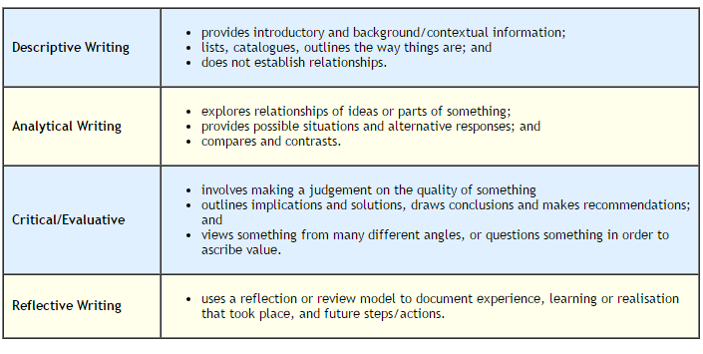
Go to the Literature and Course Content for Lesson Ideas

Slide 18
Lesson Generation
-What do I know? What are the concepts, terms, ideas?
-How are they similar or different to other concepts?
-Why do we care? What is important? When do they not work? What are their limits?

Slide 19
Appendix Items
Identify which area assessment topics you will write about
Find a piece of original work prepared during MPA…FOR MPA
Write a summary
Think about how it could be improved and write a critique

