Slide 1
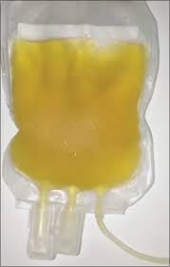
CLTAC MEETING
September 11, 2020
Update on INVESTIGATIONAL COvID-19 CONVALESCENT PLASMA (CCP)
Jessica Khouri, MD
Senior Medical Officer, CDPH
COVID-19 Therapeutics Task Force

Slide 2
State’s Therapeutics Task Force CCP Initiative
Letters sent in 7 languages to >227,000 Californians who tested positive for SARS-CoV-2 to encourage them to consider donating plasma
Website with county/zip code blood center locator: https://covid19.ca.gov/plasma/
~70 CA sites collecting or have capacity to collect CCP
Collaboration with LHJs, hospitals, academic medical centers, blood banks and blood centers with support provided by CDPH Laboratory Field Services
Facilitated increased efficiency and capacity to collect CCP statewide through memorandum by LFS to clarify CA H&SC Section 1607(d) and its non-applicability to CCP collections under the public health emergency
Coordination with Operation Warp Speed CCP initiative; Dept. of Defense CCP Coordinators presently deployed in CA Regions I and VI to facilitate increasing collections in those regions

Slide 3
CCP DONOR ELIGIBILITY
Need to meet general donor eligibility requirements under federal regulations (21CFR §630)
Detailed donor eligibility requirements found in FDA Guidance for Industry
Evidence of COVID-19 documented by laboratory testing
Complete resolution of symptoms ≥14 days before the donation. A negative result for COVID-19 by a diagnostic test is not necessary to qualify the donor.
If female donor and history of pregnancy, negative for HLA antibodies. (This may require two-step screening process.)
*Note: some California blood centers require a negative test for donors who have been symptom free between 14-28 days. And some centers have the eligibility requirement of being symptom-free for at least 28 days.

Slide 4
TRIALS AND REGULATORY PATHWAYS FOR CCP USE
24 Mar. 2020
FDA approved CCP for compassionate use as an investigational therapy on 24 March 2020
Apr.–Aug.
CCP available through clinical trials, a national Expanded Access Treatment Protocol (EAP), and through individual patient emergency Investigational New Drug (eIND) applications.
23 Aug. 2020
On 23 August 2020, FDA issued Emergency Use Authorization (EUA) for investigational CCP.
28 Aug. 2020
National EAP discontinued new physician and new patient enrollments effective 28 August 2020
CCP is now available through EUA, clinical trials and remains available through expanded access applications and individual patient eIND applications.

Slide 5
TRIALS AND REGULATORY PATHWAYS FOR CCP USE
National open-label EAP led by the Mayo Clinic: > 105,000 patients enrolled and 77,494 patients infused.
Safety data report for 20,000 subjects treated under the EAP showed overall low rates of serious adverse events;
Analysis of over 35,000* patients transfused under the protocol: those patients treated with high titer plasma and with earlier treatment had reduced mortality compared to patients who received low titer plasma and later treatment.
Emergency Use Authorization is not intended to replace randomized controlled clinical trials. Enrollment of patients into ongoing RCTs is paramount to evaluating its safety and efficacy.
Joyner et al. Safety Update: COVID-19 Convalescent Plasma in 20,000 Hospitalized Patients. Mayo Clin Proc. 2020;95. https://els-jbs-prod-cdn.jbs.elsevierhealth.com/pb/assets/raw/Health%20Advance/journals/jmcp/jmcp_ft95_6_8.pdf. Preprint accessed online June 26, 2020.
*Joyner et al. Effect of Convalescent Plasma on Mortality among Hospitalized Patients with COIVD-19: Initial Three-Month Experience. medRxiv preprint https://www.medrxiv.org/content/10.1101/2020.08.12.20169359v1. Preprint accessed online August 12, 2020.

Slide 6
CCP EMERGENCY USE AUTHORIZATION (EUA)
EUA Fact Sheet for Patients and Parents/Caregivers
EUA Fact Sheet for Health Care Providers
Given that the clinical evidence supporting this EUA was not obtained from prospective, well-controlled randomized clinical trials (RCTs), additional RCTs are needed. Convalescent plasma should not be considered a new standard of care for the treatment of patients with COVID-19. Ongoing clinical trials of convalescent plasma should not be amended based on the issuance of the EUA. Providers are encouraged to enroll patients in those ongoing clinical trials.
Translations of the Fact Sheets are available under the “Drug and Biological Products” section at: https://www.fda.gov/emergency-preparedness-and-response/mcm-legal-regulatory-and-policy-framework/emergency-use-authorization#coviddrugs

Slide 7
Additional RESOURCES
  State’s webpage which includes a zip code locator for blood centers collecting CCP is covid19.ca.gov/plasma.
  www.clinicaltrials.gov contains listing of registered trials
  National CCP coalition of more than 30 organizations including academic, research, industry, non-profit, etc.), The Fight Is In Us
  FDA Convalescent Plasma Fact Sheets and Toolkit
  CDC Donate Blood Plasma Toolkit
Notes:
https://youtu.be/xJaWGe1dqxk

Slide 8
SEROLOGY TESTING UNDER THE EUA
Ortho-Clinical Diagnostics VITROS Anti-SARS-CoV-2 IgG test
Developer: Ortho-Clinical Diagnostics, Inc.
Test: VITROS Anti-SARS-CoV-2 IgG test
Technology: High Throughput CLIA
Target: Spike
CCP EUA-approved serology test for qualifying CCP: Ortho VITROS SARS-CoV-2 IgG
Ortho-Clinical Diagnostics, Inc. VITROS Anti-SARS-CoV-2 IgG issued EUA on 24 April 2020
S/C value ≥12 → qualify as high titer CCP
Antibody | Performance Measure | Estimate of Performance | 95% Confidence Interval
IgG | Sensitivity (PPA) | 90.0% (36/40) | (76.9%; 96.0%)
IgG | Specificity (NPA) | 100% (407/407) | (99.1%; 100%)
IgG | PPV at prevalence = 5% | 100% | (81.2%; 100%)
IgG | NPV at prevalence = 5% | 99.5% | (98.8%; 99.8%)

Slide 9
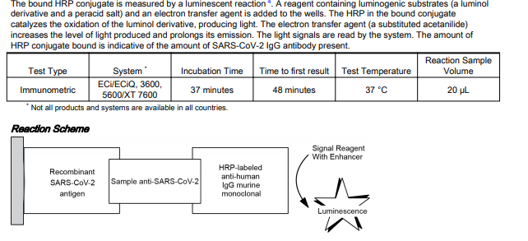
Ortho VITROS SARS-CoV-2 IgG
INSTRUCTIONS FOR USE

Slide 10
Other Uses of Convalescent plasma
Other uses of convalescent plasma
  Developing a hyperimmune human immunoglobulin (H-IG) product
  Characterizing neutralizing antibodies for development of monoclonal antibody therapies.
H-IG is produced from the plasma of healthy donors who have recovered from COVID-19 and have high antibody titers.
  Manufacturing processes → safe and pure product with consistent, concentrated high levels of protective antibodies
  Anti-SARS-CoV-2 H-IG production has begun
  First batches have been delivered for use in clinical trials through collaborations with federal agencies

Slide 11
TAKEAWAYs
  High titer investigational convalescent plasma administered early shows signals of benefit based on available data to date which is consistent with its mechanism of action.
  Randomized controlled trial data are needed to evaluate CCP safety and efficacy.
  Overarching goal of connecting prospective donors with their local blood banks and blood centers and encouraging overall donations.
  CCP initiatives in CA have been successful in ensuring supply meets demand. Demand is anticipated to increase in wake of Emergency Use Authorization.

Slide 12

Questions
Thank you

