Slide 1
“To Inspire, Equip and Connect Presbyterians in Mission”

Slide 2

Presbyterian Church (U.S.A.)
Presbyterian Mission Agency
Notes:
In fulfilling our purpose to inspire, equip and connect God’s people, the mission agency invites churches, mid-councils and groups to be a Matthew 25 Church. The mandate to be a Matthew 25 church first came from the 2016 General Assembly. It has since been adopted and confirmed by GA in 2018, and 2020, and 2022.

Slide 3
Three Primary Foci
Building Congregational Vitality
Dismantling Structural Racism
Eradicating Systemic Poverty
Notes:
Three intersecting priorities – climate change, militarism, and heteropatriarchy/gender oppression

Slide 4
Congregational Vitality
A community’s spiritual strength and demonstrated capacity for engaging in purposeful mission.
Notes:
You can tell how vital your congregation is by asking this question, “If you were to close down today, who, besides those already in your church, would miss you?

Slide 5
Systemic Poverty
Exploitation of people through
laws, policies, and practices that lead to the
perpetuation of poverty.
Notes:
Systemic poverty may be defined as a human construct designed to exploit people through laws, policies, practices that lead to the perpetuation of an impoverished status.

Slide 6
Structural Racism
Normalization and Legitimization of
Dynamics and Systems—producing adverse outcomes for people of color.
Notes:
Structural Racism is defined as a social construct that normalizes and legitimizes an array of dynamics—historical, cultural, institutional and interpersonal—that routinely advantages whites while producing cumulative and chronic adverse outcomes for people of color.
If is said, If one fish washes up on the shore, you say what’s wrong with that fish, but if a school of fish wash up on the shore, you say what’s wrong with the water. Clean up the water so the fish can swim free.
Structural Racism is not primarily about individual prejudice or an individual’s beliefs and attitudes. Rather, racism in the U.S. is a socially constructed system.

Slide 7
The Foundation
Biblical
Theological
Ecclesial Basis
Notes:
.

Slide 8
Matthew 25:31-46
³¹ “When the Son of Man comes in his glory, and all the angels with him, then he will sit on the throne of his glory. ³² All the nations will be gathered before him, and he will separate people one from another as a shepherd separates the sheep from the goats, ³³ and he will put the sheep at his right hand and the goats at the left. ³⁴ Then the king will say to those at his right hand, ‘Come, you that are blessed by my Father, inherit the kingdom prepared for you from the foundation of the world; 35 for I was hungry and you gave me food,

Slide 9
Biblically Based - Matthew 25:31-46
I was thirsty and you gave me something to drink, I was a stranger and you welcomed me, ³⁶ I was naked and you gave me clothing, I was sick and you took care of me, I was in prison and you visited me.’ ³⁷ Then the righteous will answer him, ‘Lord, when was it that we saw you hungry and gave you food, or thirsty and gave you something to drink? ³⁸ And when was it that we saw you a stranger and welcomed you, or naked and gave you clothing? ³⁹ And when was it that we saw you sick or in prison and visited you?’

Slide 10
Biblically Based - Matthew 25:31-46
⁴⁰ And the king will answer them, ‘Truly I tell you, just as you did it to one of the least of these who are members of my family,^{[a]} you did it to me.’ ⁴¹ Then he will say to those at his left hand, ‘You that are accursed, depart from me into the eternal fire prepared for the devil and his angels; ⁴² for I was hungry and you gave me no food, I was thirsty and you gave me nothing to drink, ⁴³ I was a stranger and you did not welcome me, naked and you did not give me clothing, sick and in prison and you did not visit me.’

Slide 11
Biblically Based - Matthew 25:31-46
⁴⁴ Then they also will answer, ‘Lord, when was it that we saw you hungry or thirsty or a stranger or naked or sick or in prison, and did not take care of you?’ ⁴⁵ Then he will answer them, ‘Truly I tell you, just as you did not do it to one of the least of these, you did not do it to me.’ ⁴⁶ And these will go away into eternal punishment, but the righteous into eternal life.”

Slide 12
Theologically Grounded - Matthew 25
What we DO matters to God
Everyone who hears these words of mine and does them, he/she is like a person who built their house on a rock… Matthew 7:24

Slide 13
Discussion Question
How may dismantling structural racism be related to Matthew 25?

Slide 14
Knox Presbyterian Church – Cincinnati, Ohio #4
https://vimeo.com/showcase/9574375
Notes:
Discussion

Slide 15
Discussion
What are some important steps taken to help dismantle structural racism?
Notes:
You can tell how vital your congregation is by asking this question, “If you were to close down today, who, besides those already in your church, would miss you?

Slide 16
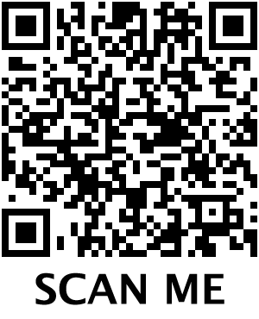

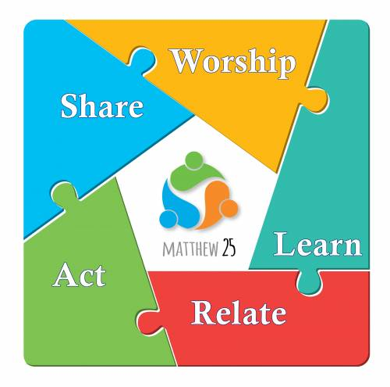
Structural Racism
pcusa.org/matthew25

Slide 17
Learn
Matthew 25 Resources
Worship
Relate
Act
Share

Slide 18

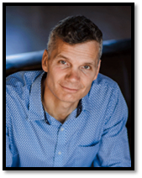
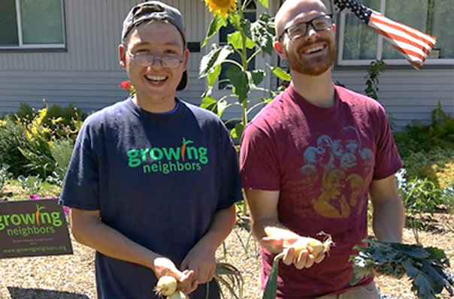
Office of Innovation
INNOVATE
Dr. Corey Schlosser –Hall, Director
Notes:
In 2023 we launched the Office of Innovation. Working with Presbyteries Lincoln Trails, Southern New England, Churches in West Philadelphia who are interested in exploring new and creative ways to bear witness to Christ and serve God’s people.

Slide 19
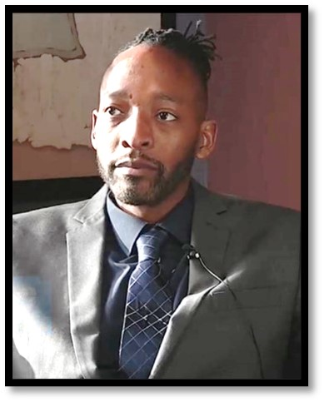
Center for Repair of Historical Harm
Rev. Jermaine Ross-Allam, Director

Slide 20
An Invitation
What is the one thing you
Will do as a result of
this workshop?
Notes:
Joining Matthew 25

Slide 21
Thank You!

