Slide 1
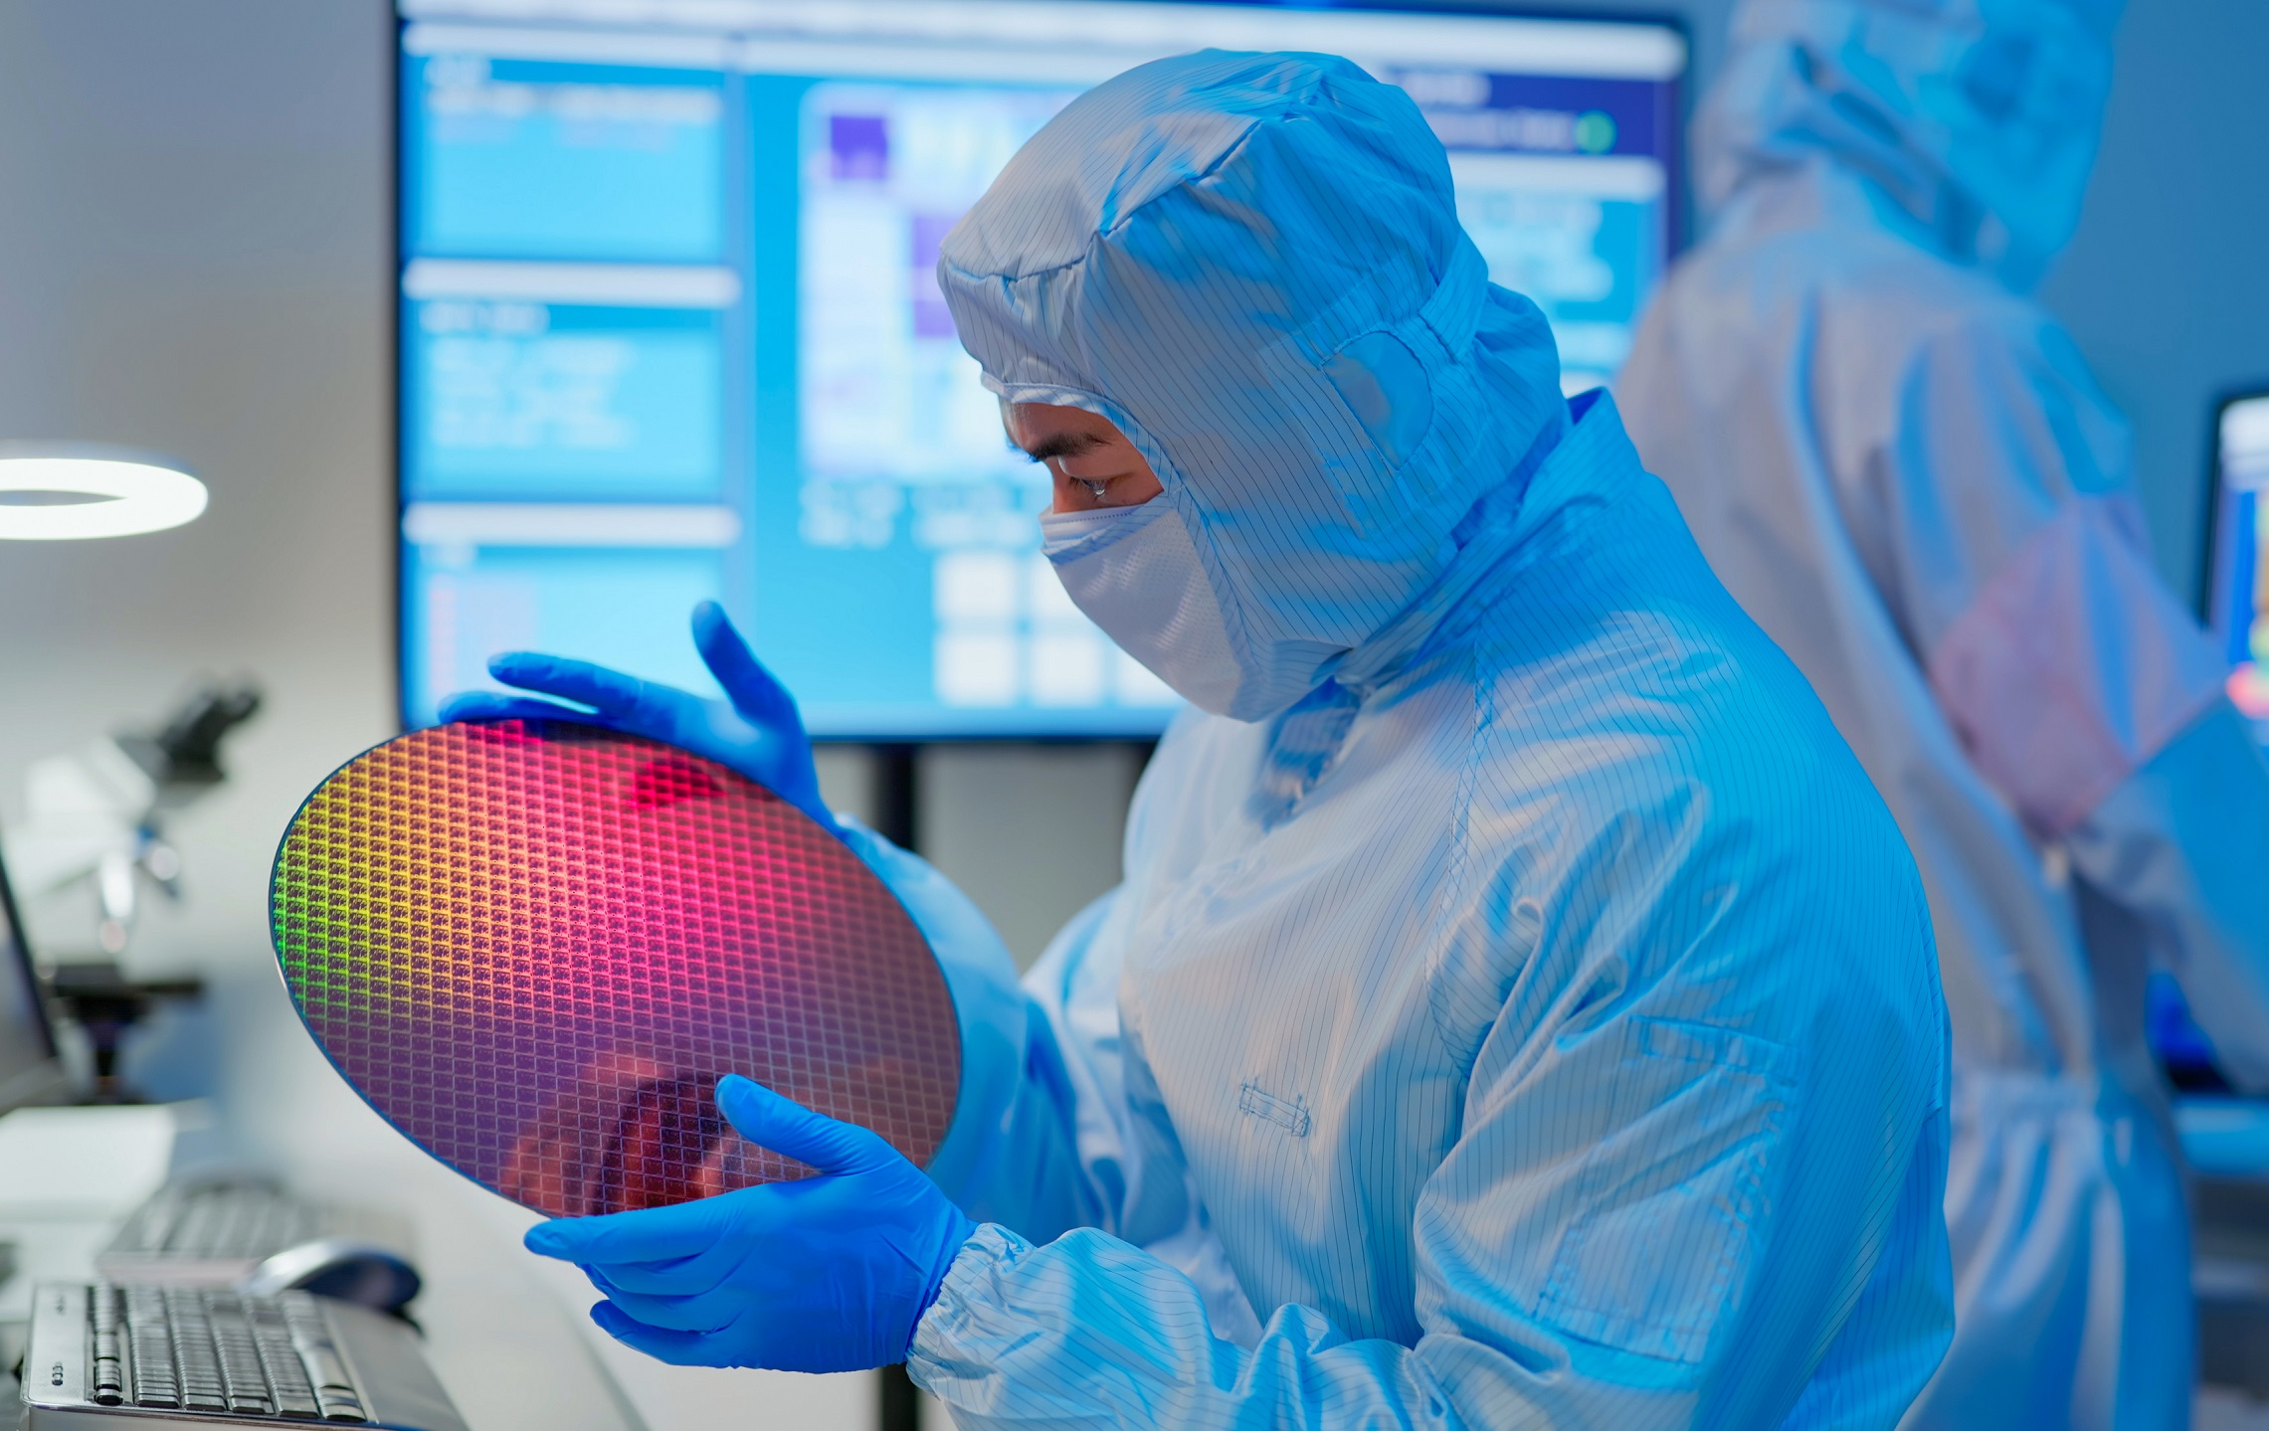






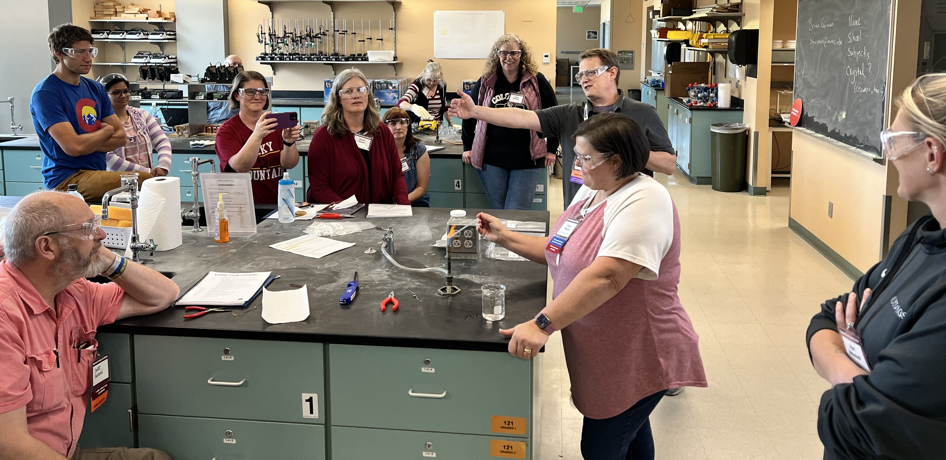
image from TSMC
Need: Advanced ceramics enable defense technologies from aerospace to microelectronics, but the U.S. is producing fewer Ceramic Engineers today than at any time in the last 70 years. The defense industry needs both technicians and engineers trained in advanced ceramics.
Advanced Ceramics for Defense Consortium (ACDC)
Ensure a robust and diverse workforce with specialty hands-on training in the fabrication, integration, testing, and deployment of advanced ceramics to support defense industry needs.
Approach:
Establish regional nodes with specialized training facilities to support hands-on coursework along with defense industry traineeship pathways for advanced ceramic education and workforce development
Provide financial support to acquire and/or upgrade state-of-the-art equipment for advanced ceramics fabrication, integration, and testing in key strategic defense areas
Secure long-term sustainability by endowing faculty lines for subject matter experts to develop and regularly offer technician and BS engineer training programs at each regional node
Increase the number of Ceramic Engineering BS degree-seekers by offering first-year fellowships and national cohort building activities
Hands-on education and training
Other universities welcome to join!
Internships, traineeships, and jobs with members
K-14 outreach and awareness
image from DARPA

