Slide 1



Welcome!
We’re glad you’re here!

Slide 2

CFP Collaborative Meeting
October 7, 2026

Slide 3
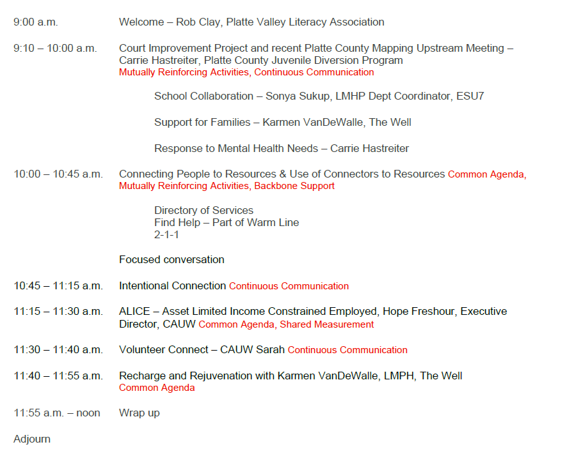
Today’s Agenda

Slide 4




Slide 5


Slide 6


Slide 7

https://www.unitedforalice.org/introducing-ALICE/iowa

Slide 8

Volunteer Connect
columbusunitedway/galaxydigital.com

Slide 9



