Slide 1
A3 Crisis Response

Slide 2
Agenda
  The Need
  History of A3 and Miles Hall Crisis Call Center
  Multidisciplinary Teams
  Levels of Response
  Where We Stand Today
  Metrics
​

Slide 3



The Need
Out of Contra Costa County’s 1.2 million residents, nearly 200,000 will need mental health services.
1 in 5 people ​
experience mental health challenges ​
Third most ​
common ambulance call​
6,500
visits to Psychiatric
Emergency Services

Slide 4

The A3 Miles Hall Crisis Call Center
A3 Miles Hall
Crisis Call Center
Named for Miles Hall and others in Contra Costa who face mental health crises without the right support.
Miles, a 23-year-old Black man, was killed by law enforcement during a mental health incident.
After his death, Miles’ mother, Taun, advocated for a system to prevent such tragedies.
844-844-5544

Slide 5

Who Are We?
Multidisciplinary Team
Nurse (RN, NP)
Peer Support Specialist
Mental Health Specialist
Level One Interventionists
Mental Health Clinician
Substance Use Disorder Counselor

Slide 6
In-Person Response
Level 1 Response
  Peer Support Specialist and/or Substance Use Counselor
Level 2 Response
  Mental Health Clinician or Nurse
  Peer Support Specialist and/or Substance Use Counselor
Level 3 Response
  Mental Health Clinician or Nurse
  Peer Support Specialist and/or Substance Use Counselor
  Police on Standby

Slide 7
Where We Stand Today
A3 Operations
24/7 since Dec. 2023
Teams dispatched from Martinez
Expanding Reach
Began serving youth in July 2024
Workforce Growth
March 2024: 26 employees
March 2025: 48 full-time employees

Slide 8
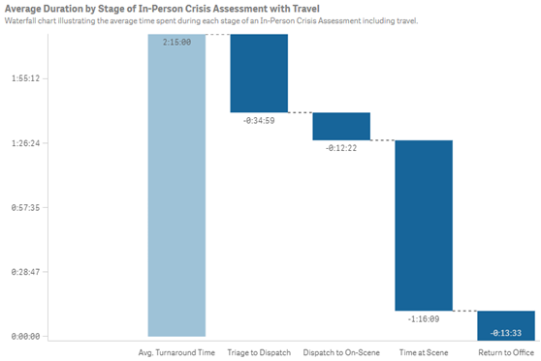
Where We Stand Today
Response Times for calls from school staff

Slide 9
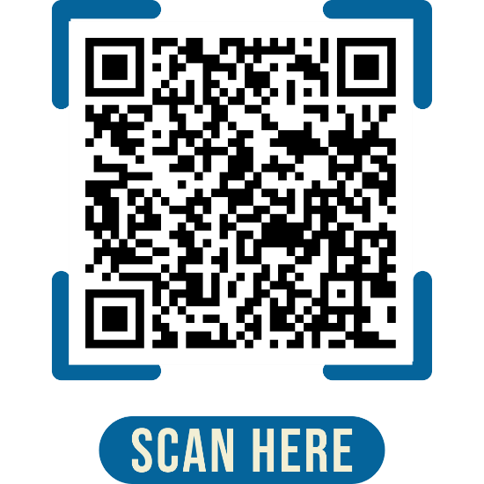
A3 Call & Response Metrics
Total Calls
20,173 total calls in 2024
*41,476 total calls to date as of August 15, 2025
  830 calls in July 2023
  1,725 calls in July 2024
  2,414 calls in July 2025
    191% increase since 2023
Field Visits
3,761 total field visits in 2024
*8,452 total field visits to date as of August 15, 2025
  70 visits in July 2023
  367 visits in July 2024
  593 visits in July 2025
    747% increase since 2023
Law Enforcement Coordination
1,089 field visits involved collaboration with law enforcement in 2024
*2,512 field visits to date as of August 15, 2025, involving collaboration with law enforcement
View data on our A3 Crisis Response Dashboard: https://www.cchealth.org/get-care/a3-crisis-response/a3-dashboard

Slide 10

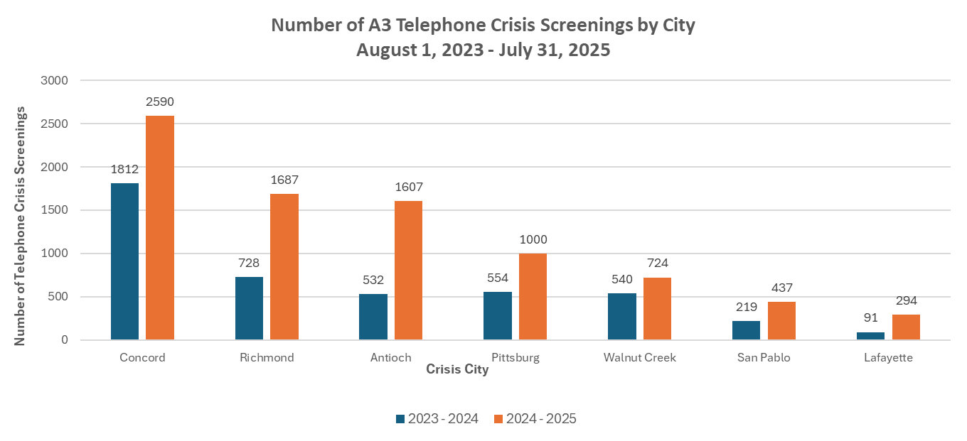

Slide 11
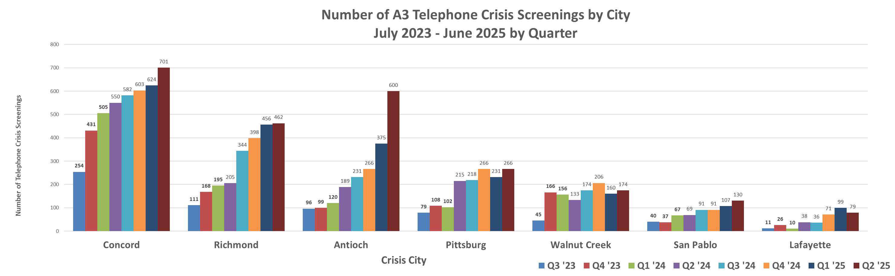

Slide 12
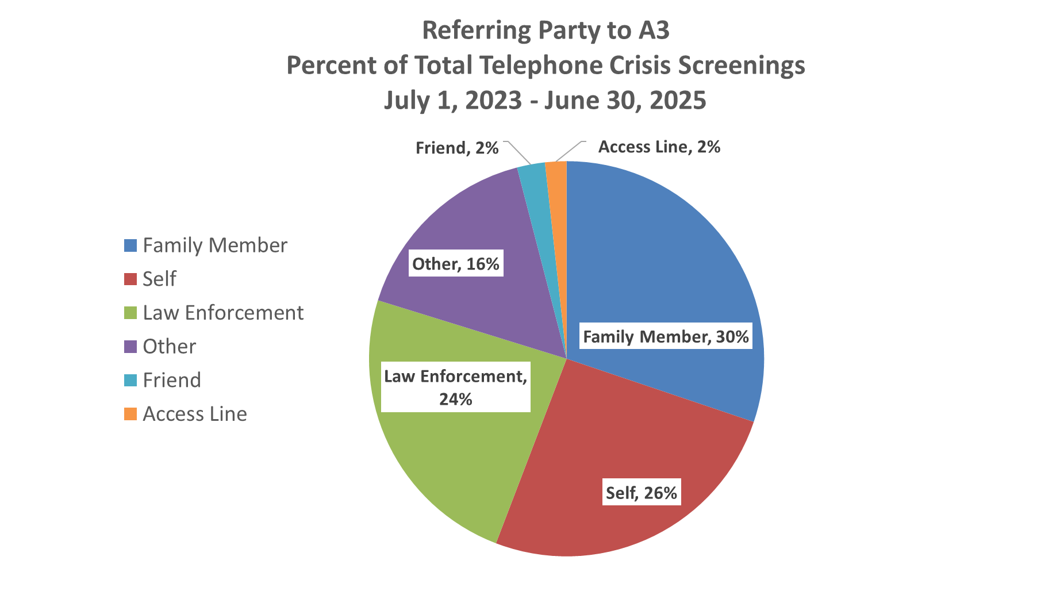
Referring Party to A3:
Percentage of Total Telephone Crisis Screenings
July 1, 2023 – July 1, 2025
Friend, 1.5%
Access Line, 1.2%
Family Member, 21.3%
Other, 40%
Law Enforcement, 16.8%
Self, 18.8%

Slide 13
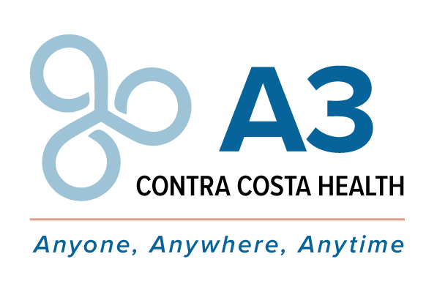
PROVIDING HOPE​
Providing timely, appropriate behavioral health crisis services to anyone, anywhere at anytime in Contra Costa County.​

Slide 14
Thank you

