Slide 1

OCIA ADAPTED FOR
Children
Prepared for the
January 31, 2026

Slide 2
Opening Prayer
Heavenly Father,
You have called us to be companions on the journey of faith
to welcome, teach, and guide those who seek to know Your Son.
We gather today as leaders and catechists entrusted with forming children and adults
in the Order of Christian Initiation adapted for children.
Grant us the insight to see Your presence in every heart we encounter,
the courage to speak Your truth with clarity and compassion,
and the patience to walk with each child as they move toward the Sacraments of Initiation.
Fill our minds with wisdom and our hearts with zeal,
that we may lead others not merely to knowledge,
but into an encounter with Christ and His Church.
Bless our work today.
May Your Holy Spirit animate this gathering,
guide our discussion, and deepen our commitment
to form disciples who will love and serve You all their days.
We ask this through Christ our Lord.
Amen.

Slide 3
Session Objectives
  Understanding the vision of the OCIA adapted for Children
  Framework & Discernment: distinction of ages, status, & readiness
  Models of Implementation & Application
  Available Resources
  Consistency across Parishes - Why it matters

Slide 4
Understanding the Vision of the OCIA,
Adapted for Children
Conversion-centered process focusing on
  Kerygmatic Evangelization
  Discernment/Readiness
  Liturgical Rites
  Gradual Incorporation into Parish-Community Life
The process applies to children and teens as much as it does to adults.
OCIA 252 makes this explicit: children of catechetical age are to be formed “according to the same elements as adults,” adapted to their age and circumstances.

Slide 5
In this Presentation we will address some common issues:
  Children rushed to the Sacraments by grade and/or calendar
  Children catechumens treated as “lite” (Rites Omitted)
  Teens placed in programs out of convenience
  Parish programs driving the process, rather than the Ritual text.
  Result? Inconsistent practice, confusion for families…
Taking into account,
  New Diocesan Norms (pub. August 2025)
  Shared principles required
  Flexibility as a pastoral tool, not an excuse for inconsistent practice

Slide 6
Who Qualifies…
  Unbaptized & Invalidly Baptized → Catechumens
  Validly baptized → Candidates (incl. those coming from a different faith tradition - Profession of Faith)
  Baptized Catholic, uncatechized → Candidates for sacraments
  “Baptism Changes EVERYTHING. Formation must reflect baptismal reality.” Fr. Paul Turner.

Slide 7
Who qualifies: PARAGRAPH 252
This rite is intended for children who have not been baptized at the time of infancy and have reached the age of discretion and catechesis. They come to Christian Initiation, brought by either parents or guardians, or moved on their own initiative with the permission of these same people. Those who grasp and nourish their own faith are moved by their own conscience, are already suitable. Nevertheless, they cannot yet be treated as adults, because, as children, they depend on parents or guardians and are extremely susceptible to the influence of companions as well as society.

Slide 8
Paragraph 253
The initiation requires not only a personal conversion of a maturity suitable to their age, but also the help of education necessary at that age. From that point it must be adapted to the spiritual journey of the children, namely their increase in faith and the catechetical instruction that they receive. As with adults, therefore, their initiation is also extended over some years, if necessary, before they may approach the Sacraments.

Slide 9


Discerning the Status of Children/Teens
Age
  Are they Baptized?
OCIA adapted for Children
NO
Catechumen
YES*
Candidate
2. Are they catechized (age-appropriately)?
NO
OCIA adapted for Children
YES
RE + Sacramental Prep

Slide 10
Discerning the Status of Children/Teens
Age
  Pastor makes the final call, but there should be communal input from OCIA director/ coordinator
  Ongoing observation, over time. Not just a one-time decision (to determine process & readiness).
  Minimum 2-year process
  Should strongly include:
    Family Formation
    Parish Life participation
    Modeling the faith (by Catechists, Sponsor, etc.)

Slide 11
What we are Recommending (Best Practice)
A minimum two-year catechumenal process for children (both catechumens and candidates
This is especially critical where:
    Families are uncatechized
    (parents are part of the process)
    Family participation in parish life is minimal.
    Use your parish life as the “calendar” for your OCIA. Just as you do with adults, plan events for families to meet and participate in things happening at the parish or sponsored by parish ministries or groups.
    Faith practice at home is weak
    Have lead catechist model faith practices in the sessions so that parents know what they can do and how to do it.
    Choose strong sponsors for the children and teens who can support parents and model the faith outside the sessions.
    Be clear in explaining the role of a Sponsor vs. Godparent and canonical criteria.

Slide 12

My Journey with Jesus
  Emerging Prayer Life
  Participation in
Community Life
  Growth in Knowledge &
Use of Scripture
  Increase in Charity/Service
  Foundation: Family Support

Slide 13

Irregular Family Situations
  Divorce & Custody Issues
  Absent parents/Uncatechized
  Inconsistent Mass attendance
  Adapt the path, not the goal
  Increase accompaniment, not speed

Slide 14
Parish Models
  Year-round Intergenerational/Family Model
  Childrens-only Catechumenate
  R.E. + Rites
  School + Rites
  RE/YM Only
Note: Can take several years to adjust depending on the size of the incremental steps needed for change

Slide 15

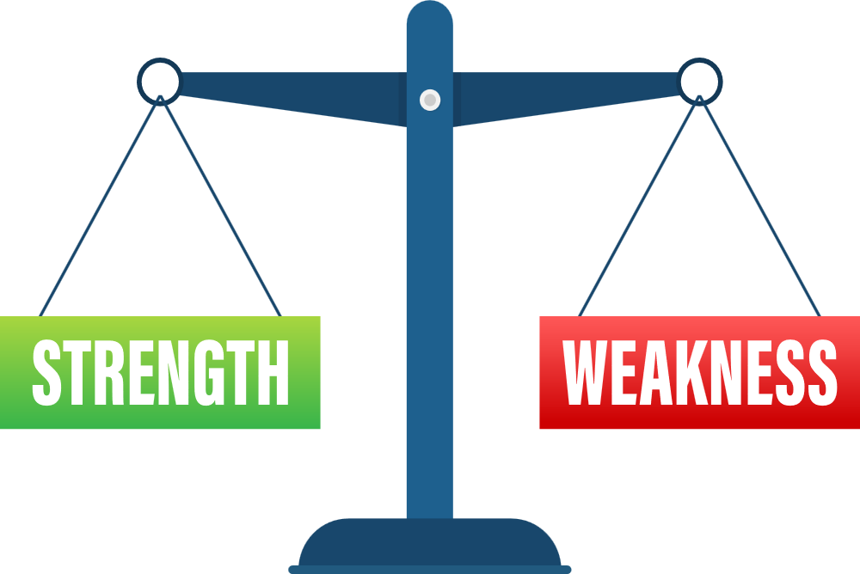
Diamond: Year-Round Intergenerational/Family Model
  Reflects lived faith
  Parents formed alongside children
  natural parish integration
  Strong Mystagogical potential
  Requires trained leaders
  Requires long-term vision (especially if moving from one of the other lesser models)

Slide 16

Platinum: Children’s only Catechumenate Model
  Strong catechumenal identity
  Age-appropriate pacing [grouping]
  Risk isolating from the larger parish community
  Add Rites
  Move as group not individuals
  Family Support needed

Slide 17

Gold: RE + Rites
  Familiar structure for PCLs
  Easier transition (to existing programs)
  RE ≠ Catechumenal formation
  Rites become ceremonial
  Discernment is driven by the calendar

Slide 18

Silver: Catholic School + Rites
  Strong exposure to Catholic doctrine
  Stable/Consistent environment
  Initiation at parish is missing
  Rites are disconnected from liturgy
  Family Support missing/replaced by teacher

Slide 19


Bronze: RE/Youth Ministry ONLY
  Familiar structure for PCLs
  Formation becomes sacramental prep
  No Catechumenal Process
  Rites minimized OR omitted
  Conversion is assumed

Slide 20

Practicing Discernment: Case Study #1
What are we dealing with? What do you need to know? and what process should they follow?
  Family of 3 children (ages 5, 7, and 9). Mom is from Central America & dad is Mexican.
  Parents both Catholics and completed initiation while in primary school.
  Not attended Mass >10 yrs.
  Parents only civilly married. Children’s father
has a prior marriage he has not annuled.

Slide 21
Practicing Discernment: Case Study #2
What are we dealing with? What do you need to know? and what process should they follow?
  Single mother (convert who came in through OCIA) seeking sacraments for her teen daughter who audited the adult OCIA (as accomodations were not available to leave her on her own).
  Daughter's status: Baptized Baptist

Slide 22
Practicing Discernment: Case Study #3
What are we dealing with? What do you need to know? and what process should they follow?
  single and divorced Catholic father brings his two daughters, ages 9 and 13, for Baptism.
  Mother is fallen-away Catholic / No interest is the Church or in supporting daughters’ faith journey.
  Limited Catholic Mass participation
  No real community involvement: Attended
OLG & Christmas, Ash Wednesday, Easter.

Slide 23
Practicing Discernment: Case Study #4
What are we dealing with? What do you need to know? and what process should they follow?
  Catholic husband & wife bringing their daughter (age 8)and son (age 5) in pursuit of sacrament of First Communion. Recently enrolled in Catholic school - school told them to go to the parish to enroll daughter for FHC.
  Both parents had not really attended Mass prior to the birth of the children. Now attend infrequently & church-hop for convenience
  Children have no prior Faith Formation.
  Mom is N.P. & dad is retired military, now pilot.
  No other support available.

Slide 24
Practicing Discernment: Case Study #5
What are we dealing with? What do you need to know? and what process should they follow?
  Devout grandmother brings her 16 year old teen grandson for First Communion and Confirmation.
  Both parents are Catholic, but fallen away from the faith: spiritual, but not really religious
  Parents don’t trust the institution of the Church.
  The teen in question has not had any prior formation since Baptism.

Slide 25

Sacramental Timing & Mystagogy
No Finish Line Mentality!
  Sacraments are beginning, not finish line
    Don’t Sacrifice the Process because you’re focused on the goal
  Lifelong journey
  Mystagogy must start from the very beginning, just as with the adult process
  Children catechumens receive all 3 Sacraments at EV
  Age is NOT a reason to delay.. Sacraments are not to be held hostage.

Slide 26

Common Pitfalls
  Confusing Initiation with Sacramental Preparation
  Not acknowledging the importance of Conversion
  Letting the calendar dictate the process
  Skipping Mystagogy because we think kids are “done” after reception OR
  Cramming catechetical content into
Mystagogy sessions, rather than letting those
be experiential.
  Disunity & Division across parishes
(breeds convenience & church hopping)
  Divergence in implementation from what the
Bishop recommends

Slide 27
Next Steps
  Commit to ongoing formation
  Assess where your parish is at
  Pick one faithful step forward to move closer to the Diamond Standard model
“Initiation thrives where leaders commit to conversion over convenience”
Nick & Diana from Team Initiation

Slide 28


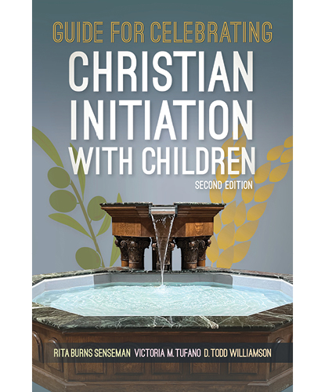
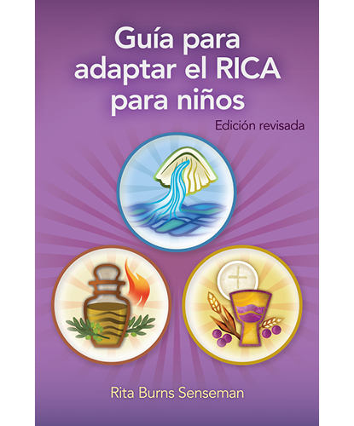

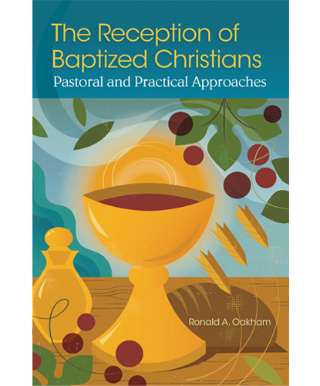
Resources
For PCLs,
after Ritual Text...consider:

Slide 29
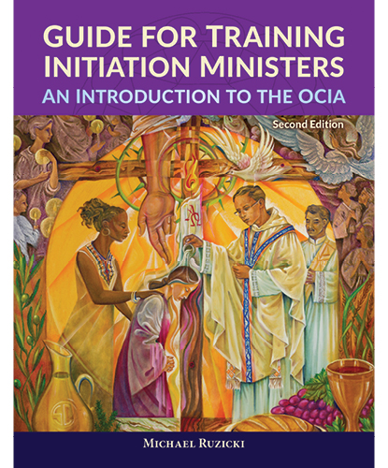
Resources
Also consider, for improving your Catechumenal Practice & Team Formation
Memberships
Individual =$30/month
Team=$1,499/year

Slide 30
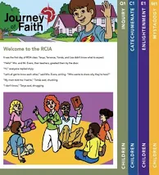
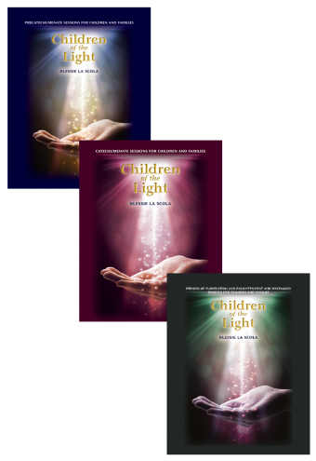




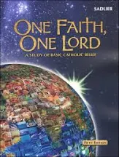
Process Resources
GIA
Pubs.
RCL Benziger
Liguori Press
RCL Benziger
Loyola Press
Team Initiation

Slide 31

Q & A

Slide 32
Let us pray

