Slide 1
Order of Christian Initiation of Adults
Diocese of St. Augustine

Slide 2
What’s Happening with Implementation?
What Do We Need to Address as Lent/Easter Approaches?

Slide 3


Challenges
What Rites must be celebrated?
What options does a Pastor/Parish have in determining what is celebrated?
Keeping the separation between catechumens and candidates for full communion and baptized, uncatechized Catholics.

Slide 4
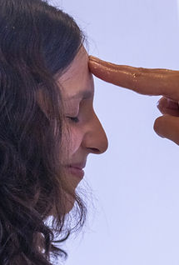
Rites for Catechumens
Rite of Entrance into the Catechumenate
Rite of Sending for Election
Rite of Election
Scrutinies
Celebration of the Sacraments of Initiation (Easter Vigil)
All are mandatory!!!

Slide 5
Please Note ….
The Simple Order of Adult Initiation (OCIA, Chapter 3) is for “extraordinary circumstances” and requires the permission of the local Ordinary (Bishop).
It is considered for use in the most exceptional of circumstances!
Reasons cited in the text – sickness, advanced age, change of residence, long journeys….
Also, when the person “was not able to begin the catechumenate with the proper rite, or, having begun, to complete all the rites.”

Slide 6
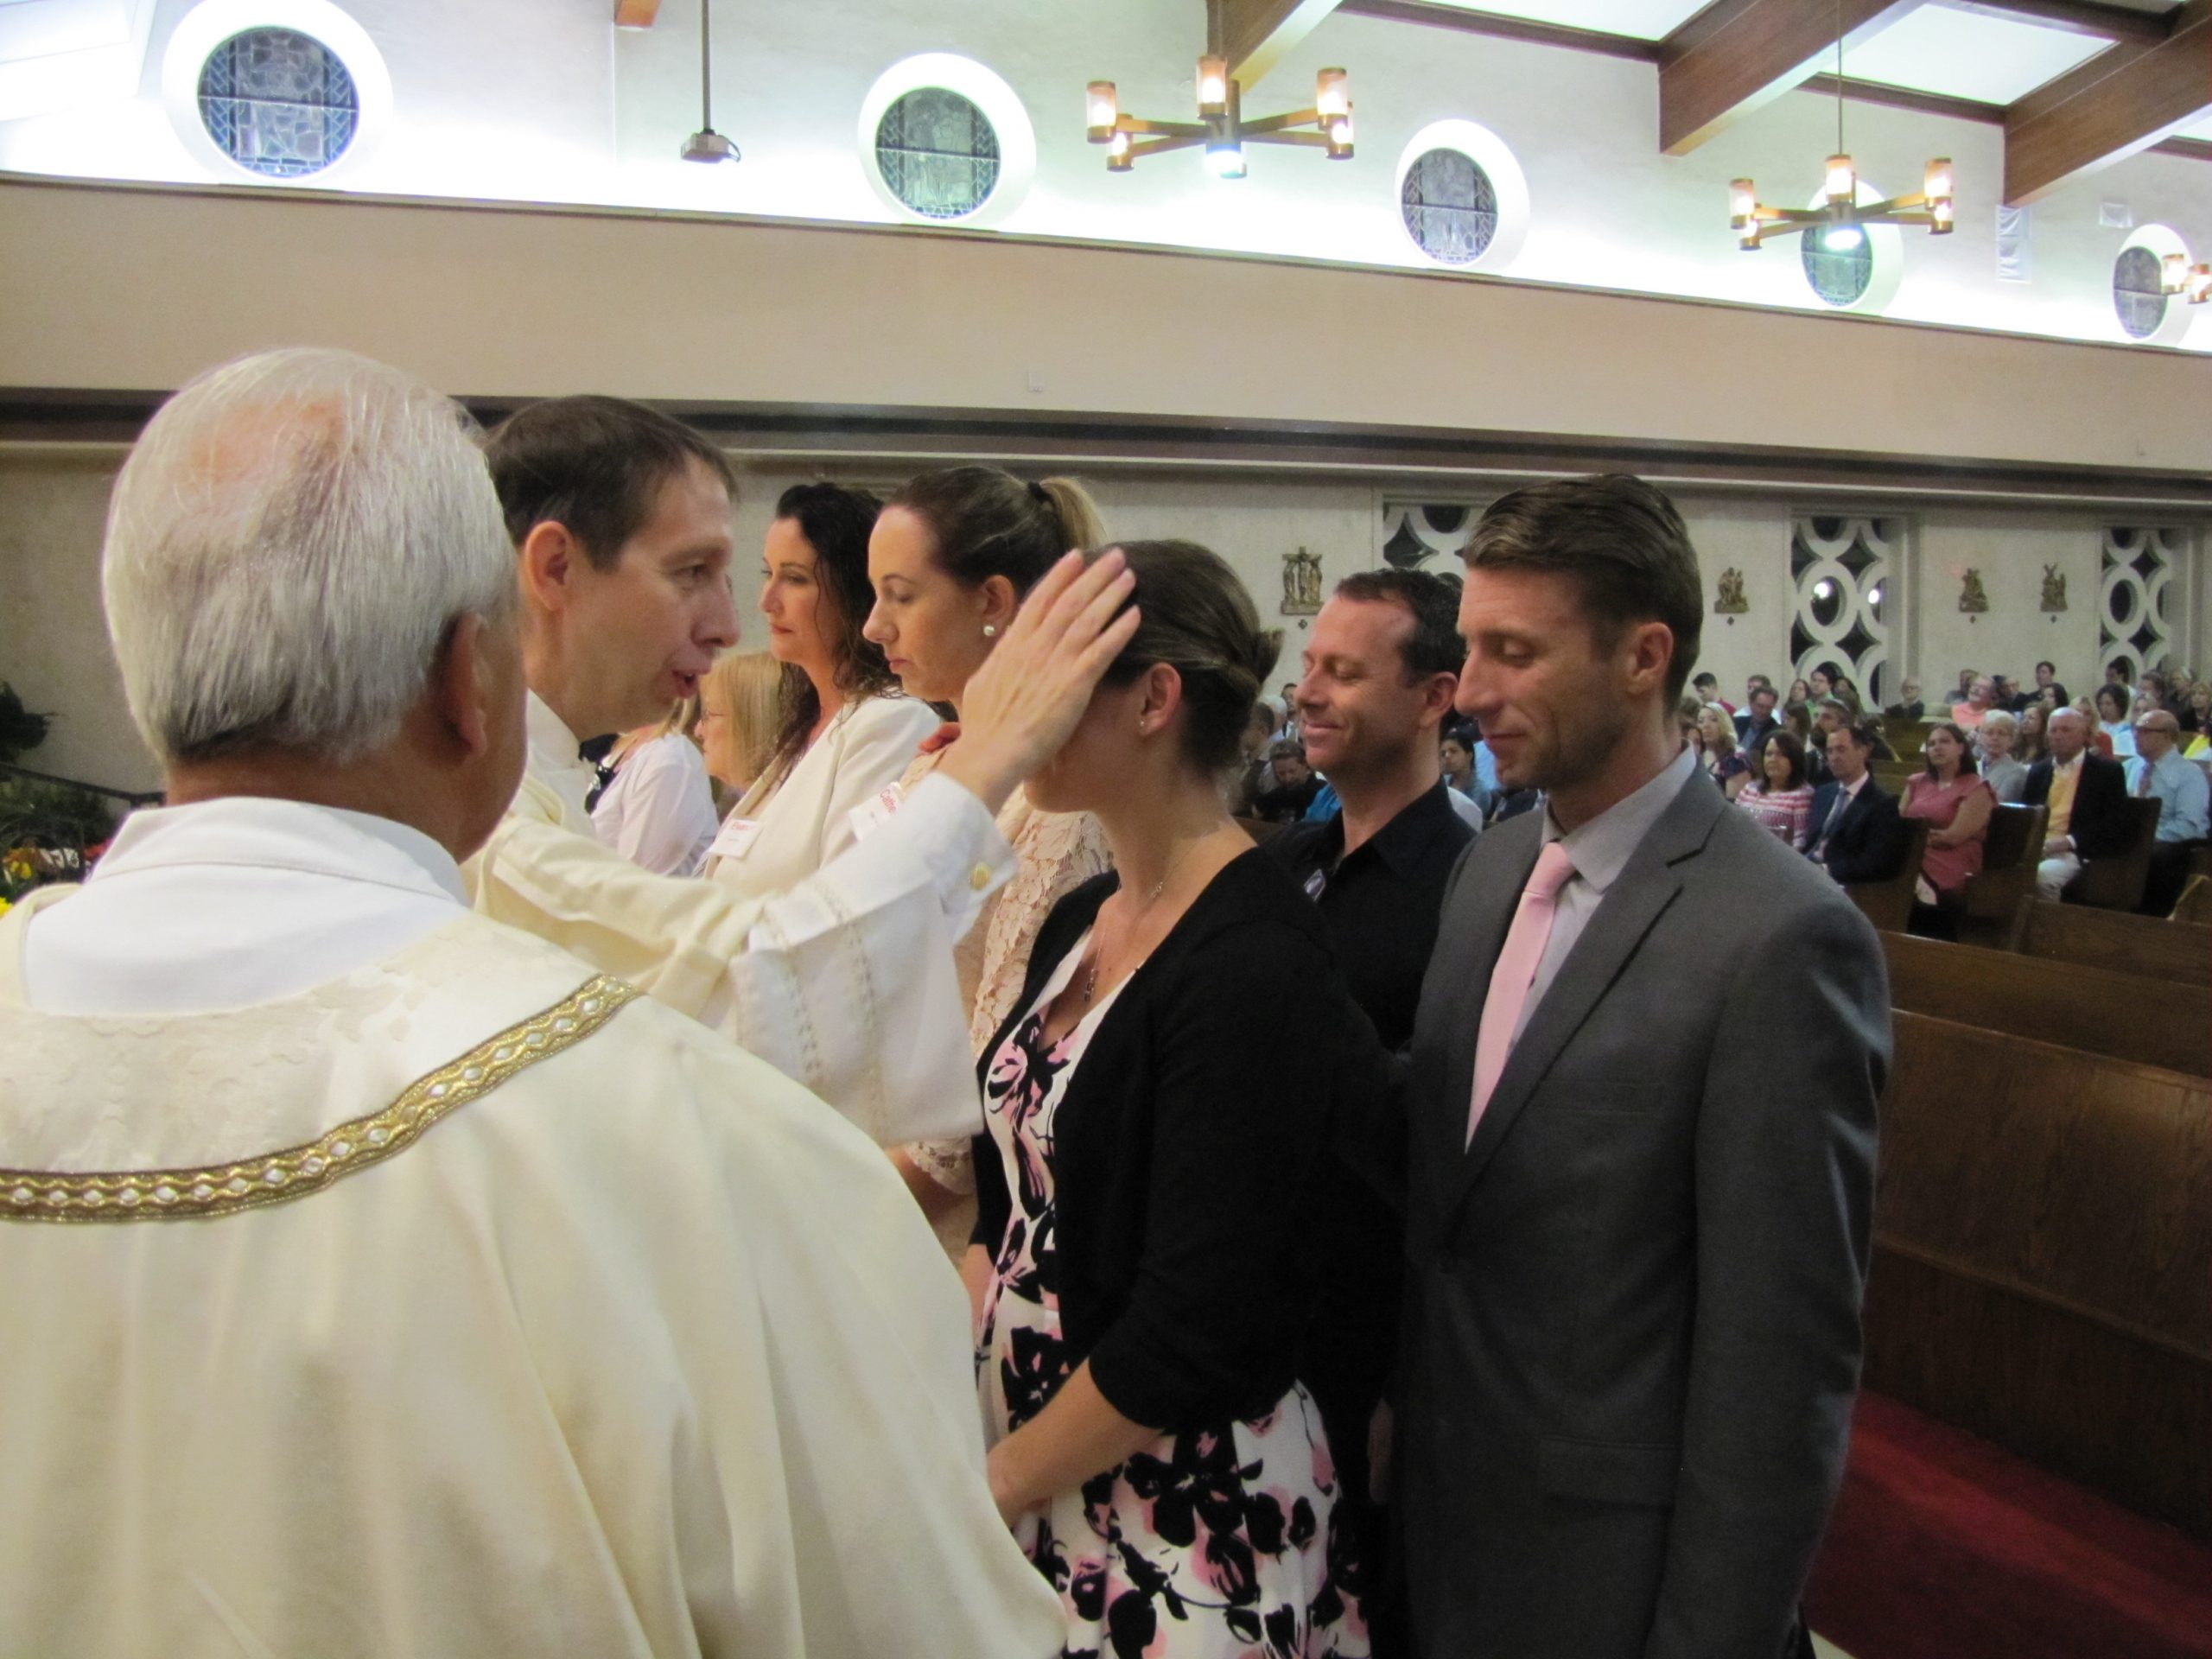
Rites for Baptized, Uncatechized Catholics
Rite of Welcoming the Candidate(s)
Rite of Sending for Calling to Continuing Conversion
Rite of Calling to Continuing Conversion
Penitential Rite (Scrutiny) – optional
Reception into Full Communion with Confirmation & Eucharist

Slide 7
Candidates for Full Communion
§ 473 – “…is so arranged so that no further burden is imposed than what is necessary to restore communion and unity.”
What is the person’s faith?
Regularly practicing?
What religion is he/she?
What’s Necessary?
Sacrament of Penance (general confession of sins)
Rite of Reception (OCIA, Chapter VI)

Slide 8
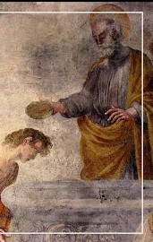
Conditional Baptism
Follow the Diocese of St. Augustine’s Norms for Conditional Baptism
Cannot be done on Good Friday or Holy Saturday!!!

Slide 9
What Other Questions Do You Have?

