Slide 1
Jesus Models The
Evangelization, Catechetical and Ministerial Encounter Method:

Slide 2
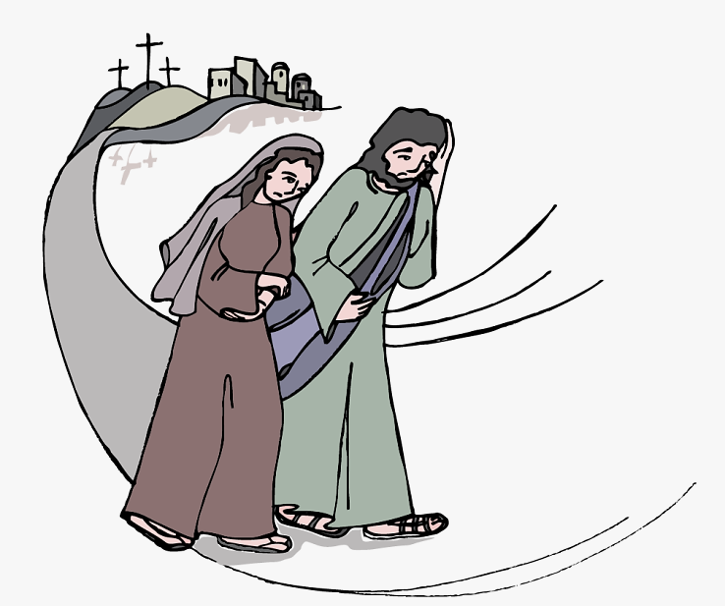
Notes:
Now that very day two of them were going to a village seven miles from Jerusalem, called Emmaus.. (Luke 24:13-15)

Slide 3
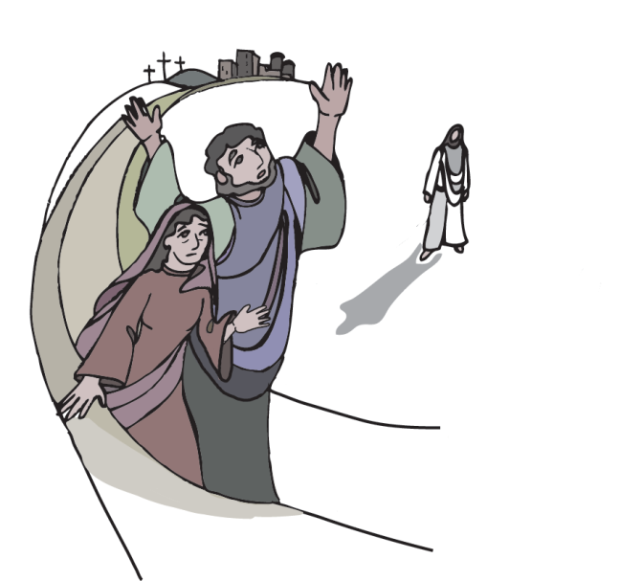
Notes:
and they were conversing about all the things that had occurred

Slide 4
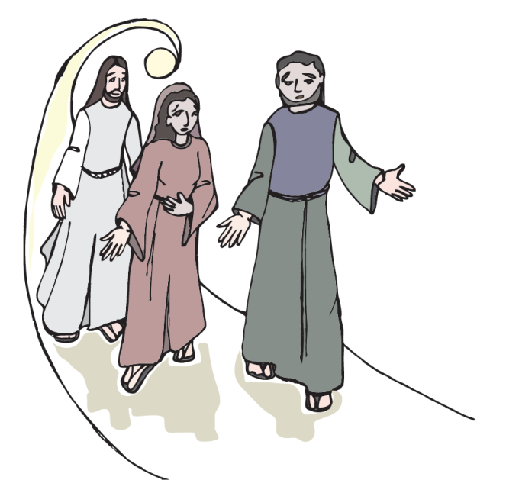
Notes:
And it happened that while they were conversing and debating, Jesus himself drew near and walked with them, but their eyes were prevented from recognizing him

Slide 5
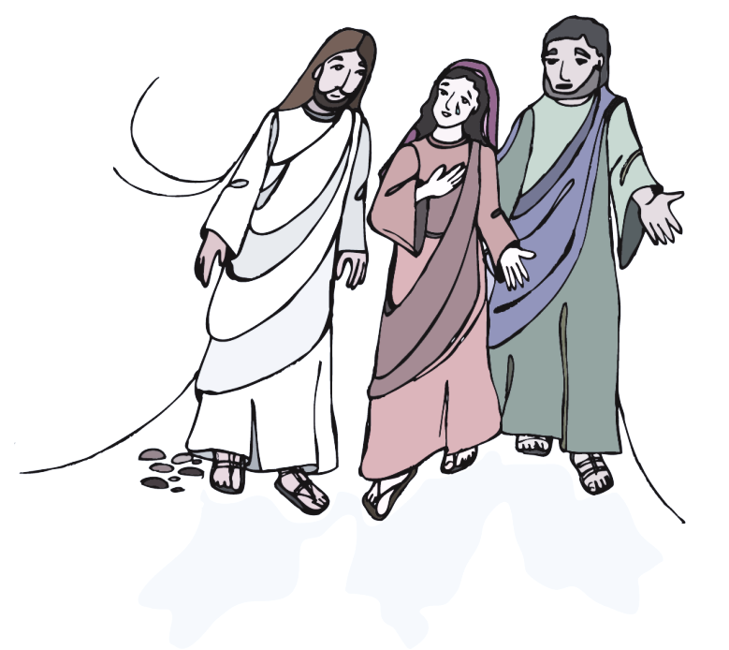
Notes:
[He asked them,] “What are you discussing as you walk along?” They stopped, looking downcast. One of them, named Cleopas, said to him in reply, “Are you the only visitor to Jerusalem who does not know of the things that have taken place there in these days?” And he replied to them, “What sort of things?” They said to him, “The things that happened to Jesus the Nazarene, who was a prophet mighty in deed and word before God and all the people, how our chief priests and rulers both handed him over to a sentence of death and crucified him.

Slide 6
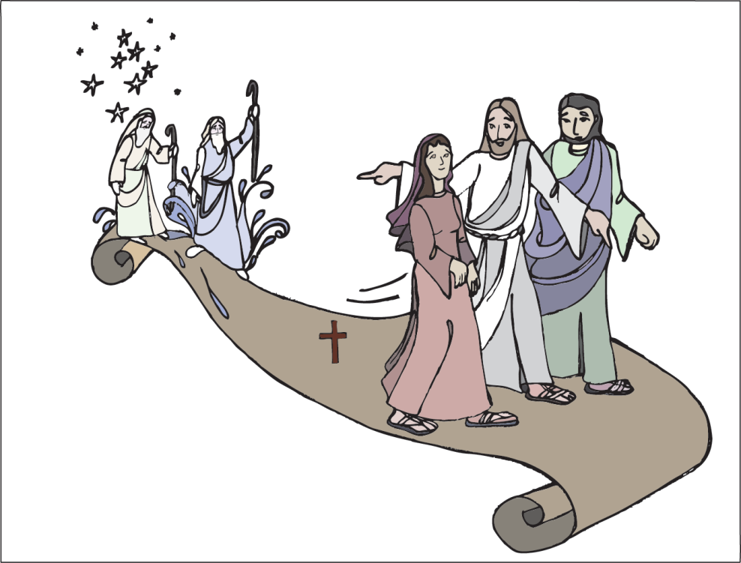
Notes:
And he said to them, “Oh, how foolish you are! How slow of heart to believe all that the prophets spoke! Was it not necessary that the Messiah should suffer these things and enter into his glory?” Then beginning with Moses and all the prophets, he interpreted to them what referred to him in all the scriptures.

Slide 7
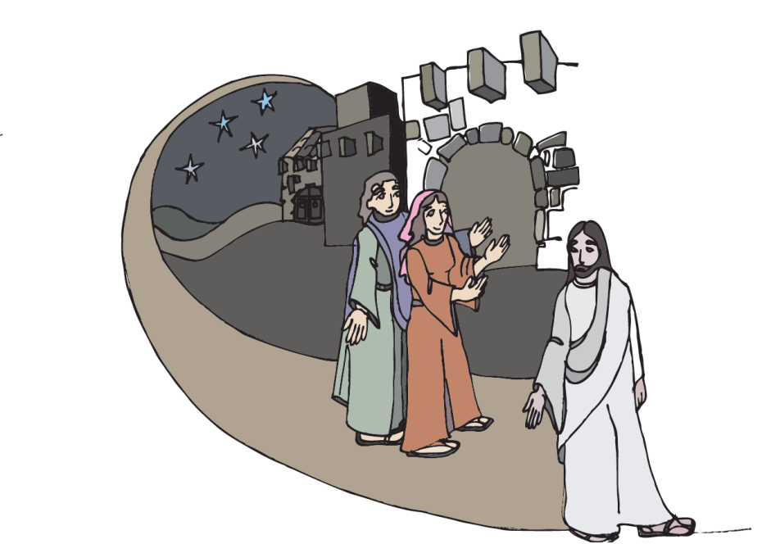
Notes:
As they approached the village to which they were going, he gave the impression that he was going on farther. But they urged him, “Stay with us, for it is nearly evening and the day is almost over.” So he went in to stay with them.

Slide 8
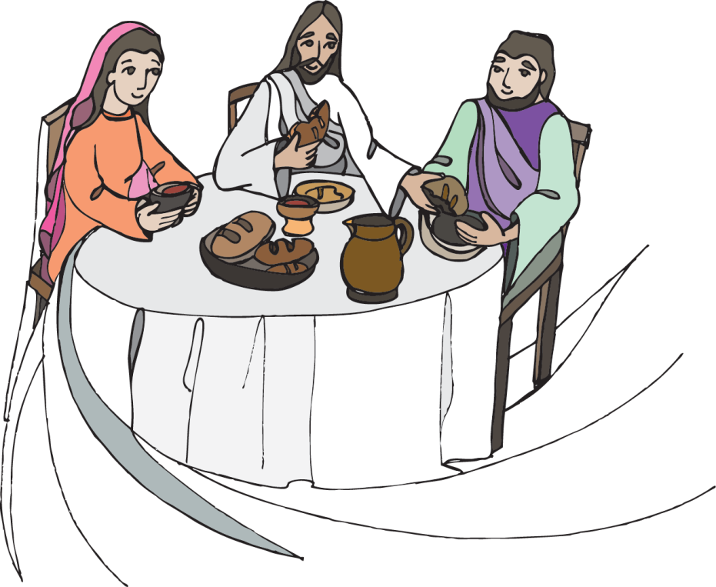
Notes:
And it happened that, while he was with them at table, he took bread, said the blessing, broke it, and gave it to them

Slide 9
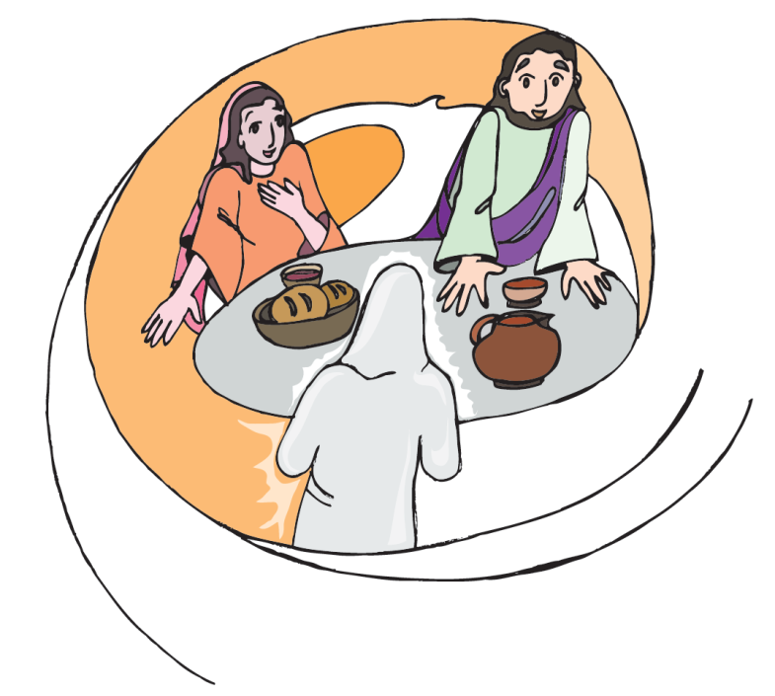
Notes:
. With that their eyes were opened and they recognized him,

Slide 10
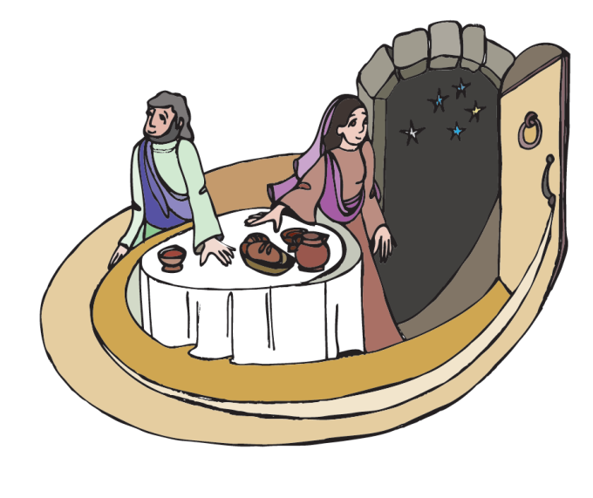
Notes:
but he vanished from their sight.

Slide 11
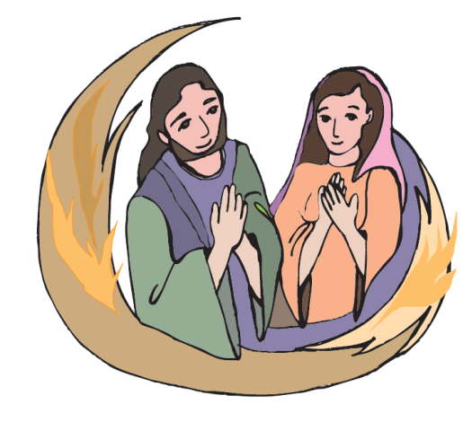
Notes:
Then they said to each other, “Were not our hearts burning [within us] while he spoke to us on the way and opened the scriptures to us?”

Slide 12
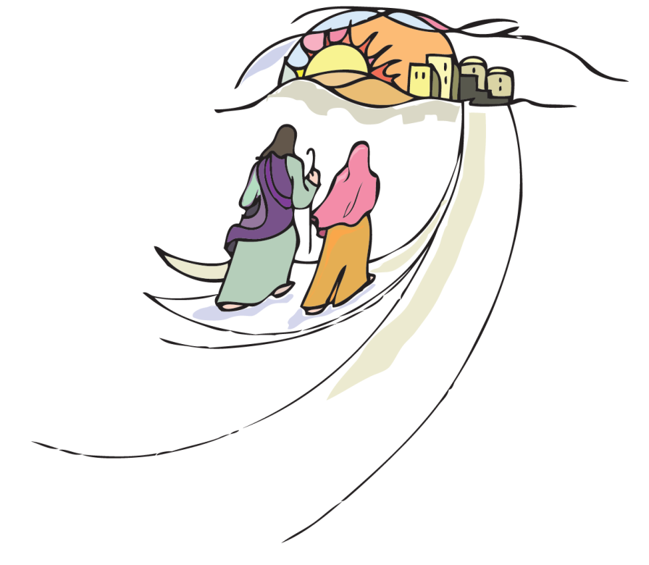
Notes:
So they set out at once and returned to Jerusalem.

Slide 13
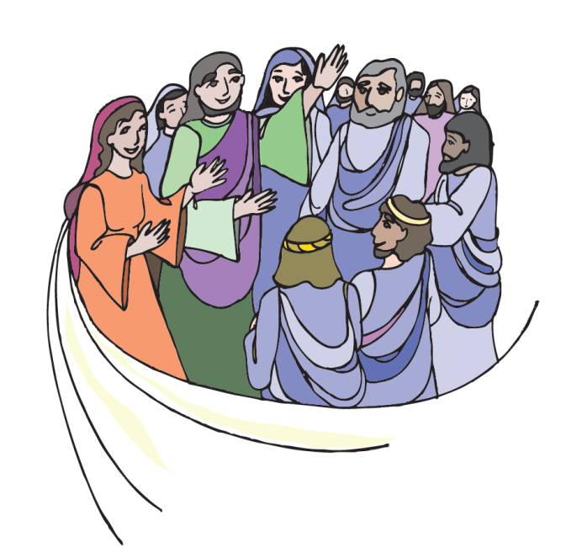
Notes:
where they found gathered together the eleven and those with them who were saying, “The Lord has truly been raised and has appeared to Simon!” Then the two recounted what had taken place on the way and how he was made known to them in the breaking of the bread.

Slide 14
Jesus Models The Evangelization, Catechetical & Ministry Encounter Method:
Relationship→ Then Instruction

