Slide 1
Models of a Year-Round Catechumenate
Practical Ideas for
Breaking the Mold

Slide 2
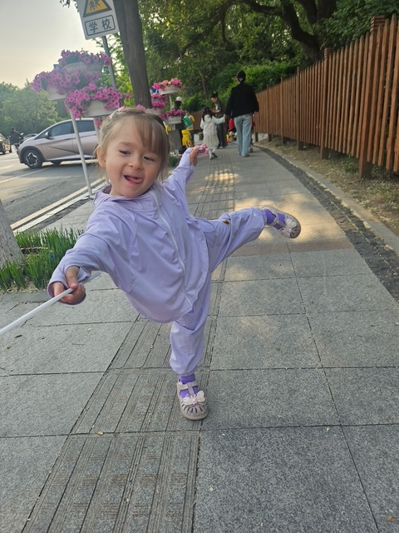
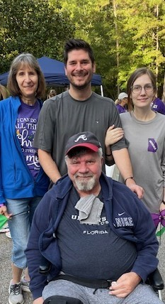
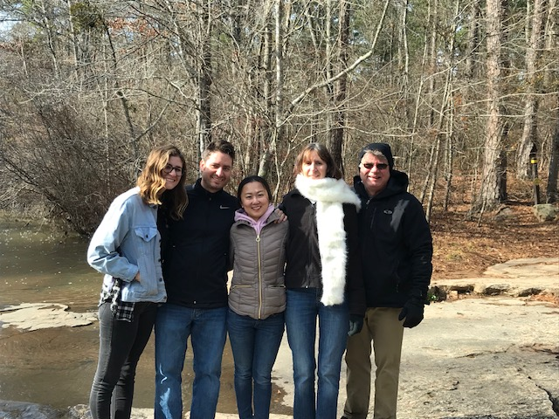
Welcome and Getting to Know Me
Background: Initiation Ministry Partners
Adults learn best from each other!
Contributions/ideas

Slide 3
Getting to Know You
Show of hands please:
How many OCIA coordinators/directors?
Serve as sponsor, catechist, or retreat leader.
Assist with hospitality, music, or prayer.
Keep records/excel sheets/calendars/organization.
Other?
Who does all the above plus some?
Your parish is currently using a school year model. Sept-May
Your parish is currently using an ongoing, year-round model.

Slide 4
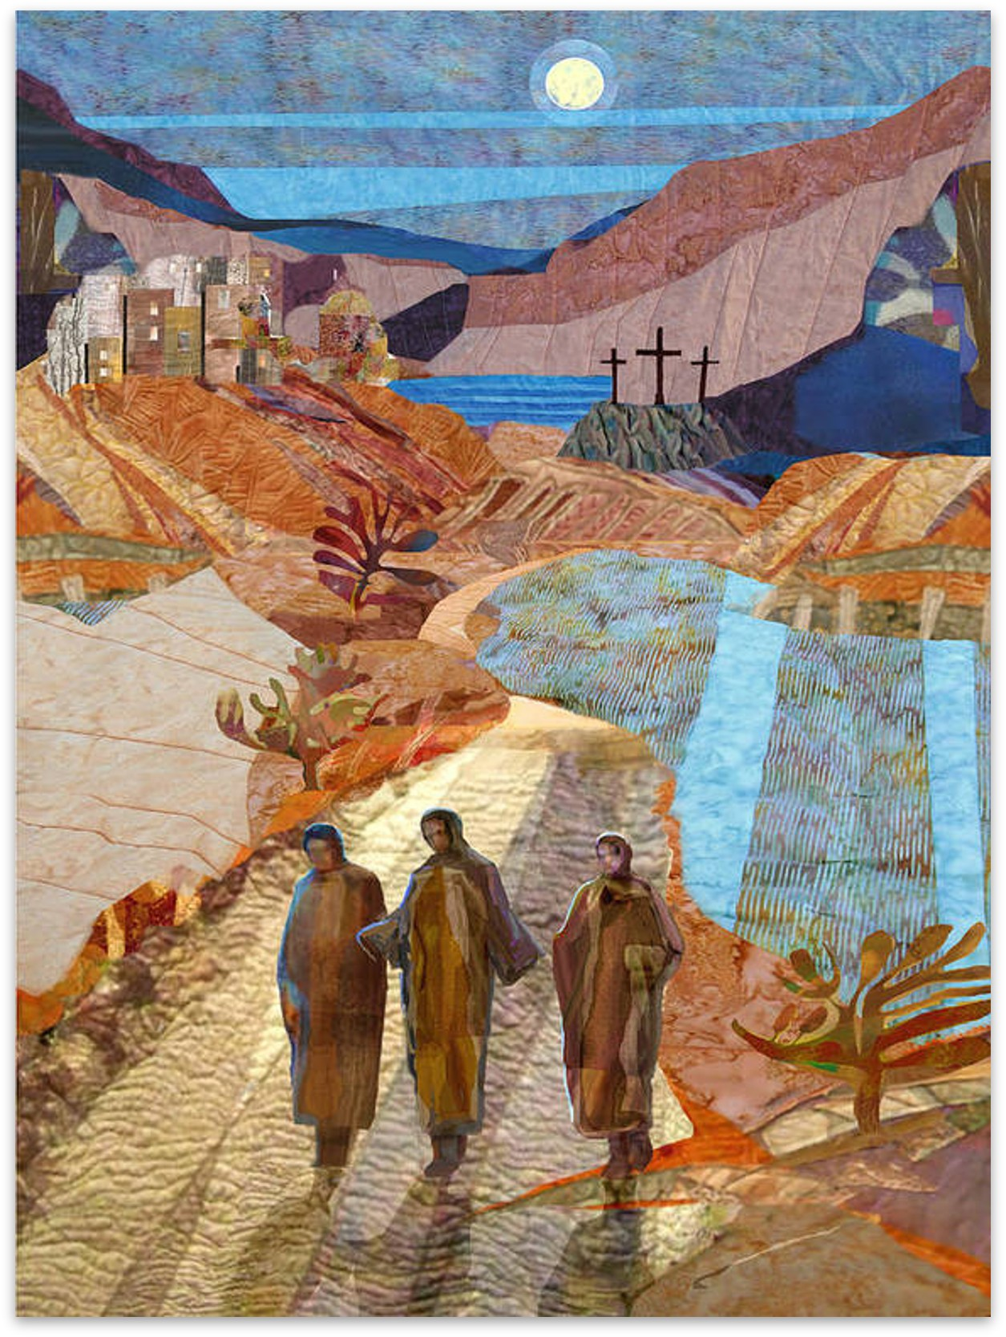
Opening Prayer
Leader: Heavenly Father, we believe that you are present with us at all times and in all
places. Thank you for bringing us together today.
Reader 1: Lord, we pray for the gift of a listening heart. As you walked with the disciples
on the road to Emmaus, you asked them to share their stories. We ask for the grace to
hear not only the words of seekers, but also the feelings and experiences behind them.
May we may truly listen with compassion.
Reader 2: Lord, you opened the Scriptures to the disciples, illuminating the truth of your
story. Grant us the wisdom to share your Word and our own faith stories with seekers
in a way that sets hearts on fire. Give us the courage to be vulnerable and authentic,
sharing our journey with others, knowing that we are all walking the road together,
both giver and receiver of your grace.
Reader 3: Like the disciples whose eyes were opened in the breaking of the bread,
we pray for a deeper recognition of your presence. Open our eyes to your presence in
our lives and in the lives of those we journey with. May we recognize your work of
conversion in us.
All: Amen.

Slide 5
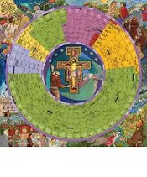

“Year-Round” Process Defined
Ongoing/Continuous
Liturgical Year / Lectionary Cycle
Weekly Sunday Mass Attendance All Year
Accompanying Individuals
Parish Community . . . As the Means
Honoring the Time That It Takes
Year of Grace 2026

Slide 6
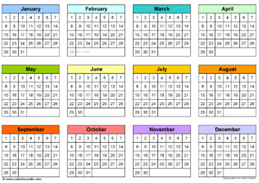
Why “Year-Round” Process Is Important
Called for by the OCIA: #9, #75, #76
Allows anyone to come in at any time
Available when The Spirit prompts
Forming Disciples
  Catechesis = a relationship with Jesus, not merely knowing content
  Primary goal of OCIA = forming committed, gospel living disciples!
OCIA: Not “One Size Fits All” process, It Takes As Long As It Takes!
Current “School Year (Academic) Model” is NOT sufficient for conversion or catechesis

Slide 7
Language for the Year-Round Catechumenate
or instructor
Group, not students or class
Join or enter, not start or begin
The rest of your life with Christ OR Continuing the journey, not end
Spiritual journey of accompaniment, not series of classes
Apprenticeship, not teaching or training
Building Disciples, OR Catechesis, not teaching
“Convert” applies to Catechumen / Candidate or both?
Words are important. What words do you use to describe the OCIA process instead of:
Program
Class
Teacher
Lecture
Student

Slide 8



Moving to Year-Round
Getting the Team on Board
Sell the Vision of the OCIA: Pastor, Staff, Team, Parish
OCIA Study Guide / Rites Book
Attend Workshops Together—In-Person + Online
Identify Gifts of Team Members
Listen To and Address Concerns
Train for Roles and Responsibilities: Catechists, Sponsors, Hospitality, Dismissal Leaders, etc.

Slide 9


Start Somewhere . . . . Just Do It!
Share: How did you start moving to a year-round process?
Take your time!
Start with simple changes
Move to Lectionary/Liturgical-based Catechesis
Dismissal
Combine ‘Breaking Open the Word’ + Catechetical Session
Transition to “Year-Round” in stages
Add “Inquiry” to be ready whenever new seekers arrive
Keep “Catechumenate” going Spring/Summer/Fall/Winter
3 Stages . . . . 3 Environments . . . . 3 Teams
Mystagogy is to Liturgy, what Lectio Divina is to Scripture

Slide 10
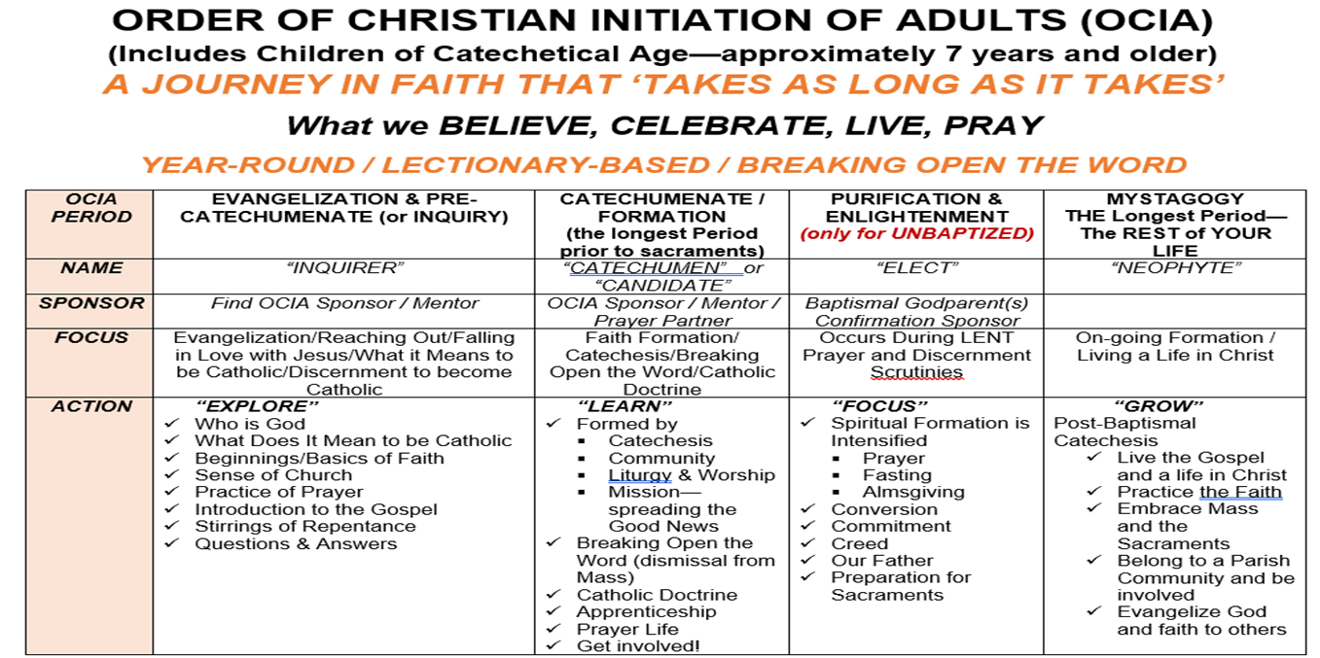
Consider the Focus of each Stage/Period of the Process

Slide 11
Practical Steps: INQUIRY
Structured Approach
Initial Conversation/Meeting/Interview is CRITICAL and Determines Path (Baptism, Marriage)
Catechumen vs. Candidate
Flexible Meeting Schedule and comfortable atmosphere.1-2 welcoming people
Sharing Stories–What Brings You Here
Uncovering/Sharing Gifts
Q & A–Encourage This!
Breaking Open the Word
Prayer
Resources: MyParishApp, FlockNotes, Laudate, Hallow, Ascension, The Chosen, FORMED
Topics: Images of God, Liturgical Calendar, The Mass
Sponsors Get Involved–Invite and Accompany
This is the Seeker’s/Inquirer’s Time, Not Ours!
Catechumen → Discernment Process → Rite of Entrance
NOTE: Rite of Welcome for Candidates is optional

Slide 12
Practical Steps: CATECHUMENATE
Meets weekly, Year-Round: Dismissal, Breaking Open the Word, Catechesis/Doctrine
Schedule?
Lectionary-Based, Liturgical Calendar
4-5 Catechists is optimal
Round tables for sharing
Dialogic Presentations & Discussions: Move from ‘formation’ to ‘transformation’
Adults learn best from each other!
“Mystery is . . . . multilayered and pregnant with meaning!” (Richard Rohr)
Why is this truth (e.g., The Resurrection) important? This is MYSTAGOGY at work throughout the entire process!
Catechumens/Candidates move as individuals and not as group
It takes as long as it takes!

Slide 13
Practical Steps: PURIFICATION & ENLIGHTENMENT
PURIFICATION and ENLIGHTENMENT = The Six Weeks of Lent
Journey to Easter Vigil
Prayerful, Spiritual Preparation Prior to Sacraments
  Elect Only
  Elect + Candidates (not Catechumens)
Retreat-like Atmosphere (Prayer table, Chairs in a circle)
Scrutinies/Creed/Lord’s Prayer/Preparation Rites for Elect ONLY
Ideas: Experience of Symbols
Easter Vigil
  Sacraments of Initiation (Elect Only)
  Combined Rite in US: Sacraments of Initiation + Rite of Reception into Full Communion
  Confirmation “Only” is not part of OCIA, just convenient

Slide 14
Practical Steps: Small or No Team? How YOU CAN Move to Year-Round/Continuous Process.
THE PARISH COMMUNITY is your Catechumenate
Imagine using this model for faith formation at all levels. What would that look like? “They devoted themselves to the teaching of the apostles and to the communal life, to the breaking of the bread and to the prayers.” (Acts 2:42)
  Sponsors!!—Accompaniment
  Parish Events, Liturgies, Activities, Gatherings: Adoration, SVDP, Women’s and Men’s Groups, Breakfast, Fish Fries, Stations of the Cross, Parish Mission, Retreats, Scripture/Bible Studies, Field Trips (Eucharistic Congress, Monastery, Cathedral, other parishes, Local Synagogue, etc)—Apprenticeship
  Regular Catechetical Sessions only form Part of the Whole Process
  Be BOLD and CREATIVE!
Lectionary-Based REALLY does Connect To Relevant Catholic Doctrine
Resources (see end of presentation)

Slide 15
Combining the use of the parish as your catechumenate with a structured approach
Use your parish calendar during the inquiry period as a time for seekers to begin exploring the parish and attending events, bible studies, parish socials, outreach activities, etc.
Meet once a month to discuss their experiences and questions and to give instruction and experience with different prayer forms.
After the Rite of Entrance into the Catechumenate, sessions can be offered weekly, if desired. Invite seekers to continue to attend bible studies, faith formation events, social justice activities.

Slide 16

It’s Messy, BUT . . . It’s Worth It!!
Advantages outweigh Disadvantages
Primary Source of Apprenticeship: The Mass and The Parish Community (Liturgies, Parish Activities, and Events)
Yes, Catechumens/Candidates MAY miss a session (that’s life)
BE FLEXIBLE!!
ADJUST as needed

Slide 17

What are YOUR Fears/Concerns Moving to
Year-Round/Continuous?
Who has moved
to a year-round
process and
what was your
experience?
What worked
and what did
not work?

Slide 18
Addressing Your Concerns
What About a Schedule?
Not Enough Catechists?
Loss of Group Bonding?
Keeping Track of Who Needs What and When, and Where Are They in the Process?
Having a group of one?
Losing a Summer Break or too many other things in summer?
Losing Your Team?
Taxing Your team?
Others . . . . ?

Slide 19
Team Initiation: Year-Round Articles
Is Your Catechumenate Open all Year-Round? What Does Year-Round Mean?
https://teamrcia.com/2022/09/is-your-catechumenate-open-all-year-round-what-does-year-round-mean/
How to Start a Year-Round RCIA Process
https://teamrcia.com/2021/04/how-to-start-a-year-round-rcia-process/
Learn Why Year-Round is Easier
https://teamrcia.com/2015/07/rcia-learn-why-year-round-is-easier/
Toward a Year-Round RCIA Process–One Thing at a Time with Small Steps
https://teamrcia.com/2020/11/toward-a-year-round-rcia-process-one-thing-at-a-time-with-small-steps/
A Year-Round Apprenticeship Model for RCIA Gives Me Confidence We Are Forming Disciples
https://teamrcia.com/2020/10/a-year-round-apprenticeship-model-for-rcia-gives-me-confidence-that-we-are-forming-disciples/
Is Your RCIA Open All Year-Round? Being Flexible.
https://teamrcia.com/2020/11/is-your-rcia-open-all-year-round-being-flexible/
We’re Flexible–How Our Parish Does Year-Round RCIA
https://teamrcia.com/2020/09/were-flexible-how-our-parish-does-year-round-rcia/
What Would Happen if Every Parish had an Ongoing (Year-Round) RCIA Process?

Slide 20
Team Initiation: Year-Round Articles-2
Q&A Multiple Seekers on the Journey of Faith–How to Start a Year-Round RCIA.
https://teamrcia.com/2020/07/qa-multiple-seekers-on-the-journey-faith-how-to-start-a-year-round-rcia/
Jesus’s Timing is Perfect–One Parish’s Experience of Year-Round RCIA.
https://teamrcia.com/2020/08/jesuss-timing-is-perfect-one-parishs-experience-of-year-round-rcia/
Rethinking the Core Catholic Content as We Move to Ongoing Initiation (Year-Round RCIA https://teaminitiation.com/2020/05/rethinking-the-core-catholic-content-as-we-move-to-ongoing- initiation-year-round-rcia/
Is Your RCIA Open All Year-Round? Having Everyone Around the Same Table.
https://teamrcia.com/2022/05/is-your-rcia-open-all-year-round-having-everyone-around-the-same-table/
Why is an Ongoing Year-Round RCIA Important?
https://teamrcia.com/2021/04/why-is-an-ongoing-year-round-rcia-important/
RCIA Requires Big Paradigm Shifts, Starting with These Two
https://teamrcia.com/2019/06/rcia-requires-big-paradigm-shifts-starting-with-these-two/
Is Your RCIA Open All Year-Round? Are we Catechizing for Knowledge or Understanding?
https://teamrcia.com/2018/12/is-your-rcia-open-all-year-round-are-we-catechizing-for-knowledge-or-understanding/

Slide 21
Resources for Year-Round / Continuous OCIA
Apprenticeship & Accompaniment
Article: Pros and Cons of a Year-Round RCIA Program
https://www.catechist.com/pros-cons-year-round-rcia-program/
Divine Blessing: Liturgical Formation in the RCIA by Dr Timothy O’Malley, Liturgical Press, Collegeville (2019)
Unfolding the Mystery of Christ: Sunday by Sunday Formation of Catechumens, Eliot Kapitan, Liturgical Press, Collegeville (2020)
Your Roadmap to a Conversion-Centered Catechumenate by John McGlynn, Liturgical Press, Collegeville (2023)
Your Parish is the Curriculum: RCIA in the Midst of Community by Diana Macalintal, Liturgical Press, Collegeville (2018)
Apprenticed to Christ: Activities for Practicing the Catholic Way of Life by Jerry Galipeau. (2007) ISBN: 978-1584593270

Slide 22
Closing Prayer
Dear Lord of all, we praise You, honor You, and thank You.
Bless us as we leave this gathering, armed with understanding, thoughts, ideas and courage to move to a Year-Round Continuous Catechumenate as we build up Your Kingdom with missionary disciples.
“Show me your ways, LORD, teach me your paths. Guide me in your truth and teach me, four you are God my Savior, and my hope is in you all day long.” (Psalm 25:4-5)
May the catechumens and candidates we serve grow stronger in their faith and shine their light for others. In the name of the Father, the Son, and the Holy Spirit. Amen.

