Slide 1

Overview: State Systems and Investments for Expanded Learning Support
Erik Peterson, Senior Vice President of Policy, Afterschool Alliance
Oregon EASE - October 10, 2023

Slide 2

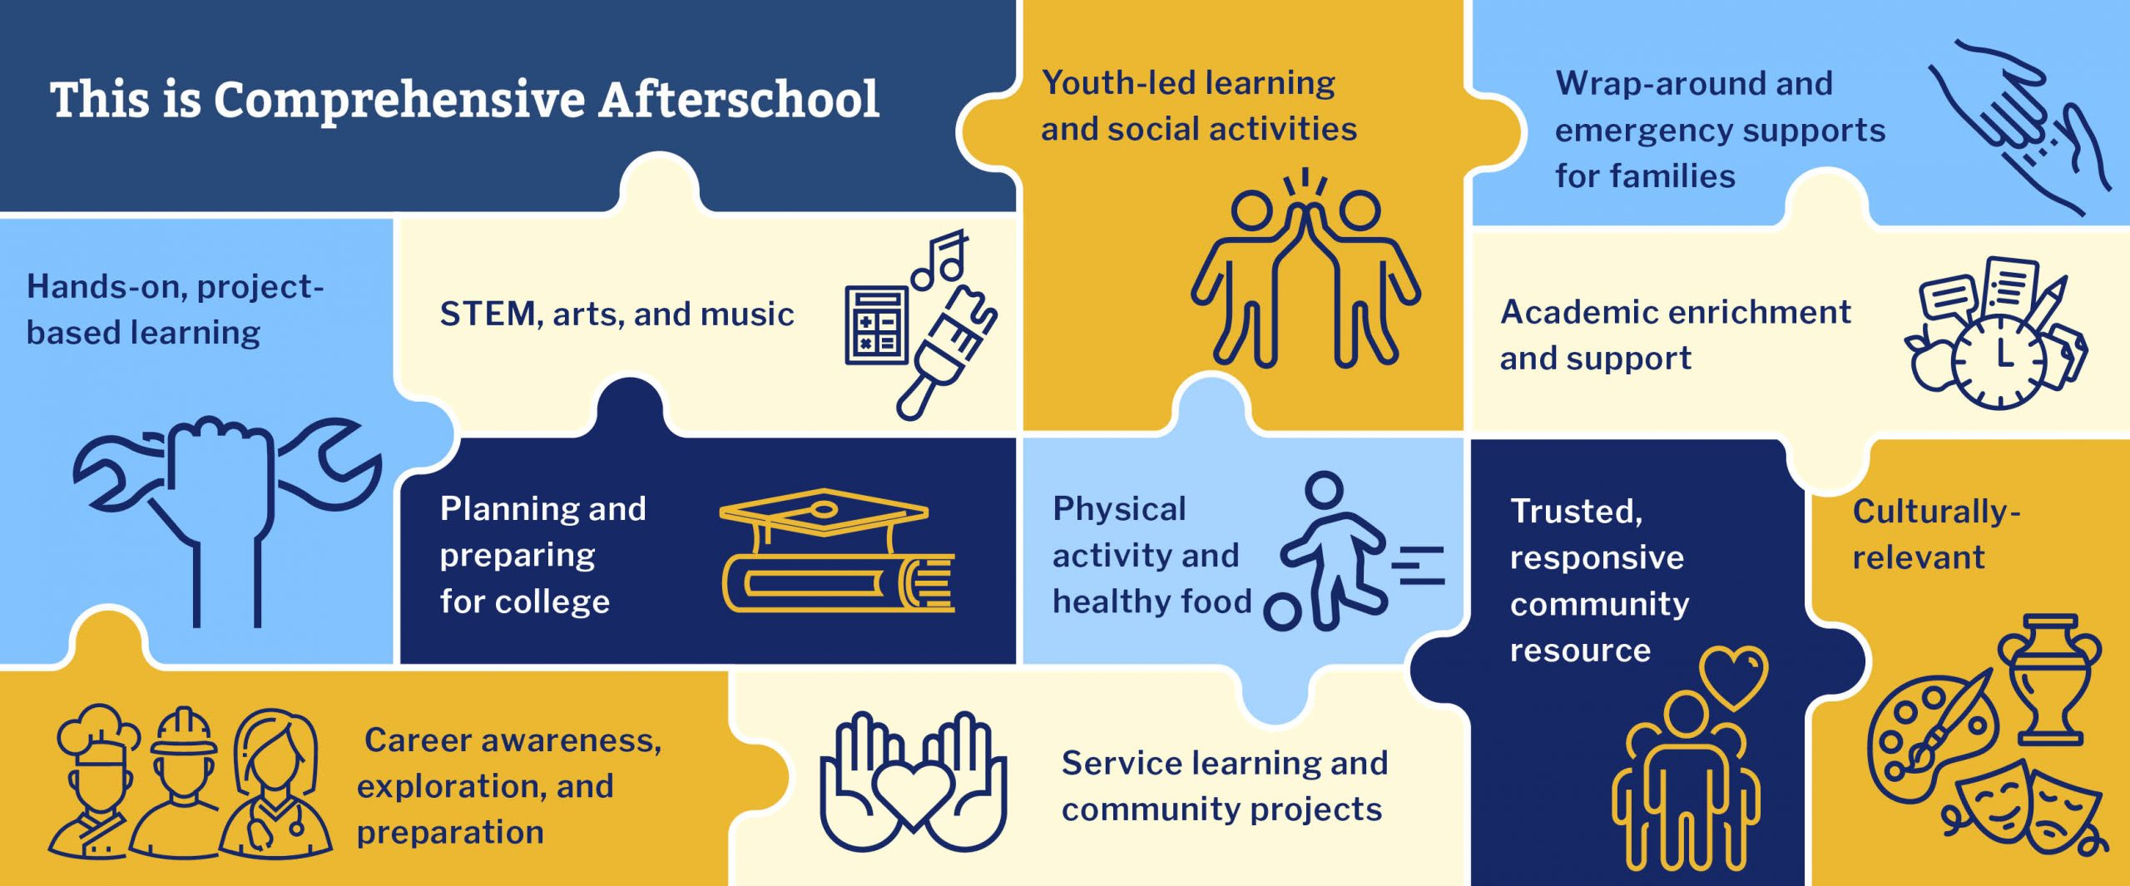
The Afterschool Alliance
The Alliance works to ensure that all youth have access to affordable, quality afterschool and summer learning programs by engaging public will to increase public and private investment in afterschool and summer learning program initiatives at the national, state, and local levels
National Partners
More than 25,000 program providers
Work with 50 statewide afterschool networks
200 Afterschool Ambassadors at the local level
VISTAs embedded to build state and local infrastructure

Slide 3

HAPPY
EVE!

Slide 4
How is Afterschool Funded at the State Level?
State Budget Appropriations
Ballot Initiatives
State Lottery Funds
Funding Formula
Cannabis and Other Revenue
Additional Efforts
Non 21st CCLC Federal Funds (TANF, CCDBG)

Slide 5
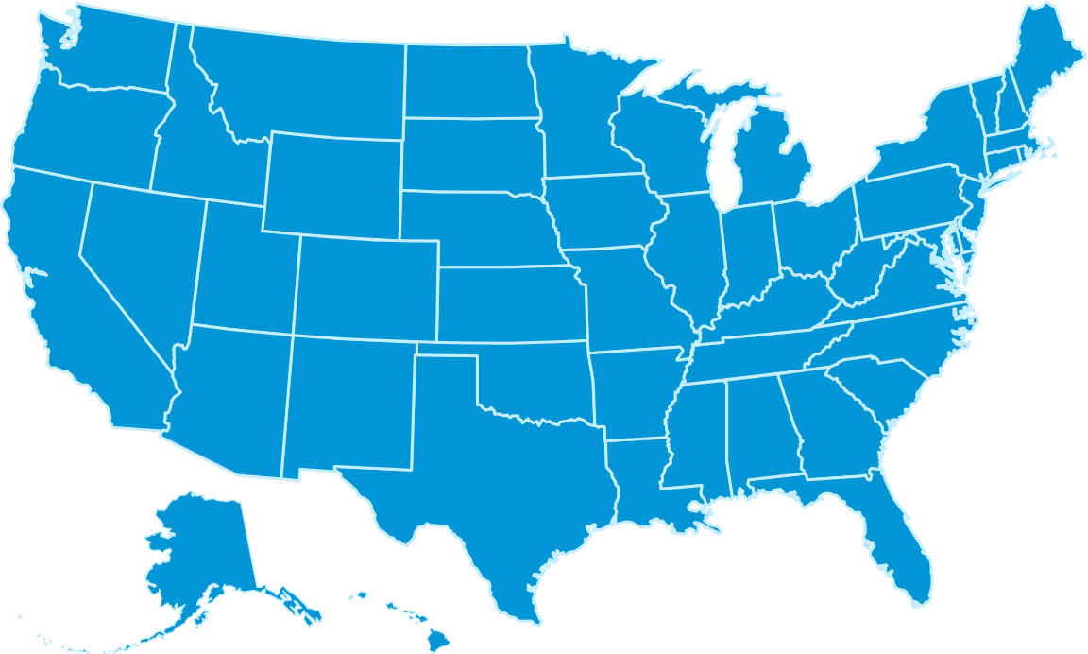


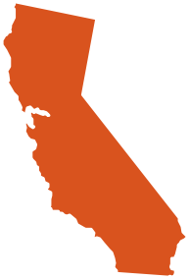


State Budget Appropriations – Budget Line Items
New York
Advantage After School Program; Empire State Afterschool Program
$88 million total in 2023
Illinois
Teen REACH
$17.8 million in 2023
Massachusetts
ASOST and ASTOS-Q (quality enhancements)
$10.9 million in 2023
Connecticut
After School Program Grant
$5.7 million in 2023
California
After School Education and Safety (ASES) Program created through ballot initiative (Proposition 49) and funded through state budget appropriations
Expanded Learning Opportunities Program (ELO-P)
$4.65 billion in 2023

Slide 6
State Budget Appropriations – New in 2022 & 23
Alabama - 2022
$1.5 million in 2022 for Afterschool and Summer Program. Additional $1.3 million provided in 2023 for $2.8 million in total funding
Minnesota - 2023
$30 million appropriated over 4 years ($7.5M annually) for the Afterschool Community Learning Grant program in 2023.
Michigan - 2023
$50 million for afterschool in 2023, with 60% to CBO’s. in 2022, state utilized $25 million in ARP funds for afterschool, now continuing with state dollars.
New Mexico - 2023
$20 million for out-of-school time programs, $10 million of which is for afterschool and summer programs.
Texas- 2023
$5 million over 2 years ($2.5 million annually) for out-of-school time programs run by CBO’s.

Slide 7


State Lottery Allocations
Tennessee
Lottery for Education: Afterschool Programs (LEAP)
Created in 2002 to reserve unclaimed lottery funds for public and non-profit afterschool programs serving students aged 5-18 with priority for programs enrolling 80% high-need students.
$14 million in 2023
Nebraska
Expanded Learning Opportunities Grants
Funded by proceeds from the Nebraska Lottery.
$1.2 million in 2023

Slide 8
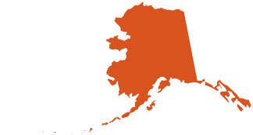
Cannabis Revenue
Alaska
The Alaska Legislature passed Senate Bill 104 which directs cannabis tax revenue to drug prevention programs. 12.5% of cannabis excise tax revenue is dedicated to the Positive Youth Afterschool Grant program, which funds afterschool programs across the state.
The first round of funding provided $1.25 million to programs, now up to $2 million
Illinois
The Cannabis Regulation and Tax Act (HB1438) became law on June 25, 2019, legalizing adult-use cannabis and creating the Restore, Reinvest, and Renew (R3) program. R3 funded 80 programs including youth development/ afterschool programs in January 2021.
Vermont
The FY24 state budget included a $4 million appropriation of tax revenue from that sale of cannabis towards the education fund to support grant programs for the expansion of summer and afterschool programs.
Research Brief - Advancing Afterschool and Summer Opportunities Using Cannabis Tax Revenue

Slide 9


Other Tax Revenue
Philadelphia
Revenue from a sugary drink tax supports community schools, afterschool, and early care programs.
Denver
Approved a local sales tax for cannabis for city operations and an additional special sales tax.

Slide 10




Non 21st CCLC Federal Funds
Temporary Assistance for Needy Families (TANF) and Child Care Development Block Grant (CCDBG) funds can be utilized by states to support school-age afterschool programming. States can also contribute matching state funds that can support youth programs.
Georgia utilizes TANF funds to support afterschool programming.
New York’s Advantage After School Program was originally created through the appropriation of TANF funds.
Utah uses Child Care Development and TANF funds to support elementary-age and older youth afterschool programs.
Missouri utilized $3 million in TANF funds for afterschool and OST programs in 2019.
Hawaii uses TANF funds to support the A+ and UPLINK program that support afterschool in the state.

Slide 11
Utah
Temporary Assistance to Needy Families (TANF) funds allocated through Health and Human Services agency to award afterschool grants to older youth programs. Human Service agency also leverages Child Care Development Fund to provide grants to afterschool programs
Coordination – State afterschool network in Utah leverages the TANF and CCDF investments to partner with the State Education Agency on their quality and 21st CCLC grants.

Slide 12
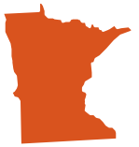

Education Funding Formula
Minnesota
Community education formula for school districts includes youth after-school enrichment revenue.
New Mexico
HB 5, passed in 2019, provided additional per-pupil funds for districts to opt into providing extended learning programs, including adding additional days to the school year and provide afterschool programming.

Slide 13
Other State Efforts to Fund Afterschool
Revenue from medicinal cannabis sales (OK)
Proposed bill, not passed.
Funding from public settlements
Tobacco industry lawsuits, Juul settlement, opioid settlements, and financial crisis settlements (2008-09)
Funding from public utility companies
Red light camera fines (IL)
Sports betting – NY bill funds youth sports with sports betting revenues
Digital Advertising Tax – MD passed HB 732 in 2020 to institute a tax on digital advertising revenue, with funds supporting education.

Slide 14
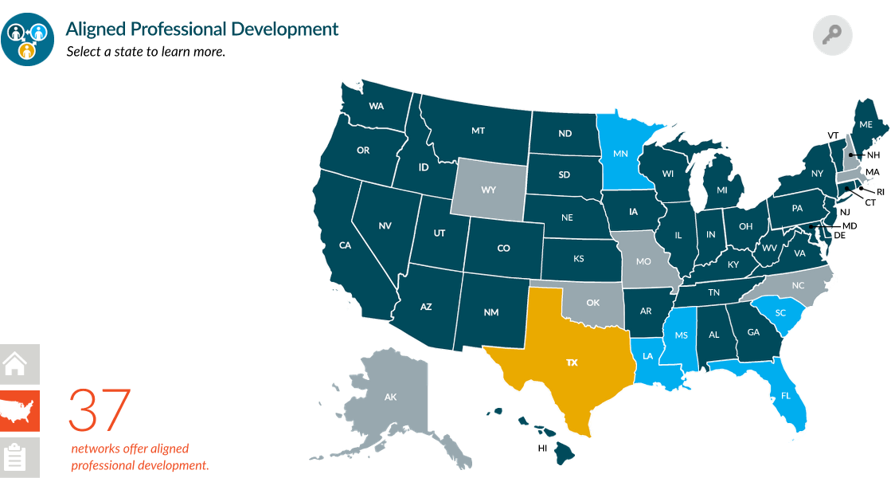
Key Components to Systems Supporting Afterschool
Quality Standards, Guidelines, and Continuous Improvement Tools
Staff Professional Development
Positive Youth Development
Content Areas
Mental Wellbeing
Capacity Building Support and Assistance
Financial and Administrative Support (GA, IL)
Organizational Health (NYC)
Notes:
Quality standards and guidelines are foundations for afterschool systems – nearly all 50 states have developed quality standards: shared definition of quality inform contiguous quality improvement efforts, and guide PD.
- Louisiana – use Q standards as flashlight not hammer - actively monitor programs and provide feedback.
Afterschool quality systems that align professionals dvlpt standards with quality standards support staff learning and sustain continuous improvement by reinforcing professional standards and practice
In 2021 37 states had aligned prof dvlpt standards – 5 more were under development.
22 states afterschool networks partner with other orgs to bring PD opps to the field.
Partnerships with college/univs. Education service districts, online and in person, meet people where they are, train trainers, regional workshops; coordination for afterschool educators to participate alongside teachers in staff PD days…
Capacity Building Support and Assistance
Financial and Administrative Support (GA, IL) nonprofit management, fiscal management, grant writing
Coordination – biggest challenges – getting fed programs to work together – braiding, coordination, consolidation? MI Department of Lifelong Education, Advancement, and Potential

Slide 15
Key Components to Systems Supporting Afterschool
Intentional Focus on Equity
Understanding Gaps in Access
Identifying How to Get Funding to Organizations that Can Address the Gaps
Coordination – within/across agencies and funding streams
Braiding and Layering Funding
Stakeholder Engagement

Slide 16
Resources
Sustainability and Funding for Programs - Compilation of resources and tools on funding and sustainability
Funding Out-of-School Time Programs—Now and in the Future - Fact sheet and resource from the Children’s Funding Project in collaboration with Afterschool Alliance and Grantmakers for Education
Building Quality in Afterschool – AIR – Tools to promote and build statewide afterschool quality systems
Wallace Foundation Knowledge Center – variety of resources to support fiscal management and quality practices
Notes:
Sustainability and Funding for Programs - Compilation of resources and tools on funding and sustainability
http://www.afterschoolalliance.org/covid/financial-support-development.cfm
Funding Out-of-School Time Programs—Now and in the Future - Fact sheet and resource from the Children’s Funding Project in collaboration with Afterschool Alliance and the Grantmaker’s for Education
https://static1.squarespace.com/static/5b75d96ccc8fedfce4d3c5a8/t/6509b0defe71912cffbfd7de/1695133919682/Funding+Out-of-School+Time+Programs+Final.pdf
Building Quality in Afterschool – AIR – Tools to promote and build statewide afterschool quality systems
https://www.air.org/project/building-quality-afterschool

Slide 17
Contact Info
Erik Peterson <epeterson@afterschoolalliance.org>

