Slide 1
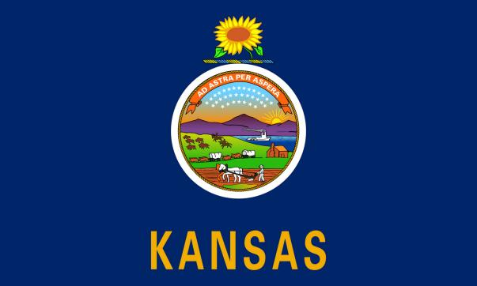
KANSAS TRIVIA

Slide 2
STATE SYMBOLS
GOVT. & CAPITOL
WILD WEST
FUN FACTS
25
25
25
25
50
50
50
50
75
75
75
75
100
100
100
100

Slide 3

ANSWER

Slide 4
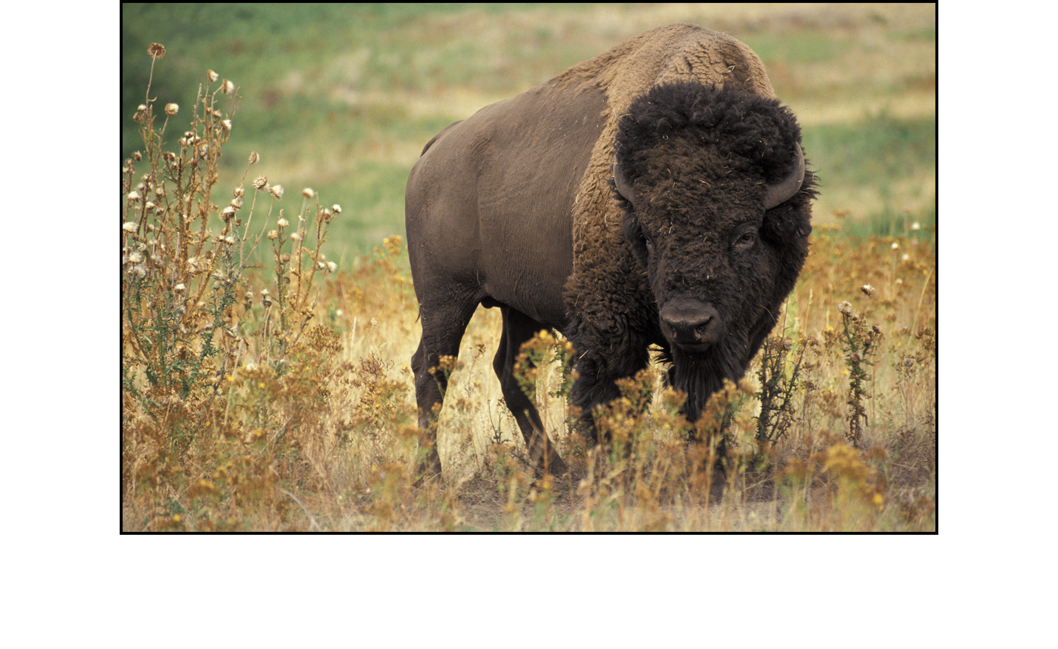
Back to game board

Slide 5

ANSWER

Slide 6
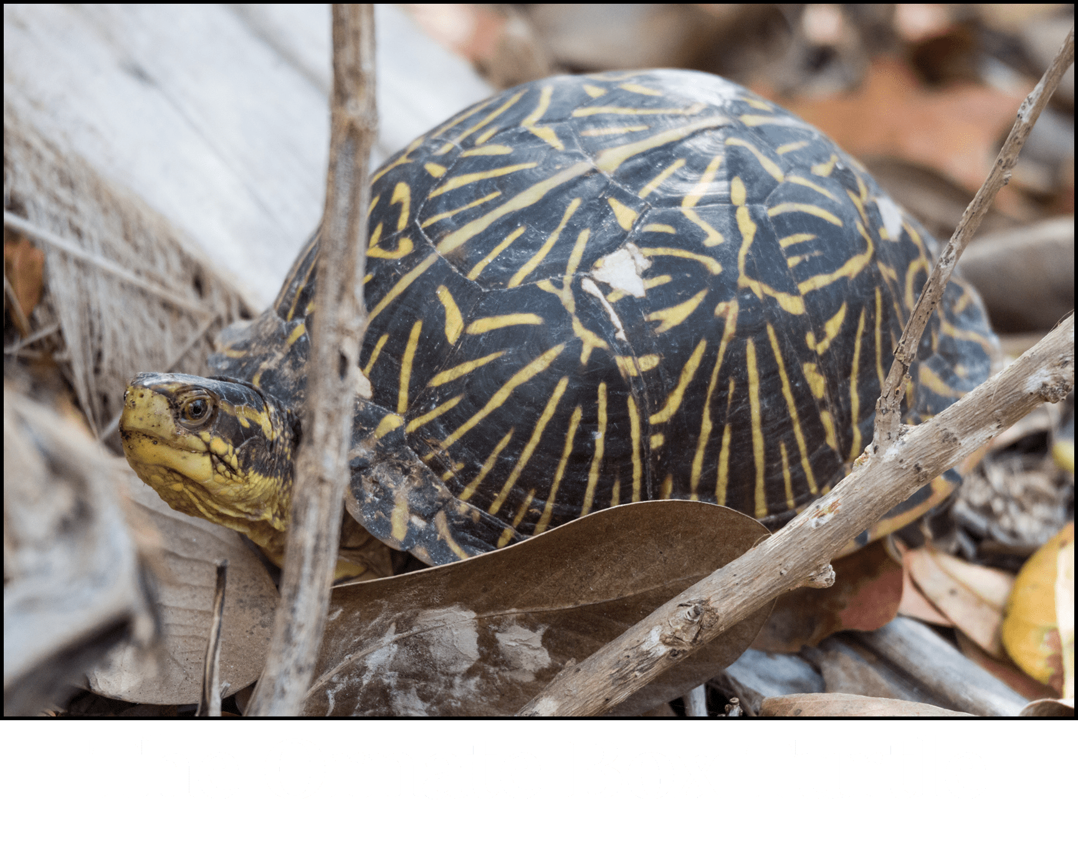
Back to game board

Slide 7
This sedimentary rock is often used for building materials. It became the state rock in 2018 thanks to a fourth grader from Overland Park.
ANSWER

Slide 8
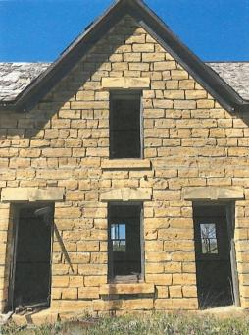
Back to game board
Greenhorn Limestone

Slide 9
This state fish became official in 2018 and is extremely common in Kansas. It usually weighs two to four pounds, though some may be larger.
ANSWER

Slide 10
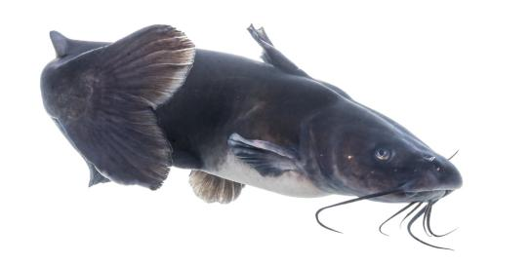
Back to game board
Channel Catfish

Slide 11
This person is the leader of the state and head of the Executive branch. The position is elected every four years.
ANSWER

Slide 12
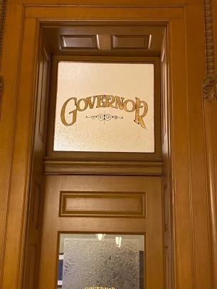
Back to game board
Governor

Slide 13
This famous abolitionist who came to Kansas to fight slavery, is featured in the Tragic Prelude mural at the state Capitol.
ANSWER

Slide 14
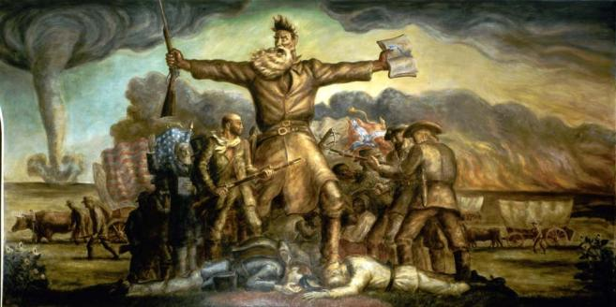
Back to game board
John Brown

Slide 15
This branch of government is responsible for interpreting and applying laws.
ANSWER

Slide 16
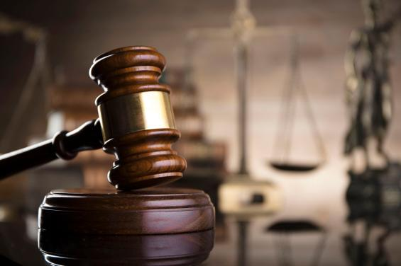
Back to game board
The Judicial Branch

Slide 17
The outer dome of the capitol is made of this material which gradually turns green when exposed to the elements.
ANSWER

Slide 18
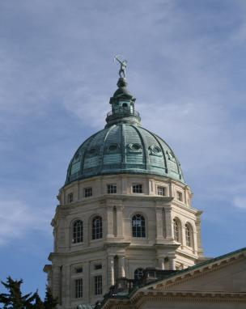
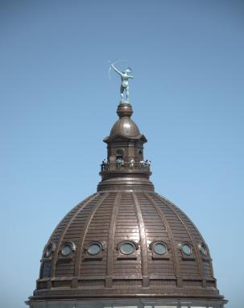
Back to game board
Copper

Slide 19
These people of the wild west road horseback as they led thousands of cattle from Texas to Kansas.
ANSWER

Slide 20
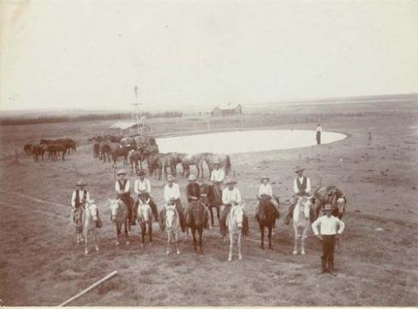
Back to game board
Cowboys

Slide 21
Cowboys wore these to protect their legs from thorny brush and cold weather. They were often made from leather.
ANSWER

Slide 22
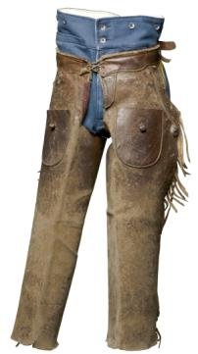
Back to game board
Chaps

Slide 23
This rope tool was used by cowboys to catch cattle or other animals.
ANSWER

Slide 24
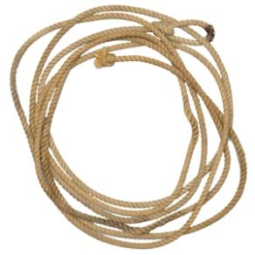
Back to game board
Lariat (Lasso)

Slide 25
During the 1800s these animals were brought to Kansas by foot from Texas. They were then shipped east from Kansas by train and sold for their beef, hides, and fat.
ANSWER

Slide 26
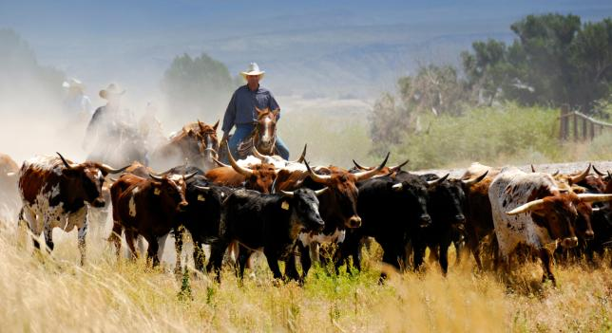
Slide 2
Back to game board
Texas Longhorn/Cattle

Slide 27
“There’s no place like home.” This 1930s film about a farmgirl from Kansas who ends up in a strange land has become an unofficial symbol of the state.
ANSWER

Slide 28
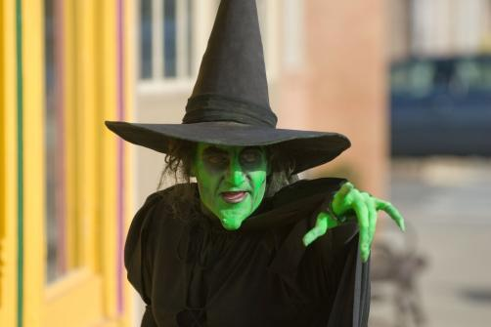
Back to game board
The Wizard of Oz

Slide 29
This famous pizza chain was founded in Wichita in 1958. It’s logo features a red hat-like shape which represents the restaurants’ roofs.
ANSWER

Slide 30
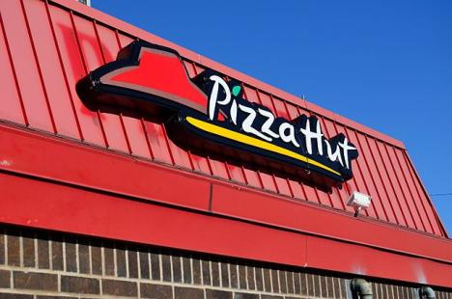
Back to game board
Pizza Hut

Slide 31
Cawker City is home to this “world’s largest” object. Every year the ball grows as more material is wrapped around it.
ANSWER

Slide 32
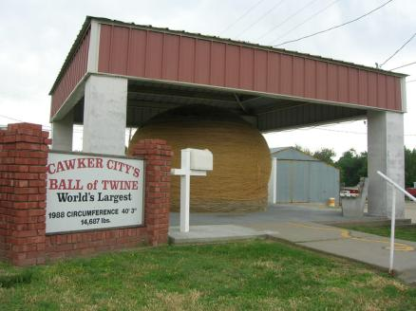
Back to game board
Photo: Kansas Tourism
World’s Largest Ball of Twine

Slide 33
This famous aviator was from Atchison. She was the first female pilot to fly solo across the Atlantic Ocean. She disappeared in 1937.
ANSWER

Slide 34
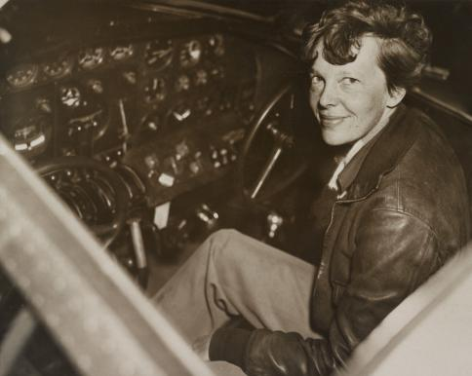
Back to game board
Amelia Earhart

