Slide 1



Findings from the 2024 Norwalk Youth Survey
Conducted Fall 2024 using Youth Voices Count™ Tool
*The following slides are only a subset of the full presentation by The Norwalk Partnership, and do not represent all the data points included in the Norwalk Youth Survey.
Presentation to The Norwalk Partnership| January 29, 2025
Margaret Watt, Positive Directions-The Center for Prevention & Counseling
Nina Chanana, Chanana Consulting

Slide 2
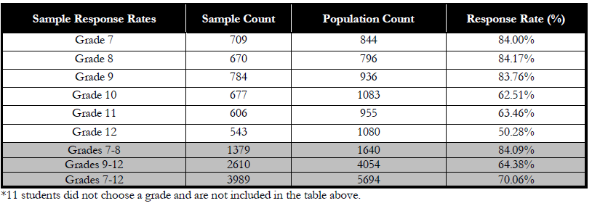
2024 Norwalk Youth Survey - Response Rate
Response Rate, 2024 Norwalk Youth Survey
Prior survey responses
2018: 1967 respondents; 2021: 2452 respondents; 2022: 3969 respondents
Notes:
Response rates by grade level are listed in the table. Note that there were 11 individuals who did not specify a grade. These cases were retained but will not be included in any grade level reporting. Response rates are calculated as a proportion of the number of surveys included in the sample to the number of total students enrolled in the 2024-2025 school year. Note that total sample counts only contain surveys that were used in the survey report; surveys that were omitted from the sample pool are not included in the counts.
Data Reporting:
The survey tool utilized several skip patterns to reduce the time spent on the survey for students, in addition, no question was required to be answered by respondents. Unless otherwise stated, data presented represent the percent of students responding to each question. However, survey response and completion rates are high enough for those questions to make strong estimates of the total population’s behavior and perceptions.

Slide 3
Trend in Depression & Suicidality in Norwalk Youth
Great news! Our 2024 survey shows the following changes from 2021:
Both depression & suicide attempt rates have been halved
Suicidal ideation rate has decreased by a quarter
Notes:
In the past 12 months, have you considered attempting suicide?
MS: 9.%
HS: 8.1%
7-12th: 8.5%
Attempt it?
MS: 3.0%
HS: 2.5%
7-12: 2.7%
Made a plan?
MS: 3.6%
HS: 4.1%
7-12: 3.9%

Slide 4
2024 Rates of Depression and Suicide Attempt in Norwalk, by Demographic Group, HS Only
Overall19%
Notes:
Males 12% vs Females 26% = 2.2x higher risk for females
SI: white and hisp 8%, black 15%

Slide 5
Weekly Hours of Extracurricular Involvement among Norwalk Youth, 2024
Compared with 2022, fewer youth report participating in clubs (27% now vs 32%) and taking lessons (28% now vs 34%) in 2024.
Notes:
2022 – NONE:
Chores: 15
Caretaking: 50
Lessons: 66 (more people NOT taking lessons in 2024
Club: 71% none -30% 1-6 hrs – 2% 7+ hours
Faith based: 72
Volunteering: 77
Working: 78

Slide 6

Weekly Hours of Physical Activity by Norwalk Youth, 2024
Compared with 2022, fewer youth report participating in team sports (39% now vs 43.5%) in 2024.
Notes:
2022:
SIMILAR IN 2024 BUT GOT WORSE: Team sports: 57% none; 30% 1-6; 13.5% 7+
BETTER BUT QUESTION PHRASED DIFFERENTLY: Other Physical activities: 60% none; 35% 1-6; 5% 7+

Slide 7
Unsupervised Daily Hours during the School Week among Norwalk Youth, 2024
Males report statistically significant higher levels of being unsupervised on weekdays compared to females.
Compared with 2022, Norwalk youth report fewer unsupervised hours in 2024.
Notes:
On a regular weekday, how many hours do you usually spend WITHOUT an adult present?

Slide 8
Community Support among Norwalk Youth, 2024
88% have at least 1 trusted adult to share thoughts & feelings with
84% have a friend or peer to talk openly with
83% feel safe in the community
80% have needed support from adults in their life, outside school, to graduate
Feel safe in community decreased, esp. in MS.
Seek help from school staff or coach increased.
Groups that are significantly less likely to:
Have a trusted adult: LGBTQ, Hispanic and Black
Have a trusted peer: LGBS, Hispanic
Feel safe in community: Females, LGBTQ, MLL, Hispanic and Black
Have need adult support outside school: LGBS, MLL
Notes:
Change since 2022:
Trusted adult: 87 to 88
Peer: +0.5
Safety: down from 84 to 83 (bigger decrease in MS)
I have the supports I need from adults in my life, outside of school, to graduate (i.e. help with future planning, a positive influence)
Please indicate if you would seek help from the sources below if you had a problem in your life.
% yes
Increased:
parent (58 to 61)
School staff (20 to 21)
Coach (14 to 16)
Decreased:
Friends (51 to 49)
Other adult (40 to 39)

Slide 9
View of Future among Norwalk Youth, 2024
73%
I feel confident I will have a job and/or go to college or a trade school when I complete high school
Groups that are significantly less likely to feel:
Life is moving in a positive direction: LGBTQ, IEP
Confident I will have a job and/or go to school after HS: Males, LGBS, IEP
64%
I feel my life is going in a positive direction
Notes:
I feel my life is going in a positive direction
I have the supports I need from my school to graduate (i.e. academics, guidance counseling, extra help)
I have the supports I need from adults in my life, outside of school, to graduate (i.e. help with future planning, a positive influence)
I feel confident I will have a job and / or go to college or a trade school when I complete high school

