Slide 1
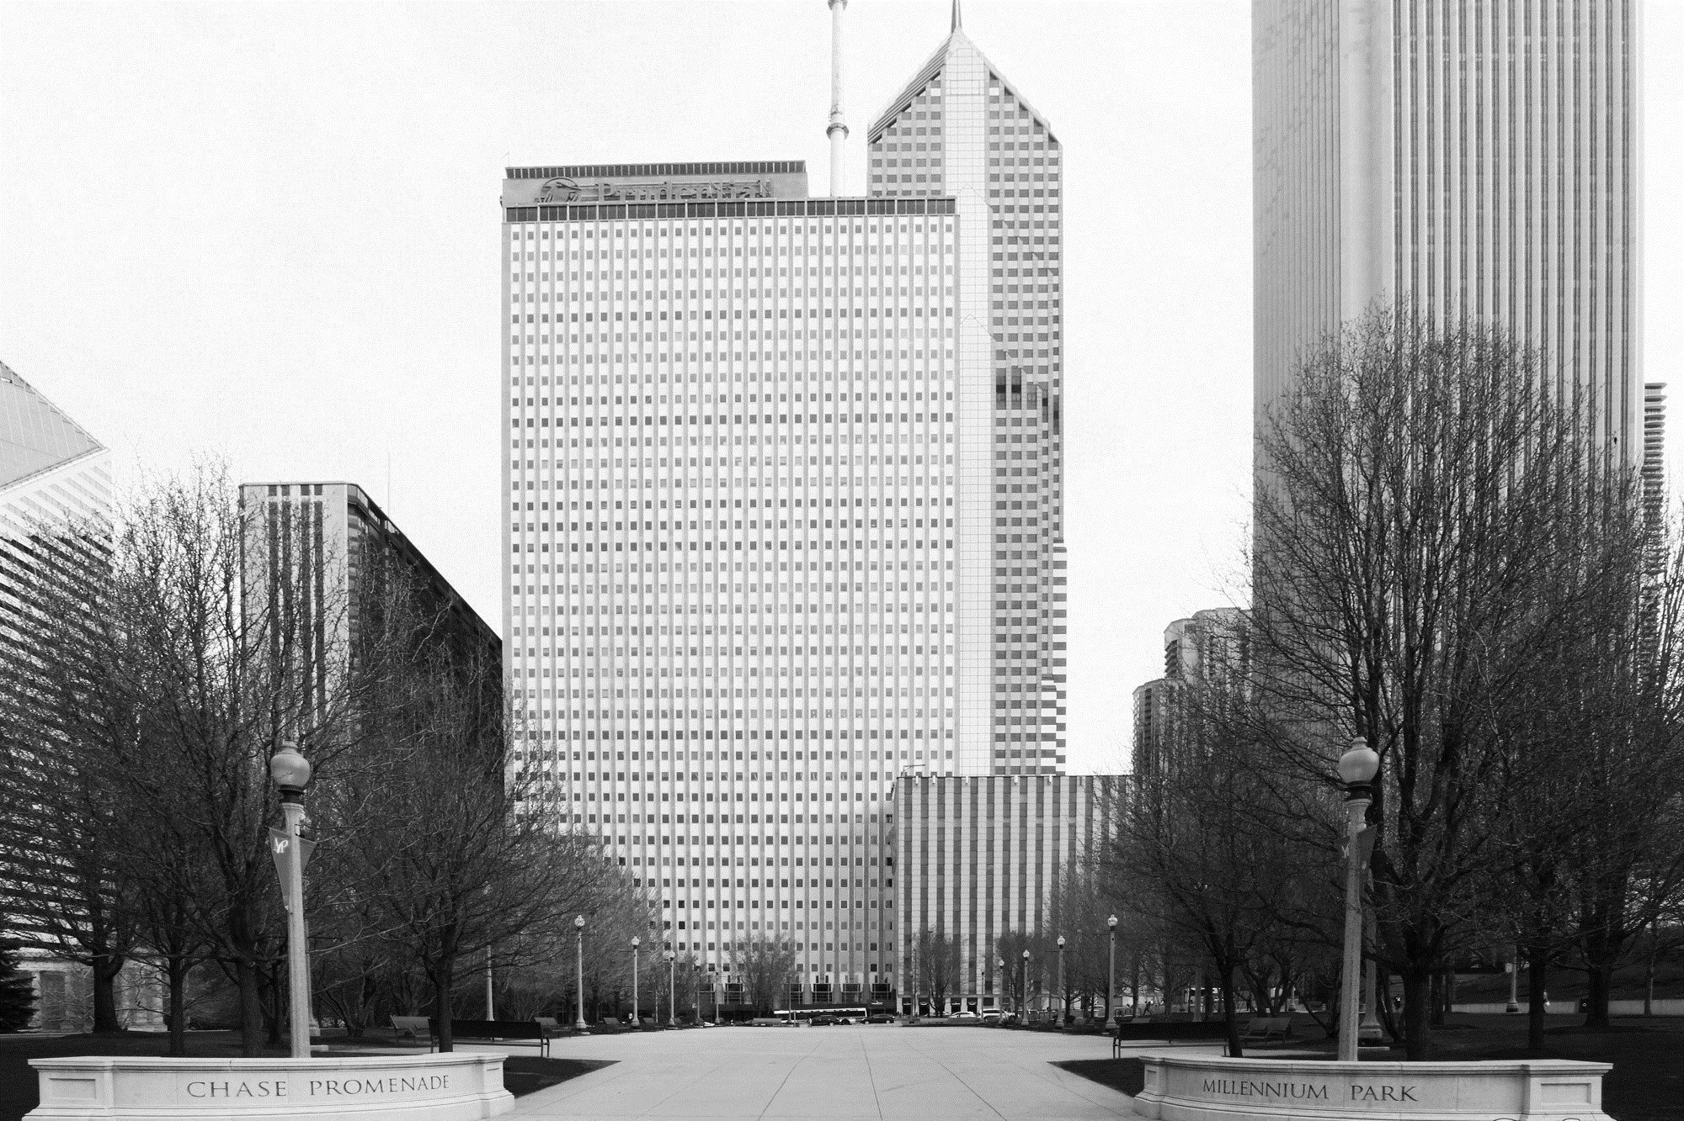


Tabb Private Equity Panel
March 30th, 2017

Slide 2
IMPORTANT DISCLOSURES
The information contained herein is provided by Prudential Capital Group (“PCG”). This document may contain confidential information and the recipient hereof agrees to maintain the confidentiality of such information. Distribution of this information to any person other than the person to whom it was originally delivered and to such person’s advisers is unauthorized, and any reproduction of these materials, in whole or in part, or the divulgence of any of its contents, without the prior consent of PCG, is prohibited. Certain information in this document has been obtained from sources that PCG believes to be reliable as of the date presented; however, PCG cannot guarantee the accuracy of such information, assure its completeness, or warrant such information will not be changed. The information contained herein is current as of the date of issuance (or such earlier date as referenced herein) and is subject to change without notice. PCG has no obligation to update any or all of such information; nor do we make any express or implied warranties or representations as to its completeness or accuracy. Any information presented regarding the affiliates of PCG is presented purely to facilitate an organizational overview and is not a solicitation on behalf of any affiliate. These materials are not intended as an offer or solicitation with respect to the purchase or sale of any security or other financial instrument or any investment management services. These materials do not constitute investment advice and should not be used as the basis for any investment decision.
These materials do not take into account individual client circumstances, objectives or needs. No determination has been made regarding the suitability of any securities, financial instruments or strategies for particular clients or prospects. The information contained herein is provided on the basis and subject to the explanations, caveats and warnings set out in this notice and elsewhere herein. Any discussion of risk management is intended to describe PCG’s efforts to monitor and manage risk but does not imply low risk.
These materials do not purport to provide any legal, tax or accounting advice. These materials are not intended for distribution to or use by any person in any jurisdiction where such distribution would be contrary to local law or regulation.
Prudential and the Rock logo are registered service marks of Prudential Financial, Inc. and its related entities.

Slide 3

Prudential Capital Partners
  Five middle-market mezzanine funds raised since 2001
  $3.7 billion invested in nearly 160 companies since 1995*
  Prudential Financial is largest investor (~30% of committed capital)
  Investments sourced through regional office network
*As of 12/31/16
Notes:
Who is Prudential Capital Partners?
Asset manager for four middle-market mezzanine funds with a combined total of $3.7 billion
Prudential Financial is our largest investor accounting for 25-30% of investable dollars
Traditional blend of other investors (LPs) consisting of public and corporate pension funds, endowments, family offices, other insurance companies
LPs seeking best in class, 3rd party alternative investment management account for remainder
Committed to the lower middle market
Deals are sourced through Prudential Capital Group’s regional office platform shown on next page
We average 30 investments per fund

Slide 4
How We Go To Market
London, Paris,
Frankfurt and Milan
Prudential Capital Group U.S. Regional Offices | 7
Prudential Capital Group U.S. Regional Deal Teams | 17
Fund Principals | 8
Dedicated Fund Team (Non-Principals) | 12
Minneapolis
San Francisco
New York
Chicago
Los Angeles
Atlanta
Dallas
Sydney**
Pricoa Capital Group
*As of 12/31/16
** The Sydney office operates through PGIM (Australia) Pty Ltd.
Notes:
Regional Office Network
12 offices worldwide
30+ local Global deal teams
Small deal teams of 3 – 4 investment professionals

Slide 5
CONTINUUM OF CAPITAL ALTERNATIVES
 | ABL / Equipment Financing | Cash Flow Senior Revolver Term Loan* |  | Senior Stretch | 2nd Lien* | Unitranche | Subordinated* | Equity
Avg. Term | 1 – 5 years | 5 years | 5 – 7 years | 5 years | 5 years | 5 years | 5 – 7 years | N/A
Pricing (exclusive of fees) | L + 1.75 – 2.5% LIBOR Floor: none | L + 4.5 – 5.5% LIBOR Floor: 1.0% | L + 4.5 – 5.5% LIBOR Floor: 1.0% | L + 5.25 – 6.25% LIBOR Floor: 1.0% | L + 9.0 – 10.0% LIBOR Floor: 1.0% | L + 7.25 – 8.25% LIBOR Floor: 1.0% | 10.0 – 12.0% Cash 1.0 – 2.0% PIK All-In: 11.0 – 14.0% | N/A
All-In Cost of Debt | 2.75 – 3.5% | 5.5 – 6.5% (Revolver + Term Loan) |  | 6.25 – 7.25% | 7.0 – 8.0% (Revolver + 2nd Lien) | 8.25 – 9.25% | 8.5 – 9.5% (Revolver + Sub. Note) | N/A
Debt Availability (Multiple of EBITDA) | N/A | 3.00 – 4.00x | 3.00 – 4.00x | 3.75 – 4.75x | 4.50 – 5.50x | 4.50 – 5.50x | 4.50 – 5.50x | N/A
Lenders | Banks | Banks | Banks, Insurance Companies, Prudential | BDCs, Hedge Funds, Private Debt Funds | Credit Funds, Hedge Funds, Private Debt Funds | BDCs, Hedge Funds, Private Debt Funds | Mezz Funds, Credit Funds, SBICs, Prudential | Private Equity, Prudential
Note: Above data reflects pricing for non-investment grade lower middle market companies ($15 - $40mm of EBITDA) ; as of 4Q16
*Typically paired with a revolving credit facility. Therefore, we have included revolver pricing in the All-In Cost of Debt section above
Source: Lincoln International & internal data
Price / Tenor / Flexibility

Slide 6
PRUDENTIAL CAPITAL
OVERVIEW
INVESTMENT CAPABILITIES
  Mezzanine debt, minority and structured equity
  Junior capital investment of $10-100 million, plus LP co-investment
  Revolver and leveraged senior term debt in addition to junior capital
  Senior debt appetite of up to ~$50 million in one-stop deals
  Syndication capabilities for $50+ million senior debt needs
  Patient capital with relationship based approached
TRANSACTION TYPE
  LBO financing
  Growth / acquisition financing
  Balance sheet restructuring
  Minority shareholder buyout
BUSINESS PROFILE
  Minimum EBITDA of
  $7 million
  Demonstrated operating history with attractive cash flow characteristics
  Generalist sector approach
Notes:
Focus on middle-market and lower middle-market companies due to the sourcing capability provided by PCG’s large regional office network
Our one-stop solution can provide the entire capital structure (senior – equity) in one single transaction
Long-term, fixed-rate notes
One-stop capability
Structured equity appetite
Patient capital with relationship based approach
Generalist sector approach
Cash flow investors

Slide 7
INDUSTRY EXPERTISE
Significant Experience In:
  Consumer Products and Services
  Business Services
  Niche Manufacturing
  Food and Beverage
  Packaging
  Transportation and Logistics
  Chemicals
  Distribution
  Other
Industry Distribution:
*As of 12/31/16

Slide 8
What Makes Us Unique

Slide 9
Unique investment capabilities
  One-Stop Capability:
  Ability to provide revolver and senior term debt alongside junior capital investment for a seamless, one-stop solution; Senior debt appetite in one-stop deals of $50MM+
  Minority Equity Positions:
  Significant capacity to invest in structured or minority equity positions in addition to core mezzanine
  Sponsored or Sponsorless:
  Ability to participate in either sponsored or sponsorless transactions through a variety of potential transaction types including:
    Recapitalization/dividend recapitalization
    Growth/acquisition financing
    Shareholder buyout
    Balance sheet restructuring (“Right-Sizing”)
    Management led buyouts
    Sponsored LBOs

Slide 10
Capital Across Balance sheet Executed by
Single Deal Team
The One-stop – A Seamless Solution
Revolving Credit Facility
Senior Term Debt
Prudential capital group
Subordinated Debt
Structured Equity
Minority Equity
Prudential capital Partners
Streamlined Approval Process
Pre-Negotiated Intercreditor
Efficient Execution
Certainty of Close
LEADS TO
Prudential capital Partners
Notes:
Prudential Capital can offer a one-stop solution, providing capital across the entire balance sheet along with the benefits of a pre-negotiated documentation and a streamlined approval process under a single relationship manager, resulting in quick execution and certainty of close
Senior Debt Capabilities
Revolving Credit Facility
Senior Term Debt
$20-50+ million of senior debt appetite
Syndication Capabilities
Multi-Currency
Junior Capital Capabilities
Subordinated Debt
Structured Equity
Minority Equity
$10-100 million of junior capital appetite, plus ability to provide LP co-investment

Slide 11
CERTAINTY OF EXECUTION
  Experience and Continuity of the Investment Team
Single Team execution
Streamlined decision making
Quick approval process
No surprises at close
Senior Management Team:
Together since the early 1990s
31 years average investment experience; 28 with Prudential
Regional Managing Directors:
23 years average investment experience; 18 with Prudential
Team Leaders:
15 years average investment experience; 12 with Prudential
Origination, Underwriting, & Portfolio Management
Notes:
Other senior investment professionals – all partners in the GP
Streamlined decision making
One team approach – origination / underwriting / portfolio management
No surprises at close
Prudential Capital’s Investment Committee has been together since the early 1990s, this leads to streamlined decision making and approval process while providing a reliability of execution on the terms as initially set forth

Slide 12
KEY TAKEAWAYS
Recapitalization Opportunities: As situations arise where your clients are potentially interested in taking some money “off the table” (i) to diversify their wealth, (ii) for estate planning purposes, (iii) to buy out a partner/family member, (iv) to fund growth and bring in new strategic partners, or for many other reasons, think of Prudential Capital as a viable solution, and a compelling alternative to private equity.
Acquisition/Growth Opportunities: Our capital is often used to fund acquisitions and/or growth initiatives for owners who want to retain control of their business. Our “one stop” capability can result in quick execution and an efficient process – ideal for acquisitions that need to be completed under time pressure
Flexibility: Prudential Capital offers flexibility in terms of the kinds of capital we provide – “one stops” with senior debt, subordinated debt, preferred equity, common equity, and a combination of all of the above.

Slide 13

One-Stop Financing
Business:
Operates 35 branded restaurants and bars across Texas and Louisiana under the Little Woodrow’s concept and Fast Eddie’s concept.
Situation:
In 2015, Little Woodrow’s and Fast Eddie’s decided to merge. In conjunction with the merger, Westlake Securities was engaged to help explore all strategic options, ranging from debt financing to a majority sale.
Result:
The Company owners were attracted to Prudential’s one-stop solution because it provided a combination of growth capital and a dividend distribution, while allowing the entrepreneurs to retain majority control of the business they had worked to build over decades.
Prudential Capital Group structured a one-stop financing solution that included a senior term loan, subordinated notes, and preferred equity.

Slide 14
Testimonials
“Having worked with Prudential Capital on two prior transactions, we were confident in their certainty of execution and access to capital for funding the entire debt capital structure for this transaction. We were pleased to continue building our long-standing relationship with Prudential Capital Group.”
Douglas Hill, Managing Director, Nautic Partners LLC
“Throughout our 15 year relationship, Prudential Capital has consistently demonstrated that they provide prudent and patient capital, while also being an outstanding partner- in good times and bad. We have worked with them on numerous occasions, and have found them to be supportive, flexible, and more than reasonable. We look forward to continuing our partnership with them.”
Rick Rosen, Executive Managing Director, H.I.G. Capital
“We have worked with Prudential Capital in numerous transactions over more than 15 years. They move quickly and efficiently to close transactions on reasonable terms and provide continued support to portfolio companies over the entire life cycle of the investment.”
Kevin Kenealey, Senior Managing Director, Mason Wells

Slide 15
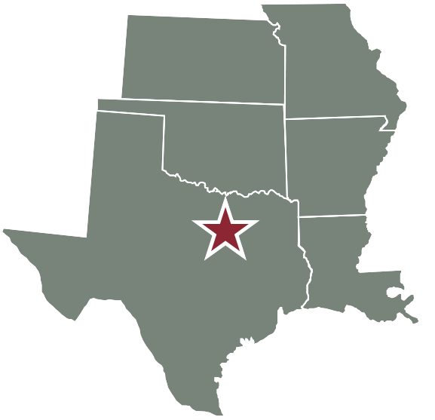
CONTACT INFORMATION
Arkansas, Kansas, Southern Louisiana and Southeastern Texas
Julia Buthman, Managing Director
(214) 720-6273 julia.buthman@prudential.com
Brien Davis, Vice President
(214) 720-6256 brien.davis@prudential.com
Grant Pritchard, Director
(214) 720-6262 grant.pritchard@prudential.com
Rohit Kandimalla, Analyst
(214) 720-6213 rohit.kandimalla@prudential.com
Dallas Office
2200 Ross Avenue, Suite 4100E
Dallas, TX 75201

