Slide 1
Four steps in helping to plan a personalized long-term care strategy

Slide 2
Important things you should know
• Not a deposit • Not FDIC or NCUSIF insured • Not guaranteed by the institution • Not insured by any federal government agency • May lose value
This material is not a recommendation to buy or sell a financial product or to adopt an investment strategy. Investors should discuss their specific situation with their financial professional.
If you have questions regarding your particular situation, contact your legal or tax advisors.
This information is general in nature and is not intended to be tax, legal, accounting or other professional advice. The information provided is based on current laws, which are subject to change at any time, and has not been endorsed by any government agency.
Nationwide Investment Services Corporation (NISC), member FINRA, Columbus, Ohio. Nationwide Retirement Institute is a division of NISC.
Nationwide, the Nationwide N and Eagle and Nationwide Retirement Institute are service marks of Nationwide Mutual Insurance Company.
© 2021 Nationwide
FOR FINANCIAL OR INSURANCE PROFESSIONAL USE — NOT FOR DISTRIBUTION TO THE PUBLIC
NFM-15736AO.3 (02/22)
Notes:
Before we get started, there are a few disclosures you can take a moment to read.

Slide 3
Important things you should know
When evaluating the purchase of a variable annuity, your clients should be aware that variable annuities are long-term investment vehicles designed for retirement purposes and will fluctuate in value; annuities have limitations; and investing involves market risk, including possible loss of principal.
This information assumes that the life insurance is not a modified endowment contract, or MEC. As long as the contract meets the non-MEC definitions of IRC Section 7702A, most distributions are taxed on a first-in/first-out basis. Surrender charges may apply to partial surrenders. Loans and partial surrenders from a MEC will generally be taxable, and if taken prior to age 59 ½, may be subject to a 10% tax penalty. Loans and partial surrenders will reduce the cash value and the death benefits payable to your beneficiaries, and withdrawals above the available free amount will incur surrender charges. If your contract were to lapse with a loan outstanding, the loan amount in excess of basis will be treated as a distribution and all or a portion will be subject to income tax.
The underlying investment options to a variable annuity or life insurance product are not publicly traded mutual funds and are not available directly for purchase by the general public. They are only available through variable annuity/variable life insurance policies issued by life insurance companies.
FOR FINANCIAL OR INSURANCE PROFESSIONAL USE — NOT FOR DISTRIBUTION TO THE PUBLIC
NFM-15736AO.3 (02/22)
Notes:
Before we get started, there are a few disclosures you can take a moment to read.

Slide 4
Important things you should know
As your clients’ personal situations change (i.e., marriage, birth of a child or job promotion), so will their life insurance needs. Care should be taken to ensure these strategies and products are suitable for long-term life insurance needs. You should weigh your clients’ objectives, time horizon and risk tolerance as well as any associated costs before investing. Also, be aware that market volatility can lead to the possibility of the need for additional premium in the policy. Variable life insurance has fees and charges associated with it that include costs of insurance that vary with such characteristics of the insured as gender, health and age, underlying fund charges and expenses, and additional charges for riders that customize a policy to fit your clients’ individual needs.
Not all Nationwide products and services are suitable for all clients or situations. There may be products, issued by other companies, which better suit your clients’ goals. Be sure to consider your clients’ objectives, their need for cash flow and liquidity, and overall risk tolerance when using any strategy.
This information was developed to promote and support products and services offered by Nationwide. It should not be taken as tax advice. It was not written or meant to be used by any taxpayer to avoid tax penalties, and it cannot be used by any taxpayer for that purpose.
Life insurance and annuities are issued by Nationwide Life Insurance Company or Nationwide Life and Annuity Insurance Company, Columbus, Ohio, member of Nationwide. The general distributor for variable insurance products is Nationwide Investment Services Corporation, member FINRA.
FOR FINANCIAL OR INSURANCE PROFESSIONAL USE — NOT FOR DISTRIBUTION TO THE PUBLIC
NFM-15736AO.3 (02/22)
Notes:
Before we get started, there are a few disclosures you can take a moment to read.

Slide 5

It Starts with a Plan……..
Diane and Jim
In their early 60’s
Jim, a retired dentist has early onset Alzheimer’s
Diane cares for Jim 24/7
Jim can’t be left alone for long
How this story ends – or could have ended – will depend on how much upfront planning was done
Notes:
Diane and Jim are in their early 60’s. Diane is taking care of her husband Jim, who was dentist but retired early due to early onset Alzheimer’s. She has become a full-time care giver to him 24/7. Unfortunately, he cannot be left alone as he can be a danger in the kitchen, has flooded bathrooms and gotten lost to name a few things.
How this story ends, or could have ended, all really depends on how much upfront planning Diane and Jim may have done. It all starts with a plan.
e

Slide 6
For today’s discussion
Health and Aging in America
The 4 Steps that Can Help Personalize a LTC Strategy
Effective Funding of LTC Expenses
How LTC benefits are paid and what to look for in a LTC Solution
Notes:
Read Slide

Slide 7
Health in America ……..
How has mortality changed as a result of the following health conditions since the year 2000? Up or down?
Breast Cancer
?
Heart Attack
?
Stroke
?
Alzheimer’s
?
Up
Down
Down
Up
+ 1.1%
-7.3%
-10.5%
+145.2%
Source: Alzheimer’s Association 2021 Alzheimer’s Disease Facts and Figures
Notes:
Note to Presenter - If this is a live presentation, keep this slide as it helps engage a live audience…… If virtual, hide this slide if you need to keep presentation shorter.
Note to Presenter - When the ppt is placed is SLIDE SHOW mode, the animation will not show the answers. You can ask the audience for an answer, then click the forward and one by one the answers will appear each time you hit the down arrow or page down key.
Let’s start by seeing how much you know about the changes in health and how Americans are faring in regard to mortality. I am going to ask you how mortality has changed as a result of the following health conditions since the year 2000.
Are deaths as a result of breast cancer up or down? Up, ½ %
Are deaths as a result of heart attack up or down? Down, -9%
Are deaths as a result of stroke up or down? Down, -13%
Are deaths as a result of Alzheimer’s Disease up or down?
Up, +145%
Yes, that is an alarming figure!

Slide 8
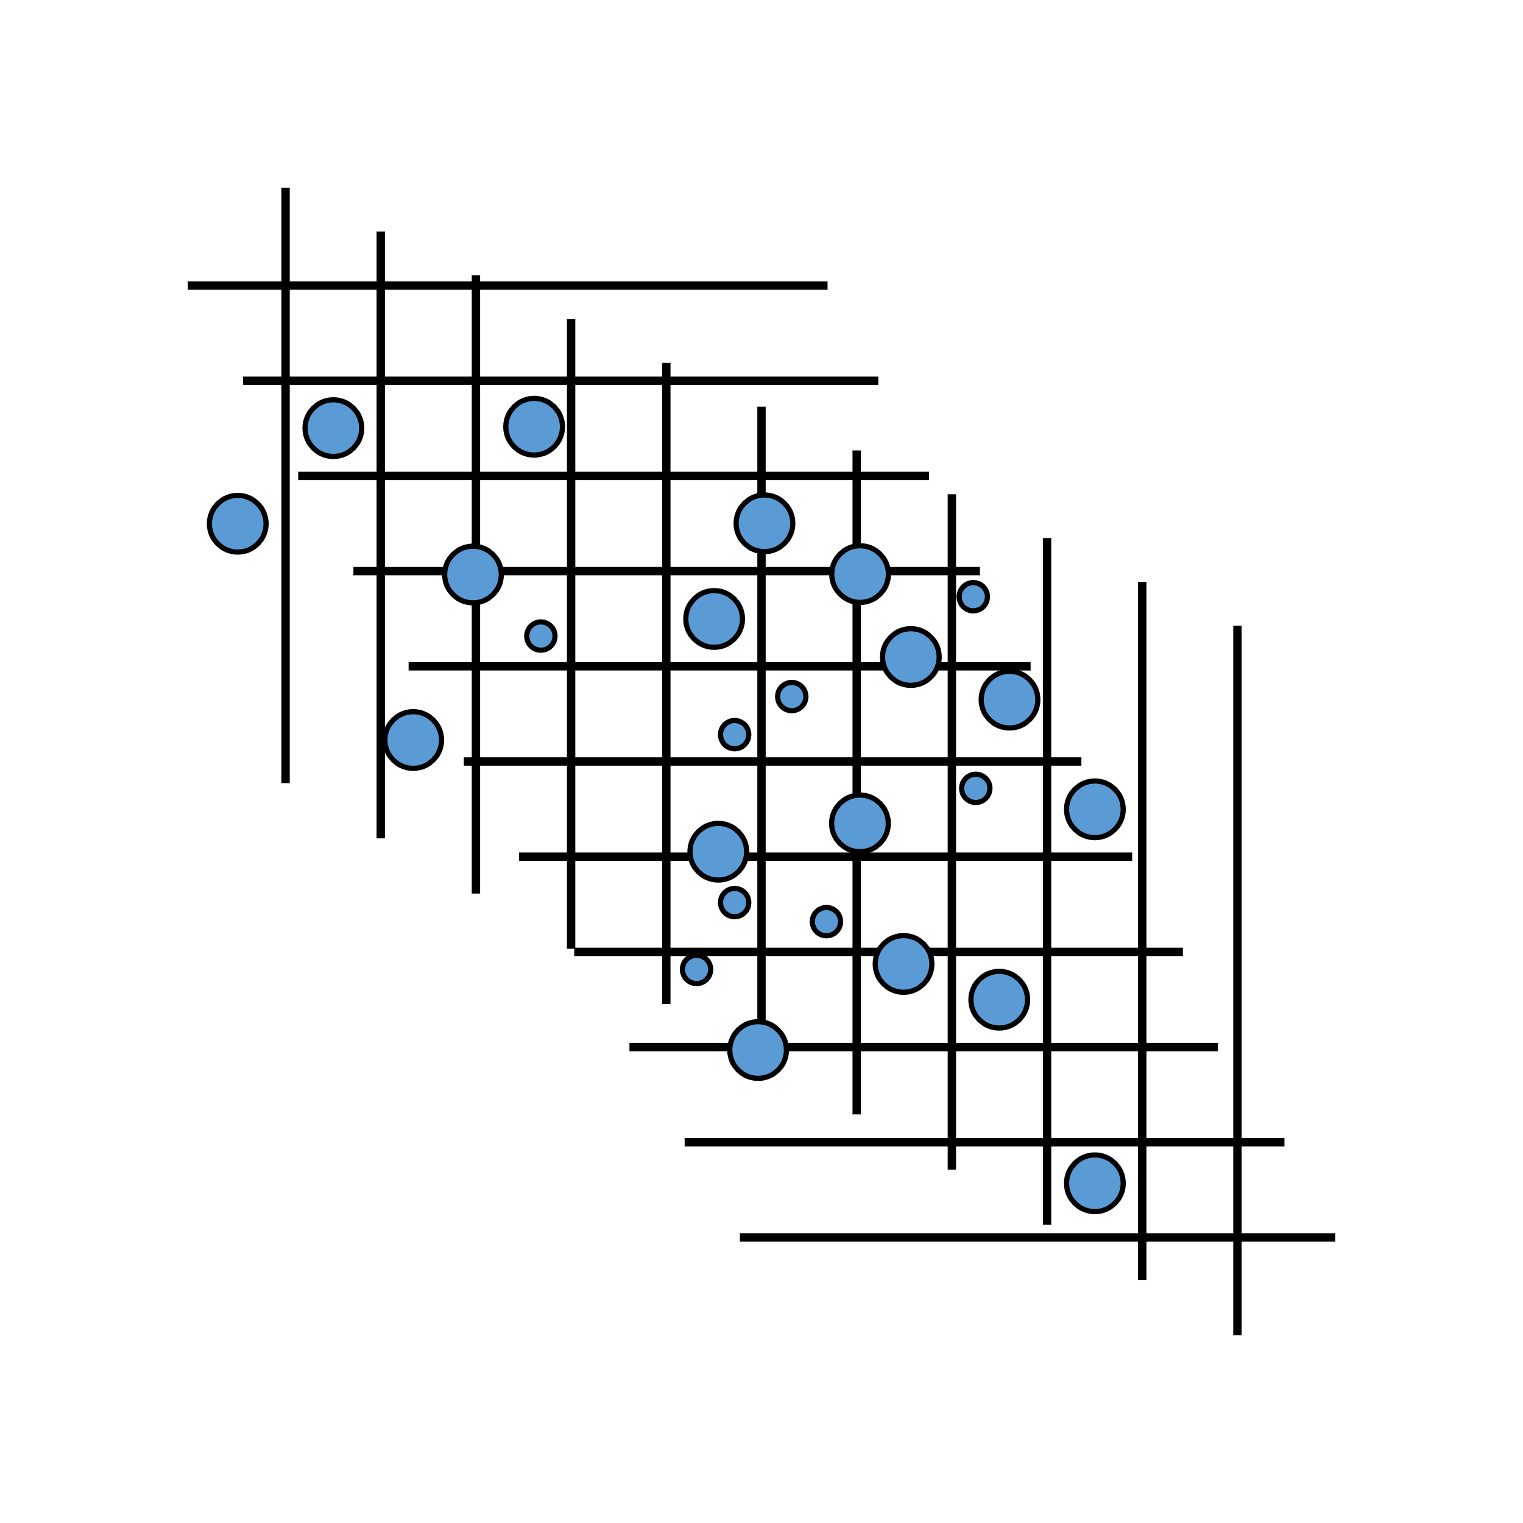
Chance of Needing LTC …….
The longer you live, the more likely you will need long-term care services?
True or False?
TRUE
¹WebMD – “Long-Term Care Insurance: What to Know” By Katy Hebebrand; Medically Reviewed by Dan Brennan, MD on September 04, 2021
Notes:
Read slide

Slide 9


It Starts with a Plan!
What would you do if you needed some help with your care?
Having a plan for you, planned by you, is important so,
  your wishes are more likely to be implemented
  and your loved ones won’t have to:
    wonder
    worry
    disagree
Let’s start planning!
Notes:
Have you ever thought about what you would do if you were to need some help with your care? Today we are going to discuss how to help you picture and personalize a strategy for your care. Having a plan just for you, planned by you, is important to help ensure you receive the care you need and in a manner you would prefer.

Slide 10
Steps to help personalize and plan a long-term care strategy
Picture the kind of care you may want and lay out a plan
Provide details to financial professional
Fund the plan
Discuss the plan with your family
4 Steps in Planning
Approach planning step by step
Notes:
It is a lot easier to develop a plan for any care you may need in the future if you approach planning in a step by step manner. We will go into what each of these steps mean in a moment, but to get an idea, these are the steps you should consider implementing.
First, picture your care and lay out a plan
Second, provide the details of your “vision” to your financial professional or insurance agent
Third, you want to be sure there is funding for your plan
Fourth, discuss the plan with your family

Slide 11

While visualizing a plan ……. here are some things to think about
Long-term care is not a place ……….. it’s an event you can plan for
You have numerous options to plan with ……….. devise a plan with flexibility
Care at home is a likely option ……….. but can take the most planning
Family care should be a choice ……….. not a necessity
While paying for your care ……….. your spouse/partner needs financial security
A well thought out LTC plan helps protect you, your family, and your options for care
Notes:
Here are some things to things about when visualizing your plan:
First, keep in mind that long-term care is not a “place”, it’s an event you plan for. Many of you may think of LTC as going to a “nursing home”, but with proper planning you have many options for care.
You have numerous options to plan with, so take the opportunity to devise a plan with flexibility.
Care at home is a likely option, but it can take the most planning.
Family care should be a choice, not a necessity.
While you’re paying for your care, your spouse or partner will still need and want financial security.
In the end, a well thought out plan helps protect you, your family and the legacy you may want to leave, and your options for care.

Slide 12

Back to Jim and Diane
Diane is overwhelmed…. her only reprieve is walking the dog
Adult children live out of town, and are raising young children
Hard for adult children to see Dad, apprehensive about having their kids around him.
Diane misses time with her family
Sadly, Jim and Diane thought there was still plenty of time to plan for LTC….
It’s never too early to start planning
Notes:
Back to Diane and Jim. Diane is overwhelmed. Her only reprieve is taking her dog for short walks to get some fresh air and a brief respite from taking care of her husband.
Their children live out of town and have their own young children to care for, so they really can’t provide much help. And to Diane’s dismay, their adult children have a hard time seeing their father in this state of decline - plus they have some apprehension of having their young children around Jim. This has created a sad situation for the family, as the mom does not get to see her children and worse yet her grandchildren nearly as much as she did prior to the onset of Jim’s Alzheimers. They never imagined such a situation could come this soon – sadly, they thought they still had plenty of time to plan for long -term care.
It’s never too early to plan for potential LTC needs, but it can be too late.

Slide 13


1st Step -
Picture your care
Where do you want to receive care?
  Home.... with family.....community care?
  Willing to move?
  Retire/receive care outside U.S.?
Who do you want to provide your care?
  Informal caregiver such as Family or Friend?
  Professional caregiver?
What local support do you have?
  Adult children nearby …….. Friends who can help?
  Local support can help extend independence longer
Notes:
The first step is to Picture” how you would like to receive care….
Where do you want to receive care? Do you want to stay in your own home?.....Live with a family member? Or perhaps you might consider sizing down into a Continuous Care Retirement Community, where you start out in an independent living environment, but are where you have options for receiving care within that community, allowing you to more easily stay in touch with the friends you have made.
Sometimes we have to move when care is required. Would you move to be near your children?....... Would your children move to be near to you? If they are of retirement age before you need care, they may be willing to move near you. Will you retire/receive care out of the country?
Next, who do you want to provide your care? A family member? A friend? Another person that is unlicensed and less expensive.......Or maybe you would feel more secure with a professional caregiver or receiving care in a facility?
Finally, what local support do you have? Do you have adult children nearby who could help you? …….. Friends who can help? Having local support can help you extend your independence for a longer period of time.

Slide 14
What care options might fit the picture?
Care options include ………but are not limited to
Home
Community
Boutique Services
Foster care for elderly
High end concierge care
Facility
Your home or home of family/friend
Adult day care and Meals on wheels
Assisted Living
Full custodial care
CCRC (start independent, but provides up to full care)
Home Health Care
Your own personal plan
Notes:
Before you start, it might help to discuss some of your care options. You may want to receive care at home – whether in your own home or in the home of a family member or friend. And while some people may want a family member as their caregiver, others may prefer care from a professional or a home health care service. Even if living at home, a person may also need services from the community such as meals on wheels. And if a person is living with family but can’t be left alone, adult day care provides a place for an individual to go while their loved ones are at work.
Some people may want the professional services that facility care can offer. Assisted living can provide care when staying at home is no longer an option, and the good news is that many of these facilities offer apartment style living where an individual may be able to bring their favorite possessions and furnishings. And while most of us would prefer to avoid nursing home care, this type care and its environment can vary.
In the last few years we are seeing more “boutique” type care services such as foster care for the elderly, and more expensive high end concierge care. In addition, you may have your own unique thoughts for how you would like to receive care.

Slide 15
It’s your plan, so IMAGINE …….
Think ahead with steps in mind
Example – Potential alternative to Assisted Living
Downsize to Independent Living in CCRC while healthy
Bring in a Home Health Care aid when care is needed
Total cost could be less than moving to Assisted Living
Keeps you in a more socialized setting
Remain closer to friends in the community
Could delay or eliminate a move to Assisted Living
Notes:
This YOUR plan, so be creative and “imagine”.
For example, instead of going to an assisted living facility where socialization may be more limited, you could make an initial downsize to independent living before you’re in need of care – where socialization if usually far more expansive. Then if care is needed, you could bring in a home health care service (some independent living facilities have such services you can contract with directly) to help with your needs. The total cost could end up being less than moving to assisted living.
In addition to more social opportunities, you may be able to stay close to the friends you have made in the community; and perhaps delay or eliminate the need to move to Assisted Living.

Slide 16


Imagine care with no restrictions
Write down anything you can think of
Don’t worry how it sounds for now
Notes:
Read slide

Slide 17

Or plan with family in mind
“Our daughter and her family live close to us but have busy lives. A one floor house just two doors down from her home just went on the market, and she would like us to buy the house. We can help more with the grandkids now – and they will be right there to help us later as we age.”
“My son is looking to change jobs and I am about to retire. We love Florida and have all decided to move there so my son and his family will be close by should I need help”.
Notes:
Read Slide

Slide 18
Consider who will participate in the caregiving
How much support from family/friends will be needed?
  Physical caregiving
    Family, unlicensed non-family or licensed professional
  Help with finances and bill paying
    Trusted person to help manage money and pay bills
  Advocate with facility care or community services
    Arranging/advocating for services, care, billing, and your rights
  Going on doctor’s appointments
    Providing transportation and participating in the appointment
Notes:
When planning for LTC, individuals and couples should thing about how much involvement they may wish or need from family or friends. If you have family or friends that you want participating in your care, think about how you want these people to help you.
Some people may want physical caregiving directly from family members (or friends) - while others may want physical caregiving to come from another source, with family support saved for help with financial decisions, bill paying, going on doctor’s appointments and other advocacy.
Family support should be discussed up front with the people you want involved in your care to make sure they are both willing and able. We will discuss this more later in the presentation.

Slide 19
2nd Step -
Discuss plan with a financial professional
Financial professional should be provided with as much detail as possible – the what and the why
  Example #1: We want to ………
    size down to an independent living community in the next 10 years
    socialization, community, staying active, are important to us
    we would prefer to remain in independent living using HHC services so we can delay a move to assisted living if possible
  Example #2: I want to ………
    spare my daughter from challenges of caring for me AND her family
    I’ve had the same two best friends since college – and we swore we would stick together even through old age
    we would like to share a home, move to the same retirement community, or move to the same care facility
Notes:
The second step is for the client to discuss their plan with a financial professional. Before your appointment, write down your ideas and motivations. Provide your financial professional with as much detail as possible. Here are a couple of examples of the type of details that will help your financial professional guide you to the solution you are looking for.
Example #1: “We would like to size down our home to independent living in the next 10 years. Socialization, community, and staying active, are important to us and the more independent we can stay, the more likely we can stay connected with life. Should we ever need help with our care – and if possible and practical - we would prefer to remain in independent living using Home Health Care services and delay or avoid moving on to assisted living.”
Example #2: “I want to spare my daughter from the challenges of caring for me AND her family. I’ve had the same two best friends since college – and we swore we would stick together even through old age. We would like to share a home, move to a retirement community or eventually all go to the same care facility.”

Slide 20

Dig into the details……
Provide as much detail as you can
  Details help lead to planning better solutions
Retain some flexibility in your plan
  Think about a back-up plan
  Original plans may not work out as imagined
Discuss gaps in your plan
  Note the decisions you can’t make right now
  Your financial professional may be able to help fill in gaps
  Some LTC coverage provides flexibility to fill in gaps later
Notes:
Communicating the details of your plan will help your financial professional pin down a LTC funding solution. Details help lead to a solution that will help meet your individualized needs. The more details, the better!
Retain some flexibility in your plan. Think about a back-up solution to your preferred plan because what you initially plan may not always work out as imagined
Discuss the gaps in your plan. Note the decisions you just can’t make right now. Your financial professional may be able to help fill in the gaps. But if you just can’t make certain decisions, some LTC coverage solutions provide flexibility that will allow you to fill in gaps later. For example, an Indemnity policy will allow benefits not needed for care expenses to be used in a flexible fashion. And with a Cash Indemnity policy, the insurance company places no restrictions on how you use your LTC benefits..

Slide 21
3rd Step –
Funding the Plan
Long-term care is paid for by either…….
Lifestyle
Income
Insurance
Cost efficient leveraged benefit amount
Cost is the potential loss of health, well being or earning ability of a spouse or other loved one
Dollar for dollar expenditure of your money could put lifestyle/legacy at risk
Notes:
Once you have a plan in mind, and have discussed that plan with your financial professional, the next step is to think about how to fund your plan……..
If someone does indeed end up needing to pay for LTC services, there are generally 3 ways to pay for such services. You can pay with:
Lifestyle – the cost of paying with lifestyle is the potential loss of health, well being and/or earning ability of a spouse or other loved one providing your care.
Income – which is a dollar for dollar expenditure of your money, and could impact a spouse financially by reducing funds for living expenses and lifestyle, or require a depletion of assets to supplement what income won’t pay
Insurance – This is the most cost efficient way to pay for care since you are using leveraged dollars to pay for care expenses.

Slide 22
Diane and Jim - Act 3
Diane is starting to forget the Jim she married – those memories replaced by stress of caregiving
They are OK financially, but she worries that they can’t afford to hire help
What if Jim’s condition escalates to where she can not longer be the caregiver?
Will she have enough money for a long life ahead?
She feels she needs to solely care for Jim herself as long as possible
Insuring for the future can help provide a more manageable future
Notes:
She is starting to forget the wonderful man, father and life that had together, as those memories are being replaced by the daily stress of caregiving. They are currently fine financially, but Diane is very concerned about the cost of assistance and feels that she cannot afford to hire help. And what if Jim has to go to a facility if she can no longer handle Jim’s care? The fear of running out of money is very real – she hopes she still has a long lifespan ahead of her - so she believes that being his full-time care giver is in her best financial interest as well.
Insuring for the future can help change the future for the better

Slide 23
Insuring the Plan ………
Traditional LTC Policy
Life Insurance with LTC Rider
Linked Benefit LTC Policy
Most coverage for least cost
Only pays for LTC
Premiums not guaranteed
Generally only lifetime payment schedules
Life insurance now, LTC later
Death benefit used for LTC
Beneficiary paid unused benefits
Some solutions are guaranteed
Flexible premium schedules
Primary need is LTC coverage
Death benefit recovers cost of premium if LTC is not needed
Policy premium guaranteed
Choice of premium schedules
Notes:
If insuring your plan makes sense to you, let’s look at some real solutions that can help cover the cost of this need.
A traditional LTC policy will provide the most LTC coverage for the least amount of money. There may be more features available with this solution. But this solution is for people who do not want or need life insurance, as it only pays LTC benefits if you need qualifying LTC services. The premiums are not guaranteed and can be raised in the future on an unlimited basis (with state approval). Currently, only life time premium payment schedules are available with most companies.
Life insurance with a LTC Rider is for people with a life insurance need, but also have LTC concerns. The death benefit can be accelerated for LTC benefits, but if LTC is little or never needed, the remaining death benefit will be paid to the beneficiary. Some solutions are guaranteed -,both premiums and benefits. There are flexible premium schedules available, This solutions provides the best leverage of death benefit, but will provide the least in LTC benefits.
Linked Benefit LTC polices are for people whose primary need is LTC, but want cost recovery if LTC is little or never needed. This policy has a death benefit that is guaranteed to be at least equal to or better than the premium paid. The death benefit will not enjoy the same leverage as a death benefit on life insurance with a LTC rider, but it will always, at the very least, provide cost recovery of premiums paid if LTC benefits are not needed. These policies can be purchased with a single premium or with premium payment schedules of up to 10 years.
.

Slide 24

What to look for in LTC insurance coverage
Not all policies are created equal….. Look at the following:
Is there broad language in the policy covering all current LTC services as well as newly invented future services?
Is there coverage for temporary claims?
Is the cost and benefit structure easy to understand?
Can policy premiums increase in the future?
  Guaranteed premium policies are available
How are benefits paid?
  Reimbursement
  Cash Indemnity
Notes:
If you’re looking at a LTC policy or rider, you should know not all policies are created equal. Here’s a list of some important things to keep in mind.
First, look to see what services are covered by the policies. Not all LTC services may be covered, so you may want to look for the broadest range of state qualified services. Also think of types of care that may evolve in the future. It helps to have a LTC policy will cover future forms of care as well as those listed in the policy, even if they have not been defined yet.
Second, does the policy offer coverage for temporary claims? There are some policies (such as chronic illness riders) that will only cover the condition if it will last the rest of your life.
Is the cost and benefit structure easy to understand?
And you will want to know if policy premiums could increase in the future, or if premiums and benefits are guaranteed.
Finally, make sure you understand how your LTC benefits would be paid. We will discuss that next.

Slide 25


Understanding LTC Benefit Models
Reimbursement Plans
  Only actual LTC costs are reimbursed
  Bills and receipts must be submitted each month
  Care providers may not agree to do direct billing with insurance company
  Licensed providers generally required
  Non-covered expenses are paid out of pocket
  Less flexibility but may help with money management
Cash Indemnity Plans
  Full monthly LTC benefit paid to policy owner
  No monthly bills or receipts to submit
  No restrictions on how LTC benefits are used
  100% of care can be provided by family or other unlicensed care givers
  Alternative care, transportation, prescriptions, etc.
Notes:
Reimbursement plans only reimburse for the actual cost of qualifying care covered by the policy. In order to determine the amount of the reimbursement, all bills and receipts need to be turned in each month. Most companies offering reimbursement plans will coordinate the billing and payments directly with the service or facility, but please note that many care providers will not agree to 3rd party billing. Also, Reimbursement policies have limitations and do not cover all expenses a person may consider necessary for their care; thus there may be items or services on a bill that will not qualify for reimbursement (i.e. getting your hair done at the facility’s beauty parlor), therefore those expenses will have to be paid for out of pocket. While less flexible, these plans provide some management of expenses thus may be good for people who have problems handling money.
Basic Indemnity plans pay LTC benefits directly to the policy owner for the full amount of the benefit. Monthly submission of bills and receipts are often not required once the claim is verified and LTC benefits are being received - (though a few companies will ask for “proof of at least one billable service” each month). The insurance company places no restrictions on the use of LTC benefits received that are not needed to pay for licensed care.
Cash Indemnity Plans are more flexible than straight indemnity plans. Bills and receipts do not have to submitted to prove a billed service was used. The insurer places no restrictions on how benefits are used, thus the LTC benefits can be used for whatever care services a person wishes to have. 100% of benefits can be used to pay an informal caregiver, including an immediate family member. You will also be able to use benefits for alternative care services, care invented in the future and expenses that reimbursement plans don’t cover such as experimental care, transportation, prescriptions and certain home modifications.

Slide 26
4th Step –
Discuss Plan with Family
Include family (supporters) in the initial planning if appropriate
  Supportive children may add value or suggestions to plan
  This is YOUR plan – not your children’s plan
Once plan is set – communicate plan to family members
  Let family members/advocate know what the plan is
  Provide copies of important information
  Financial information can be kept private…….
    But - provide names/phone numbers of financial professionals, attorney, CPA, etc. who do possess the information
Notes:
The third step is communication. It’s important for you to discuss your plan with your family and/or your support team. If it’s possible and makes sense, you may even want to include family members or others that will support your care needs in the initial planning, as supportive children may add value to the planning process. However, some people may prefer to leave children out of the intial planning phase. Remember, this is YOUR plan – not your children’s plan
Once your plan is set – if family was not involved in the planning phase, you may want to consider communicating your plan to family members. It may be very helpful to let family members and advocates know what the plan is and provide copies of important information the support group may need in order for them to provide the assistance expected of them. Not everyone wants their children to know the details of their finances and affairs, so if your prefer to keep details of your finances private, please make sure to supply children and/or advocates with the names and phone number of your financial professionals, lawyers, doctors, etc, so your support group won’t face even more challenges when the need for their assistance arises.

Slide 27
Keep the plan on track
Now and later …………..
Clarify expectations – discuss with participants upfront
  Let family/participants know what you are asking of them
  Make sure they are willing to help
Give family permission to veer from plan
  Help alleviate family’s guilt when plans must change
Have an annual “refresher” discussion with your family
  Review your plan and location of important documents
  Life changes such as death, divorce, relocation can disrupt plan
  Makes sure you still have agreement from support team
Notes:
Clarify your plan with your family now. Clarify any expectations you have of your children or your other support people. Let children know what you are asking of them. Get their agreement now and ask them to please be honest and let you know if you are asking too much of them so you can make other arrangements if necessary.
One of the best gifts you can give your children/support people permission to veer from the plan if necessary. Help alleviate children’s guilt when plans must change because your plan is no longer working out. Arrangements do not always go as planned, and you may no longer possess the capacity to make rational decisions for yourself when changes to your care must be made.
Have an annual review with your support team. People are not likely to remember much of what you told them 10 or 20 years ago – so make sure on an annual basis that your support team knows the who, what and where of your plan, and where the important documents and phone numbers are located. AND, make sure your support people are still willing and able to support you in the plan that has been laid out,

Slide 28
How LTC coverage could have changed Jim and Diane’s story
LTC benefits could have changed the outcome and helped provide Diane with:
Dedicated funds specifically to pay for LTC needs – and help relieve financial concerns
Funds to hire the care that was too physically or emotionally stressful
More meaningful respite time off to relax and revive – not just a few moments walking the dog
More emotional balance, which could help keep her good memories alive
Help create a better and more balanced home situation for family and friends to visit and stay connected
Notes:
Having LTC coverage might have significantly changed the outcome. LTC benefits could have helped provide Diane:
Dedicated funds specifically to pay for LTC needs – and help relieve financial concerns
Help to pay for care that is physically or emotionally stressful
More meaningful respite time off to relax and revive – not just a few moments walking the dog
Help maintain better emotional balance, better for Jim and can help Diane keep her good memories alive
A better and more balanced home situation might allow for more visitation from the children and grandchildren.

Slide 29
It starts with a plan
Picture your care and plan a care strategy
Provide details to financial professional
Fund the plan
Share details with family or friends involved with care plan
Please consult your legal council to make sure you have in place all the documentation required to help make your plan a reality

Slide 30
Thank you for your time!
Please consult with your financial professional to learn more about long-term care planning

