Slide 1

Helping you plan for long-term care
Brought to you by the
Advanced Consulting Group of Nationwide®
Nationwide, the Nationwide N and Eagle, Nationwide is on your side and other marks displayed in this presentation are service marks of Nationwide Mutual Insurance Company or its affiliates, unless otherwise disclosed. © 2019 Nationwide

Slide 2

Some things you need to know
Federal income tax laws are complex and subject to change. The information in this memorandum is based on current interpretations of the law and is not guaranteed. Neither Nationwide, nor its employees, its agents, brokers or registered representatives gives legal or tax advice.
This material is not a recommendation to buy, sell, hold or roll over any asset, adopt an investment strategy, retain a specific investment manager or use a particular account type. It does not take into account the specific investment objectives, tax and financial condition or particular needs of any specific person. Investors should work with their financial professional to discuss their specific situation.
Neither Nationwide nor any of its representatives may provide legal or tax advice; please consult a legal or tax advisor for answers to your specific questions.
Life insurance is issued by Nationwide Life Insurance Company or Nationwide Life and Annuity Insurance Company, Columbus, Ohio, members of Nationwide Financial.
Guarantees and coverage are based on the claims paying ability of the issuing company.
2
NFM-2121AO.13 (07/19)
Notes:
<Disclosure needs to be on screen long enough to read>

Slide 3
Investing involves risk, including the possible loss of principal.
As your personal situations change (i.e., marriage, birth of a child or job promotion), so will your life insurance needs. Care should be taken to ensure this product is suitable for your long-term life insurance needs. You should weigh any associated costs before making a purchase. Life insurance has fees and charges associated with it that include costs of insurance that vary with such characteristics of the insured as gender, health and age, and has additional charges for riders that customize a policy to fit your individual needs.
Keep in mind that as an acceleration of the death benefit, the LTC rider payout will reduce both the death benefit and cash values. Care should be taken to make sure that your clients' life insurance needs continue to be met even if the rider pays out in full. There is no guarantee that the rider will cover the entire cost for all of the insured's long-term care as these vary with the needs of each insured.
This information assumes that the life insurance is not a modified endowment contract, or MEC; as long as the contract meets the non-MEC definitions of IRC Section 7702A, most distributions are taxed on a first-in/first-out basis; surrender charges may apply to partial surrenders; loans and partial surrenders from a MEC will generally be taxable and, if taken prior to age 59½, may be subject to a 10% tax penalty; loans and partial surrenders will reduce the cash value and the death benefits payable to your beneficiaries, and withdrawals above the available free amount will incur surrender charges; if your contract were to lapse with a loan outstanding, the loan amount in excess of basis will be treated as a distribution and all or a portion will be subject to income tax.
3
NFM-2121AO.13 (07/19)
Notes:
<Disclosure needs to be on screen long enough to read>

Slide 4

Agenda
Why Long-term Care planning is important
What you need to know about long-term care
How to start to plan for your LTC needs
4
Notes:
Read slide

Slide 5
……….What is long-term care?
It’s a variety of supports and services designed to help people live as independently and safely as possible when they can no longer do so on their own.
It also represents the additional stream of income that will be needed to pay for needed services.
5
Notes:
It might help to understand exactly what long term care is. It’s a variety of supports and services designed to help people live as independently and safely as possible when they can no longer do so on their own.

Slide 6
What do the words “long-term care” mean to you?
?
NURSING HOME?
Long-term care is not a place, it is an EVENT
that deserves planning
6
Notes:
Ask audience – “So, what are your thoughts on long-term care? What do the words “LONG TERM CARE” means to you? “ Presenter listen for the answers.
For a lot of people, the words long-term care brings NURSING HOME to mind. A nursing home is a PLACE – long-term care is not a place it is an EVENT that deserves the same kind of planning that other important events in your life receive.

Slide 7
A LTC event will more likely be “care at home”
Home Health Care is the story ¹
52%
20%
28%
Home Health Care
Assisted Living
Nursing Home
Claims are changing¹
  A claim lasting at least 1 year will average 3.9
  25% of claims will be for temporary conditions
    Recoverable strokes
    Orthopedic surgery complications
    Side effects of cancer recovery
38%
entering a nursing home fully recover or continue care
at home²
¹“Share of LTCI Claims Starting with Nursing Care Falls: AALTCI”, ThinkAdvisor, Allison Bell – April 20, 2018
² National Care Planning Council (NCPC), August 2016
7
Notes:
But the good news is that home health care is likely how care will be received for the majority of people, and another 20% will likely receive care in assisted living, not a nursing home. You may be surprised to find out that only 28% of people needing LTC actually receive care in a nursing home, and that statistic includes the 38% there to rehabilitate from a condition that will result in full recovery, or the ability to continue care back at home.
Claims continue to change in length and scope. Claims that last one year will average a claim period of 3.9 years. And about 25% of initial claims will end in recovery, due to improvements in medical care for conditions such as recoverable strokes – or other conditions such as orthopedic surgery complications of side effects of cancer treatments.

Slide 8
What are the chances YOU will need LTC?
IN REALITY……….. Just for one person
70% chance of needing LTC if you live to age 65¹
According to statistics¹
0% or 100%
What if it turns out to be 100%?
Now what?
¹ 2017 Medicare Handbook
8
Notes:
We hear a lot of statistics, including the one from the Medicare Handbook from 2017 saying that if you live to age 65 there is a 70% chance you will need some type of LTC services. But how does that translate to just one individual person? How does that translate to you? How many of you think – or hope – you will be in the 30% of people who will never need any LTC? It’s common to want to believe it will happen to the “other guy”. And that sometimes keeps people from acting on a plan for LTC . But in reality, as one individual, the chance of needing LTC is either 0% or 100%. In other words, you will either need LTC or you won’t. And no one can predict which destiny one individual person will fall into.
But chances are that people many people will want to believe that they won’t need LTC. But, what if they are wrong?
What if it turns out they fall into the 100% category? Now what? How will their LTC be paid for?
So let’s discuss the options for paying for LTC services.

Slide 9
Paying for Long-term Care - misconceptions
Health Insurance Does not cover long-term care
Medicare Will cover a portion of skilled care costs for up to 100 days - after a 3-consecutive day-stay under treatment in a hospital. The first 20 at 100%, the remaining 80 at a significant co-pay.
Medicaid Covers people with less than $2000 in countable assets (according to Medicaid regulations and varies by state). Options for care limited
Long-term Disability Long-term Disability coverage from your employer is for disability - not LTC insurance. It generally ends when your job ends.
9
Notes:
First, we’ll start with common misconceptions on how long-term care is paid for..
Health insurance – Many people believe health insurance covers LTC expenses, but it does not.
Medicare – this is only a short lived temporary solution, assuming you can qualify. To get the limited benefits available, you must have a 3 day consecutive stay in a hospital, officially admitted (not the emergency room) and under treatment (not observation). You may qualify for up to 100 days of benefits. The first 20 days are paid at 100%, but the remaining 80 days require you to pay a significant co-pay.
Medicaid is a solution only for the very poor — again, not a solution for most people. And options for care is limited, in most areas limited to nursing home care.
One common misconception people have this that they believe the long-term disability coverage offered by their employer is LTC insurance – but it is not. This coverage is intended only to cover a disability you have while employed, and the insurance generally ends when you leave the company or retire.

Slide 10
Long term care is generally paid for by either…..
Lifestyle
Income
Dollar for dollar expenditure of your income and assets
Insurance
Cost efficient leveraged benefit amount
Cost is the potential loss of health, well being or earning ability of a spouse or other loved one
10
Notes:
If someone does end up needing to pay for LTC services, there are generally 3 ways to pay for them. You can pay with:
Lifestyle – the cost of paying this way is the potential loss of health, well being and/or earning ability of a spouse or other loved one providing care
Income – which is a dollar for dollar expenditure of your money, and could impact a spouse financially by reducing funds for living expenses and lifestyle, or require a depletion of assets to supplement what income won’t pay
Insurance – This is the most cost efficient way to pay for care since you are using leveraged dollars to pay for care expenses.

Slide 11
Have you started to plan for long-term care?
Here are some things to think about:
While you’re receiving care ………….. ……………….your spouse needs financial security
When it comes to care ……………….. ……………….having options is preferable
Care from family and friends should be a choice………… ……………….not a necessity
11
Notes:
Have you started to plan for potential LTC needs?
Here are some things to things about
While you’re receiving care ………….. ……………….your spouse needs financial security
When it comes to care ……………….. ……………….having options is preferable
Care from family and friends should be a choice…………
……………….not a necessity

Slide 12
11th hour planning may leave you short
If you plan to self-fund for LTC…….
Do you have enough personal and financial resources?
  Will your income support LTC expenses and your livelihood?
    LTC is paid for with income, not assets
If you set aside an asset to grow and cover LTC…….
  Will it grow to be enough when you need it?
  Will it stand up to market timing?
If you dip into assets, how long will your assets last?
  Risk to spouses or partner’s financial security?
Risk to your spouse’s health if they have to provide care
12
Notes:
11th hour planning does not generally provide the best planning opportunity. There is much to consider when planning for LTC expenses.
If you’re considering self funding, are you sure you have enough resources and support?
Do you have enough income to pay for your LTC expenses and sustain your lifestyle? Remember, LTC is paid for with income, not assets. If you don’t have enough income, then you will have to sell an asset, which will no longer be able to provide income.
If you self insure, and decide to set aside and asset to grow and pay for LTC expenses, will the asset grow to be enough when LTC is needed? Will the asset stand up to market timing when you actually need the funds to pay for care?
If you dip into assets, how long will they last? Will reducing assets put your spouse’s financial security at risk?
Finally, have you considered the impact to your spouse’s health if they are the one to primarily provide you care? According to Ron Kauffman’s article “I’m Losing Myself Being a Caregiver”, Caring.com Oct. 15,. 2016, 40% of seniors providing care will predecease the spouse they are caring for.

Slide 13
Why include LTC coverage in your plan?
Having a plan and coverage in place helps:
Protect income and assets for your spouse
Preserve an inheritance for loved ones
Keep care options open with dedicated funding
Maintain your loved one’s personal and professional lives
Preserve physical, emotional and financial health of potential family caregivers
Increase chances your care choices can be implemented
When you plan ahead, your family/friends don’t have to:
….…… wonder …..….. worry ……… disagree
13
Notes:
Having a plan and coverage in place helps protect income and assets for your spouse to continue living their life as expected. It also preserves assets for loved ones to inherit.
Having a plan keeps more care options open since you have dedicated funding planned to use for care expenses.
A plan helps maintain loved one’s personal and professional lives. Adult children having to provide care make income and career sacrifices as well as have lost time with family. A plan, and better yet, a plan that includes funding to pay for care helps preserve the physical, emotional and financial health of potential family caregivers or friends who help.
Most importantly, a plan in place increases the chance your care choices can be implemented
When you plan now, your family and friends won’t have to:
….…… wonder at the last minute what it is they should do, worry or feel guilty as to whether they have made the right decisions for you, and face potential disagreements with siblings or other family members over decisions to be made.

Slide 14
Insuring your Plan ………
Traditional LTC Policy
Life Insurance with LTC Rider
Linked Benefit LTC Policy
Most coverage for least cost
Only pays for LTC
Premiums not guaranteed
Generally only lifetime payment schedules
Life insurance now, LTC later
Death benefit used for LTC
Beneficiary paid unused benefits
Some solutions are guaranteed
Flexible premium schedules
Primary need is LTC coverage
Death benefit recovers cost of premium if LTC is not needed
Policy premium guaranteed
Paid up in 10 years or less
14
Notes:
If insuring the risk makes sense to you, let’s look at some real solutions that can help cover the cost of this need.
A traditional LTC policy will provide the most LTC coverage for the least amount of money. There may be more features available with this solution. But this solution is for people who do not want or need life insurance, as it only pays LTC benefits if you need qualifying LTC services. The premiums are not guaranteed and can be raised in the future on an unlimited basis (with state approval). Currently, only life time premium payment schedules are available with most companies.
Life insurance with a LTC Rider is for people with a life insurance need, but also have LTC concerns. The death benefit can be accelerated for LTC benefits, but if LTC is little or never needed, the remaining death benefit will be paid to the beneficiary. Some solutions are guaranteed -,both premiums and benefits (as long as you pay your premium as scheduled). There are flexible premium schedules available, so you can choose a payment plan that best meets your budget. This solution provides the best leverage of death benefit, but will provide the least in LTC benefits.
Linked Benefit LTC polices are for people whose primary need is LTC, but want cost recovery if LTC is little or never needed. This policy has a death benefit that is guaranteed to be at least equal to or better than the premium paid. The death benefit will not enjoy the same leverage as a death benefit on life insurance with a LTC rider, but it will always, at the very least, provide cost recovery of premiums paid if LTC benefits are not needed. These policies can be purchased with a single premium or with premium payment schedules of up to 10 years.
.

Slide 15
……….Understand How Benefits are Paid
Hypothetical example:
Policy maximum monthly LTC benefit of $7,000
Insured receiving care at home – cost is $3,200 a month
Reimbursement |  | Indemnity and Cash Indemnity
Bills and receipts must be submitted to determine reimbursement amount |  | Generally, no monthly proof of billed services (do check policy)
If qualified care expenses for the month for are $3200 ……….. |  | Full monthly benefit paid - $7000 – (licensed service or facility generally required for some care)
…………..Policy reimburses $3200 |  | Remaining $3800 can be used with no restriction from insurance comp.
Expenses not covered by policy must be paid for out of pocket |  | Cash Indemnity - insurance company places no restrictions on any benefit use (i.e. family caregiver)
This example is hypothetical and does not represent any particular client or LTC claim. Outcomes may vary.
15
Notes:
Now, let’s look at how LTC benefits may be paid. That means understanding the difference between indemnity and reimbursement plans. We will use a hypothetical example. Our insured owns a policy with LTC coverage of $7,000 per month, and is receiving care at home at a cost of $3,200 a month.
Reimbursement plans only reimburse for the actual cost of qualifying care. In order to determine the amount of the reimbursement, all bills and receipts need to be turned in each month. Some insurance companies offering reimbursement plans will coordinate the billing and payments directly with the service or facility. But keep in mind Reimbursement policies have limitations and do not cover all expenses a person may consider necessary to their care; thus there may be items or services on a bill that will not qualify for reimbursement (i.e. getting your hair done at the facility’s beauty parlor, or massage therapy), thus those expenses will have to be paid out of pocket. In our example, there are $3,200 of qualifying expenses, so that is what the reimbursement policy will pay. There are no extra benefit dollars for other expenses the policy does not cover.
Indemnity plans pay LTC benefits directly to the policy owner for the full amount of the benefit. In addition, with indemnity plans the submission of bills and receipts are usually not required once the claim is verified, though a few companies do ask for “proof of billable services” each month before they will pay the full monthly benefit amount. You will want to check policy details. While a licensed provider is normally required for some services, any benefits not needed to pay for care can be used without restriction from the life insurance company . In our example, the full $7,000 is received by the policy owner, and after paying the care service for the $3,200 bill, there is $3,800 remaining that can be used for any purpose.
Cash Indemnity Plans are similar, but more flexible than basic indemnity plans. Once on claim, bills and receipts do not have to submitted to prove a billed service was used. The insurer places no restrictions on how benefits are used, thus the LTC benefits can be used for whatever care services and other needs there are. 100% of benefits can be used to pay an informal caregiver, including an immediate family member.

Slide 16
How do you qualify for a LTC claim?
All tax qualified LTC solutions require a U.S. Licensed Health Care Practitioner must certify insured has either:
Two Activities of Daily Living (ADLs) impaired
Cognitive impairment
Provide a Plan of Care
OR
AND
Includes Alzheimer’s and dementia
Unable to perform 2 or more ADLs for at least 90 days: bathing, dressing, continence, eating, toileting, transferring
An elimination period may apply
  varies by carrier
  0 to 100 days
16
Notes:
In order to qualify for LTC benefits, all tax qualified LTC solutions (regardless of the type of LTC solution), require that a licensed health care practitioner (LHCP), (most companies require the professional to be acting within the scope of his or her license) must certify there is cognitive impairment (includes Alzheimer’s and dementia) - OR - that the insured is unable to perform two or more activities of daily living, and the condition is likely to last 90 days or longer.
The six ADLs are: Bathing - Continence - Dressing
Eating – Toileting – Transferring
In addition, a personalized Plan of Care must be provided at time of claim. Please note that the insurance company may have an elimination period, which is a period after the claim is filed that the insured must pay their own bills. These periods vary among insurance companies but typically are from 0 to 100 days.

Slide 17
……….What to look for in a solution
Is there coverage for all state qualified services?
  Broad language that will cover newly invented care services
Is there coverage for temporary claims?
Is the cost and benefit structure easy to understand?
Can policy premiums increase in the future?
  Guaranteed premium policies are available
How are benefits paid?
  Think about what type of care you’ll want and who you will want to provide it.
    Reimbursement
    Indemnity
    Cash Indemnity
17
Notes:
If you’re looking at a LTC policy or rider, you should know not all policies are created equal. Here’s a list of some important things to keep in mind.
First, look to see what services are covered by the policies. Not all LTC services may be covered, so you may want to look for the broadest range of state qualified services. Also think of types of care that may evolve in the future. It helps to have a LTC policy will cover future forms of care as well as those listed in the policy, even if they have not been defined yet.
Second, does the policy offer coverage for temporary claims? There are some policies (such as chronic illness riders) that will only cover the condition if it will last the rest of your life.
Is the cost and benefit structure easy to understand? Look for a defined benefit amount.
And you will want to know if policy premiums could increase in the future, or if premiums and benefits are guaranteed.
Finally, make sure you understand how your LTC benefits would be paid. Each payment mode has positive attributes, but it is important to think about how you want to use your benefits so you will have a better idea as to which benefit structure may be best for you- whether a reimbursement, indemnity or cash indemnity plan.

Slide 18

……How much coverage will you need?
Start with a Long-term Care Cost Assessment
The Nationwide Financial LTC Cost Assessment
  Powered by calculations from one of the world’s leading actuarial firms
  Provides a personalized estimate of expenses for several possible long-term care scenarios.
18
Notes:
A lot of people wanting to put a plan together don’t know where to start. After all, it may help to know how much potential LTC expenses could be in the future when making a plan.
Fortunately, your advisor can help with a tool called the Nationwide Personalized Long-term Care Cost Assessment. This tool was developed by a team of professionals including leading physicians and experienced actuaries using proprietary health risk analysis and up-to-date actuarial cost data. The tool analyzes personal health and lifestyle information, along with actuarial data. The result is a meaningful, personalized cost estimate that can help you plan for future long-term care costs.

Slide 19
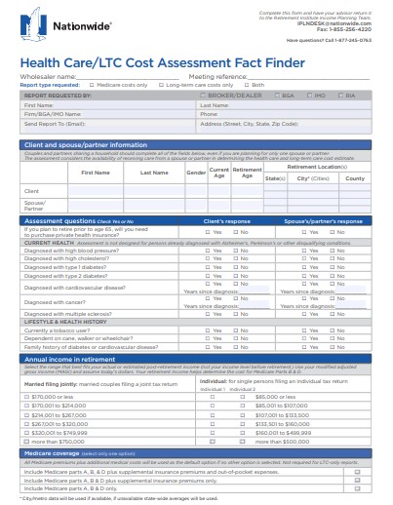
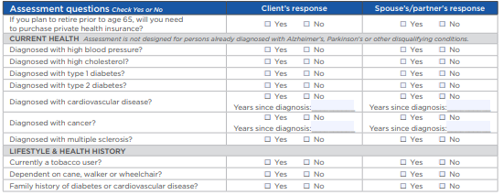
Long-term Care Cost Assessment
Considerations include:
Current health condition of client
Geographical location
Historical LTC inflation factors
19
Notes:
This estimate is based on your current health condition, which will help estimate the age LTC services may needed. In addition, the geographical location of where you plan to live in retirement, as well as historical inflation history of long-term care services to help estimate future inflation – are factors that affect the ultimate cost of LTC.
Data on this report has been assessed using actuarial standards from Milliman, one of the nation’s most respected actuary organizations used by the majority of insurance companies in the United States.
The Health Care Cost Assessment Client Fact Finder will be kept confidential and used to provide an estimate of your potential Health Care and LTC costs in retirement . The portion of this report is dedicated to reporting the estimated LTC costs and can be generated on its own. The estimate is based on overall health condition, marital status and place your client lives.
Your overall situation and health conditions may change over time and that this may affect the estimate of your future LTC costs. Please keep in mind that the estimates resulting from this fact finder are for hypothetical purposes only and are not guaranteed.

Slide 20
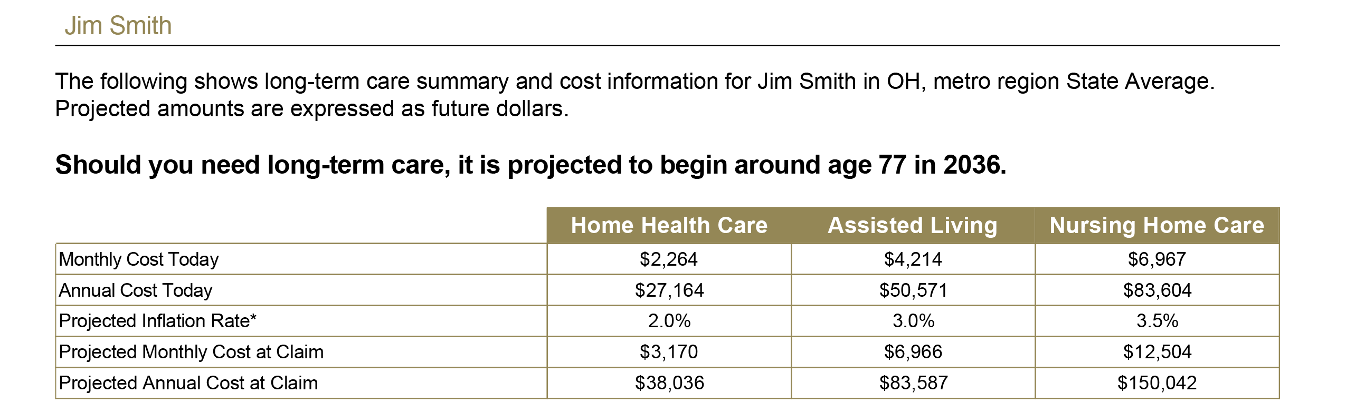

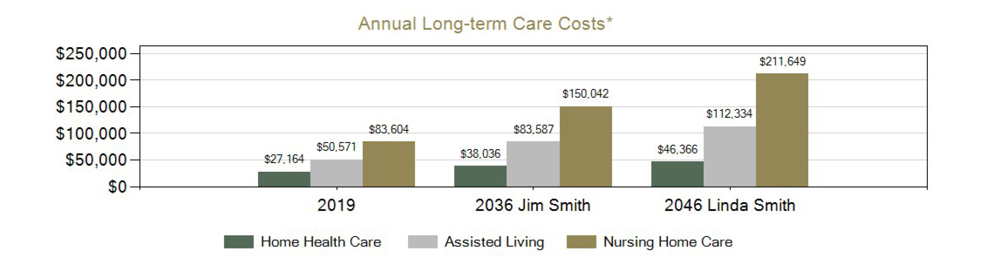
Long-term Care Cost Assessment
The client, Jim, is estimated to need LTC services at age 77
The spouse, Jane, is estimated to need LTC services at age 87
Use numbers from this report to help estimate LTC costs with help from your financial advisor
20
Notes:
Here is an example of the report generated by the questionnaire to assist you and your advisor in estimating costs and planning for LTC coverage. This report shows a couple, both 60 years old when the report is generated.
Based on the answers from the medical history questionnaire, John, is estimated to need LTC services around age 77.
Note that when there is a spouse, the spouses numbers will also show on the report so a sense of the total risk at hand can be assessed. Jim’s spouse, Jane, is not expected to need long-term care until the age of 87. The report clearly shows how inflation affects the cost of care in just the few years spread between John and Jane’s estimated need
Of course there is no guarantee that any care would be needed at all, or that the claim would be the average 3.9 year time period. The range of policy use could be anywhere from 0 to 10 years or more. You and your advisor will ultimately discuss how long to insure for based on what other factors exist in your financial and personal scenario. Keep in mind this is only an estimate based on actuarial data, and there is no guarantee that either estimation of age or costs will actually be the figures shown.

Slide 21
Nationwide ®
is on your side -
LTC solutions are part of a life insurance policy
Life insurance helps provide family and asset protection
Evaluate your need for life insurance and purchase an appropriate policy
If LTC benefits are used, it is important to ensure that sufficient life insurance coverage remains, even if all LTC benefits are used
Keep in mind that as an acceleration of the death benefit, a LTC rider payout will reduce both the death benefit and cash surrender values.
Withdrawal and loans may also reduce the amount of LTC benefits available.
There is no guarantee that the LTC solutions you choose will cover the entire cost for all of the insured's long-term care as these vary with the needs of each insured.
All guarantees are subject to the claims-paying ability of Nationwide®
21
Notes:
Nationwide has LTC solutions, and you can talk to your advisor about what Nationwide has to offer. But as you discuss your LTC needs and potential use of a Nationwide solution, please keep the following in mind.:
LTC solutions are part of a life insurance policy
Life insurance helps provide family and asset protection
Evaluate your need for life insurance and purchase an appropriate policy
If LTC benefits are used, it is important to ensure that sufficient life insurance coverage remains, even if all LTC benefits are used
Keep in mind that as an acceleration of the death benefit, a LTC rider payout will reduce both the death benefit and cash surrender values.
Withdrawal and loans may also reduce the amount of LTC benefits available.
There is no guarantee that the LTC solutions you choose will cover the entire cost for all of the insured's long-term care as these vary with the needs of each insured.
All guarantees are subject to the claims-paying ability of Nationwide®

Slide 22
Nationwide® solutions for LTC needs
LTC solutions with a life insurance or long-term care focus
No “use it or lose it” concern, if LTC is little or never needed:
  Solutions with death benefit to enhance estate value for heirs
  Solution with death benefit for cost recovery of policy
  Tax free monthly LTC benefits paid to policy owner
  Indemnity and Cash Indemnity – flexible LTC benefits
Solutions offered with guaranteed premiums and benefits
Flexible premium schedules
Pays both temporary and permanent claims
Covers LTC services existing today and those evolving in the future
22
Notes:
You’ve learned a lot today about long-term care and the type of LTC solutions that are available. Nationwide offers solutions to help you with your LTC planning that include the following;
LTC solutions with a with life insurance as first focus
Or solutions with a primary focus on long-term care with cost recovery.
No “use it or lose it” concern if LTC is little or never needed:
Solutions that offers a death benefit to enhance estate value for heirs if LTC is little or never used
Solution with death benefit that provides cost recovery of policy if benefits are little or never used
Tax free monthly LTC benefits paid to policy owner
Indemnity and Cash Indemnity benefits are available, providing for a more flexible use of LTC benefits
Solutions are offered with guaranteed premiums and guaranteed benefits –(of course, you must pay your premiums as scheduled.)
Solutions offer flexible premium schedules to meet your needs
Most importantly, Nationwide LTC solutions pay both temporary and permanent long-term care claims. And Nationwide solutions will cover LTC services that exist today as well as those that will evolve in the future.
Talk to your advisor about what LTC solutions may best help you meet the needs of you, your family and you financial strategy.

Slide 23
Why Nationwide®?
U.S. based Fortune 100 company
Mutual Company - with 80 year heritage
$345 million - donated by the Nationwide Foundation since 2000 to non-profit organizations across the U.S.
$10 million grant in 2014 by Nationwide Foundation to Nationwide Children’s Hospital
16,000 units of blood donated annually by Nationwide associates
$115 million donated to United Way since 2000 by Nationwide associates, agents and retiree
91,540 volunteer hours by Nationwide associates in 2014
23
Notes:
Why Nationwide? First, we are a United States based Fortune 100 company. Next, we are a mutual company, located in the midwest, with a heritage of over 80 years.
Nationwide believes in supporting their community, state and country. Here is a look at what Nationwide has provided in help.
$345 million was donated by the Nationwide Foundation since 2000 to non-profit organizations across the U.S.
$10 million grant in 2014 by Nationwide Foundation to Nationwide Children’s Hospital
16,000 units of blood donated annually by Nationwide associates
$115 million donated to United Way since 2000 by Nationwide associates, agents and retiree
91,540 volunteer hours by Nationwide associates in 2014

Slide 24
Your Next Steps …….
Talk with your insurance professional about starting to implement a Long-term Care plan
Get a personalized long-term care cost assessment
Evaluate sources of funding during retirement
Consider LTC coverage options
Planning ahead:
    Protects your care choices and life plan
    Protects your spouse financially
    Protects your adult children from having to make uncomfortable decisions
    Preserves assets for loved ones to inherit
24
Notes:
So what is your next step?
Talk with your insurance professional about starting to implement a long-term care plan. You can start by:
Getting a personalized long-term care cost assessment
Evaluating sources of funding during retirement, and
Considering LTC coverage options
Most importantly, having a plan ready to go if and when LTC needs arise will help:
Protects your care choices and life plan
Protect your spouse financially
Protect your adult children from having to make uncomfortable decisions
Preserve your assets for loved ones to inherit

Slide 25

Here when you need us
National Sales Desk: 1-800-321-6064
Nationwide Financial Network®: 1-877-223-0795
Brokerage General Agents (BGAs): 1-888-767-7373
Option 9, extension:677-6500
25
NFM-2121AO.13 (07/19)
Notes:
Any questions?

