Slide 1
Commission collaborative
Thursday, April 6, 2017
James R. Thompson Center
14th Floor,
V-Tel Room
Illinois State Charter School Commission
&
Illinois State Board of Education

Slide 2


Slide 3
Agenda
I Who, I What IWAS 10:15 – 10:45 AM
Overview of Categorical Funding 10:45 – 12:00 PM
Lunch 12 – 12:45 PM
GATA, Get It, Good 12:50 – 1:15 PM
Authorizer Announcements 1:15 – 1:45 PM
I’m an LEA Now What 1:45 – 2:50 PM
Questions and Evaluations 2:55 – 3:25 PM
Closing Remarks 3:25 – 3:30 PM
Parking Lot
Housekeeping
Ice Breaker

Slide 4
I Who? I what? Iwas
ISBE Chicago

Slide 5
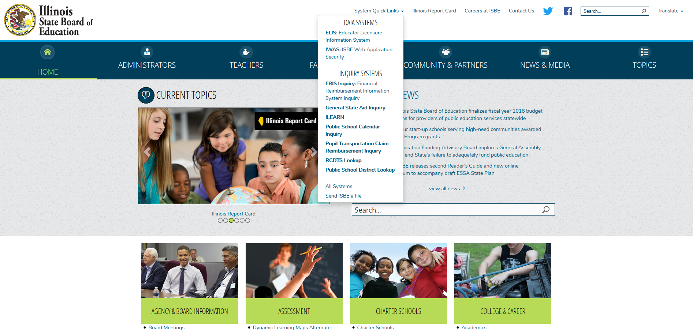
IWAS LINK ON ISBE HOME PAGE
Click the IWAS
Link on the ISBE
Main Page
Notes:
You will need an IWAS account to access the application. Everyone that submits a Letter of Intent, and is listed as the primary contact, will be given access to IWAS and the Charter Schools Program QSO grant. Confirmation emails will be sent upon release of the RFP.
Go to the ISBE home page at www.ISBE.net
Click on the IWAS hyperlink that can be found in the drop-down menu under System Quick Links at that top of the page.

Slide 6
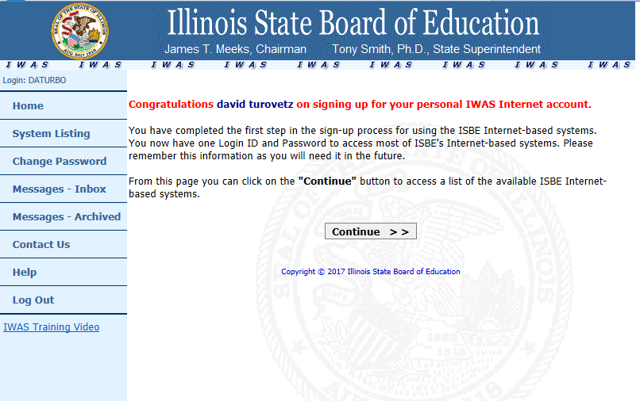
Log in or Sign up
Notes:
If everything matched, you should see this screen. Click continue

Slide 7
IWAS ACCESS
District Admin
RCDT Admin
District Entry
District View
Business Manager
Admin Level 1-4
Document Author
School Leader assigns Access Level and Authority
Access Level and Authority is distinguished across programs
Ability to modify?

Slide 8
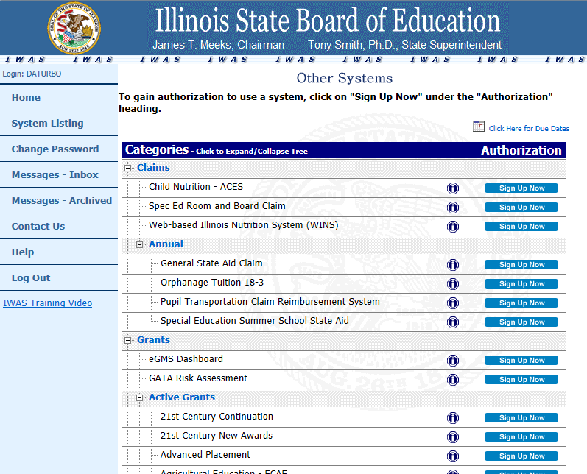
Log in or Sign up
Notes:
A list of all possible grants will appear. Click on the Sign Up Now button next to the Charter Schools Program on the listing.

Slide 9
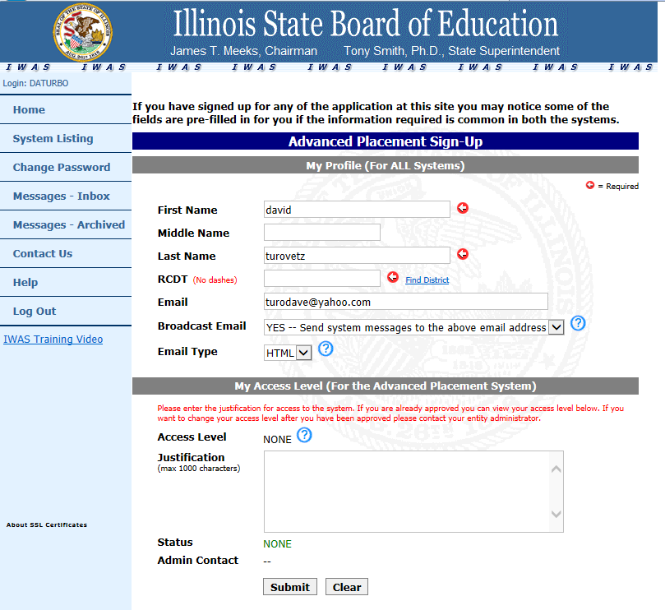
Log in or Sign up
Notes:
Complete the fields required. Enter the Agreement Number that was sent via e-mail. Copy from the email and paste into the Agreement Number window to ensure complete accuracy. Enter the Organization Name exactly as it appears in the e-mail as well. Enter the reason for needing access to the system. Click on the SUBMIT button.

Slide 10
Overview of grants and claims
ISBE Springfield

Slide 11
Division of funding and disbursement services
Tim Imler, Division Administrator
Kim Lewis and Sally Cray

Slide 12
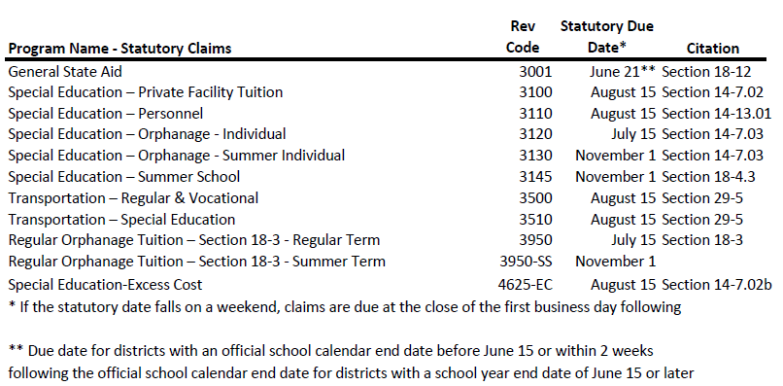
Mandated Categorical Claim Dates

Slide 13
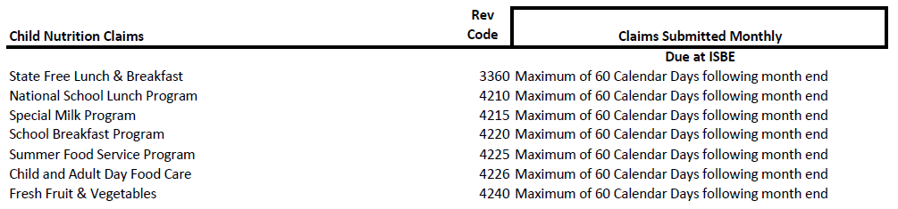
Budget Based Grants have required quarterly expenditure reports:
Quarter Due Date
9/30 10/20 12/31 1/20 3/31 4/20 6/30 7/20
Source: https://www.isbe.net/Documents/expend_reports_due.pdf

Slide 14
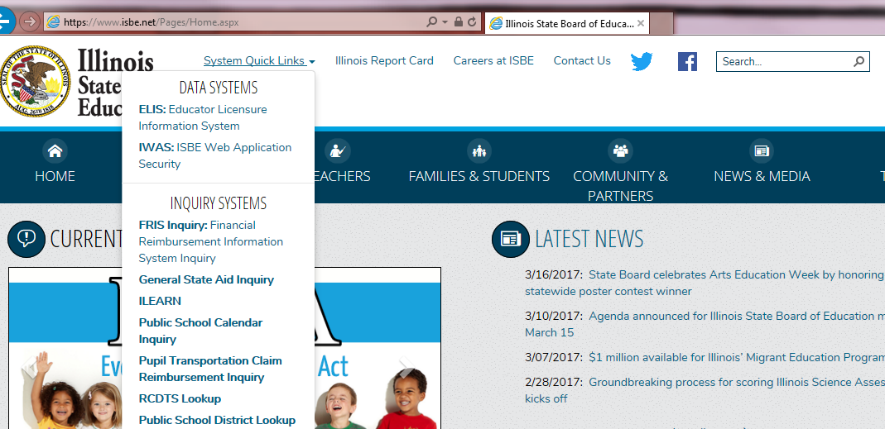

Slide 15
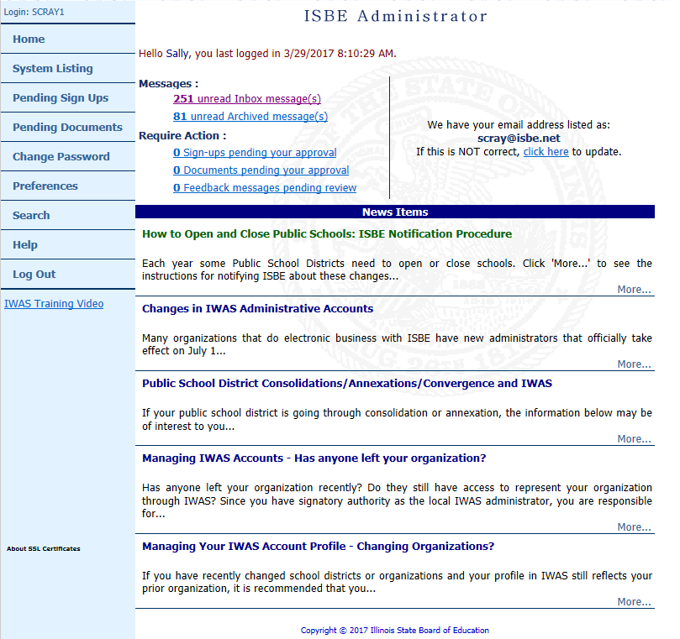
Messages:
IWAS Broadcast emails announcing grant availability
Programmatic messages
Require Action:
Your “To Do list”
News Items
System Listing:
Personalized to you and your responsibilities at your charter school
Email Address:
Ensures delivery of messages

Slide 16
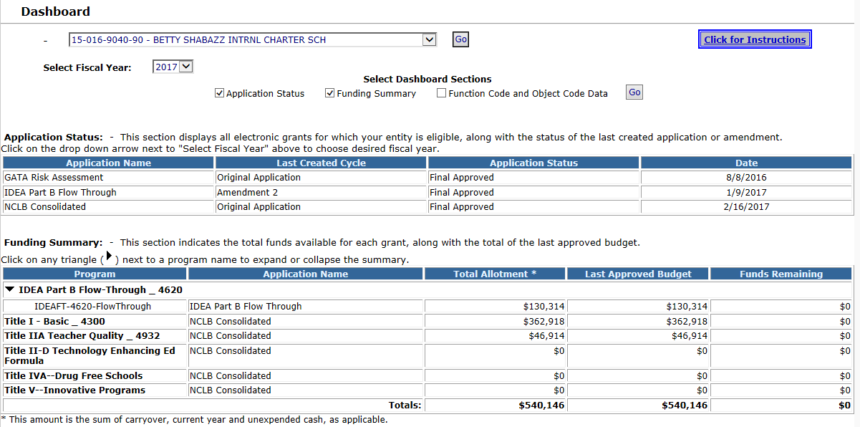

Slide 17

IWAS based grant applications
From today
…..forward!

Slide 18
Fiscal year 2017
March:
Consider amending approved grants
Gather data for third quarter expenditure reports
April:
Third quarter expenditure report due April 20
May:
Status of FY17 amendments
Amendments must be submitted 30 days prior to project end date. May 31 if June 30
FY18 planning and application completion
June:
Status of FY17 amendments
FY18 planning and application completion and submission
July:
Fourth quarter expenditure report due July 20
Status of FY17 amendment
Amendments must be submitted 30 days prior to project end date. If end date is August 31, July 31
August:
Liquidate outstanding obligations
September:
If a project had an August 31 end date, expenditure report is due September 20

Slide 19
Fiscal year 2018
March and April:
Planning for FY18
Notification of grant funds for your charter school will be announced via IWAS Broadcast emails and general articles in the Weekly Superintendent emails.
May:
Completion of grant applications
June:
Completion of grant applications
Applications must be submitted on or before July 1 to establish earliest begin date
July:
Work towards obtaining grant approval

Slide 20
Status of a grant application
Submission to ISBE
Approval
Allows for expenditures to be made according to the “substantially approvable” budget included in the grant application
Allows for expenditure reports to be submitted
Allows for amendments to be created and submitted

Slide 21
Grant Specifics
IDEA Part B Flow Through
IDEA Part B Preschool
ELL
Title I
Title IIA
**ALLOCATION BASED**
Allocations are announced and provided within the application
Questions – contact the program staff
Allocations often change
Carryover becomes available
Projected allocations evolve to final allocations

Slide 22
Title I and IIA
Preliminary eligibility released mid-winter
https://www.isbe.net/Pages/New-Census-Estimates-Released.aspx
Projected allocations released in spring
Application will have allocation available for budgeting
Final allocations available in the fall
Application will have final allocation and carryover (if final expenditure report for previous year submitted) available for budgeting
https://www.isbe.net/Pages/No-Child-Left-Behind-Federal-Funding.aspx

Slide 23
IDEA Part B 611 and 619 Funding
The federal formula for calculating district allocations under IDEA Part B are determined based upon three components: Base Year, Total Public and Non-Public Enrollment and Poverty.
Base Year – Computed from resident district and adjusted if: an individual charter school’s enrollment is at a minimum student enrollment of 100, and the increase of students with disabilities ages 3-21 as of Dec 1 of each year is 20% or higher than the previous year
Public Enrollment – September 30
Poverty – Ratio of State charter to resident district enrollment
Preliminary allocations in Spring – Final in August/September

Slide 24
English Language Learning (ELL)
Intent to Apply was due January 31, 2017
Application includes 3 programs:
TBE/TPI – Transitional Bilingual/Transitional Program of Instruction
LIPLEPS – Language Instruction Program for Limited English Proficient Students
IEP – Immigrant Education Program
TBE/TPI = state funding, no carryover
LIPLEPS and IEP = federal funding with carryover allowed

Slide 25
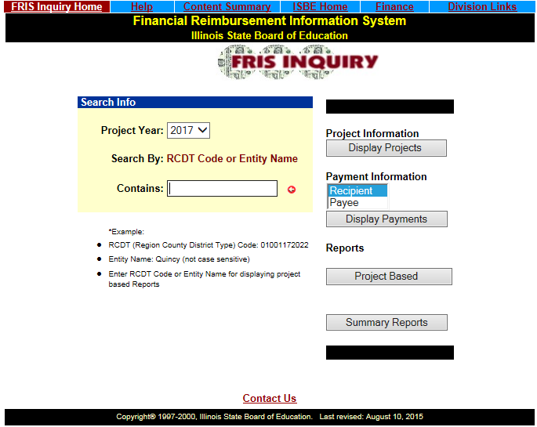
FRIS Inquiry Financial Reimbursement Information System
From ISBE Home Page
-System Quick Links
-HELP Screen
-FRIS Inquiry has info back to 1995
-Includes:
-Project Info
-Payment Info
-Reports
-Project based
-State Wide Summary
-Includes only funding/financial information (no text included)

Slide 26
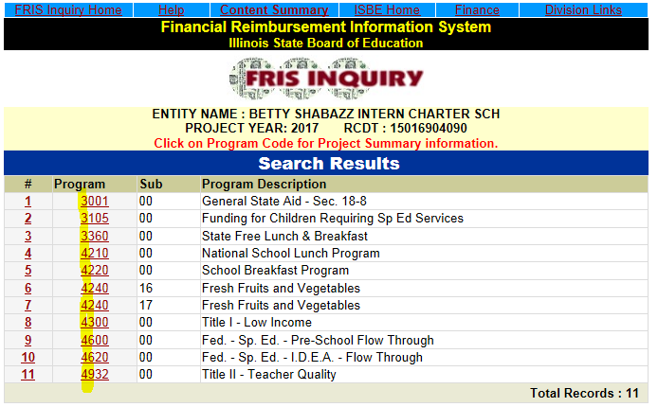
FRIS Inquiry Financial Reimbursement Information System
Program codes:
-beginning 3 = State funded programs
-beginning 4 = Federal funded programs
Summary includes:
-Project contact info
-Allotment info
-Disbursements
-Budget
-Expenditures
-Payment Schedule
Payment Information includes:
-Payments made to a payee or recipient
-Can search for a payment by:
-voucher number
-date range
-amount
Reports include:
-project based reports
-state-wide summary reports

Slide 27
Contact Information
Division of Funding and Disbursement Services
217/782-5256
timler@isbe.net klewis@isbe.net scray@isbe.net
Expenditure Reports:
IDEA - Jodi Whitlow jwhitlow@isbe.net
ELL – (LIPLEP and IEP) Diann Gragg dgragg@isbe.net
ELL – (TBE/TPI) Sharon Hopson shopson@isbe.net
Title I – Jennifer Jonas jjonas@ibse.net
Title IIA – Diann Gragg dgragg@isbe.net
Special Education Services
Chicago office 312/814-5560 Springfield office 217/782-5589
Title Grant Administration
217/524-4832

Slide 28


Slide 29


Slide 30
GATA, Get it, Good
ISBE Chicago

Slide 31
Purpose & Goals of GATA
The purpose of GATA is to provide for the development of a coordinated, non-redundant process for the provision of effective and efficient oversight of the selection and monitoring of grant recipients, ensuring quality programs; limiting fraud, waste, and abuse; and defining the purpose, scope, applicability, and responsibilities in the life cycle of a grant.

Slide 32
Purpose & Goals of GATA
The overarching goals of GATA are to
eliminate duplicative grant requirements, and
reduce administrative burdens while
increasing accountability and transparency through the application of standardized processes.
Adopts the federal uniform guidance (2 CFR 200 “super circular”) for all grants and develops supplemental rules for areas not addressed by the federal regulations.

Slide 33
GATA Registration Process
Grantees must be prequalified prior to applying for an award in FY 2018.
Prequalification is an annual process.
Grantees must register at GATA and complete an Internal Control Questionnaire.
Grantees must also complete a GATA Risk Assessment in the ISBE IWAS system to be eligible.
Grantees must have an
FEIN number,
DUNS number, and c
current SAMS CAGE code to begin the process.
Information and numbers must be consistent between the two systems.

Slide 34
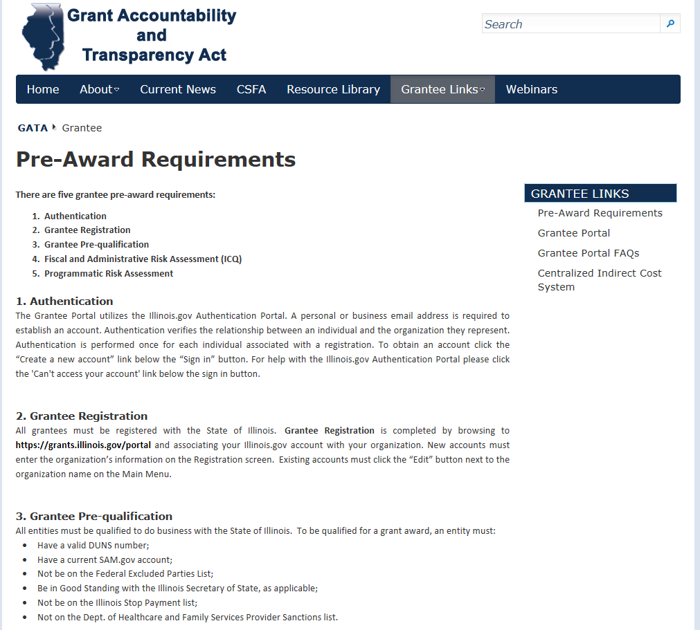
Gata pre-award

Slide 35
Anticipated for FY 2018
Governor’s Office of Management and Budget and state agencies have developed a policy framework called Grantee Compliance Enforcement System (GCES).
The Illinois Stop Payment List is a component of the GCES.
Effective January 1, 2017, the GCES establishes a uniform framework for all state grant-making agencies to respond to grantee noncompliance.
The GCES outlines procedures for notifying grantees of noncompliance issues that include, but are not limited to, failure to provide required reports, return unexpended funds, or submit audits.

Slide 36
Anticipated for FY 2018
The GCES protocol allows grantees the opportunity to respond and resolve noncompliance issues.
Grantees on the Illinois Stop Payment List may have grant funding withheld from other agencies until the noncompliance issue is resolved.
State agencies are prioritizing resources to support full implementation of the GCES by the start of FY 2018.

Slide 37
Authorizer Announcements
State Charter School Commission

Slide 38
Updates and announcements
Commission
Commissioners
Commission Connection
Upcoming Meetings
End of Year School Activities
Annual Review Performance Reports
School Support
SpEd
4th Quarter Activities
Facility Reviews
Enrollment Policy
Accountability Plan U

Slide 39
Enrollment policy
Proposed Policy
Current
July, October, December, March
Certification form & enrollment list
No limits on enrollment within cap
No notice to Resident District
No “true-up”
August, October, January, April
Certification form, enrollment, transfer & waitlist; and ISBE SIS
Annual Enrollment Projection
Notice to Resident District
“True-Up” twice per year

Slide 40
I’m an LEA, now What?
Southland Charter School
and
Prairie Crossing Charter School

Slide 41
Funding
PCTC (General State Aid)
State Categorical Funding
Federal Funding

Slide 42
PCTC
Maximize PCTC by staying on top of waiting list
Pay attention to your host district’s financial plans
Maintain good records of transfers in and out

Slide 43
State Categorical Funding
Special Education Private Facility Tuition
Funding for Children Requiring Special Education Services
Special Education Personnel
Orphanage Individual Tuition
Excess Cost
State Free Lunch & Breakfast
Transportation – Regular
Transportation – Special Ed

Slide 44
Special Ed Private Facilities
Pays anything above 2X the district per capita tuition cost
Reimbursed quarterly in the following year
Be sure you have done the following:
Have a signed contract with the facility
Include the information in i-Star immediately
Stay up to date with date in i-Star
WATCH THE FACILITY CODES!!

Slide 45
Funding for Children Requiring Special Ed Services
Determined by ISBE based on attendance (85%) and poverty (15%)
No claim to process

Slide 46
Special Education Personnel Reimbursement
Reimbursed quarterly the following year
$9,000 for every 1.0 FTE of certified special education staff working in a special education position
$3,500 for every 1.0 FTE of non-certified staff working in a special education position
Be sure you are keeping data up to date in i-Star

Slide 47
Special Education Orphanage Tuition
Pays for 100% of costs for special education wards of the state
Coded as “E” in i-Star
BE SURE YOU IDENTIFY THESE STUDENTS THROUGHOUT THE YEAR
Must deduct these students from your transportation claim
Estimated amounts during the year of occurrence. Final claim paid (or invoiced) in August.

Slide 48
Transportation
Special Ed Transportation-
Pays for 80% of special education transportation
Paid quarterly the following year
Claims submitted in IWAS in July with a correction period generally in October
MAKE SURE YOU HAVE TRANSPORTATION LISTED AS A RELATED SERVICE ON THE IEP AND IN i-Star

Slide 49
Transportation
Regular Transportation-
Pays for costs of transportation for students living more than 1 ½ miles from school or crossing a hazardous route
Paid quarterly the following year
Commissioned Charter Schools will almost always receive the flat grant reimbursement amount of $16 per student

Slide 50
Other State Categoricals
Excess Cost- Special Education students whose cost exceed 4X the per capita of the charter school
State Free Lunch

Slide 51
i-Star
Be sure all information is current and accurate in i-Star at all times to insure proper funding
Watch Fund Codes (B, E, X)
Private Facility Codes
Don’t miss claim dates

Slide 52
Federal Funding
National School Lunch
School Breakfast
Title I
Title II
IDEA
E-rate

Slide 53
National School Lunch & Breakfast
Stepped up financial compliance audits this year
Focus on non-program revenue and expenditures

Slide 54
Title I & Title II
Title I & II
Student support services and professional development
Funding can be extended through August 31st
Allocations generally released in May
Budgets and claims submitted on IWAS
Allowed 10% overage in a single line item before amending
Can only carry over 15% to following year
Can incur expenses once a substantially approvable budget is submitted. Try to do by June 30th to capture July 1st expenditures
TRS penalties
Work closely with your assigned project manager at ISBE

Slide 55
IDEA
Supplemental special education expenditures ages 3-22
Budgets and claims in IWAS
Can carry over 100% of each year’s allocation
Can incur expenses once a substantially approvable budget is submitted. Try to do by June 30th to capture July 1st expenditures
10% budget line overage also applies
Watch out for supplement vs supplant (Excess Cost) and Maintenance of Effort
TRS Penalties

Slide 56
Excelling at the isbe audit
General Record Checklist for General State Aid (3001) Audit
Written residency policy.
2. The district’s work papers and other supporting documentation that show how the claim was prepared.
3. Summary monthly enrollment/attendance reports (or registers) from all attendance centers.
4. The detail monthly enrollment/attendance reports (or registers) from all district attendance centers.
• Must have detail by student names.

Slide 57
Excelling at the isbe audit
General Record Checklist for General State Aid (3001) Audit
5. The final amended school calendar for the year under audit.
6. The final amended school calendar for year-round attendance centers (If Applicable).
7. Monthly enrollment/attendance reports from all special education sites outside of the district (If Applicable).
8. Monthly enrollment/attendance reports from other local education agencies where eligible students (such as School Choice) are attending (If Applicable).

Slide 58
Excelling at the isbe audit
General Record Checklist for General State Aid (3001) Audit
9. Schedules and/or grade cards for all part time students (If Applicable).
10.Attendance sheets/ Time sheets for Homebound/Hospital students (If Applicable).
11.The detailed general ledger Tuition Revenue accounts for the year being audited.
12.Attendance records for non-claimable students must also be kept such as students from other districts paying tuition, students listed on the Special Education Orphanage Claim, Pre-Kindergarten At Risk, etc.

Slide 59


Slide 60


Slide 61
Questions

Slide 62
Thank you

