Slide 1
Practice Manual - Chapter 7
The frequency for a service may be planned over a period of up to 6 months (e.g., 1x/week, 4x/month, 10x/6 months)
This is one strategy for addressing a known/expected family need for flexibility or fluctuation in that level of support
Must be based on a family’s need for this flexibility in support for implementing strategies to meet the IFSP outcomes
This level of flexibility will not be necessary or appropriate for all families
Must not be used to meet a local system’s or service provider’s need for flexibility

Slide 2
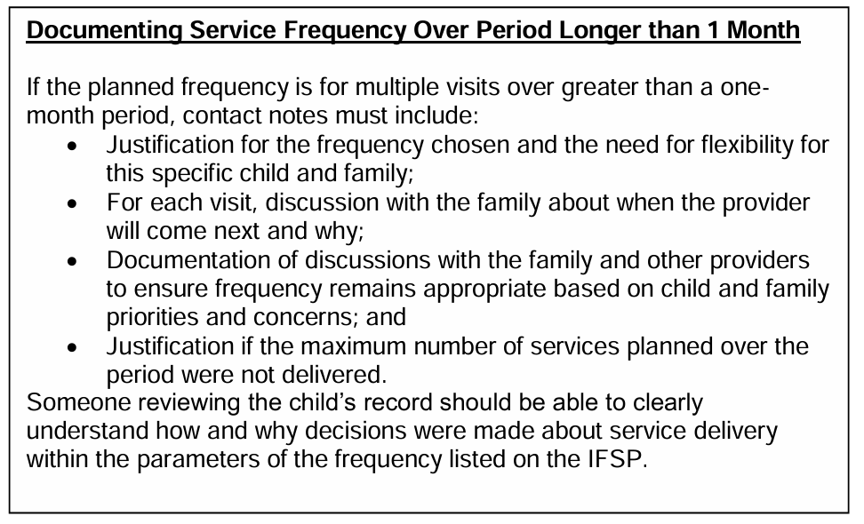
Practice Manual – Chapter 7

