Slide 1


Maryland 250 Commission
The US Semiquincentennial in Maryland
2026
Maryland’s Story is America’s Story

Slide 2
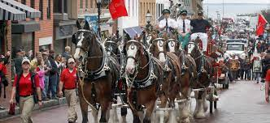
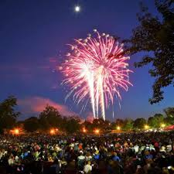
Remember the US Bicentennial in 1976?
50 years later, Maryland 250 gives another opportunity to tell our story.
Maryland’s Story is America’s Story

Slide 3
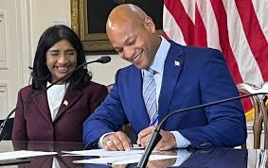
About Maryland 250
National initiative for America’s 250th: state/local execution (39 states)
New Executive Order (MD): 3 themes (history, civics, service)
Opportunity: tourism, historians, philanthropy, business, education, etc.
Maryland’s Story is America’s Story

Slide 4
Maryland 250 Shall
Acknowledge confiscation of Indigenous land & displacement of Indigenous people.
Honor the legacy of both free & enslaved African Americans.
Maryland’s Story is America’s Story

Slide 5
Maryland 250 Shall
Support identification & enhancement of cultural assets.
Engage youth, new Americans, lifelong learners.
Celebrate service and create opportunities that promote social responsibility and unite and strengthen Maryland’s diverse communities.
Maryland’s Story is America’s Story

Slide 6
Maryland 250 Vision (Pre-Commission)
9 words: democracy, unity, patriotism, innovation, engagement, inclusive, statewide, yearlong, legacy
History: local commissions planning local commemorations
Civics: local citizen academies; voter reg; advocacy training
Service opportunities statewide
Maryland’s Story is America’s Story

Slide 7

Maryland 250: The Ask
Start or join a local 250 planning committee
Launch a 250 fund for community projects
Engage community in programs, legacy projects
Share stories with us
Tell us about local events so we can promote
Help build interest and excitement in the 250th
Maryland’s Story is America’s Story

Slide 8
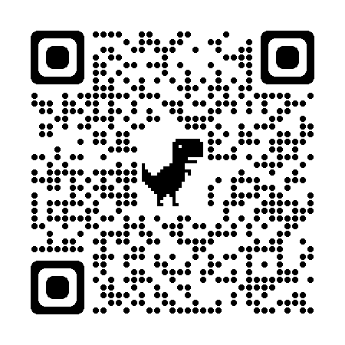
Maryland’s Story is America’s Story

