Slide 1
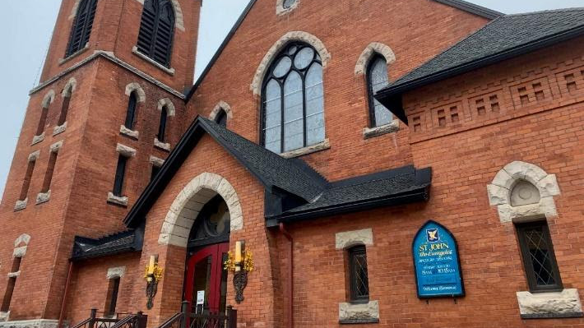
Shaping and Sustaining Parish Ministry and Presence in the Parish of St John the Evangelist (Elgin St) Presentation to Property and Finance Committee Anglican Diocese of Ottawa November xx, 2021
Prepared by:
Detlef Dransch - Rectors Warden Stephen Giles – People’s Warden T.J. Purves – Treasurer Cannon Gary van der Meer - Rector

Slide 2
Our Purpose Today
Shaping and maintaining a 125 year Anglican Church of Canada presence in Centertown
Developing a path to sustaining and expand ministry and relationships between St. John’s, the Centertown community and outlying suburbs.
Request a significant investment by the Diocese of Ottawa to continue parish ministry and service in Centertown.

Slide 3
St John’s: A Strategic Asset of the Diocese of Ottawa
Location
Strategically located at one of the busiest intersections in downtown Ottawa
Pedestrian and vehicle traffic results in approx. 13,000 passersby daily
Affords high visibility of the Anglican Church and its community engagement.
Recent Elgin St corridor improvements draws more visitors from Centertown and suburbs
A History of Social Justice
A reputation of being out front on social justice issues—ordination of women, AIDS ministry, refugee ministry; same gender marriage; amendment to the marriage cannon; CoSA, and
An active partner in community issues that affect women, housing, and food supply in Centertown.
Community Thrift Shop serving marginalised and low-income families
A Community Ministry Partner
20 year partner with the Well/La Source
A Community Partner
Host to many choirs and music groups (Strings of St John’s, Gay Men’s Chorus, Bach Choir, Celtic Choir), AA, NA and a 14 year host to Salsa Ottawa

Slide 4
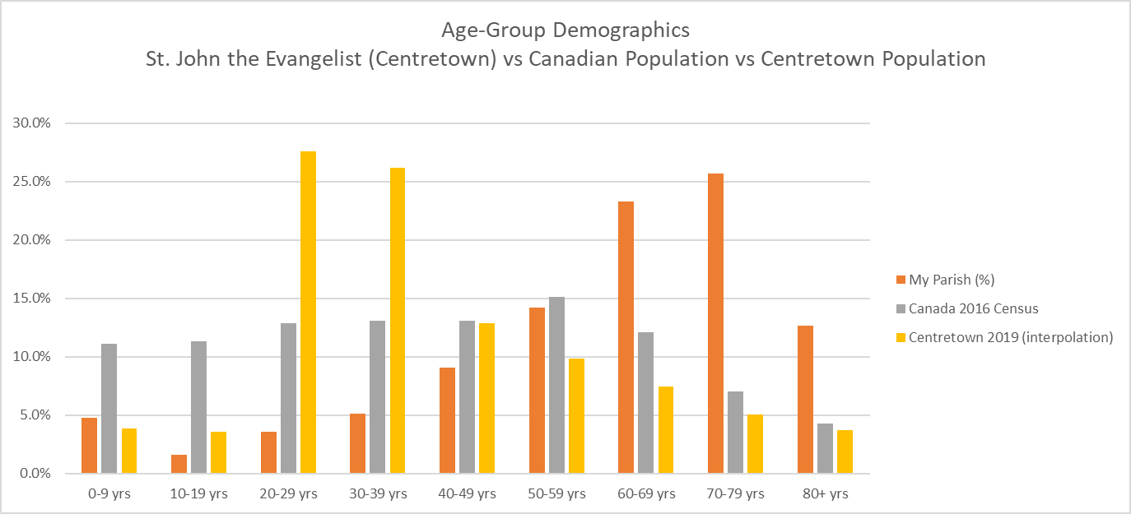
Centertown Demographics

Slide 5
Centertown Demographics
Explanation of previous slide if required

Slide 6
Financial History
Parish has had recurring deficits for the past 7+ years--Parish reserves completely exhausted
Past capital campaigns launched to raise funds for specific projects (roof repairs, Narthex renovation and north transept wall repair) with great success
November 2019 – Proposal to Property and Finance Committee to allow the sale of parking lot to cover deficit (including deferred Maintenance)
Response: loan of $200k - $250k offered/ St. John’s Corporation decision not to pursue at that time
Sale of 4 indoor parking spaces nets $140k to offset deficit
January 2020 – grant request of $200k
Request rejected
Establishment of a Property and Finance Working Group
Working Group recommendations
Develop a financial plan based on a significant loan
Show when Parish is back to break even status (2-7 years)
Stewardship Campaign to be launched October/November 2021

Slide 7
Property and Finance Sub-Group Established
Established as a result of meeting with Property and Finance Committee in 2019. Discussions suspended due to COVID-19 pandemic
Purpose was to provide guidance on how to proceed in a manner that would sustain parish ministry in Centertown
Members: Robert Sicard, Sanjay Grover, Tracy Albert, Gary Van der Meer, TJ Purves, Detlef Dransch, Stephen Giles
Two meetings held, St John’s advised to develop a 5-7 year financial plan with a focus on:
Increasing revenue;
Addressing building and Infrastructure deficiencies, and
Expanding Ministry in Centertown.

Slide 8
Our Parish Buildings (1)
Three Strategic Assets
Church Building
134 Somerset St
Parish Hall
275 Elgin St
Parking Garage located at Somerset Gardens
138 Somerset St

Slide 9
Our Parish Buildings (2)
Building Condition Assessment
Comprehensive assessment conducted in 2018?
Building utilization
Church building (Nave) under-utilized during the week due to static seating configuration and lack of air conditioning
Parish Hall under-utilized as a permanent source of revenue in a high traffic location on Elgin St
Warrior’s Chapel underutilized as a worship/multi-use space

Slide 10
Building Condition Assessment 2018
A complete survey/assessment of the building was conducted on April 11, 2018, and April 16, 2018, by IRC staff and sub-consultants.
The report was prepared based on the findings of the visual assessment and included:
1. evaluations of the building components;
2. recommendations for repairs and replacement;
3. budget estimates, for all rehabilitation work, and
4. photographs of typical deficiencies.
Assessment revealed major structural and maintenance items that should be addressed in the near, medium and long-term to maintain the integrity of the buildings

Slide 11
Required Capital Investments
Bell Tower Repairs $235K
Parish Hall Re-fit to rental
$140K
Chapel Renovation $140K
Nave Renovation $275K
Wiring Replacement $113K
Investment Proposal includes:

Slide 12
Investment Proposal #1 Wiring Replacement
Proposal includes:
Replacement of outdated non-code conforming wiring
Estimated Cost $113,000 (BCA)

Slide 13
Investment Proposal #2 Bell Tower Repairs
Proposal includes:
Brick replacement and re-pointing of Bell Tower
Estimated Cost
$235,878 (BCA)

Slide 14
Investment Proposal #3 Parish Hall re-fit as Commercial Rental Space
Proposal includes:
Estimated Cost $143,462
Re-fit to include severance of all existing HVAC, electrical and plumbing to become a standalone facility with
Current rental rates estimated at between $30 to $40/sq ft resulting in guaranteed yearly revenue of $45,000 to $60,000 /year
Parish Hall (1500sq ft) currently underutilized/undervalued
Current weekly rental revenue not dependable

Slide 15
Investment Proposal #4 Warrior Chapel re-fit for multi-purpose use and rental
Proposal includes:
Installation of glass enclosure
New HVAC (currently none)
New electrical for improved lighting and audio-visual cabability
Estimated Cost $143,462
(McRobie)

Slide 16
Investment Proposal #5 Nave re-fit for multi-purpose use and rental
Proposal includes the conversion of the nave into a multi-purpose space achieved by:
Estimated Cost $275K
( ? )
Installation of air conditioning
Removal of pews,, replacement with chairs and floor repairs

Slide 17
Revenue Streams
Proposal includes:
Stewardship Campaign 2021
Increase in Parking revenue
Increase in Community Thrift Shop Revenue (expanded hours)
Parish Hall Conversion to Rental
Growth in Parish Membership

Slide 18
Revenue Stream – Parish Givings
2021 $322,000
2022 $340,000?
2023 $340,000?
2024 $340,000?
2025 $340,000?

Slide 19
Revenue Stream: Community Thrift Shop
Established over 50 years ago to assist the marginalised and low income families
Supported by a strong and committed Manager and volunteer group
Participates in a voucher system provided by social service partners
Donations from parish and local community currently exceeds capacity
Presently open 3 half days per week. Potential for increased hours resulting in increased revenue
Projected revenue by year (expanded hours):
2021 $25K
2022 $65K
2023 $70K
2024 $70K
2025 $70K

Slide 20
Revenue Stream: Somerset Gardens Parking Garage
Garage established in early 90’s as an element of the real estate deal between Somerset Gardens Condominium and SJE
SJE to have 100 year use and revenues from 20 partially covered outdoor parking spaces. Monthly condo fees are paid on each space
Management of rentals is contracted out to private sector parking company
Projected Revenue:
2021 $35K 2022 $84K 2023 $84K 2024 $88,250K 2025 $90,015K 2026 $91,816K

Slide 21
Rental Revenue
 |  | 2021 Budget |  | 2021 Forecast |  | pre-Covid budget (for reference) | 2022 | 2023 | 2024 | 2025 | 2026
Donations - General Use |  | 324,000 |  | 322,000 |  | 340,000 | 340,000 | 340,000 | 340,000 | 340,000 | 340,000
Donations - new parishioners |  |  |  |  |  |  |  |  | 20,000 | 25,000 | 30,000 |  | growth of number of parishioners
Stewardship Campaign |  |  |  | 0 |  |  | 15,000 | 30,000 | 30,000 | 31,000 | 32,000
Donation - Designated |  | 13,000 |  | 9,000 |  | 15,000 | 15,000 | 15,000 | 15,000 | 15,000 | 15,000
Rental and Other Income |  | 141,500 |  | 111,000
 | Rentals | 50,000 |  | 45,000 |  | 95,000 | 125,500 | 153,150 | 156,213 | 159,337 | 162,524 |  | Increase from PH rental & more from other spaces
 | Community Shop | 25,000 |  | 25,000 |  | 55,000 | 55,000 | 55,000 | 55,000 | 55,000 | 55,000

Slide 22
Projected Revenues 2021-2026
 |  | 2021 Budget |  | 2021 Forecast |  | pre-Covid budget (for reference) | 2022 | 2023 | 2024 | 2025 | 2026
Donations - General Use |  | 324,000 |  | 322,000 |  | 340,000 | 340,000 | 340,000 | 340,000 | 340,000 | 340,000
Donations - new parishioners |  |  |  |  |  |  |  |  | 20,000 | 25,000 | 30,000
Stewardship Campaign |  |  |  | 0 |  |  | 15,000 | 30,000 | 30,000 | 31,000 | 32,000
Donation - Designated |  | 13,000 |  | 9,000 |  | 15,000 | 15,000 | 15,000 | 15,000 | 15,000 | 15,000
Rental and Other Income |  | 141,500 |  | 111,000
 | Rentals | 50,000 |  | 45,000 |  | 95,000 | 125,500 | 153,150 | 156,213 | 159,337 | 162,524
 | Community Shop | 25,000 |  | 25,000 |  | 55,000 | 55,000 | 55,000 | 55,000 | 55,000 | 55,000
 | Parking Lot Revenue | 60,000 |  | 35,000 |  | 84,000 | 84,000 | 86,520 | 88,250 | 90,015 | 91,816

Slide 23
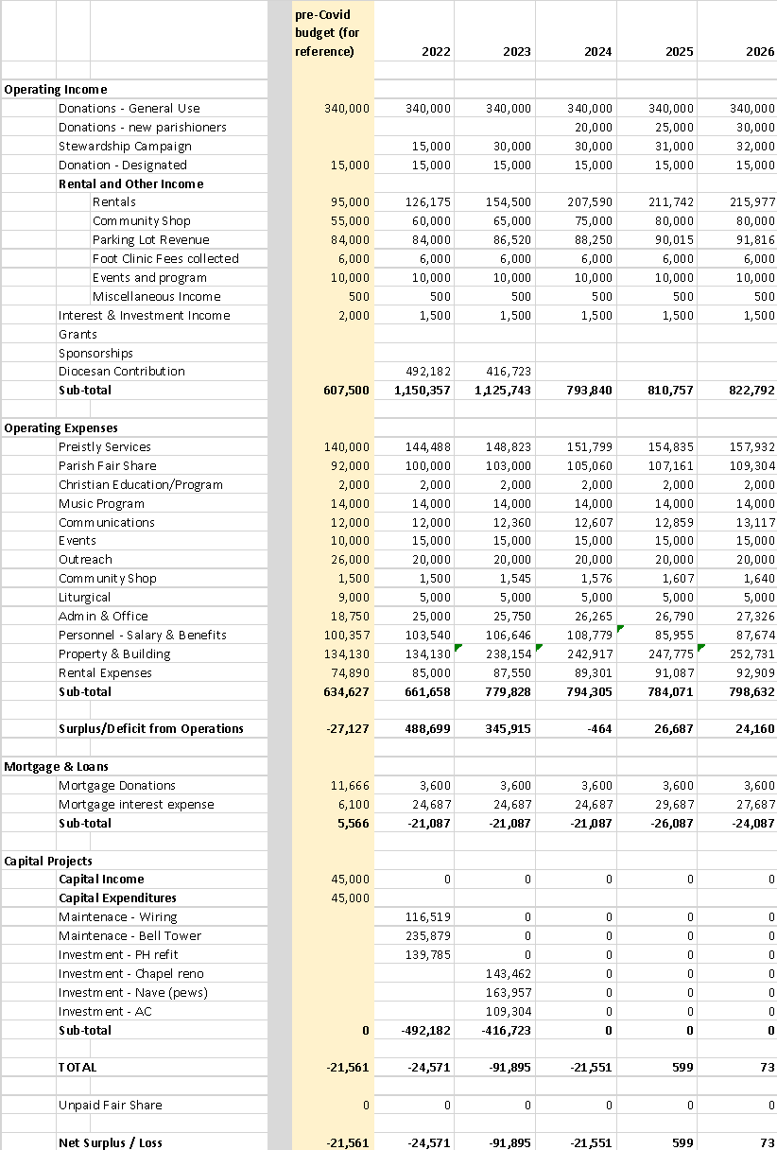
Investment Proposal 2022-2026

