Slide 1








Welcome
Celebrating 50 Years
THANK YOU CORPORATE SPONSORS:

Slide 2


Thank You Corporate Sponsors:
Welcome
Gina Shaffer,
Shaffer Law Office
THANK YOU EVENT SPONSORS:

Slide 3

Board Chair
THANK YOU CORPORATE SPONSORS:

Slide 4

DERRICK ELZEY,
State Farm Insurance
ASHLEY HALDEMAN,
PAM Health Rehabilitation
Hospital of Georgetown
NICOLE FILLIS,
O.C. Tax Service, LLC
TYLOR LENNOX,
Coastal Wealth Management, LLC
In Appreciation
Thank you for your service
to the Board of Directors
THANK YOU CORPORATE SPONSORS:

Slide 5
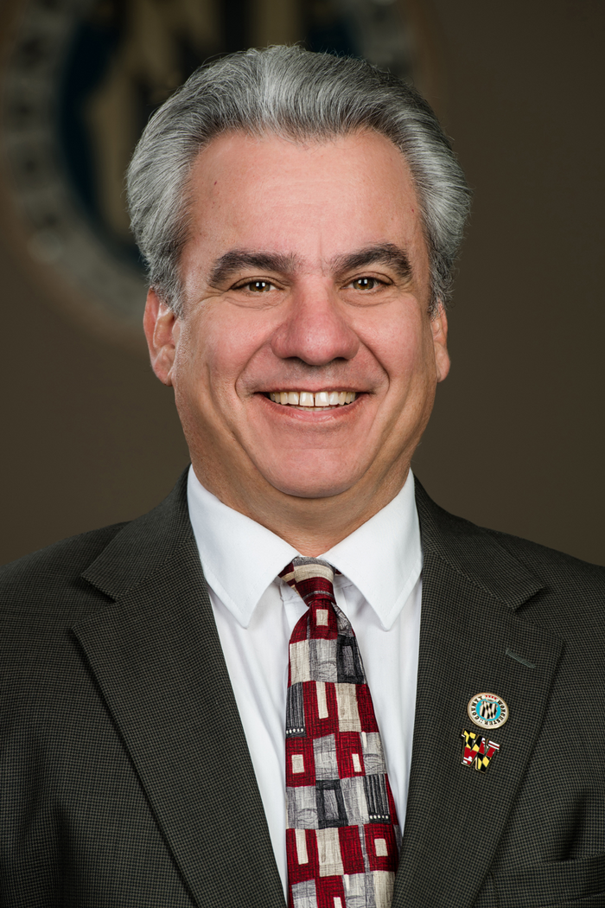
Welcome
County Commissioner District 5 -
Anthony W. Bertino, Jr.
THANK YOU CORPORATE SPONSORS:

Slide 6
Our 2026 Board of Directors
Donna Frankowski,
ERA MARTIN ASSOCIATES
Board Chair
Rich Cropper,
Cropper Services, LLC
Board Vice Chair
Bianca Deacon,
Shore Thing Promotional
Products
Board Secretary
Kayleigh Yarris,
Taylor Bank
Board Treasurer
Dan Erb,
Bright Title & Settlement Services
Stephanie Gamm,
Wor-Wic Community College
Melissa Lenz,
YOUR Bayside Concierge
Tim Price,
Royal Plus Inc. RPCAT
Gina Shaffer
Shaffer Law Office, LLC
THANK YOU CORPORATE SPONSORS:

Slide 7

Thank You Corporate Sponsors:
Welcome
Joe Connell,
Lavahot
THANK YOU EVENT SPONSORS:

Slide 8









Chamberversaries
Celebrating 25+ Years!
THANK YOU CORPORATE SPONSORS:

Slide 9
Affordable Business Systems
AJ Future Financial Planners
Carquest Auto Parts & Marine
Chesapeake Hearing Centers
Claudia Nicholls/State Farm
Coastal Association of Realtors
Comcast Advertising
Copy Central of Ocean Pines
Custom Mechanical, Inc.
Deeley Insurance Group
DePalma Dental, LLC
Fager’s Island, Ltd.
Farmers Bank of Willards
Hileman Real Estate, Inc.
Kitty’s Flowers
M & T Bank
Maryland Coastal Bays
Mike’s Flooring & Design
Mitchell, Hastings & Sweigert Financial Services
OC Today Dispatch
Ocean City Boat Lifts & Marine
Ocean Downs Casino
Phoenix Physical Therapy
PKS Investment Advisors
Service Today
Tech MD
WMDT-TV 47
Worcester Cty Veteran’s Memorial
Worcester Youth & Family Services
Chamberversaries
Celebrating 20 Years!
THANK YOU CORPORATE SPONSORS:

Slide 10

Anchor Events
Partner Luncheon
Captains Mtg.
& Flounder Tournament
28 January
26-27 June
19 February
29 August
Best of Awards Celebration
Classic Car, Truck & Jeep Show
THANK YOU CORPORATE SPONSORS:

Slide 11
Visitor Center
Mon-Thur: 9am-2pm
Fri: 9am-12pm
Thank You Corporate Sponsors:

Slide 12

Business After Hours
Ribbon Cuttings
Connections Referral Network
Ambassadors Group
CHAMBER NETWORKING
Make the Most of Your Chamber Partnership
THANK YOU CORPORATE SPONSORS:

Slide 13
THANK YOU
for your partnership
THANK YOU CORPORATE SPONSORS:

